Slide 1
SS Grade 8 Name: _________________________ Period:
MODULE: Unit 2- Industrial Revolution
Objective: What were the causes and effects of the Industrial Revolution?
Table of Contents
Date | Topic(s) | Page Numbers
Days 1 - 2 | Rise of Industry & Enterprise | 1 - 6
Days 3-8 | Big Business | 7-18
Days 9 -12 | Captains of Industry project | 20-21
Days 13-17 | Immigrants | 22-30
Day 18-20 | Development of Cities | 31-34
Days 21 - 24 | Labor Unions | 35-39
Days 21-24 | Processing Activities | 40-42

Slide 2
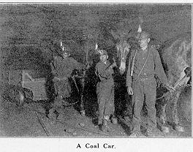
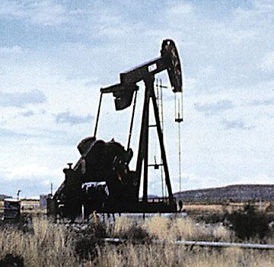
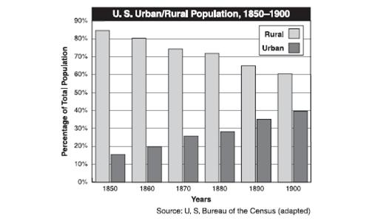
Unit 2 EQ 1: What conditions spurred the growth of industry?
I. RISE OF INDUSTRY
NATURAL RESOURCES
___________ – power steam engines / machines
large coal deposits found in __________, _______________ & ________
______ – ____________ machines / ________ lamps
________________ – make __________ found in Minnesota and Pittsburgh
Coal is a resource that is very difficult and dangerous to mine – many miners died from black lung and mining accidents – machinery in factories and railroads used coal as fuel
Oil is a resource that originally was used only as a lubricant – in today’s world oil is a necessity
https://www.brainpop.com/socialstudies/ushistory/industrialrevolution/
B. Increased Labor Force
____________________ immigrants
many Americans gave up _______________ to work in factories
large number of ___________ _____________ move to cities
increased number of _____________

Slide 3
I. RISE OF INDUSTRY
Foundations for Growth: Companies and railroads wanted to expand, but they needed money to do so. They raised money, or capital, by becoming a corporation.
A corporation is a company that sells partial ownership, or shares, of its business to public investors. The shares of partial ownership are called stock. The shareholders, or investors who buy shares of stock, hope the corporation will be successful and the value of their stock will increase. Then they can sell their shares for a profit.
Many railroads and businesses incorporated, or formed corporations. Businesses also borrowed money from banks to pay for start-up or expansion costs. Banks made profits on the loans.
C. INCREASED CAPITAL (MONEY)
________________ seek to make money by investing in companies (buying stock) result
companies have more capital ($) to spend on ______ ______________ __________ _________________
One advantage that corporations of the late 1800s had over individually-owned businesses is that corporations
needed fewer employees
hired only skilled workers
received the support of labor unions
had stockholders who invested money
CRQ1: How did people raise enough money to expand their businesses in the 19th century?
____________________________________________________________________________________________________________________________________________________________________________________________________________________________
D. TRANSPORTATION
Unit 2 EQ 1: What conditions spurred the growth of industry?

Slide 4
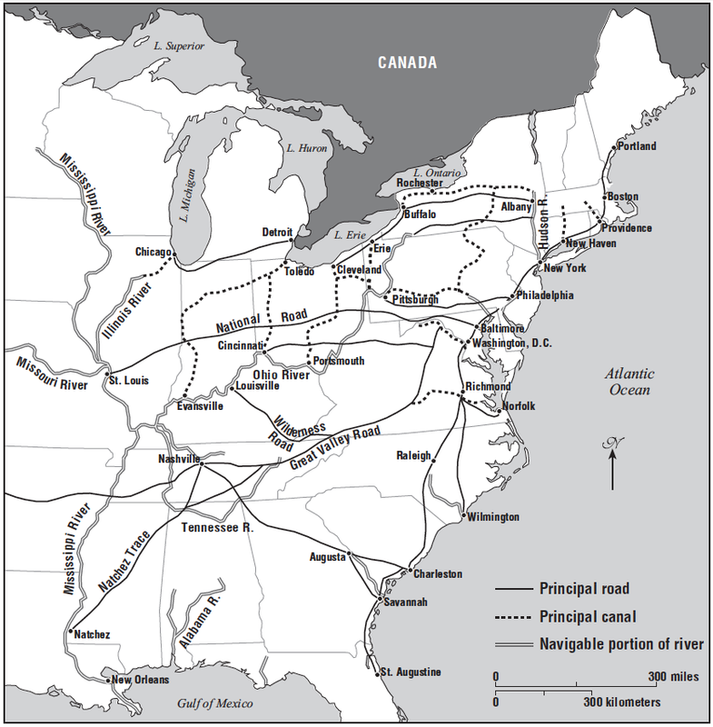
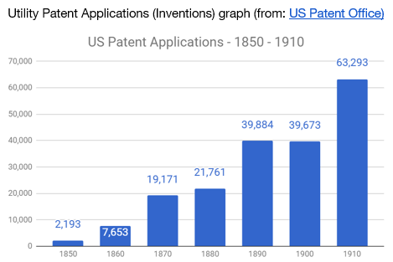
CRQ: Why did the roads and canals go through major cities such as Chicago, New York, Baltimore and Charleston?
____________________________________________________________________________________________________________________________________________________________________________________________________________________________________________________________________________________________________________________________________________________________
II. FREE ENTERPRISE
free enterprise
____________________ & private businesses are free to organize and operate for ___________($) in _________________ with others
individuals & private businesses are free to choose what to produce
B. supply and demand
__________ ← ___________/ ← ____________  ___________
C. _____________________
people who assume the risks for success or failure of the business enterprise
leaders that organize _________ and _____________, adopt new _______________ and inventions, and raise _________________
Unit 2 EQ 1: What conditions spurred the growth of industry?

Slide 5
Unit 2 EQ 1: What conditions spurred the growth of industry?
Review the graphic organizers. When you are done, in the appropriate spaces below, explain
HOW natural resources, transportation, and technology supported the post Civil War Industrial Revolution in the United States.
Make one claim each for how natural resources, transportation, and technology supported the post Civil War Industrial Revolution
Support each claim with examples from the graphic organizers
Transportation
Supported the Industrial Revolution by: ____________________________________________________________________________________________________________
Evidence:
__________________________________________________________________________________________________________________________________________________________________
Natural Resources
Supported the Industrial Revolution by: ____________________________________________________________________________________________________________
Evidence:
__________________________________________________________________________________________________________________________________________________________________
Technology
Supported the Industrial Revolution by: ____________________________________________________________________________________________________________
Evidence:
__________________________________________________________________________________________________________________________________________________________________
Industrialization in the United States
Late 1800’s - Early 1900’s

Slide 6
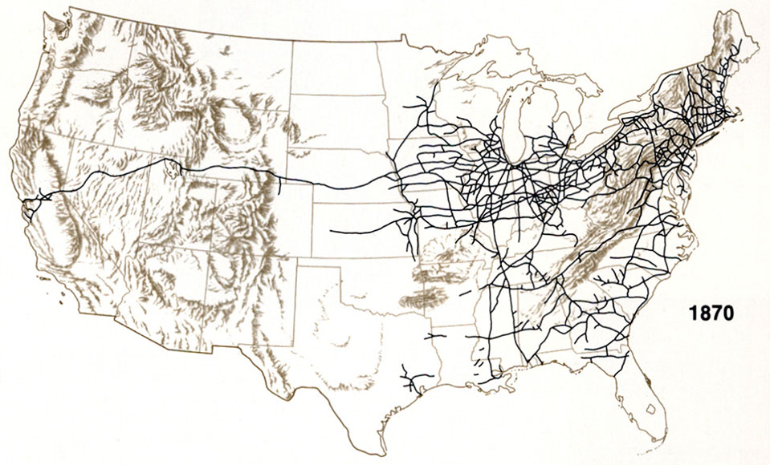
Unit 2 EQ 2: What were the causes and effects of the expansion of the railroad network 1860 - 1890?
III. RISE OF BIG BUSINESS
____________ __________, ______ ____________, ____________ & _____________ ________________
https://www.youtube.com/watch?v=gR7oHh-fXUw
A. RAILROADS
1860 = 30,000 miles of track
1900 = over 193,000 miles of track
famous RR’s
_____________________
_____________________
_____________________
_____________________
CRQ 1: Why might southern farmers have used rivers/oceans to transport their crops and not the railroad?
CRQ 2: What effect might these factors have had on industrialization in the south compared to the north?

Slide 7
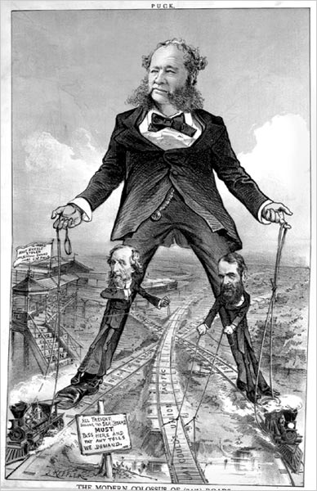
.
A. RAILROADS
__________________________________
__________ ___________ of RR industry
raised several million $’s to ____________ RR’s and ______________ RR’s
= hired ________________ to control sections of the RR’s (large-scale operation)
https://www.dailymotion.com/video/x2pqi4n
S
P
A
M
The early railroad lines each used their own tracks, which differed in width. As a result, trains could not share tracks. Travel was slow and inefficient. Goods and people had to be unloaded and reloaded when they traveled from one railroad line to another. The railroad barons agreed to use tracks of the same width, or a standard gauge, during the late 1880s. It made travel and transporting goods less expensive because goods and materials did not have to be unloaded and reloaded every time lines changed. Trains could share tracks and make the whole trip.
Unit 2 EQ 2: What were the causes and effects of the expansion of the railroad network 1860 - 1890?

Slide 8
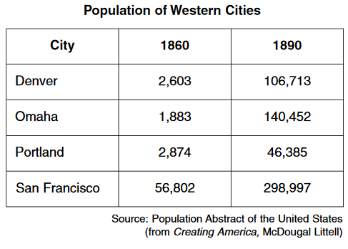
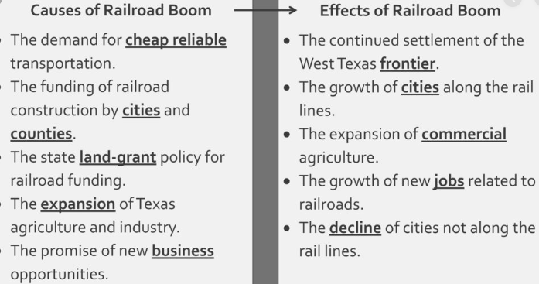
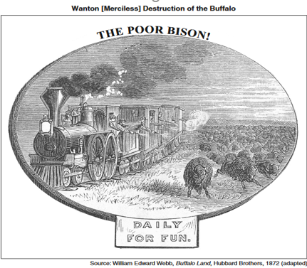
Unit 2 EQ 2: What were the causes and effects of the expansion of the railroad network 1860 - 1890?
CRQ 1: What does this chart show about the effect of the transcontinental railroad on the population of western cities?
CRQ 2: Based on the image and chart, what was one negative impact of the railroad on the west?

Slide 9
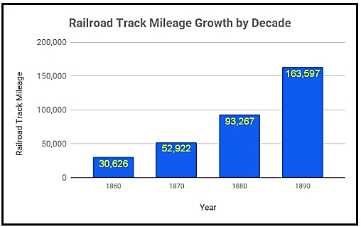
Unit 2 EQ 2: What were the causes and effects of the expansion of the railroad network 1860 - 1890?
Document 1
Historical Context
1) Explain the historical circumstances that led to the development of the Railroad. _______________________________________________________________________________________________________________________________________________________________________________________________________________________________________________________________________________________________________________________________________________________________________________________________________________________________________________________________________________________________________________________________________________________________________________________________
Railroad Expansion The North had many more miles of track than the South. This helped them win the Civil War. America’s economy grew along with the expansion of the railroad system. In 1869 the first railroad connecting the East and West, or transcontinental railroad, was completed. After this, many other railroads were built. Five other railroads crossed the country by 1869, and hundreds of other smaller lines linked cities and towns. The railroad system grew quickly, from 30,000 miles of track in 1860 to nearly 250,000 miles of track in 1900. Many big railroad companies bought smaller companies or forced them out of business. Consolidation, or combining separate companies into one larger company, helped make the railroad system more efficient. It also made the railroad owners, called railroad barons, wealthy and powerful.

Slide 10
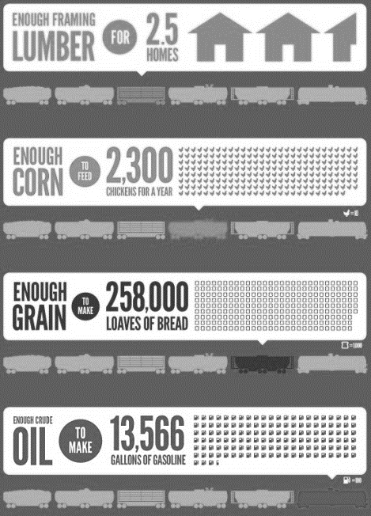
Document 2
2a) Based on this excerpt from George Francis identify his/her point of view concerning the economic opportunities the railroads have created. _______________________________________________________________________________________________________________________________________________________________________________________________________________________________________________________________________________________________________________________________________________________________
2b) Explain the extent to which George Francis’s account is a reliable source for understanding the historical impact of the railroad in the United States. In your response, be sure to include your evaluation of the source’s reliability and your reasoning for that evaluation
_______________________________________________________________________________________________________________________________________________________________________________________________________________________________________________________________________________________________________________________________________________________________
_______________________________________________________________________________________________________________________________________________________________________________________________________________________________________________________________________________________________________________________________________________________________
Railroads Stimulate the Economy : The expanding national railroad system caused the economy in the United States to grow. Trains carried raw materials to factories. Trains transported manufactured goods from factories to market. Produce from agricultural regions was transported by train to cities. The expanding railroad system created a demand for iron and later steel to make railroad tracks, which stimulated the iron and steel industries. Manufacturers built locomotives. The lumber industry supplied wood for railroad ties. The coal industry provided fuel for locomotives. Manufacturers built railway cars and equipment. Thousands of workers made their living building the railroad tracks and train stations as the railway system expanded. Source: railroad financier George Francis Train stated

Slide 11
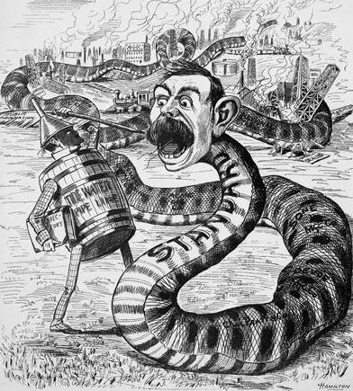
B. OIL REFINING
- John D. __________________
Unit 2 EQ 4:How did big business change the workplace and give rise to labor unions?
developed ___________ _________________ in Cleveland
formed the __________________ ________ _____________ (1867)
built its own _______________, ___________________, ________________
received shipping deal from __________
https://vimeo.com/291010023
result
cheaper to ____________ and ________ oil
cheaper to __________ oil
controlled ________ of the oil refining business
S
P
A
M
The Oil Business John D. Rockefeller created the most famous corporate empire of the times. When he was 26 years old, Rockefeller and four partners set up an oil refinery to process oil in Cleveland, Ohio. In 1870 Rockefeller formed the Standard Oil Company of Ohio. He bought most of the other oil refineries in Cleveland and other cities. He combined the competing companies into one corporation, a practice known as horizontal integration. The corporation produced other equipment and materials it needed, such as tank cars, pipelines, and wooden barrels. Standard Oil became wealthy and powerful
CRQ: According to the political cartoon, how did John D. Rockefeller become the leader of the oil industry? TTQA

Slide 12
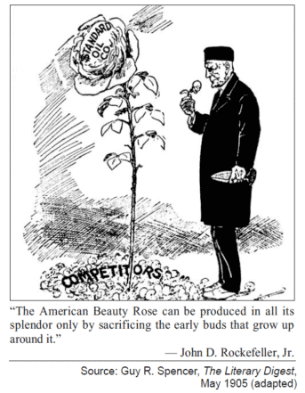
Unit 2 EQ 4:How did big business change the workplace and give rise to labor unions?
CRQ1 :How did Standard Oil eliminate its competition? Underline in the text where you find evidence to support the answer.
Rockefeller used other methods to control the oil industry. He lowered his prices so other companies would go out of business. He put pressure on his customers to keep them from using other companies. He received rebates, or secret discounts, from the railroad in exchange for his business. Rockefeller bought stock in many different oil companies. The shareholders traded their stock for stock in Standard Oil.
Rockefeller formed a trust, or group of companies managed by the same board of directors, in 1882. Rockefeller’s trust became a monopoly, which means that a single producer had almost total control of the oil industry.
S
P
A
M
“I am but one of many victims of Rockefeller’s colossal combination,” said Mr. [George]Rice, “and my story is not essentially different from the rest…I established what was known as the Ohio Oil Works…I found to my surprise at first, though I afterward understood it perfectly, that the Standard Oil Company was offering the same quality of oil at much lower prices than I could do – from one to three cents a gallon less than I could possibly sell it for. I sought for the reason and found that the railroads were in league with the Standard Oil concern at every point, giving it discriminating rates and privileges of all kinds as against myself and all outside competitors.” ~ Source: George Rice, “How I Was Ruined by Rockefeller,” New York World, October 16, 1898.
CRQ2: According to the political cartoon above how did John D. Rockefeller become the leader of the oil industry?

Slide 13
Unit 2 EQ 4:How did big business change the workplace and give rise to labor unions?
C. STEEL INDUSTRY
Andrew ________________
used ________________ & latest ___________________ to make steel
bought _______ _______ _______, ________ & ________ for shipping
results
cheaper to _____________ and ________ steel
cheaper to ______ steel
controlled the US _____________
became the first __________ $ company
Historical Context of Steel Industry
Before the Civil War, skilled workers used a slow and costly process to produce iron, which tended to be soft and malleable. The development of Henry Bessemer's converter aided the search for a more durable metal. The Bessemer process transformed iron into steel by injecting air into it, thereby reducing the amount of carbon. The process is credited with launching the steel industry and cheapening the cost of production because it was no longer necessary to employ highly paid skilled workers.
Carnegie was one of the first to upgrade his steel mills with the expensive, but efficient Bessemer machines – this move aided in Carnegie moving from a poor Scottish immigrant to a billionaire.
Carnegie developed a more efficient way to produce steel – he used the latest technology and controlled every resource needed to produce steel.
Carnegie dominated the steel industry by 1890. By 1900 he produced one-third of the nation’s steel. He built a steel mill near Pittsburgh that used the Bessemer process. He named his company after his biggest customer, the president of the Pennsylvania Railroad, J. Edgar Thompson.
Carnegie utilized an approach known as vertical integration. He bought companies that offered services and manufactured equipment his company needed. In this way, he was able to control all phases of the business. His companies were combined into the Carnegie Steel Company in 1900. He sold the steel company to J.Pierpont Morgan. Morgan combined Carnegie Steel with his other businesses to create the first billion-dollar corporation in the world, United States Steel.
CRQ: How did Andrew Carnegie become so successful in the steel industry? Provide 3 bullets
https://www.youtube.com/watch?v=f5ayVoY2qcY

Slide 14
Unit 2 EQ 4:How did big business change the workplace and give rise to labor unions?
D. MEAT-PACKING INDUSTRY
- prior to 1860, cattle shipped to _________→ __________________→ __________
Gustavus _________
developed the _________________ RR car
meat was now __________________ then _______________________
results
cheaper to produce and ship meat
cheaper to sell the meat
controlled the __________-___________ _________
E. BUSINESS ORGANIZATION
Monopolies: Instead of buying companies, their holding companies bought enough stock in the company to control it. Corporations expanded through mergers, or combining companies. Corporate mergers enabled a few huge companies controlled by a few powerful men to have most of the economic power. Because these individuals monopolized their industries, there was no competition. These companies did not have to keep their prices low or improve their goods or services in order to win customers.
______________________ = groups of investors who buy shares of stock in a company
______________________ = $ stock holders receive based on the number of stock they own
______________________ = corporations join together to compete with other companies

Slide 15
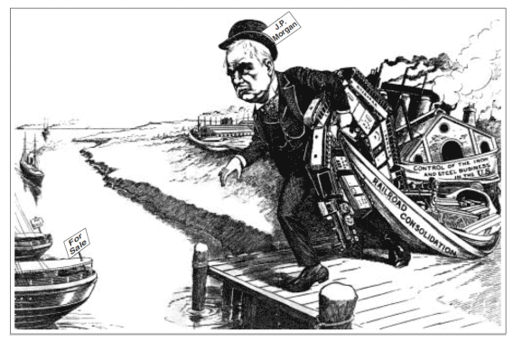
S
P
A
M
1. Which 19th-century business practice does this cartoon illustrate?
forming cooperatives C. establishing trade zones
creating monopolies D. expanding global markets
2. The cartoonist would most likely support federal government attempts to
pass antitrust legislation
limit regulation of business
establish high tariffs
stop industrial pollution
Unit 2 EQ 4:How did big business change the workplace and give rise to labor unions?

Slide 16
F. PHILOSOPHY OF BUSINESS
___________________ = Government does not make rules or control business (stays out of business)
Gospel of Wealth = _____ ____________ owners use part of their wealth for the good of society (____________________)
_________ _________________= Survival of the fittest
Social Darwinists vs Reformers
First Passage: “The publication of The Origin of Species in 1850 by the Englishman Charles Darwin marked a major step in the theory of evolution. It proposed that more individuals of each species are born than can possibly survive. As a consequence, there is a constant struggle for existence, and only the fittest survive.” ~ U.S. History and Government
Second Passage: “The social Darwinists believed that the process of natural selection would result in the survival of the best competitors and in continuing improvement in the population.
The theory was used to support laissez-faire capitalism and political conservatism. Class stratification was justified on the basis of ‘natural’ inequalities among individuals.
Attempts to reform society through state intervention would, interfere with natural processes; unrestricted competition in accord with biological selection.
The poor were the ‘unfit’ and should not be aided; in the struggle for existence, wealth was a sign of success. Social Darwinism was used as a philosophical rationalization for imperialist, colonialist, and racist policies.“ ~ Britannica
Unit 2 EQ 4:How did big business change the workplace and give rise to labor unions?
1. “Prices and wages should be determined by the marketplace.” The author of this statement would most probably support
government ownership of utilities
minimum-wage laws
wage and price controls
laissez-faire capitalism
2. After the Civil War, one-way business leaders tried to eliminate competition was by
forming monopolies or trusts
developing overseas markets
increasing the prices of their products
paying high wages to their workers
CRQ 1: According to Social Darwinists, what did class stratification [class hierarchy] justify?
CRQ 2: According to Social Darwinists, what did state intervention interfere with? TTQA

Slide 17
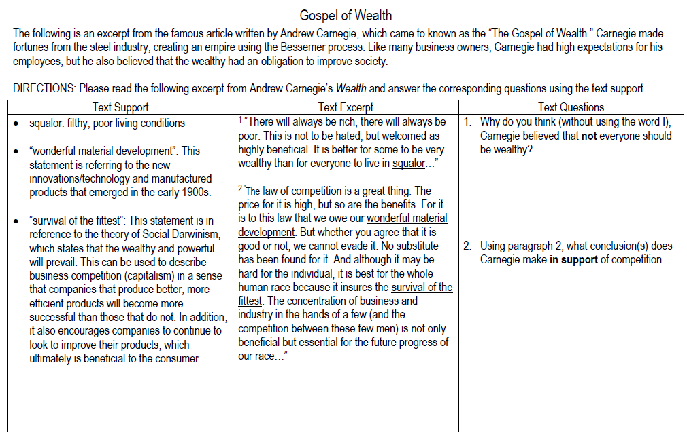
H.W.
Unit 2 EQ 4:How did big business change the workplace and give rise to labor unions?

Slide 18
H.W.
Unit 2 EQ 4:How did big business change the workplace and give rise to labor unions?

Slide 19
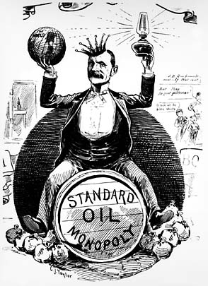
Robber Barons? Because of the lavish lifestyle of those who became rich from industry, the period from 1865 to 1900 became known as the Gilded Age Business entrepreneurs began to exercise a dominant influence on American life Some observers thought of these entrepreneurs as captains of industry because they helped forge the modern industrial economy Through efficiencies of large-scale production, these industrialists lowered the prices of many goods, making them more affordable Others called them robber barons because of the ruthless tactics they used to destroy competition and to keep down workers’ wages | Underline in the text Why certain successful entrepreneurs referred to as “captains of industry” Box in the text: Why some of these captains of industry were referred to as “robber barons”
S
P
A
M
CRQ: What does this image reveal about big business in the Gilded Age?
Unit 2 EQ 4:How did big business change the workplace and give rise to labor unions?

Slide 20
GROUP PROJECT:
Captain of Industry or Robber Baron?
OBJECTIVE: Over the next few days, you and your group members will research one of several prominent men whose names have become synonymous with big business (for better or worse). You will report on their legacy and whether or not they should ultimately be labeled a ‘Captain of Industry’ or ‘Robber Baron’.
THE CREW: Andrew Carnegie, John Pierpont Morgan, John Davison Rockefeller, Leland Stanford & Cornelius Vanderbilt.
THE TASK: Each group will conduct research about the man they have been assigned. The following are the topics you need to discuss on your SWAY:
Title Slide : ( Image & Quote)
Slide 1 - Background (childhood, education).
Slide 2 - Rise to the top (education, first jobs, how they got rich).
Slide 3 - Industry they came to dominate (railroads, companies owned, etc.).
Slide 4 - Reasons they may be a Captain of Industry ( explain how they helped industry using examples).
Slide 5 - Reasons they may be a Robber Baron ( explain using examples: cheating, lying and just being generally shady).
Slide 6 - Their legacy (what they left behind, charities, etc.)
Your group’s decision: Captain or Criminal?
THE RESOURCES: Your preliminary research should start on my website, where there are numerous links provided.

Slide 21
Title Slide 10 pts | Background 10pts | Rise to the Top 10pts | Industry 10pts | Captain of Industry 20pts | Robber Barron 20 pts | Legacy 10pts | Group Decision 10pts
______ Participation Grade 1 – 5pts
______ Participation Grade 2 – 5pts
______ Participation Grade 3 – 5pts
______ Participation Grade 4 – 5pts
______ Participation Grade 5 – 5pts
______ Sway – 100 pts
Total Score _______/125 =
Final Grade ___________%
GROUP PROJECT:
Captain of Industry
or
Robber Baron?

Slide 22
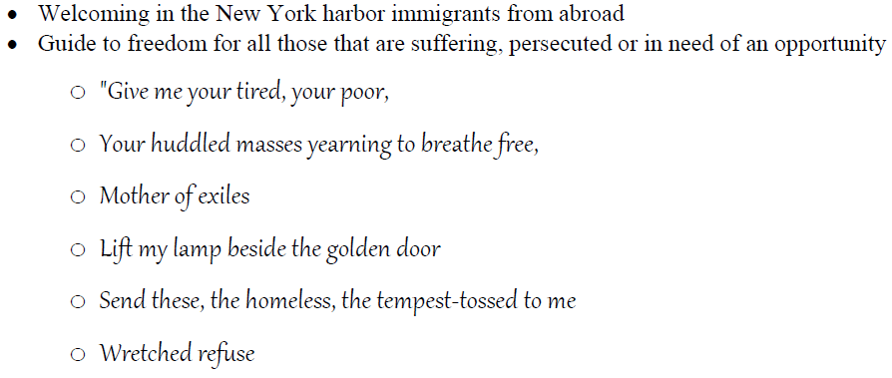
Reasons for leaving
(____________________)
______ ___________ _________ (fungus destroyed potato crops in Ireland)
Reasons for coming
(__________________)
_______ ______ ________ ________
(many settled in cities)
Restrictions
______ _______________
(too many people) in Europe
_______ ___________ ________ and in their countries to farm
not enough industrial jobs available
many moved west to be farmers (______________ _________)
OLD IMMIGRANTS (PRE-1870S) Mostly from Western Europe = Germany, Great Britain, Ireland, Sweden mostly Protestant
Immigrants Journey to America
European Immigrants (__________________________)
most were crammed in _____________ (airless rooms below deck)
most arrived in New York City (________ __________)
screened for ___________
many immigrant’s ________ were changed
_______________________________ became a symbol of American _____________________
Unit 2 EQ 5: How was the experience of immigrants impacted during the industrial revolution?

Slide 23
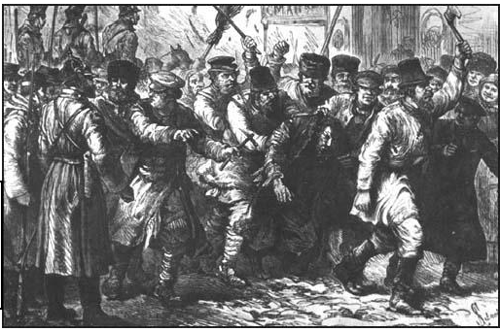
Reasons for leaving
(____________________)
fleeing
_________ ________
Reasons for coming
(__________________)
__________ of __________ _____ in America – most settle in cities
Restrictions
convicts, insane, people on charity
not enough factory jobs available
___________
in America
“New” Immigrant (post-1870s) Mostly from Southern and Eastern Europe = Italy, Greece, Russia, Poland mostly Catholic & Jewish
A Flood of Immigrants : Before 1865 most immigrants came to America from northern and western Europe or as enslaved African Americans. The European immigrants spoke English, were Protestant, and fit easily into the American culture. In the mid-1880s, immigrants came to the United States from southern Europe. Many of these newer immigrants were Catholics or Jews. Most did not speak English.
They settled in urban neighborhoods with others who shared their languages, religions, customs, and these immigrants faced difficulties blending into the American culture.
Many people emigrated, or left their countries, because of economic or political conditions in their homelands. Hunger, poverty, lack of jobs, discrimination, and unfair laws were problems people wanted to leave behind. Many ethnic groups left their homelands to escape persecution, or unfair treatment by the government. Ethnic minorities were often treated unfairly because they spoke different languages and practiced different customs and religions than most people of the country.
CRQ: What circumstances caused immigrants to emigrate from their countries?

Slide 24
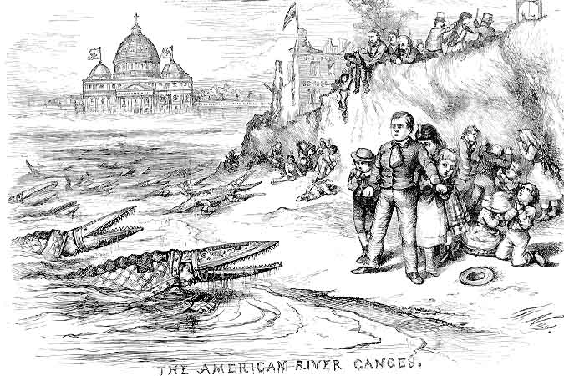
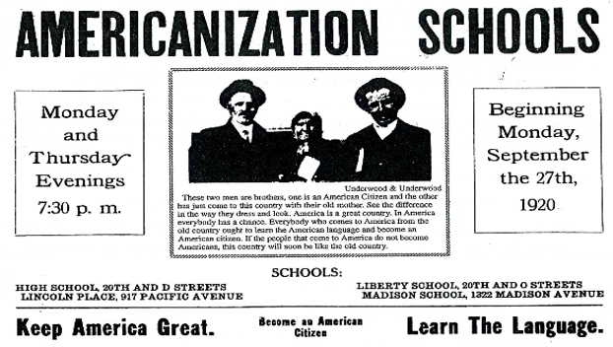
Unit 2 EQ 5: How was the experience of immigrants impacted during the industrial revolution?
Anti- Catholic Cartoon by Thomas Nast 1871
CRQ1: Identify the images that reflect the Anti-Catholic bias of the cartoonist.
Most immigrants wanted to fit in, or assimilate into American culture. They did not want to forget the customs and traditions of their homelands, however. Children learned English in school. Parents often spoke their original language at home. Immigrants from rural areas had to adjust to city life. Most had little or no education, so they worked at jobs that required no skill.
CRQ2: How were many immigrant children assimilated?

Slide 25
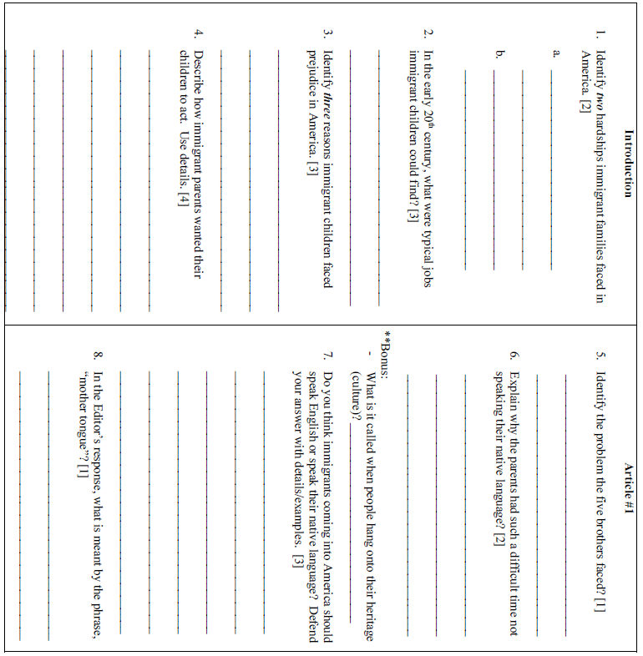
Unit 2 EQ 5: How was the experience of immigrants impacted during the industrial revolution?

Slide 26
Unit 2 EQ 5: How was the experience of immigrants impacted during the industrial revolution?

Slide 27
Reasons for leaving
(____________________)
most live in __________ (poor)
Reasons for coming
(__________________)
opportunity for a better life
(______________)
Restrictions
jobs available
could not own land
cheap labor needed to
____________ ____________ ____________
______________________________________________
said no Chinese worker could enter the U.S. for 10 years. Result = stopped almost all Chinese from coming to the U.S.
_______________________________________
current Japanese Americans would get more rights if Japan did not send anymore immigrants
Asian Immigration 1881-1920 Mostly from China and Japan most settle in the west brought Buddhism and Daoism to America
Asian Immigrants (arrive on west coast)
most were crammed in steerage
most arrived in San Francisco (____________ __________)
screened for disease
most Asian immigrants were __________ _____________
On the West Coast, immigrants from China and Japan were processed on Angel Island in San Francisco Bay. At the reception centers, immigrants gave their names, country of origin, job skills, and where they planned to live. Long or difficult names were often shortened at the reception centers. Immigrants had to pass health examinations. They were not allowed to enter the country with contagious diseases.
Unit 2 EQ 5: How was the experience of immigrants impacted during the industrial revolution?

Slide 28
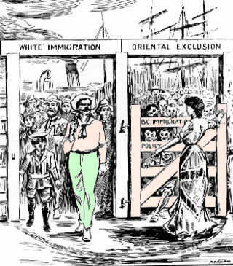
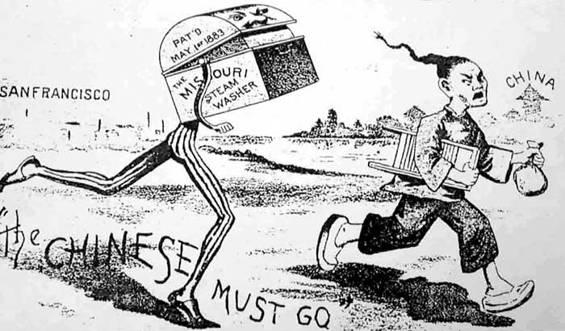
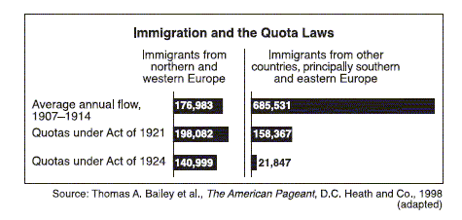
S
P
A
M
How does this late 19th century political cartoon reveal the attitudes of nativists towards the Chinese?
1. The Gentlemen’s Agreement, and Chinese Exclusion Act were attempts by Congress to restrict
immigration
property ownership
voting rights
access to public education
2. The data in the chart support the idea that the immigration laws of 1921 and 1924 were primarily designed to
stop illegal entry into the country
admit skilled workers
encourage immigration from southern Europe
reduce immigration from specific regions

Slide 29
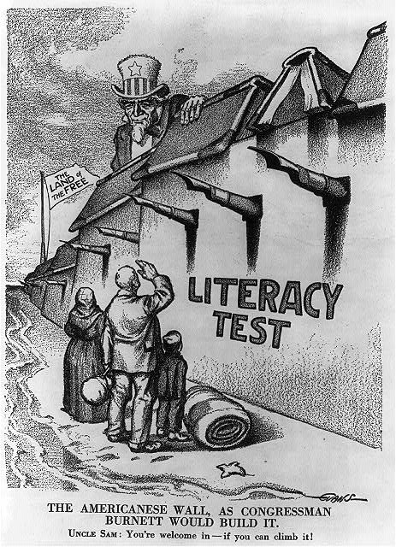
Nativism: a) Native-born Americans have demonstrated “nativism” toward immigrants of minority groups who have deviated from the dominant culture. b) Nativists groups discriminated against individuals because of race, religion, political beliefs, and economic fears. b) American-born workers did not welcome the new immigrants. They were afraid immigrants would compete for their jobs. They worried that immigrants would be willing to accept low wages, which would pull all wages down. American-born workers were not used to the unfamiliar languages, customs, and traditions. c) The Ku Klux Klan originated as primarily an anti-black organization during the Civil War era and resurfaced as an anti-Semitic, anti-Catholic, and anti-immigrant group in the 20th century | Immigration Restrictions: On a number of occasions, Congress has responded to nativist sentiments with the passage of restrictive legislation. 1- The Chinese Exclusion Act (1882) – restricted Chinese immigration for a 10-year period 2- Gentleman’s Agreement (1907) – Japan persuaded to deny passports to those who wanted to emigrate 3- Literacy Test (1917) – Immigrant required to pass literacy test in either English or another language 4- Immigration Act of 1921 – Quota system set at 3% of total of that nationality in U.S. in 1910; general limit of 350,000 immigrants per year
CRQ 1: How did representatives in Congress sometimes respond to nativist concerns? TTQA
Americans Against Immigration
_______________ = Americans Against Immigration
A. Resented Immigrants working for __________ __________
use ________________ against immigrants
work to ___________ immigration in America
Unit 2 EQ 5: How was the experience of immigrants impacted during the industrial revolution?

Slide 30
US History
Creative Writing Assignment: An Immigrant’s Letter to Home
Pretend that you are a twelve-year-old who has sailed to America. It has been one year since you left home, one year since you saw your parents. Write a letter to your parents describing your life the last year. Your letter should include the following:
Describe your voyage.
You should describe the conditions on your ship. Include details about the food, sleeping, weather, other people and groups on board, etc.
Include how your feelings about the voyage.
(2) Describe what life has been like during your first year there.
You can use conditions in factories, settlement houses, and tenements as the basis of your letter.
To make your letter sound real, put yourself in the mind of a child writing home to his/her parents who have not seen or heard from him in over one year. Your parents will want to know details about the many challenges you have faced, and how you have survived them. Use your imagination, but be sure not to contradict historical facts.
Your letter should be detailed and should be a minimum of two paragraphs in length. Remember that most immigrants came for political, economic, or religious reasons – why did you and your group come?
At least one paragraph should describe the voyage and at least one paragraph should describe the life of the life you have lead sine arriving. You are not required to type your letter, but it must be legible – I will not give a passing grade to a letter I cannot read.
Unit 2 EQ 5: How was the experience of immigrants impacted during the industrial revolution?

Slide 31
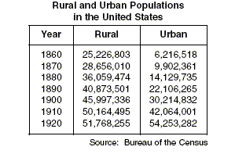
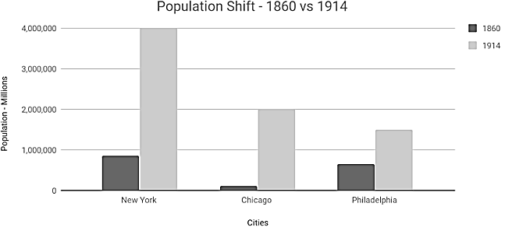
I. DEVELOPMENT OF CITIES
A. Geography
largest cities grew along the _____________
ocean ports = _________________________
B. Industries
______________________ brought people to cities
C. Technology
____________________ _______________ skyscrapers, elevators, mass transit (street cars)
_________________ ______________ created by Henry Ford – greatly increased production
Unit 2 EQ 3 What were the causes and effects of the rapid growth of city populations?
Growth of Cities
Cities experienced rapid growth in the late 1800s. Immigrants, farm workers, and African Americans migrated to cities in search of work. Expanding railroads, new methods of transportation, and the availability of natural resources contributed to the growth of cities.
Almost half of the population lived in American cities by 1910. In 1870 only one-fourth of the population lived in American cities. Eighty percent of the population in 1890 was made up of immigrants. New York, Chicago, and Detroit became major urban centers.
New farm machinery performed much of the work previously done by farm workers. Items that were previously made by women on farms, such as clothing and household goods, could be purchased in stores or from catalogs. Women left farms to find jobs in cities. Most African Americans lived in poverty in the South. Many moved to Southern cities looking for work to pay off debts. They also hoped to find less discrimination and injustice in large cities.
.
1. Which generalization about population growth is supported by information in this chart?
For every census listed, rural population exceeded urban population.
By 1920, more people lived in cities than in rural areas.
The Civil War significantly slowed the rate of population growth.
Most urban population growth was due to people migrating from rural areas.
2. An increase in the number of factories in the mid-1800s led to
an increased dependence on products made in homes
an increase in urbanization
a decrease in levels of water and air pollution
a reduction in immigration from Europe

Slide 32
II. PROBLEMS CAUSED BY INDUSTRIAL EXPANSION
________________________
from sewage
_________________________
Result = street lighting, police forces, fire departments/fire hydrants
_________________________
The sewers could not handle the amount of human waste in crowded cities. Garbage and horse manure filled the streets. The filthy cities were unsanitary. Diseases spread quickly.
Result = improved sanitation systems, water treatment plants
In 1900 many babies died before their first birthday. Whooping cough, tuberculosis, and other contagious diseases were common. Poverty led to crime. Children who were homeless or orphaned became pickpockets. Gangs committed more serious crimes
.
Religious groups worked to help the poor. Orphanages, prisons, hospitals, soup kitchens, and homeless shelters were created. The Salvation Army was founded in 1879. The YMCA (Young Men’s Christian Association) and YWCA (Young Women’s Christian Association) were established.
Settlement houses were established in poor neighborhoods. Many services, such as medical care, playgrounds, nurseries, and libraries, for the poor were provided at settlement houses. Most settlement workers were women. They worked to get police protection, garbage removal, and public parks for the poor areas. Jane Addams founded Chicago’s Hull House in 1889.
Unit 2 EQ 4:How did big business change the workplace and give rise to labor unions?

Slide 33
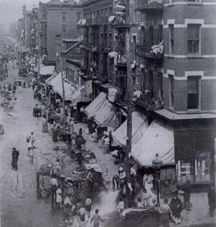
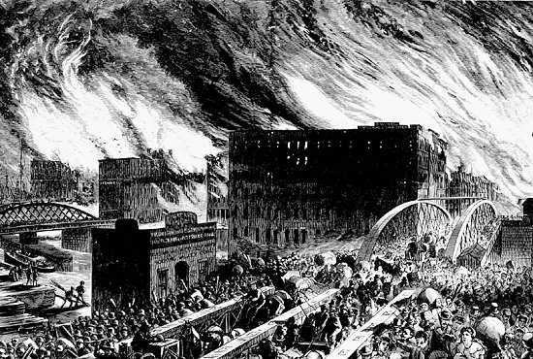
II. PROBLEMS CAUSED BY INDUSTRIAL EXPANSION
There was a huge gap between the rich and the poor. The population of cities grew faster than housing could be built. Cities were crowded.
__________________________
___________________________________
Many immigrants & Women performed unskilled labor for long hours and low pay.
______________________________
Tenements were located in poor, run-down neighborhoods called slums. Tenements had many small, dark rooms. Several families shared rooms. They also shared cold running water and often times no toilet.
Many worked in
sweatshops, which were hot, crowded workshops where workers made clothing. poor lighting and ventilation
It was not unusual for men, women, and children to work 12 hours a day, 7 days a week.
needed the $
parents had no place for kids to go
Child labor laws, passed by many states, were ignored by employers. The laws stated that children must be at least 12 years old and could work no more than 10 hours each day. These laws did not apply to children who worked on farms.
Due to industrialization and a large influx of immigrants, American cities boomed – below the streets of NYC are bustling with people – overcrowding become a problem
The Great Chicago Fire of 1871 – buildings were built so close to one another the fire spread rapidly – also there wasn’t an adequate fire department for the city
Unit 2 EQ 4:How did big business change the workplace and give rise to labor unions?

Slide 34
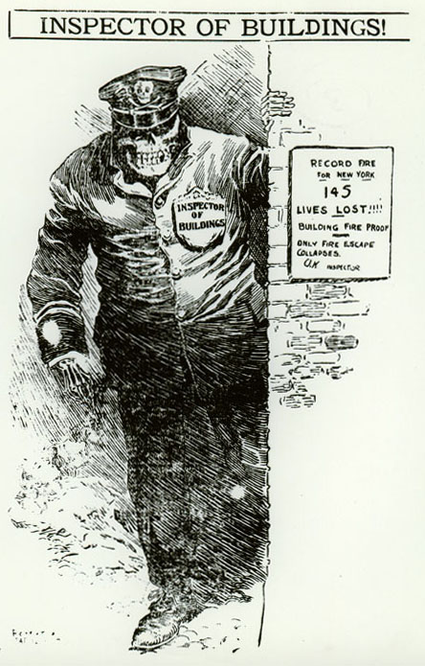
Triangle Shirtwaist Factory Fire:
The fire at the Triangle Shirtwaist Company claimed the lives of 146 young immigrant workers
The factory was a typical sweatshop factory in the heart of Manhattan
Low wages, excessively long hours, and unsanitary and dangerous working conditions
The International Ladies’ Garment Workers Union organized workers in the women’s clothing trade
Near closing time on Saturday afternoon, March 25, 1911, a fire broke out
146 of the 500 employees died
Owners locked the exit doors, claiming that workers stole materials
The tragedy subsequently brought about a modern factory inspection system and laws to regulate the labor of women and children
~ cornell.edu
CRQ1: What Historical Circumstances led to the Triangle Shirt Wait Factory Fire?
CRQ2 : Why did the fire at the Triangle Shirtwaist Factory change public opinion?
Unit 2 EQ 4:How did big business change the workplace and give rise to labor unions?

Slide 35
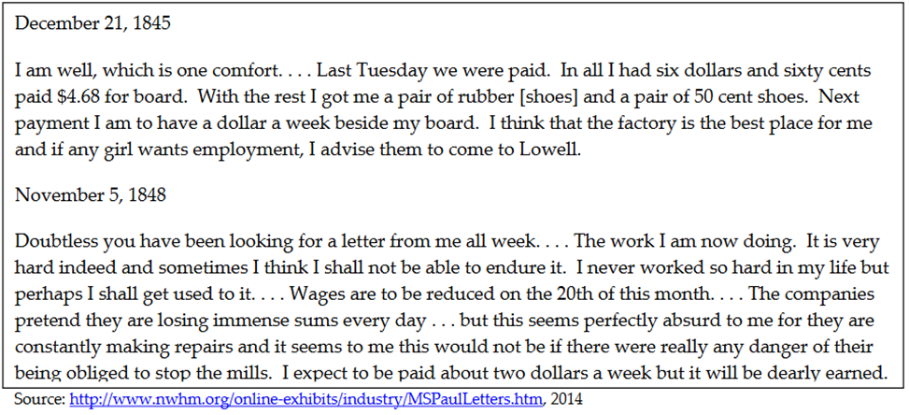
Unit 2 EQ 4:How did big business change the workplace and give rise to labor unions?
I. FACTORY WORKERS DURING INDUSTRIALIZATION
________________the number of people in ________ & ________________________
factory workers needed little or no _______ to work
workers could be ______________ _____________
workers had little _____________ ______________ with their employer
____________number of ___________ _________
Working Conditions : In the late 1800s, many companies were formed. Factories became larger. New jobs were created. Workers were able to afford the goods they needed and even a few luxuries. Laborers worked long hours for little pay, however. They often worked six days a week for 10 or 12 hours. Employers could fire them for any reason at any time.
When business was bad, workers were fired to save money. Many were replaced by immigrants who were willing to work for less pay. Factories were not safe or healthy places to be. Workers were often injured or became ill.
CRQ: What were the working conditions in factories?
Imagine that you are Mary’s sister in 1848 and you have just talked with your father about the letter Mary just sent . Explain whether you would consider working at your sister’s mill if you found out that your father would no longer be able to work and your family needed money.

Slide 36
Labor Unions Form : Workers organized labor organizations to fight for better pay and working conditions. Trade unions represented skilled workers in a trade, such as carpentry. They were not very successful because they only represented one trade. Labor leaders expanded their unions in the mid-1800s. The Noble and Holy Order of the Knights of Labor, a garment cutters union in Philadelphia, was formed in 1869. They met secretively and had secret handshakes to keep their union membership hidden. Employers fired workers who joined unions.
This union became a national organization that allowed women, African Americans, immigrants, and unskilled laborers to join. In the 1890s, the group lost power and members because of a series of strikes, where workers refused to work until their working conditions and pay were improved.
The American Federation of Labor (AFL) was created in 1886. Different national trade unions came together to form this federation. The AFL represented skilled workers in different trades. The AFL fought for better pay, shorter hours, better working conditions, and the right of the union to represent workers in bargaining with company management personnel, known as collective bargaining. Despite many violent strikes, the AFL continued to grow.
Labor Union | Industry and Activity
Knights of Labor | an organization of individuals ____________ ___ ______ ___________ _____ ___________ ____________Leader workers should set up own mines, factories, and RR’s believed in solving worker / owner disputes with ______________________ against strikes
American Federation of Labor (AFL) | The______________________________________ (AFL) 1886 founded by _____________ ______________ made up of _________________ workers who had belonged to national trade unions higher ______ & shorter _________ favored the use of ______________
CRQ: Why were labor unions formed?
Unit 2 EQ 4:How did big business change the workplace and give rise to labor unions?

Slide 37
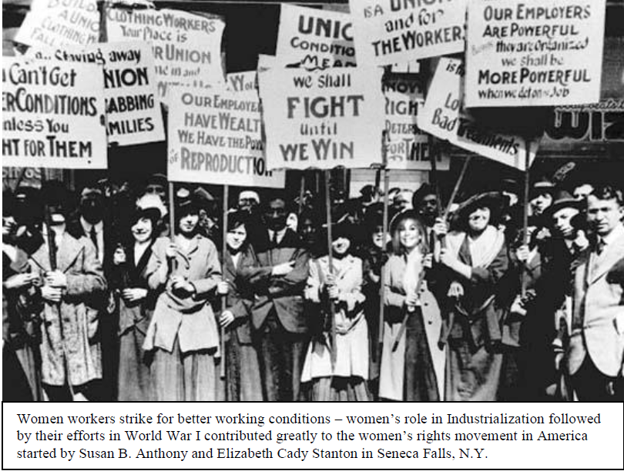
Women were not allowed to join many unions. They formed unions of their own. The International Ladies’ Garment Workers Union (ILGWU) pushed for a safer working environment after a disastrous fire in 1911. When a fire broke out in a crowded sweatshop in New York City at the Triangle Shirtwaist Company, almost 150 workers died. They could not escape the fire because the doors were locked to prevent them from leaving early.
In the 19th century, the major national labor unions wanted to improve the position of workers mainly by
obtaining the legal right to organize and bargain collectively
using government troops to settle labor disputes with management
supporting government ownership of major industries
endorsing a third political party for workers only
In the United States, industrial unions of the 1880’s and of the 1980’s had similar goals in that both campaigned for
national health insurance
better unemployment insurance
greater job security and higher wages
wage and price freezes
During the late 19th century, Samuel Gompers, Terence Powderly, and Eugene Debs were leaders in the movement to
stop racial segregation of Native American Indians
limit illegal immigration
gain fair treatment of Native American Indians
improve working conditions
The American Federation of Labor became the first long-lasting, successful labor union in the United States mainly because it
refused to participate in strikes against employers
concentrated on organizing workers in industries in the South
formed its own political party and elected many pro-labor public officials
fought for the rights of skilled workers

Slide 38
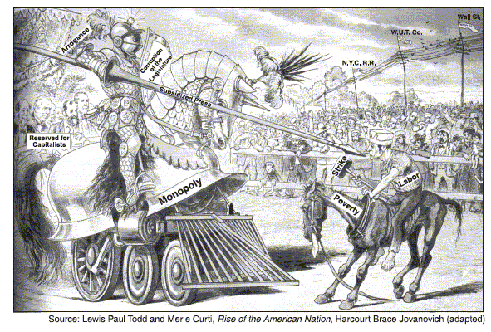
S
P
A
M
CRQ: Explain Collective Bargaining and the benefit that it had for workers. TTQA
“Collective bargaining consists of negotiations between an employer and a group of employees so as to determine the conditions of employment. The result of collective bargaining procedures is a collective agreement. Employees are often represented in bargaining by a union or other labor organization. Collective bargaining is governed by federal and state statutory laws, administrative agency regulations, and judicial decisions. In areas where federal and state law overlap, state laws are preempted. See, U.S. Constitution, Art. VI.” ~ law.cornell.edu
Some individuals feel that collective bargaining gives unions too much power while other individuals feel that collective bargaining is necessary to ensure that workers are not mistreated or even exploited

Slide 39
Unit 2 EQ 4:How did big business change the workplace and give rise to labor unions?
Labor in the Gilded Age - Directions: You have been assigned to read about four major labor related events in US History from the Gilded Age. Read about your event, and fill out the table below based on your reading.
Event | Industry | People Involved | What happened: Cause, Effect, Impact
Haymarket Riot 1886
Homestead Strike 1892
Pullman Strike 1894

Slide 40
 | Cause or Effect of The Gilded Age (Circle appropriate term) | Social, Political, or Economic Cause or Effect WHY?
Monopolies and Corruption | Cause Effect | Political and Economic effect
Inventions and Innovations | Cause Effect
Immigration and Population shifts | Cause Effect
Factory Working Conditions | Cause Effect
Transcontinental Railroad & Graph | Cause Effect
Westward Expansion | Cause Effect
Rise of factories & assembly line | Cause Effect
Labor Unions & Monopolies | Cause Effect

