Slide 1
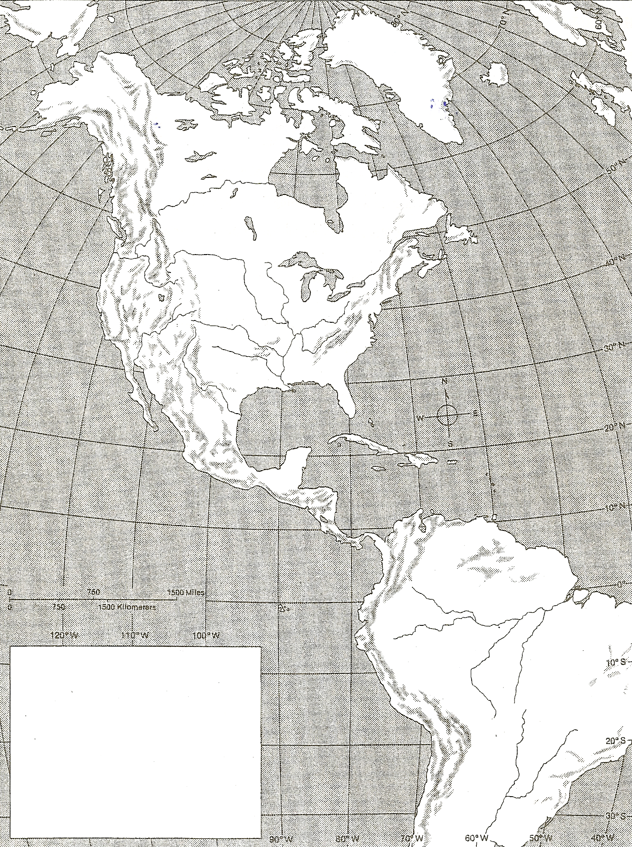
MAP EXERCISE:
HUNTERS REACH AMERICA
(THE FIRST AMERICANS)
DIRECTIONS: Use the maps from your packet and the maps of the textbook to complete this geography exercise.
1. Locate and label the following geographic features.
-North America
-South America
-Asia
-Pacific Ocean
-Atlantic Ocean
-Rocky Mountains
-Appalachian Mountains
-Bering Strait
2. Use a colored pencil to shade in the area where a land bridge was exposed during the last ice age.
3. Draw the routes taken by ancient people who crossed the land bridge from Asia to North and South America.
4. Create a key in the blank box on the map showing the information that you have placed on the map.
-Show the following information:
A. Land Bridge
B. Routes of Early Humans
Migration Theories
Land Bridge
Routes of Early Humans
18

Slide 2
New World
Old World
Shared Native American Traits

Slide 4
 | MAYANS | INCAS | AZTECS
LOCATION: (Where did they live?)
DATES: (When did the civilization exist?)
GOVERNMENT: (What type of government?) (Who ran the government?)
SOCIAL CLASSES: (List the social classes that they had.)
RELIGION: (What type of religion did they have?) (What were the names of their god(s)?) (Who ran the religion?) (What types of rituals/ceremonies did they perform?)
ACHIEVEMENTS: (What did they create, invent, or do that helped others?)

Slide 6
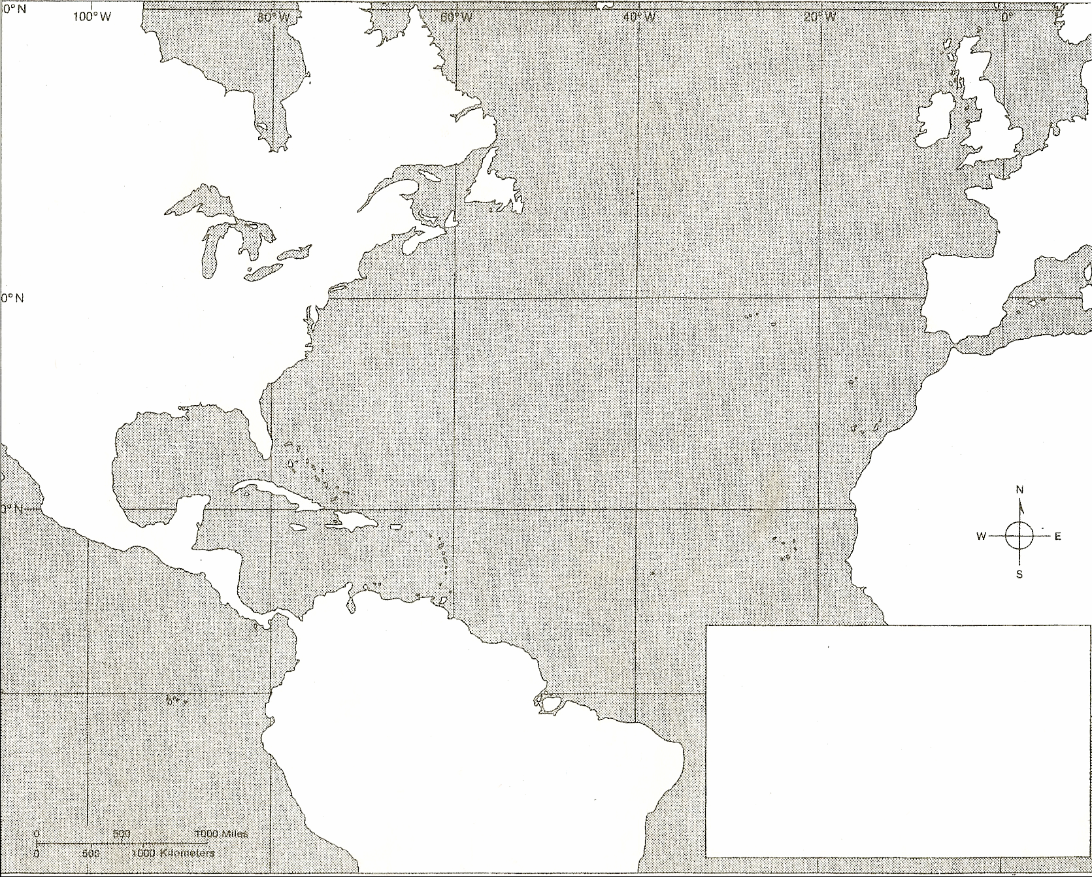
MAP EXERCISE:
DIRECTIONS:
1. Locate the following on the map.
Spain
Portugal
South America
Atlantic Ocean
Hispaniola
Cuba
Africa
North America
Caribbean Sea
2. Use a colored pencil and draw the route that represents the 1st voyage that Columbus made to the New World.
3. Create a key in the blank box showing the 1st voyage and the dates for the 1st voyage.
COLUMBUS REACHES AMERICA

Slide 7
