Slide 1
Objectives
Explore how English traditions influenced the development of colonial governments.
Describe the causes and major events of the French and Indian War.
Summarize how the wars and their outcomes changed the relationship between Britain and the colonies.
Unit 1 Part 3

Slide 2
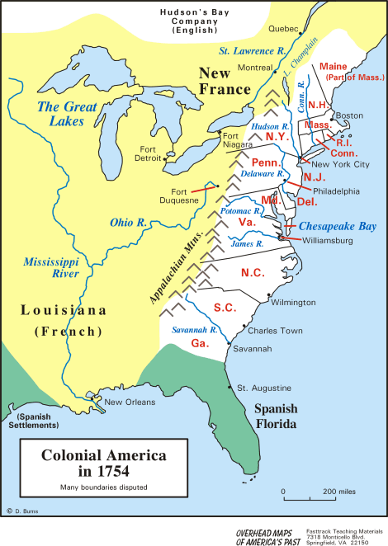

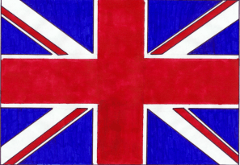
How did Great Britain's wars with France Affect the American colonies : 1754-1763
The English & English Colonists… | The French & French colonists…
Want to use your land for fur trading and farming Think that Native Americans are “savages” Want to expand their territory further to the West Have a steadily growing population in America | Want to use your land for fur trading Have married Native Americans and raised families with them in America Have many missionaries living in the west that try to convert Native Americans to Christianity Have a relatively small population in America
Which side will you choose? In the 1750s war was about to break out between the French and the English, and Native American tribes were faced with a tough choice. Which side would they choose? Use these facts to help you make a decision. ____________________________________________________________________________________________________________________________________________________________________________________________________________________________

Slide 3
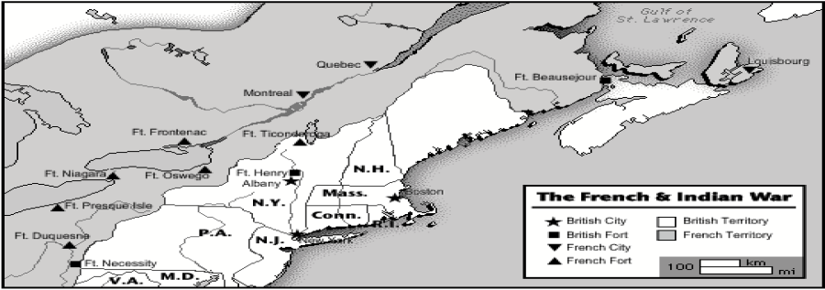
British-French Rivalry
The British and French had been rivals for centuries. As the British moved closer to French-held territories in North America, tensions between the British and French colonists increased. The French did not want British land companies or colonists to share in the profits of their fur trade in the Ohio River valley. In the 1740s, British fur traders built a fort at Pickawillany in Ohio country. The French attacked them and drove them out.
The French then built forts along the rivers in the upper Ohio Valley, close to the British colonies. The French also attacked Nova Scotia in present-day Canada, which was controlled by Great Britain. New Englanders captured the French fortress, Louisbourg, on Cape Breton Island north of Nova Scotia, but Britain later returned it to France.
Why did the French not want westward expansion past the Appalachian Mountains? __________________________________________________________________________________________________________________________________________________________________________________________________________________________________________
What British Fort protected Albany, New York from Attack?
How many French Forts were located on Great Lakes?
3. British soldiers sailed from Boston to Ft. Beausejour. About how many miles did they travel?
4. According to this map, which French Fort was built inside British controlled territory?

Slide 4
American Colonists Take Action Virginians wanted to settle the Ohio Valley. In 1753 the governor of Virginia sent George Washington to notify the British that they were on British territory and that they must leave. When they refused, Washington was sent back with a militia, a volunteer group of citizen soldiers. They found the French were building a fort on the site. Washington established a small post located nearby. Washington’s militia attacked a French scouting party. Because they were outnumbered and inexperienced, they lost and had to surrender. The French eventually released the soldiers and let them return to Virginia where they were regarded as heroes.
What is a militia? _________________________________________________________________________________________________________________________________________________________
Why were Washington’s Militia regarded as heroes even though they lost? _________________________________________________________________________________________________________________________________________________________
French and Indian War 1754-1763
French fur traders and British colonists needed Native American allies to help them establish control of North America. The French had better relations with Native Americans because they did not try to take Native American land or change their way of life. Native Americans helped the French in the wars between Great Britain and France by raiding British settlements.
The Iroquois Confederacy, the most powerful group of Native Americans in the East, was a union of many different groups of Native Americans. They traded with both the British and French and dominated the Great Lakes region. When the British moved into the Ohio Valley, the Iroquois Confederacy became their allies and gave them trading rights. As a result, the British had more power than the French.
Why was the Ohio Valley important to both the French and the British? ________________________________________________________________________________________________________________________________________________________________________________________________________________________________________________________________________________________

Slide 5
British Colonies Preparations for War:
The British Take Action
The French and Indian War continued in North America during the late 1750s and early 1760s. The French formed alliances, or unions, with Native Americans to fight the colonists. In 1754 the British Parliament decided to send troops to help the British colonists. British General Edward Braddock, with George Washington as his aide, set out with British troops and colonial militia for Fort Duquesne. British troops in red coats were easily spotted and ambushed by Native American warriors and French troops. Braddock and almost 1,000 soldiers were killed. This defeat led Britain to declare war on France, marking the beginning of the Seven Years 'War. French, British, and Spanish troops fought in Cuba, the West Indies, India, the Philippines, North America, and Europe. French troops captured several British forts. Their Native American allies raided farms from New York to Pennsylvania, killed settlers, and drove many others back to the coast. British forts at Lake Ontario and Lake George were captured by the French.
William Pitt turned things around for the British forces when he became secretary of state and then prime minister of England. He chose skilled commanders and agreed to pay for all supplies. Pitt later taxed the colonists to help pay for the cost of the war. Pitt wanted both a path to the western territories and French Canada. British troops under the command of Jeffrey Amherst and James Wolfe recaptured the fortress at Louisburg. British officers and a group of New Englanders captured Fort Frontenac at Lake Ontario. British forces made the French abandon Fort Duquesne in Pennsylvania, which was later renamed Fort Pitt.
How did William Pitt help the British in their war against France? Cite Evidence ____________________________________________________________________________________________________________________________________________________________________________________________________________________________________________________________________

Slide 6
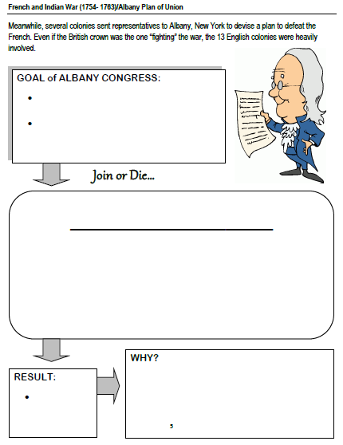
Delegates from New England, New York, Pennsylvania, and Maryland met in Albany, New York, to discuss the threat of war and plan their defense. They also wanted to sway the Iroquois to become their allies against the French. Benjamin Franklin’s plan, called the Albany Plan of Union, was adopted by the delegates. It called for a general government for the American colonies. It further proposed an elected legislature with the power to collect taxes, establish an army, and regulate trade. None of the colonies approved the plan or united to fight the French. A series of battles and a war followed, called the French and Indian War. The British were fighting the French and their Native American allies.
What were the first steps toward the French and Indian War? ____________________________________________________________________________________________________________________________________________________________________________________________________________________________________________________________________________________________________________________

Slide 7
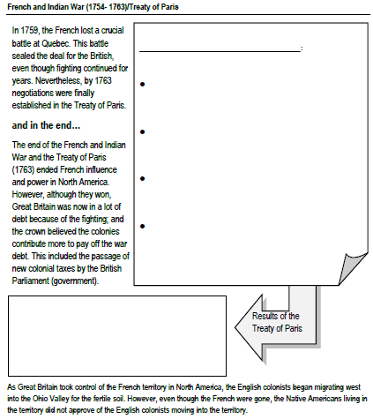
The Fall of New France In 1759 the British captured several French islands in the West Indies and the city of Havana in Cuba. The French were defeated in India, and a French fleet of ships was destroyed. General James Wolfe surprised and defeated the French forces outside the Fortress of Quebec. Wolfe was killed in battle. General Amherst and his troops captured Montreal the next year. The victories in Quebec and Montreal ended the fighting in North America.
The Treaty of Paris was signed in 1763. Britain was given most of the Canadian and French lands east of the Mississippi River from France, and gained Florida from Spain. Spain received the Louisiana Territory west of the Mississippi River. France kept some of its sugar-producing islands in the West Indies. The continent was divided along the Mississippi River between Britain and Spain. Native Americans who lived on the lands were not covered by the Treaty of Paris.
What did Britain gain from the Treaty of Paris? _______________________________________
_______________________________________
_______________________________________
_____________________________________________________________________________________________________________________

Slide 8
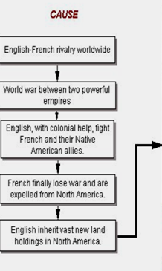
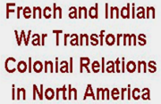
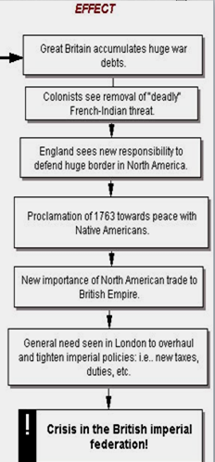
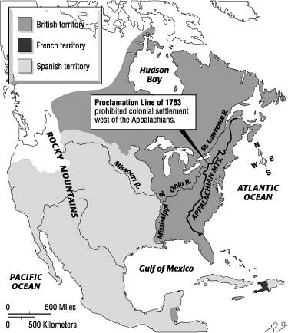
What was the Proclamation of 1763?
__________________________________________________________________________________________________________________________________
Trouble on the Frontier : Native Americans in the Ohio River valley lost their French allies and considered the British their enemies. In the spring of 1763, Chief Pontiac formed an alliance of Native American groups to fight the British who threatened their way of life. He and his allies attacked the British fort at Detroit and captured most outposts in the Great Lakes region. During raids that became known as Pontiac’s War, Chief Pontiac’s alliance killed settlers on the Pennsylvania and Virginia frontiers. The war ended after British troops defeated Pontiac’s allies, the Shawnee and Delaware people. Pontiac signed a peace treaty and was excused of any punishment by the British. With the end of the French and Indian War came peace. Then King George III signed the Proclamation of 1763 banning any westward expansion beyond the Appalachian Mountains. Hoping to avoid more fighting with Native Americans, he upset land companies and their investors, called speculators, who had already purchased property west of the Appalachians. Tensions between the colonists and Britain were growing.

Slide 9
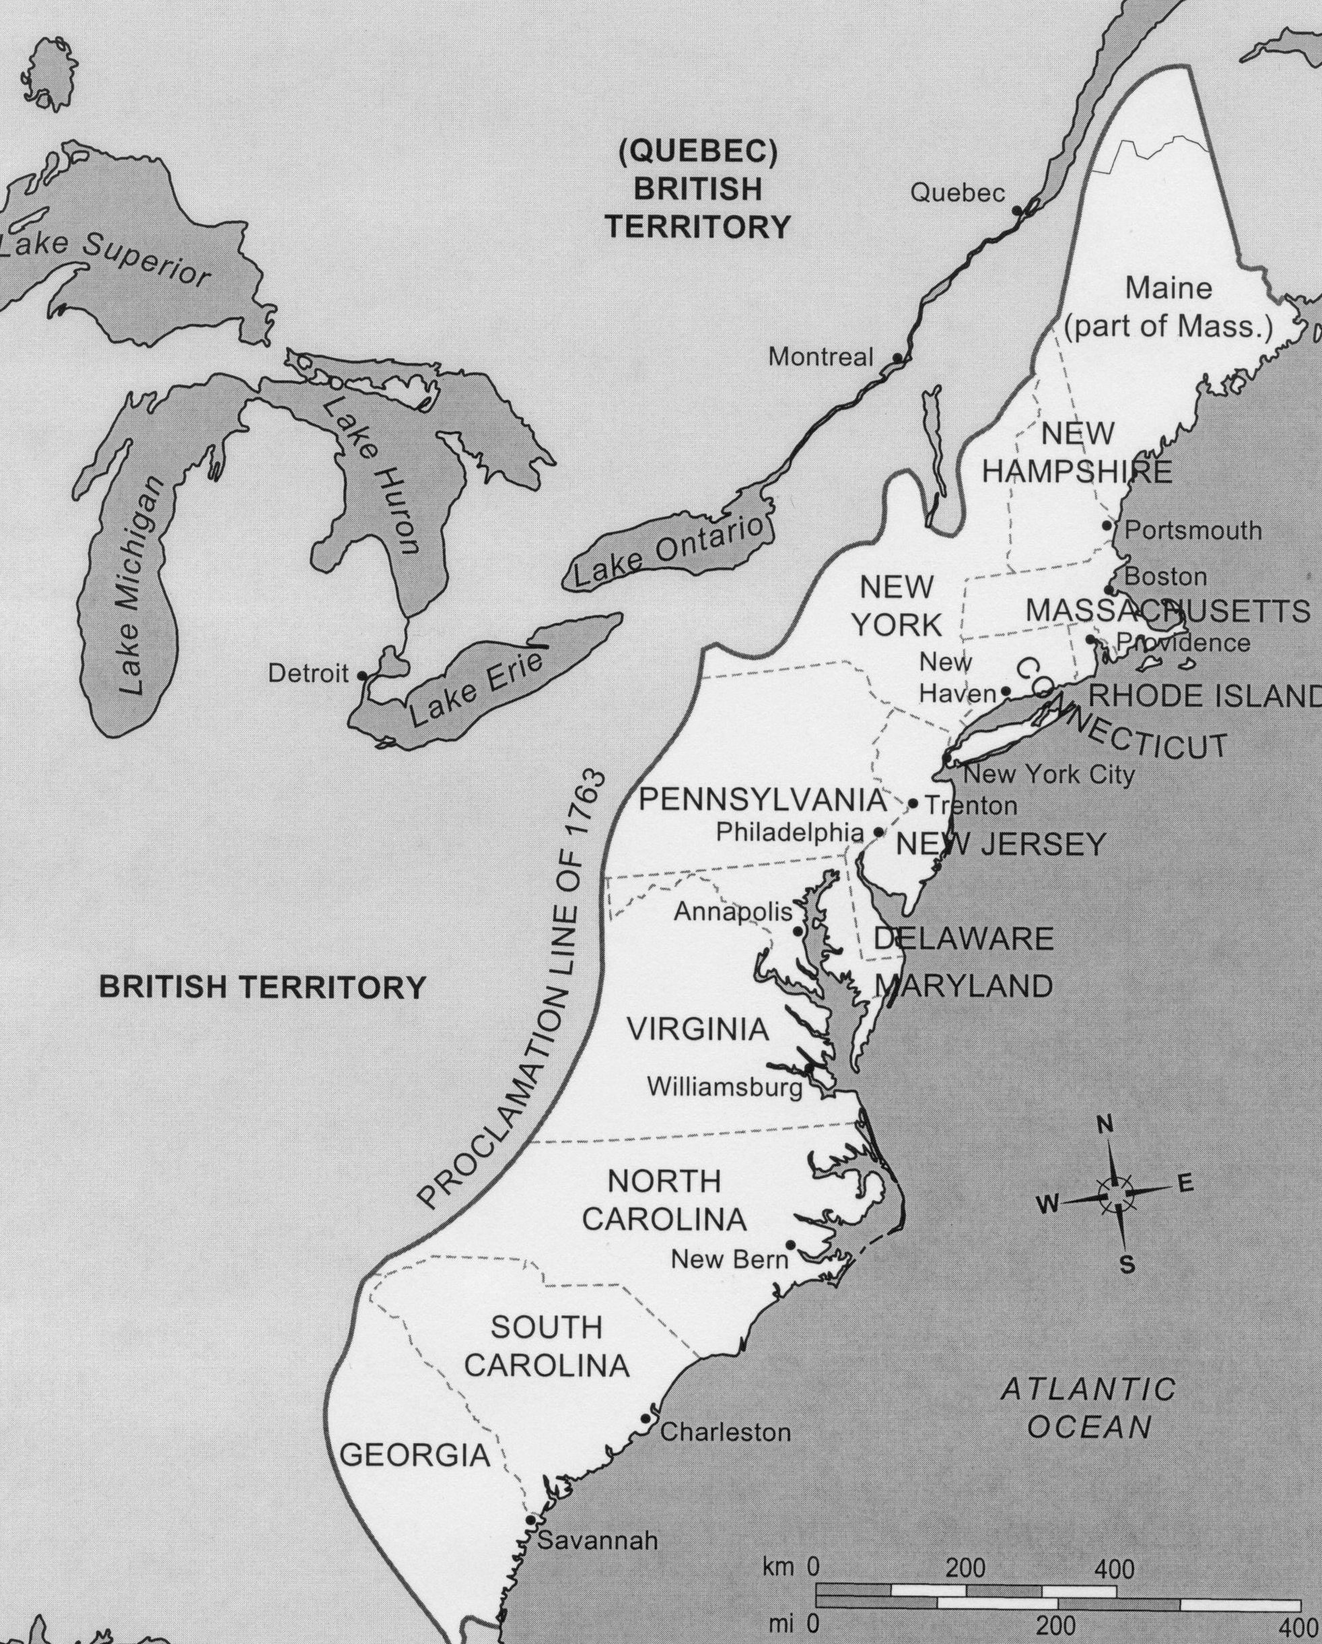
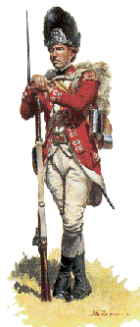
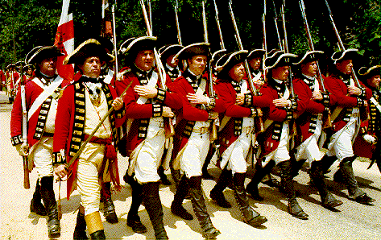
Relations With Britain
After Britain won the French and Indian War, they did a number of things to anger the colonists and cause them not to trust them. Colonists strongly opposed taxation without the consent of colonial legislatures. Many colonists felt that the following British actions interfered with their freedom:
The British planned to send 10,000 soldiers to the colonies and the frontier to help stop conflicts over land with the Native Americans.
They declared in the Proclamation of 1763 that colonists were not allowed to move into Native American lands west of the Appalachian Mountains.
The king and Parliament of Britain also planned to tax the colonists for revenue, or to raise money, to help pay for the cost of the French and Indian War.
Customs officers obtained writs of assistance, or legal permission to search homes and warehouses for smuggled goods without warning.
They passed the Sugar Act in 1764 to lower the tax on imported molasses, hoping to encourage colonists to pay the tax instead of smuggling sugar from the West Indies.
They established special courts to hear smuggling cases, which denied colonists the right to a jury trial.
Proclamation Line of 1763: Colonists could not cross line and move into Indian land. 10,000 soldiers sent to colonies to enforce the law. Colonists hated England for doing this. Many colonists ignore the law and move into new lands.
Proclamation Line
The British | The Colonies
wanted more control over the colonies
wanted the colonies to help pay for the wars | wanted more land for settlements
 | wanted to maintain their individual autonomy
wanted colonies to cooperate in time of war
STOP: How did Britain hope to collect money to help pay their debts from the French and Indian War? __________________________________________________________________________________________
____________________________________________________________________________________________________________

Slide 10
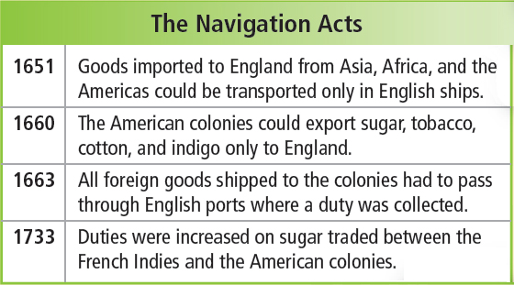
How did English ideas about government and the economy influence life in the 13 colonies?
Navigation Acts and Salutary Neglect
Magna Carta
Parliament
Glorious Revolution

