Slide 1
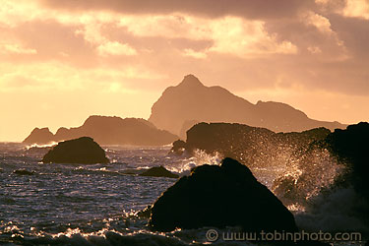
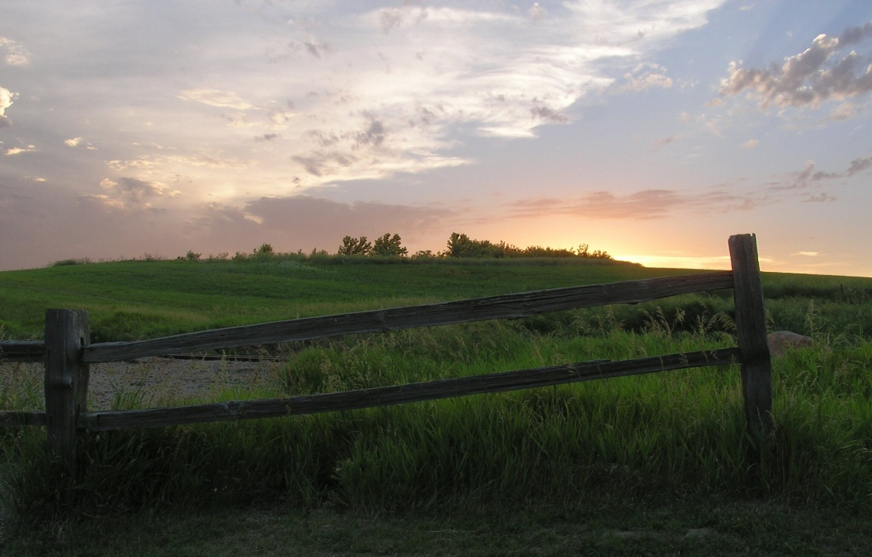
AMERICAN
GEOGRAPHY
Module Unit 1

Slide 2
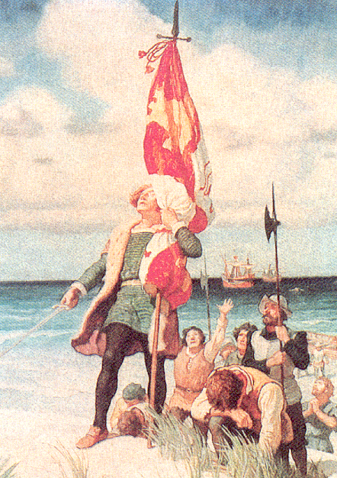
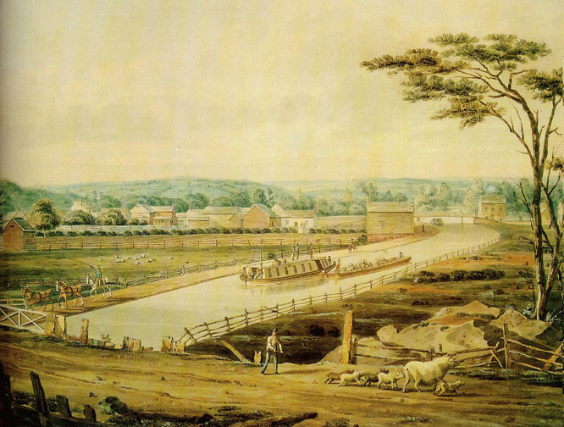
1. GEOGRAPHY OF THE AMERICA’S:
Understanding geography is important to our understanding of the past and present.
-Geography is linked to history.
-To understand history, you must understand geography.
-All of human history has taken place in the environment.
Unit 1 Objective: Why is understanding geography important to the study of history?
Question: What do all 3 events have in common?
Answer: ALL 3 took place in the environment.
Columbus landing in New World in 1492.
General George Washington at Valley Forge in 1777.
Erie Canal in New York in the 1800’s.

Slide 3
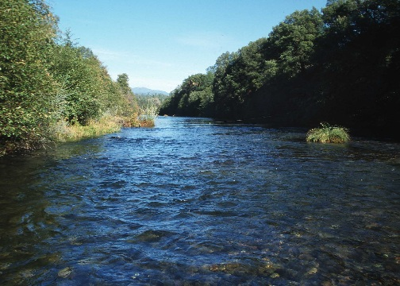
Unit 1 Objective: Why is understanding geography important to the study of history?
2. GEOGRAPHY: The study of the physical, biological, and cultural features of the Earth’s surface.
●Geography is the environment in which we live.
Rivers and mountains are physical or geographic features.
Gold, trees, and cotton are examples of natural resources.
Plants and animals are part of the geography.

Slide 4
Unit 1 Objective: Why is understanding geography important to the study of history?
PHYSICAL FEATURES: landforms & geographical features on the Earth’s surface such as mountains, rivers, lakes, and deserts.
NATURAL RESOURCES: Materials humans take from the environment to use to survive.
Ex: Plants, Trees, Gold, Oil, Water, Sun
WEATHER: The condition of the Earth’s atmosphere at a given time and place.
CLIMATE: The average weather of a place over a period of 20-30 years.
Made up of temperature and precipitation (rain, snow, sleet, hail)

Slide 5
List examples of different landforms found in upstate New York

Slide 6
Unit 1 EQ Objective: What are the five themes of Geography?
What are the five themes?
Tools geographer’s use to study features on earth.
Location:
Place:
Region:
Human Environment Interaction:
Movement

Slide 7
3. Location: Describes where places are at on earth.
Unit 1 EQ Objective: What are the five themes of Geography?
A. RELATIVE: compared to other places (variable)
B. ABSOLUTE: exact location on earth (fixed)
Changes dependent upon where you’re comparing it to.
Miles
Distance
Direction
Doesn’t change
Latitude/Longitude
Hemispheres
Grid System
Address

Slide 8
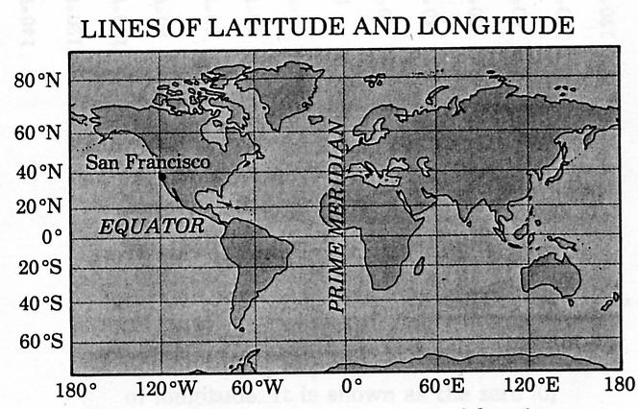
Unit 1 EQ Objective: What are the five themes of Geography?
When you combine the two sets of lines, you get a grid. This allows you to find exact or absolute locations on the Earth’s surface.

Slide 9
Answer: Absolute Location
What type of location is this?
Examples:
Rome is located at 41 N, 12 E
Argentina is located in the southern hemisphere
Ecuador is located in Tropic of Cancer.
LNE is located in Lincoln, NE.

Slide 10
Answer: Relative Location
What type of location is this?
Examples:
Rome is located near the Mediterranean Sea.
Argentina is near Brazil.
Ecuador is south of Mexico.
Lincoln is 50 miles from Omaha.

Slide 11
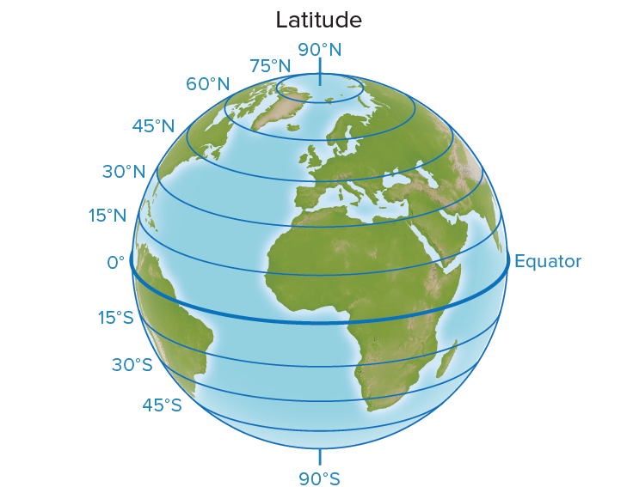
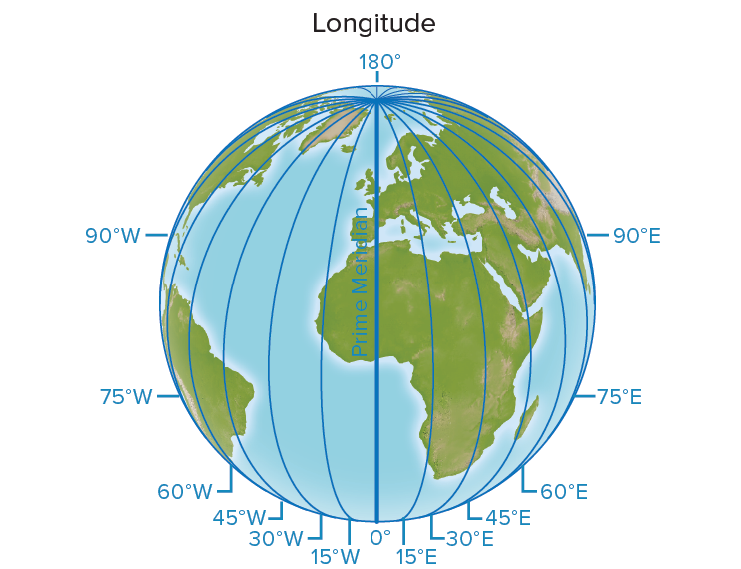
Unit 1 EQ Objective 2: How do latitude and longitude help people to locate places in the world?
4. LATITUDE: Lines on a map that measure distance north and south from the Equator.
5. LONGITUDE: Lines on a map that measure distance east and west from the Prime Meridian.
Think Latitude = Ladder
They go left to right on the map.
Longitude = Long way from top to bottom. They run up and down the map.

Slide 12
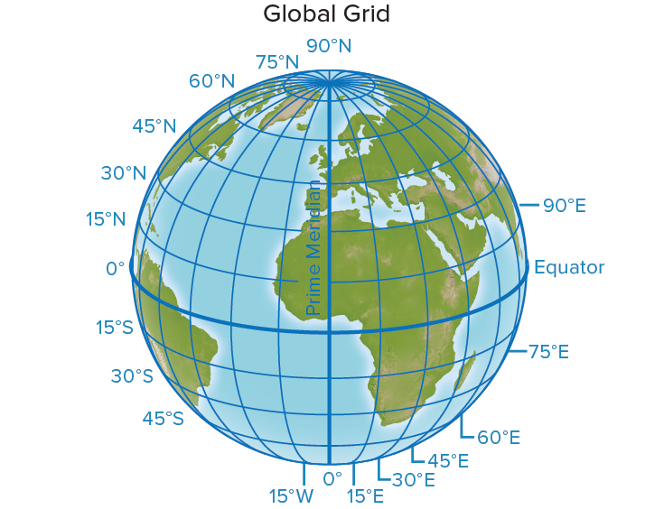
Coordinate
Intersecting latitude and longitude lines
Always write a coordinate like this…
Latitude, Longitude
Houston (29°N, 95°W)
or
Houston (95°W, 29°N)

Slide 13
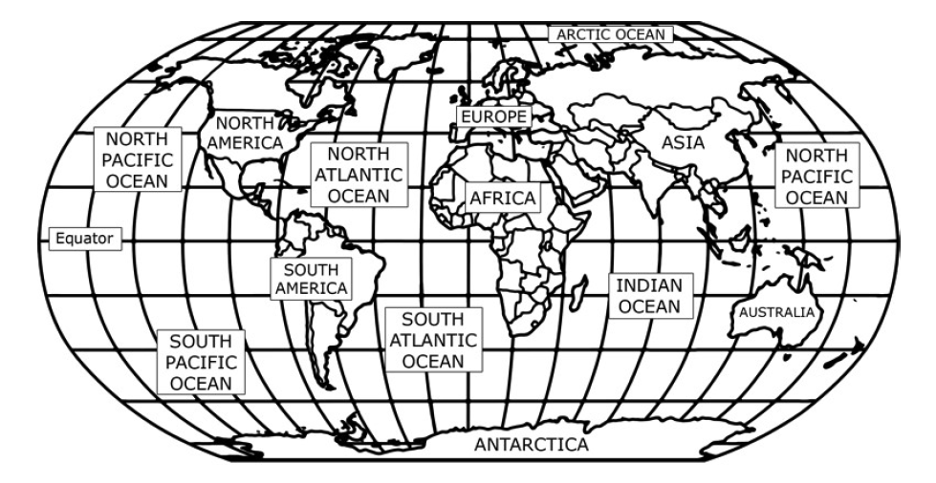
Unit 1 EQ Objective 2: How do latitude and longitude help people to locate places in the world?
Legend:
Equator
Prime Meridian
Latitude Lines
Longitude Lines
World Map

Slide 14
For notebook page 6
On page 6
Cut out the Cardinal and Intermediate Directions foldable
Color/Notes/glue into notebook
On page 7
Cut out Continents foldable
Color/ Notes/ glue into notebook

Slide 15
Cardinal & Intermediate Directions
Label each Cardinal tab North, South, East & West
Label the intermediate directions square Northwest, Northeast, Southwest, Southeast
Color West Blue
Color North Red
Color East Yellow
Color South Green
Color Northwest Purple
Color Southwest Blue Green
Color Northeast Orange
Color Southeast Yellow Green
Cut out
Fold curved tabs to create a crease.
Only glue the back of the square to the paper.

Slide 16
Notes on the Continents Copy to the back of each page of you Continents booklet.
Unit 1 EQ Objective: What are the five themes of Geography?
Green : AFRICA-Somalia, Kenya, Egypt, South Africa, Libya, and South Sudan
Purple: ANTARTICA-
Yellow: ASIA-China, Japan, India, Russia
Pink: AUSTRALIA-Australia, New Zealand
Orange: EUROPE-Denmark, Netherlands, Italy, France
Blue: NORTH AMERICA- Canada, Mexico, and United States
Red: SOUTH AMERICA-Brazil, Chile, Peru, Bolivia, and Argentina
****NOTE-Middle East- Countries like Egypt (north Africa) and Southeast Asia (Iraq, Iran, Saudi Arabia)

Slide 17
Unit 1 EQ Objective: What are the five themes of Geography?
6. UNDERSTANDING GEOGRAPHY: AMERICA’S LOCATION:
●The United States is part of North America.
●North America is one of the seven continents on the Earth.
3
1
5
4
6
2
7

Slide 18
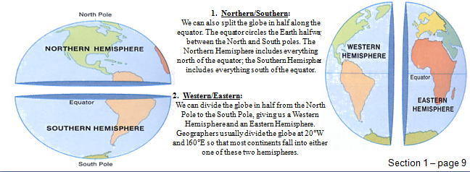
Unit 1 EQ Objective 1: What are the five themes of Geography?
6. AMERICA’S LOCATION:
America’s location is in the Northern and Western Hemisphere’s.
North America

Slide 19
HEMISPHERES:
WHERE ARE YOU?
A line from the North Pole to the South Pole divides Earth into the ________________________ Hemisphere and _______________________ Hemisphere.
Both North and South America are in the _______________________________ Hemisphere.
Both Africa and Europe are in the ______________________________ Hemisphere.
The equator divides the globe into the __________________________________ and _________________________________ hemispheres.
People in the U.S. live in the _____________________________ and _______________________________ hemispheres

Slide 20
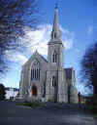
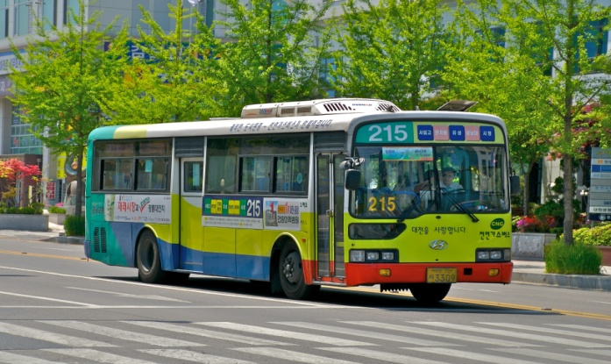
Unit 1 EQ Objective: What are the five themes of Geography?
7. Place: Describes an area’s physical and human features.
A. Physical Features: (LANDFORMS, GEOGRAPHICAL FEATURES)
B. Human/ Cultural Features: Houses, transportation, jobs, language, and religion.

Slide 21
Answer: Physical Features
What type of feature is this?
Specific to THAT place, not generic.
The way a place looks.

Slide 22
Answer: Human/Cultural Features
What type of feature is this?
Specific to THAT place, not generic.
Peoples activities change the way a place looks or is represented.

Slide 23
Answer: Physical Features
What type of feature is this?
Created by nature.
Mountains
Rivers, Lakes, Seas
Climate
Vegetation

Slide 24
Answer: Human/Cultural Features
What type of feature is this?
Man-made or invented.
Language
Unique buildings
Religious Practices
Celebrations/traditions/holidays

Slide 25
Answer: Physical Features
What type of feature is this?
Examples:
Andes Mountains are in South America.
Amazon River flows through Brazil.
Pampas are located in Argentina.
The isthmus of Panama connects Central & South America.

Slide 26
Answer: Human/Cultural Features
What type of feature is this?
Examples:
Portuguese is the official language of Brazil.
Many Mexicans are Catholic.
Mayan ruins are located in Mexico.
Cinco de Mayo is a national holiday in Mexico.

Slide 27
For notebook Page 9 Using the IPADs to View “Thinglink.. Research and fill in 9 types of landforms leaving room for a small image or description for each.
Unit 1 EQ Objective: What are the five themes of Geography?
https://www.thinglink.com/scene/1030478849097334786

Slide 28
LANDFORM DEFINITIONS
Unit 1 EQ Objective: What are the five themes of Geography?
Canyon-deep valley with steep sides usually carved by a river
DESERT-an area of land with little to no rain arid=dry cold nights hot days
HILLS-raised area of land
ISLAND-land surrounded by water
LAKE-small water area sometimes man made ---FRESH WATER
MOUNTAINS-tall high lands in nature higher than hills (ISOLATE/PROTECT)
PLAIN-flat lands good farmland
PLATEAU-large flat land higher than hill
VALLEY-lowlands between mountains

Slide 29
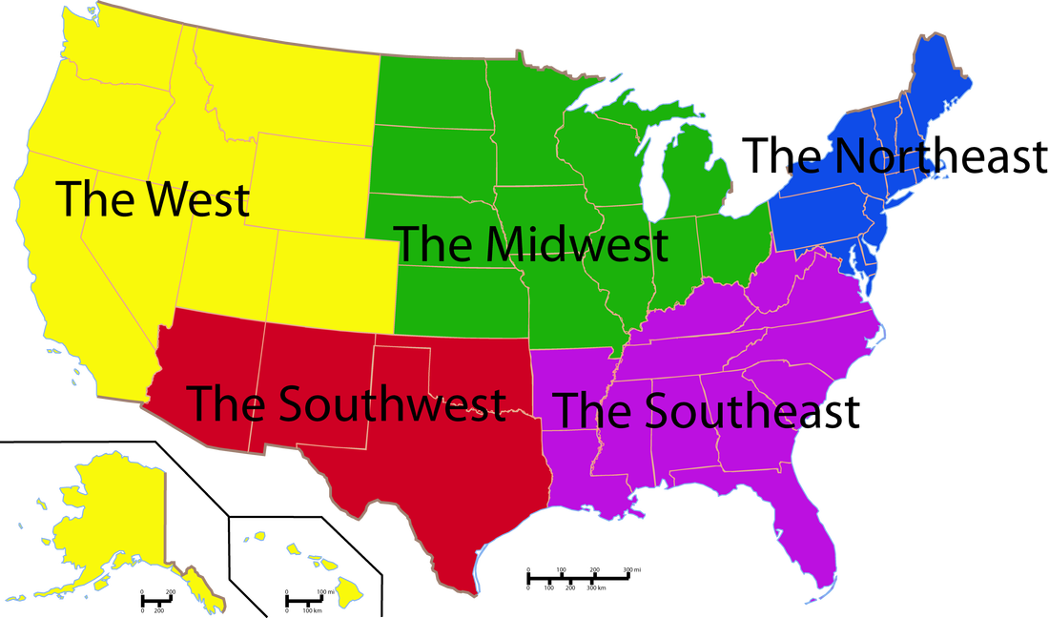
8. Region: The world is divided into different regions based upon similarities & differences. Climate Location Beliefs Languages Ethnicity/Race
Unit 1 EQ Objective: What are the five themes of Geography?
POLITICAL/SOCIAL REGIONS OF THE UNITED STATES:
The United States is broken down into 5 general sections.
Create a Legend for the map in your notes

Slide 30
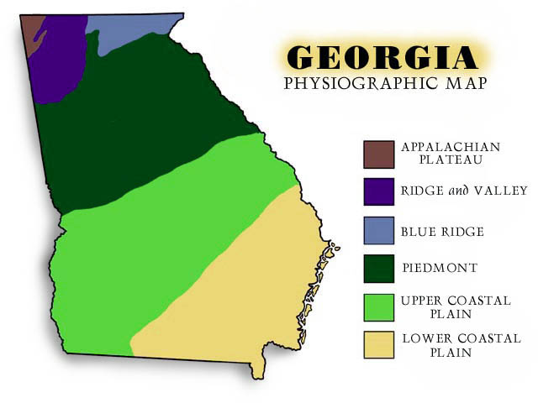
Regions make the study of geography more manageable
Unit 1 EQ Objective: What are the five themes of Geography?
The world is also divided into regions based on certain human characteristics- such as the way people are governed or the kind of language they speak.
The world is often divided into regions or areas, based on certain physical features- land-type or plant and animal life.

Slide 31
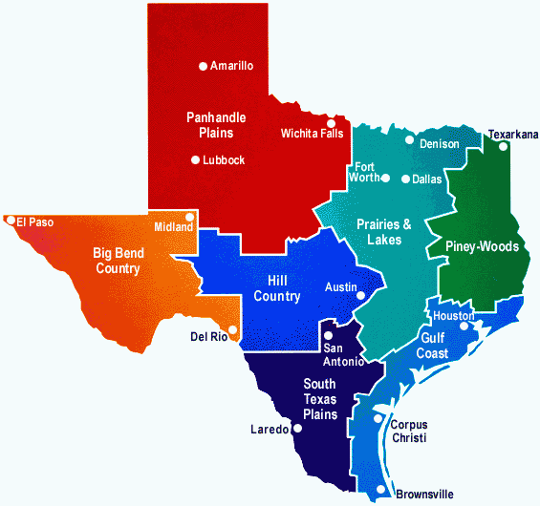
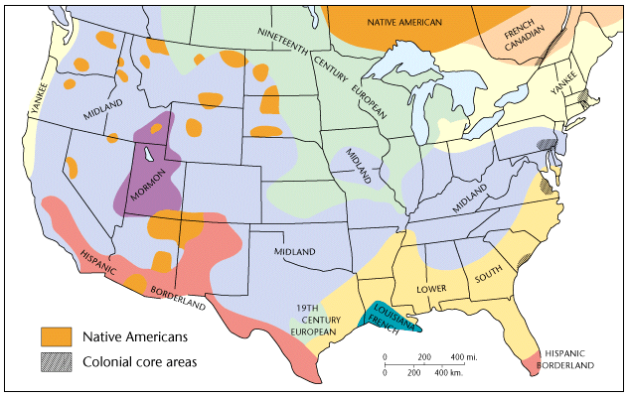
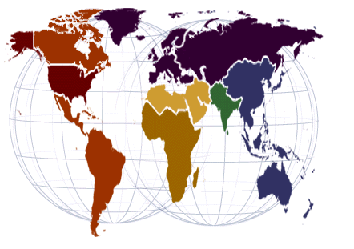
One place can be part of several different regions.
Texas, US, and World regions
Unit 1 EQ Objective: What are the five themes of Geography?

Slide 32
Why is this region called the rust belt?
Unit 1 EQ Objective: What are the five themes of Geography?

Slide 33
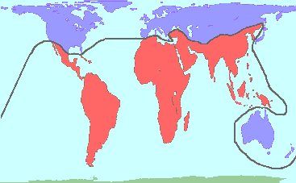
Red=Developing
Purple= Developed
Analyze the map above.
What conclusion can be made regarding the development of the world into two different regions?
Unit 1 EQ Objective: What are the five themes of Geography?

Slide 34
Perceptual
What is someone's perception?
What are people’s perceptions of Texas?
Unit 1 EQ Objective: What are the five themes of Geography?

Slide 35
9. Human Environment Interaction:
ADAPT- People adapt to the environment by changing the way they live in order to survive.
MODIFY- People change the environment by physically changing it.
●As humans, we can either change our environment, or we have to change to fit into it.
Clearing land and planting crops is an example of humans Modify/ changing the environment to suit our needs.
Sometimes, humans cannot change the environment. Therefore, humans need to Adapt/ change to fit into and survive in the environment.
Unit 1 EQ Objective: What are the five themes of Geography?

Slide 36
Unit 1 EQ Objective: What are the five themes of Geography?
9. Human Environment Interaction:

Slide 37
Modifying vs. Adapting
Unit 1 EQ Objective: What are the five themes of Geography?
Which pictures most shows MODIFYING the environment?

Slide 38
Modifying vs. Adapting
Unit 1 EQ Objective: What are the five themes of Geography?
Which pictures most shows ADAPTING TO the environment?

Slide 39
Modifying vs. Adapting
Unit 1 EQ Objective: What are the five themes of Geography?
Which pictures most shows ADAPTING TO the environment?

Slide 40
Modifying vs. Adapting
Unit 1 EQ Objective: What are the five themes of Geography?
Which pictures most shows MODIFYING the environment?

Slide 41
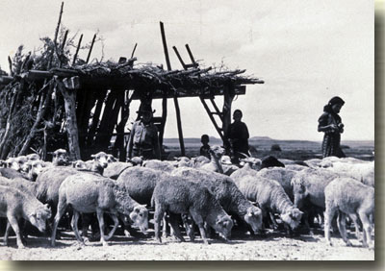
Unit 1 EQ Objective: What are the five themes of Geography?
We change the environment and sometimes Mother Nature changes it back.
Nature continues to shape our environment and impacts where we live, how we live, and how we adapt and modify the environment
https://www.youtube.com/watch?v=UUWbgAjeuiw
Notes:
What kind of place is it?
People modify our environment by heating and coolings buildings for comfort.ﾊﾊ ﾊ One person's advantage may be another person's disadvantage.ﾊ Some like the excitement of large cities whereas others prefer remoteness.ﾊﾊ Environment is not just trees, spotted owls, and rain forests.ﾊ Environment is a feeling.ﾊ What is the environment of a big city?ﾊ Boston?ﾊ Los Angeles?ﾊ Dallas?Given the choice, where would you live?ﾊ Why?ﾊ What is the environment?ﾊ How do people interact with the environment?ﾊ How do the physical features affect us?How have we adapted to or changed our landscape? For example, in the Sudan even though everything is seemingly barren, the land sustains farmers and nomadic herders.ﾊ People and animals have adapted to a hot, dry climate.

Slide 42
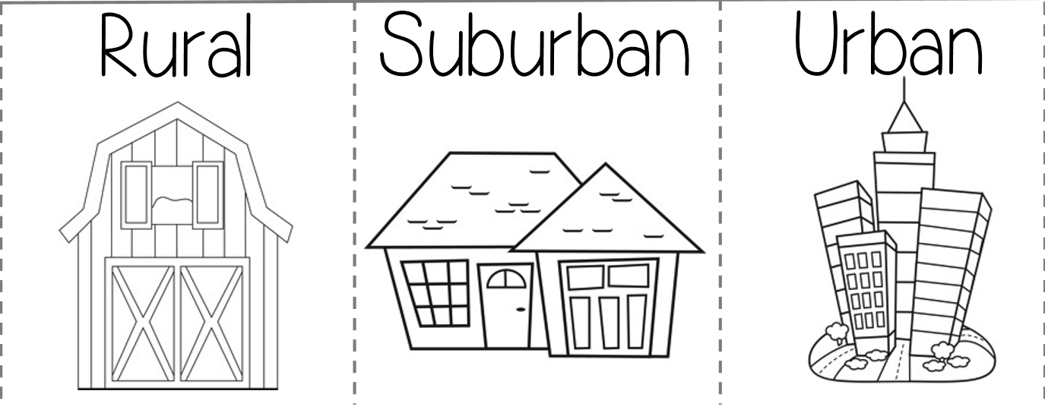
Unit 1 EQ Objective: What are the five themes of Geography?
farming or agricultural areas Example: Morrisville | residential area on the outskirts of a city or large town Example: Fayetteville Manlius | cities where buildings, where people work, and live are all close together. Example Syracuse:

Slide 43
10. Movement: Movement of people, goods, and ideas.
Places do not exist in isolation.
Interconnectedness of the world changes the way places“look”.
Today: “globalization”
People, goods & ideas move from place to place.
Examples
Immigration from Latin America to US.
War in Iraq (troops, supplies, ideas, people)
UNL (people, ideas)
Instagram, Snapchat (ideas)
Unit 1 EQ1 Objective: What are the five themes of Geography?

Slide 44
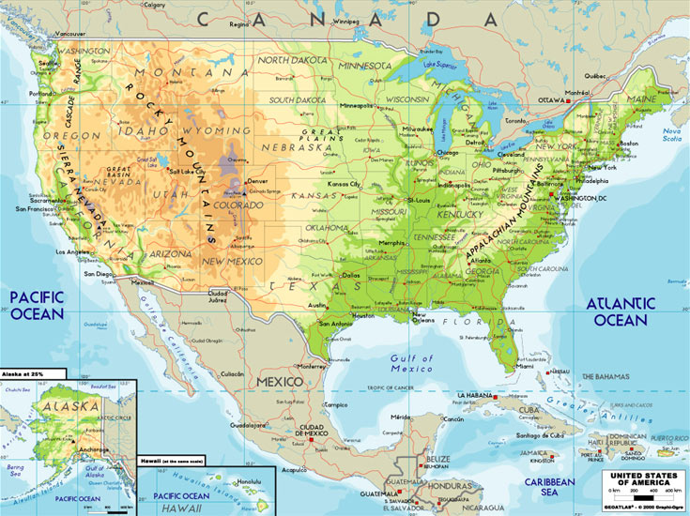
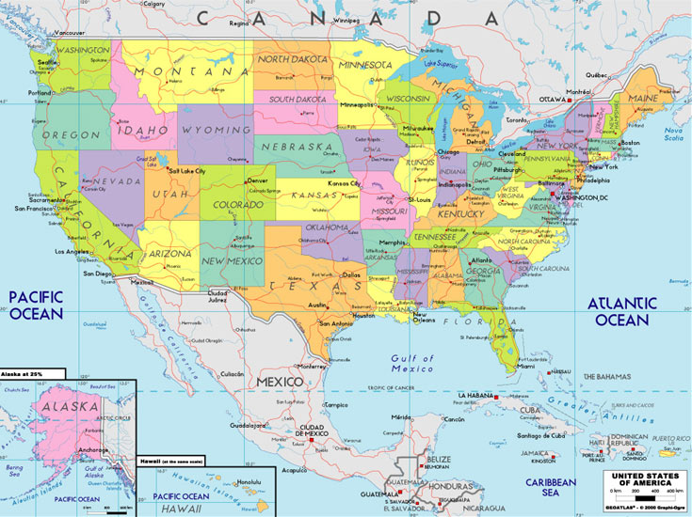
11. MAP: A representation of the features of the Earth or part of the Earth.
TYPES OF MAPS: There are 2 main types of maps; physical and political maps.
Unit 1 EQ 3 Objective: What different types of maps do people use?

Slide 45
PHYSICAL MAP
A. PHYSICAL MAP: A map that shows the physical features, geographical features, or landforms on the surface of the Earth.
Unit 1 EQ 3 Objective: What different types of maps do people use?

Slide 46
POLITICAL MAP
B. POLITICAL MAP: A map that shows states, national boundaries, cities, capitals, roads, and other human features.
Unit 1 EQ 3 Objective: What different types of maps do people use?

Slide 47
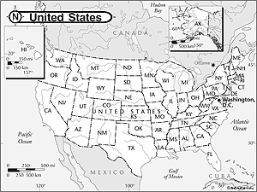
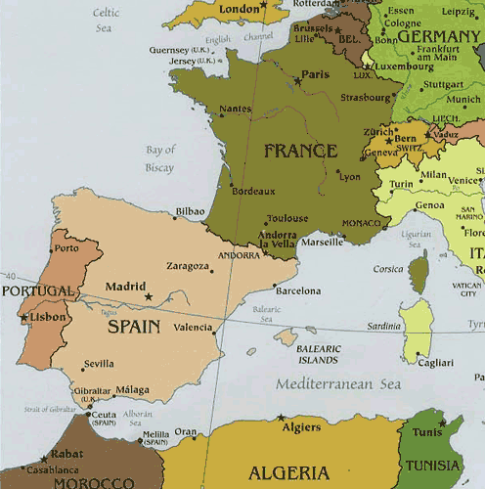
Political OR Physical?
Unit 1 EQ 3 Objective: What different types of maps do people use?

Slide 48
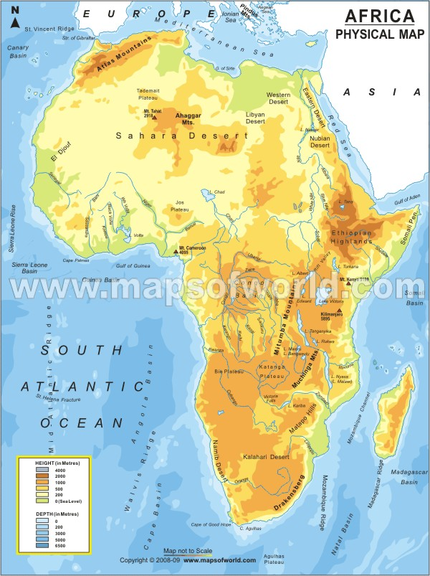
Physical OR Political?
Unit 1 EQ 3 Objective: What different types of maps do people use?

Slide 49
Unit 1 EQ 3 Objective: What different types of maps do people use?

Slide 50
Unit 1 EQ 3 Objective: What different types of maps do people use?

Slide 51
Unit 1 EQ 3 Objective: What different types of maps do people use?

Slide 52
Unit 1 EQ 3 Objective: What different types of maps do people use?

Slide 53
Unit 1 EQ 3 Objective: What different types of maps do people use?

Slide 54
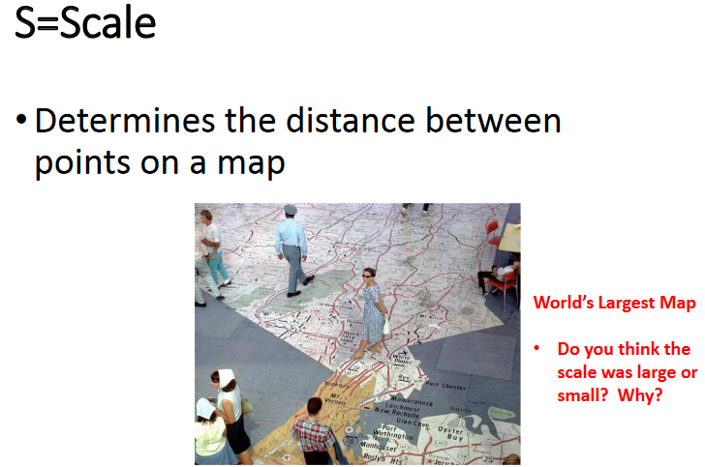
Unit 1 EQ 3 Objective: What different types of maps do people use?

Slide 55
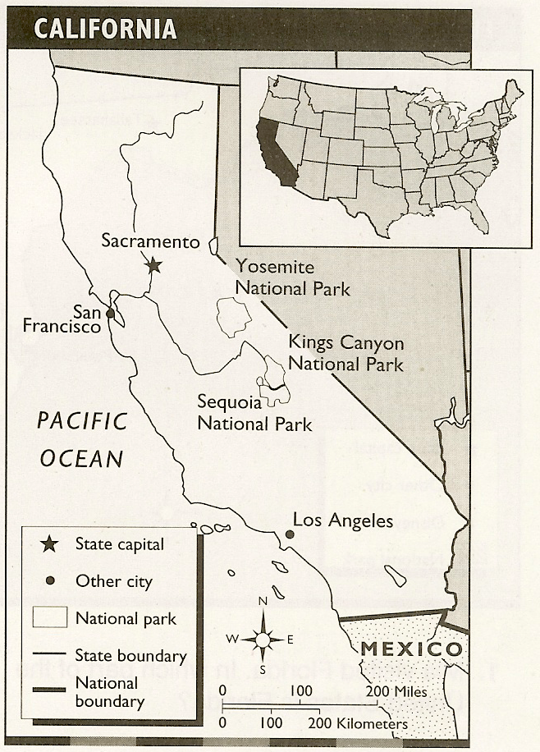
LABEL THE MAP PARTS ON THE MAP
Unit 1 EQ 3 Objective: What different types of maps do people use?
Title
2000
Date
A. Marzus
Author
Orientation
Scale
Legend

Slide 56
12. WATER: How do rivers and lakes benefit the economy of the United States?
The rivers and lakes have benefits to the economy of the US by giving people water and food as well as moving or transporting people and goods.

Slide 57
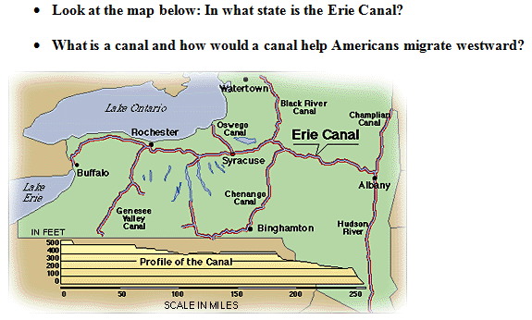
Unit 1 EQ 4 Objective: How do rivers and lakes benefit the economy of the United States?

Slide 58
Unit 1 EQ 4 Objective: How do rivers and lakes benefit the economy of the United States?
Huron
Ontario
Michigan
Erie
Superior
H.O.M.E.S

Slide 59
Unit 1 EQ 4 Objective: How do rivers and lakes benefit the economy of the United States?
https://www.thinglink.com/scene/1223687788235325445
12. WATER
The Great Lakes
and St. Lawrence Sea Way Include 6 Facts From Your Research

