Slide 1
Unit 8
WWII Causes and Effects

Slide 2
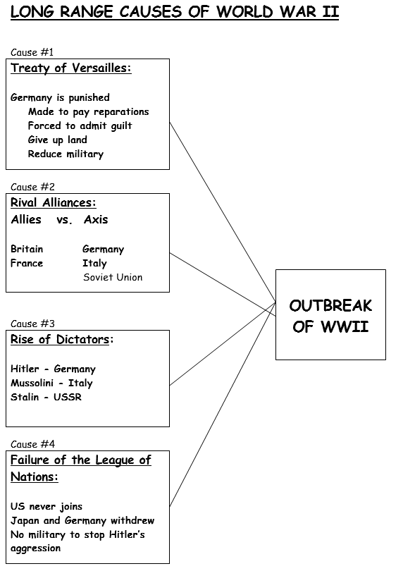
Dwight Eisenhower − American general and commander of Allied forces during World War II
George S. Patton, Jr. − American general and tank commander during World War II
unconditional surrender − giving up completely without any concessions
saturation bombing − dropping massive amounts of bombs to inflict maximum damage
strategic bombing − dropping bombs on key targets to destroy the enemy’s capacity to make war
Tuskegee Airmen − African American squadron that escorted bombers in the air war over Europe during World War II
Chester Nimitz − Commander of the U.S. Navy in the Pacific
Battle of Midway − American victory and turning point of the war in the Pacific
genocide − willful annihilation of a racial, political, or cultural group
concentration camp − camps used by the Nazis to imprison “undesirable” members of society
death camp − Nazi camp designed for the extermination of prisoners
War Refugee Board − U.S. government agency founded in 1944 to save Eastern European Jews
Yalta Conference − 1945 meeting at which Roosevelt, Churchill, and Stalin discussed plans for the postwar world
superpower − powerful country that plays a dominant economic, political, and military role in the world
General Agreement on Tariffs and Trade (GATT) − treaty designed to expand world trade by reducing tariffs
United Nations − organization of nations formed after in 1945 to promote peace
Universal Declaration of Human Rights − United Nations document affirming basic human rights
Geneva Convention − international agreement governing the humane treatment of wounded soldiers and prisoners of war
Nuremberg Trials − trials in which Nazi leaders were charged with war crimes
How did the Allies turn the tide against the Axis?
After the dark days of 1942, the Allies began to make important advances.
Tough years of fighting lay ahead, but many began to see a glimmer of hope.

Slide 3
A. Philip Randolph − African American labor leader
Executive Order 8802 − World War II measure that assured fair hiring practices in jobs funded with government money
bracero program − program in which laborers were brought from Mexico to work on American farms
internment − temporary imprisonment of members of a specific group
Korematsu v. United States − Supreme Court case that upheld the government’s wartime internment policy
442nd Regimental Combat Team − Japanese American combat team that became the most decorated military unit in American history
rationing − system that limits the amount of certain goods people can buy
Office of War Information (OWI) − encouraged support of the war effort
D-Day − June 6, 1944, the day Allied forces invaded France
Battle of the Bulge − German counterattack that failed, resulting in an Allied victory
Harry S. Truman − President during the end of World War II
island hopping − American strategy of capturing selected islands in the Pacific in a steady path to Japan
kamikaze − Japanese pilots who deliberately crashed their planes into American ships
Albert Einstein − world-famous scientist who alerted Roosevelt of the need to develop atomic weapons
Manhattan Project − code name for the program to develop an atomic bomb
J. Robert Oppenheimer − key leader of the Manhattan Project
Holocaust − name now used to describe the systematic murder by the Nazis of Jews and others
anti-Semitism − prejudice and discrimination against Jewish people
Nuremberg Laws − laws enacted by Hitler that denied German citizenship to Jews
Kristallnacht − November 9, 1938 – night of organized violence in which Jews were arrested and killed and synagogues and Jewish businesses destroyed
How did the World War II change America at home?
World War II stirred patriotism even as it brought out long-simmering fears and tensions.
Americans from different backgrounds living in different places across the country made huge sacrifices to support the war effort.
How did the Allies defeat the Axis Powers?
It took years of hard fighting to reverse Axis advances and move toward victory in World War II.
A new weapon finally ended the war, changing both warfare and global politics forever.
How did the Holocaust develop and what were its results?
Hitler found a target for his anger and hatred in Jews and other “undesirables.”
Nazi persecution resulted in the deaths of 6 million Jews and 5 million other people
What were the major immediate and long-term effects of World War II?
World War II changed the United States in profound ways.
The nation emerged from the war as a superpower, prepared to take an active role in world affairs.

Slide 4
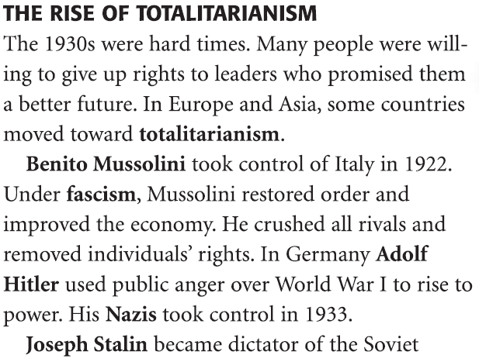
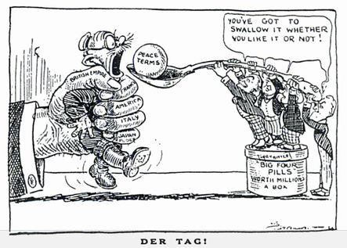
Isolationism (between WWI and WWII))
U.S. returned to Washington’s farewell address
U.S. becomes neutral
Dawes Act 1924
4. Rise of Totalitarian Governments - Italy & Germany
Harsh punishment of Germany
Guilt for WWI
$33 billion in reparations
Restricted military
Lost territory
The Failure of the League of Nations:
The League of Nations proved powerless against the Fascist dictators
The idea of collective security – that peaceful nations would ban together to stop aggressors – failed when major countries [U.S.A. and the U.S.S.R.] failed to join.

Slide 5
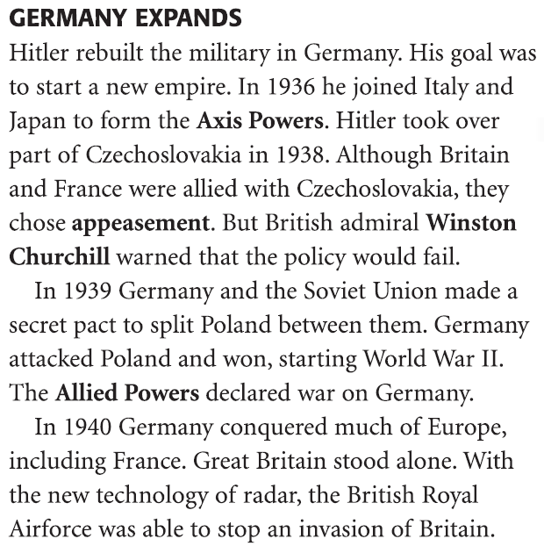
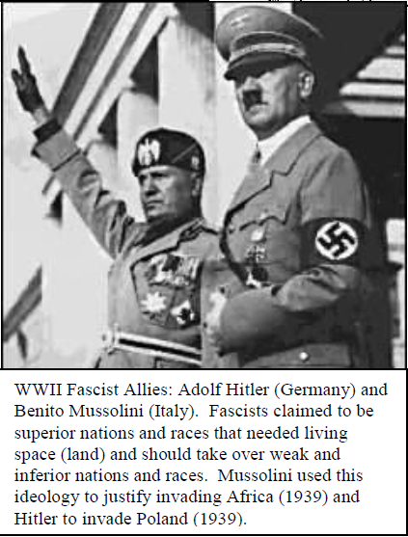
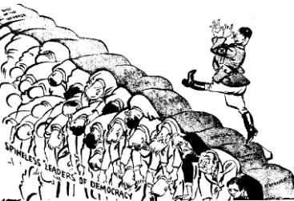
Great Britain: Winston Churchill - Prime Minister of Great Britain during most of World War II, Winston Churchill was a great leader. His country was the last country fighting against the Germans in Europe. He is known for his famous speeches to his people when the Germans were bombing them during the Battle of Britain.
United States: Franklin D. Roosevelt - One of the greatest presidents in the history of the United States, President Roosevelt led the country out of the Great Depression and through World War II.
Russia: Joseph Stalin - Stalin's title was General Secretary of the Communist Party. He led Russia through terrible and devastating battles with Germany. Millions and millions of people died. After winning the war, he set up the Eastern Bloc of Soviet led communist states.
Germany: Adolf Hitler - Hitler became Chancellor of Germany in 1933 and Fuhrer in 1934. He was a ruthless dictator who hated Jewish people. He wanted to purge Germany of all weak people. He also wanted to take control of all of Europe.
Italy: Benito Mussolini - Mussolini was supreme dictator of Italy. He founded the concept of a fascist government where there is one leader and one party that has total power. He was an inspiration to Adolf Hitler.
Japan: Emperor Hirohito - Hirohito reigned as Emperor of Japan from 1926 until 1989. He remained Emperor after the war. The first time his subjects heard his voice was when he announced Japan's surrender on the radio.
5. Munich Conference
What is the message of this cartoon?
“The great rule of conduct for us in regard to foreign nations is, in extending our commercial relations, to have with them as little political connection as possible.” This quotation supports a foreign policy of
imperialism
appeasement
neutrality
economic sanctions

Slide 6
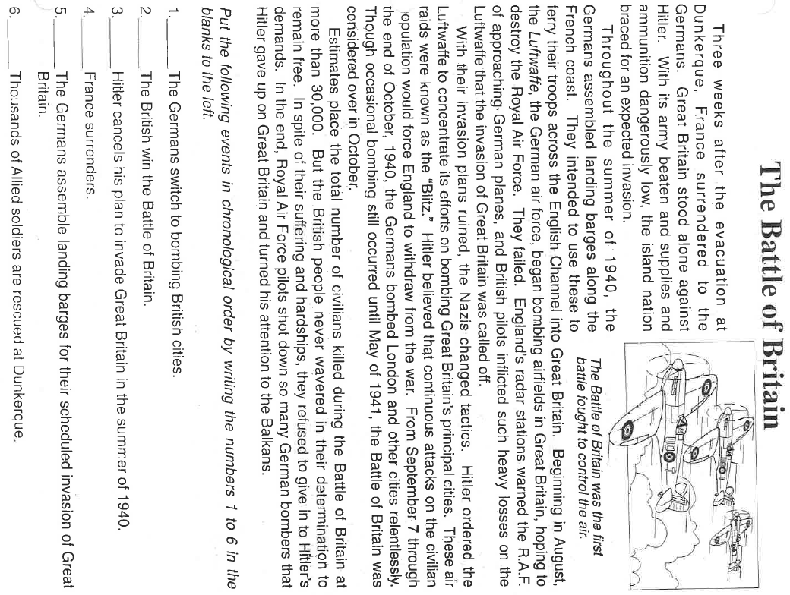
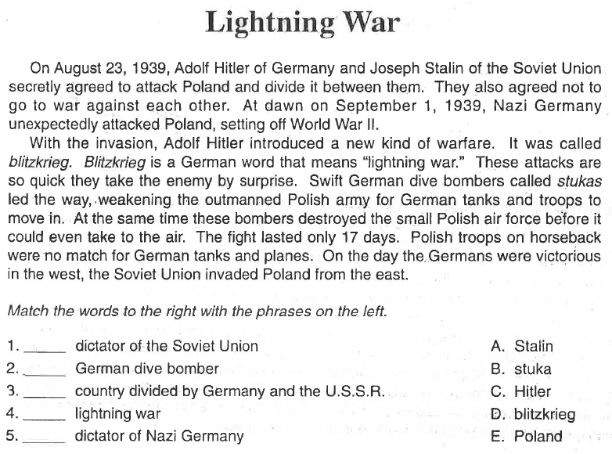
What is the message of this cartoon?

Slide 7
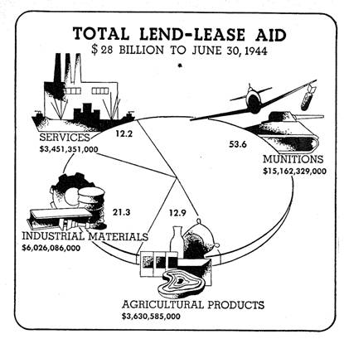
II. Events leading to WWII
________________________________
________________________________
U.S. can only give or sell war materials to countries fighting Germany
U. S. would sell war material if the buying nation paid in cash and responsible for transportation
_______________________________
Japan (oil, steel, rubber)
_______________________________
Pearl Harbor attacked 12/7/1941
Destroyers for bases
U.S. gives G.B. old destroyers
U.S. gets 2 naval bases
______________________________
In the early 1940’s, the "destroyers-for-military-bases deal" with Great Britain and the Lend-Lease Act were evidence that the United States
recognized that its policy of neutrality conflicted with its self-interest
followed its policy of neutrality more strictly as World War II progressed in Europe
believed that the Allied policy of appeasement would succeed
wanted to honor the military commitments it had made just after World War I
In the 1930’s, the United States attempted to avoid a repetition of the events leading up to United States involvement in World War I by
establishing the Good Neighbor policy with Latin American nations
forgiving the foreign debts incurred during World War I
officially recognizing the existence of the Soviet Union
passing a series of neutrality laws

Slide 8
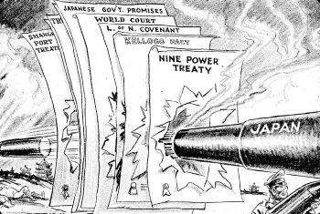
While most Americans anxiously watched the course of the European war, tension mounted in Asia. Taking advantage of an opportunity to improve its strategic position, Japan boldly announced a "new order" in which it would exercise hegemony over all of the Pacific. Battling for survival against Nazi Germany, Britain was unable to resist, abandoning its concession in Shanghai and temporarily closing the Chinese supply route from Burma. In the summer of 1940, Japan won permission from the weak Vichy government in France to use airfields in northern Indochina (North Vietnam). That September the Japanese formally joined the Rome-Berlin Axis. The United States countered with an embargo on the export of scrap iron to Japan.
1. What country actively sought to dominate Asia at this time? a. China b. Japan c. Korea d. Philippines 2. The U.S. initiated an embargo against Japan of what product? a. oil b. rubber c. sugar d. tin
In July 1941 the Japanese occupied southern Indochina (South Vietnam), signaling a probable move southward toward the oil, tin, and rubber of British Malaya and the Dutch East Indies. The United States, in response, froze Japanese assets and initiated an embargo on the one commodity Japan needed above all others – oil.
3. When did the Japanese attack the American fleet docked at Pearl Harbor?
4. What did the Japanese demand of the United States?
5. How many people lost their lives during the Japanese attack on Pearl Harbor?
9. What two European countries declared war on the U.S. three days after the U.S. declared war on Japan?
General Hideki Tojo became prime minister of Japan that October. In mid-November, he sent a special envoy to the United States to meet with Secretary of State Cordell Hull. Among other things, Japan demanded that the United States release Japanese assets and stop U.S. naval expansion in the Pacific. Hull countered with a proposal for Japanese withdrawal from all its conquests. The swift Japanese rejection on December 1 left the talks stalemated. On the morning of December 7, Japanese carrier-based planes executed a devastating surprise attack against the U.S. Pacific Fleet at Pearl Harbor, Hawaii. Twenty-one ships were destroyed or temporarily disabled; 323 aircraft were destroyed or damaged; 2,388 soldiers, sailors, and civilians were killed. However, the U.S. aircraft carriers that would play such a critical role in the ensuing naval war in the Pacific were at sea and not anchored at Pearl Harbor. American opinion, still divided about the war in Europe, was unified overnight by what President Roosevelt called "a day that will live in infamy." On December 8, Congress declared a state of war with Japan; three days later Germany and Italy declared war on the United States.

Slide 9
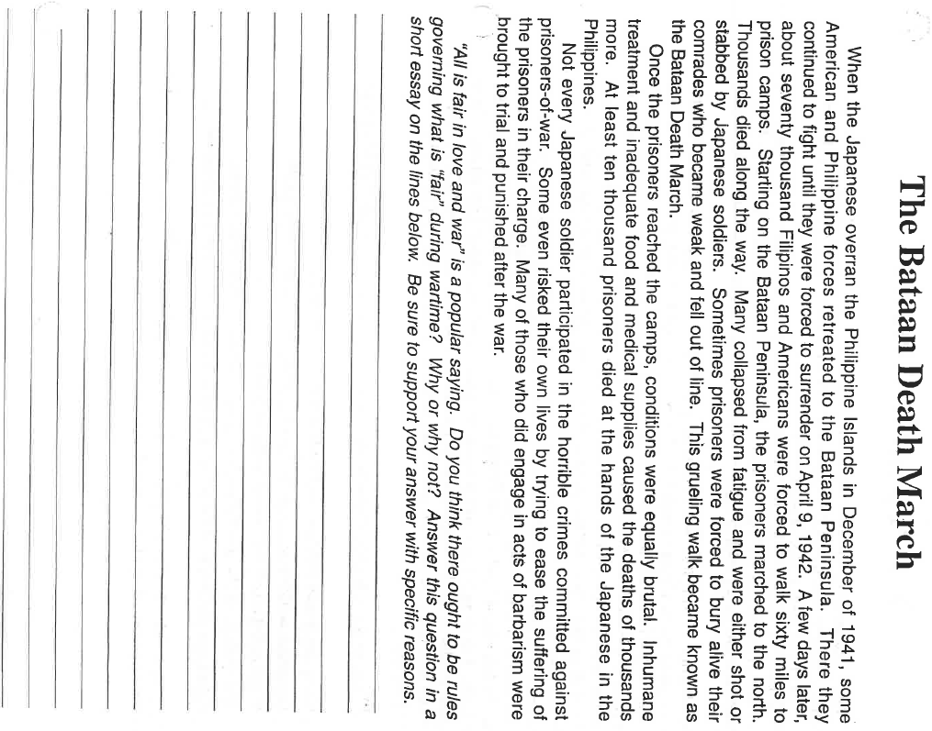
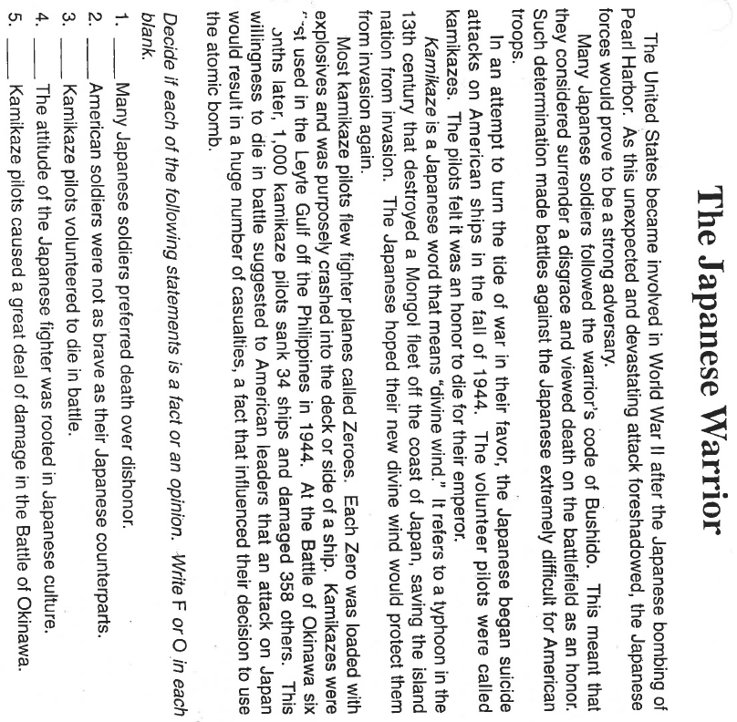
________________________________________________________________________________________________________________________________________________________________________________________________________________________________________________________________________________________________________________________________________________________________________________________________________________________________________________________________________________________________________________________________________________________________________________
IV. During WWII

Slide 10
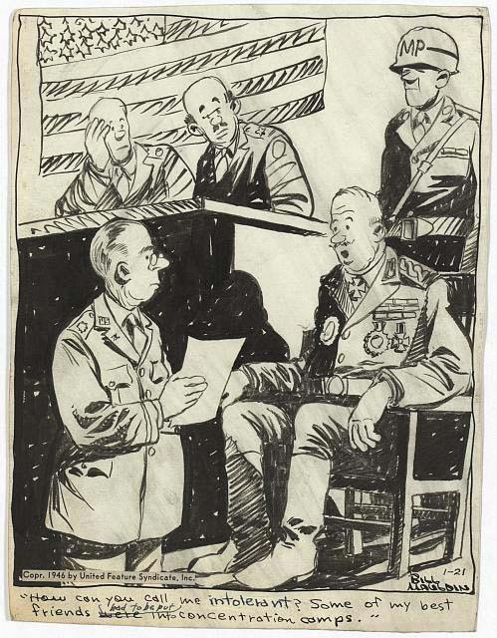
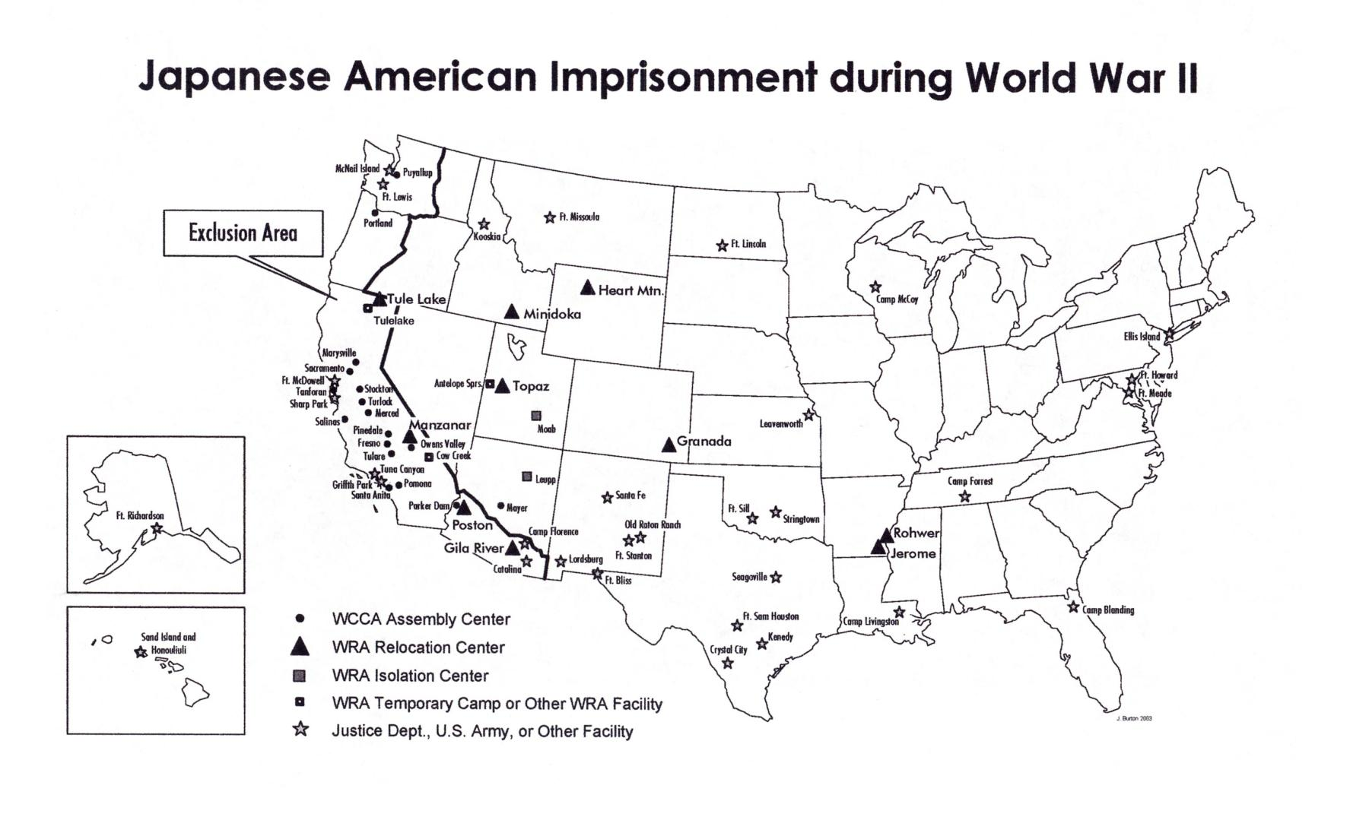
Korematsu v. U.S.
As a result of Pearl Harbor and the fear of Asian espionage, Americans also committed what was later recognized as an act of intolerance: the internment of Japanese Americans. In February 1942, nearly 120,000 Japanese Americans residing in California were removed from their homes and interned behind barbed wire in 10 wretched temporary camps, later to be moved to "relocation centers" outside isolated Southwestern towns. Nearly 63 percent of these Japanese Americans were American-born U.S. citizens. A few were Japanese sympathizers, but no evidence of espionage ever surfaced. Others volunteered for the U.S. Army and fought with distinction and valor in two infantry units on the Italian front. Some served as interpreters and translators in the Pacific.
Japanese In 1983 the U.S. government acknowledged the injustice of internment with limited payments to those Japanese Americans of that era who were still living.
In 1988, Congress voted to pay $20,000 to each of the surviving Americans of Japanese descent who were interned during World War II because
the danger of war with Japan no longer existed
all of the interned Japanese Americans eventually became American citizens
the World Court ordered the United States to pay reparations
many Americans believed the internment was unjust and unnecessary
A violation of civil rights that occurred in the United States during World War II was the
arrests made as a result of the Palmer raids
passage of an open immigration law
internment of Japanese Americans
forced removal of Native American Indians from their reservations

Slide 11
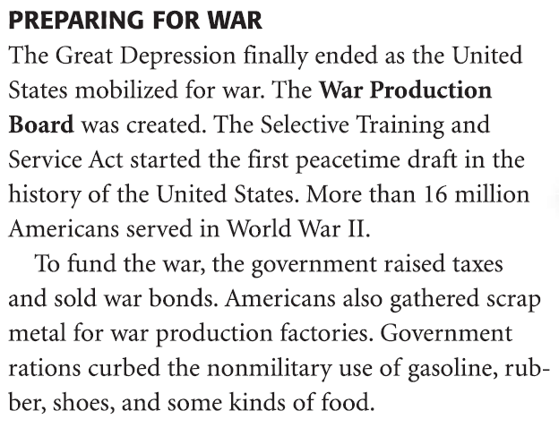
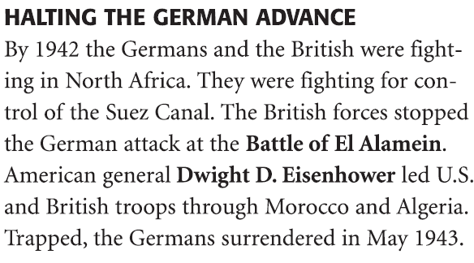
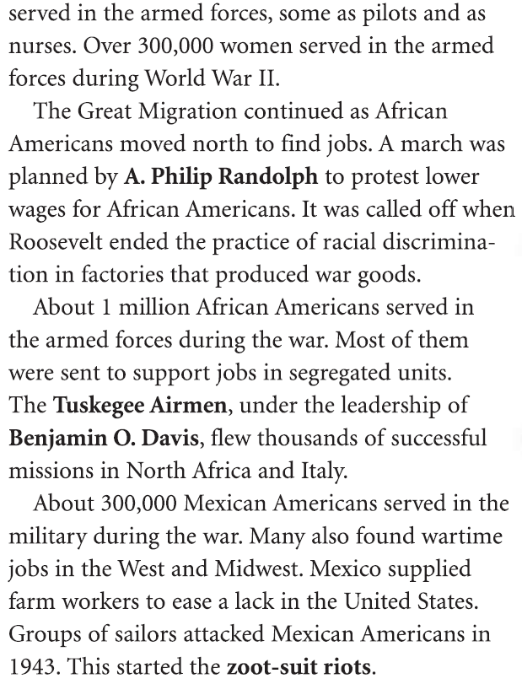
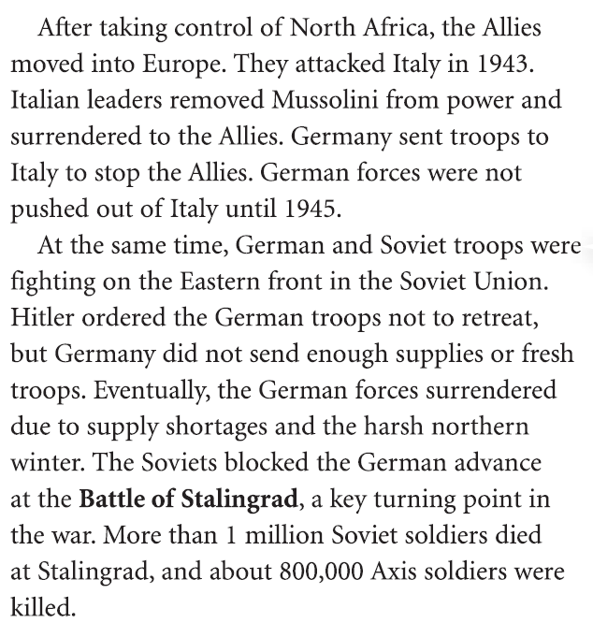
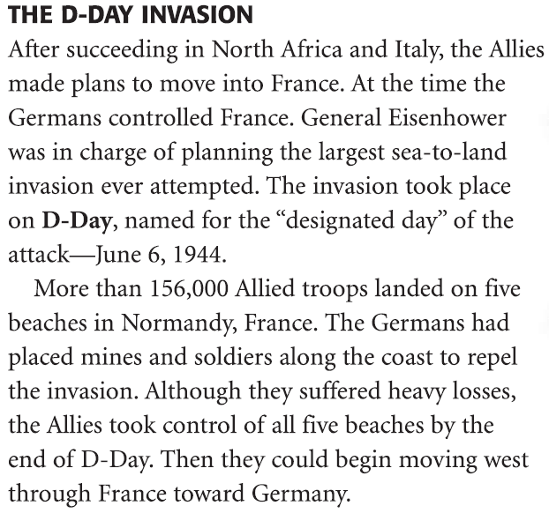
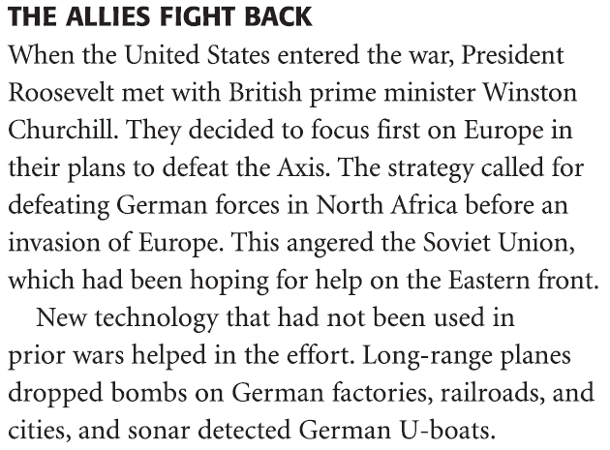
War Production Board
Women & Minorities
Explain how WWII helped some African Americans
What was so important about D-Day (Battle at Normandy)?

Slide 12
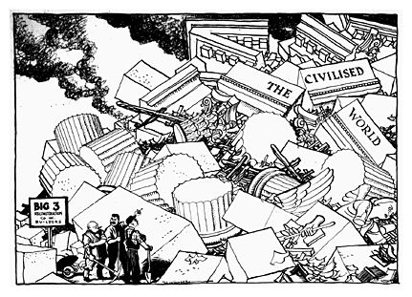
Atlantic Charter 1941
Teheran Conference 1943
Yalta Conference 1945
7 Potsdam Conference 1945
The Atlantic Charter:
In 1941, Roosevelt told Americans he hoped to establish a world based on “Four Freedoms”: freedom of speech, religion, from want and from fear.
Roosevelt and British Prime Minister Winston Churchill aboard a warship in the Atlantic discussed their common objectives for a postwar world.
They signed the Atlantic Charter, laying the foundation for the United Nations.
~ Adapted from The Key to Understanding U.S. History and Government
During WWII, world leaders discussed plans for the postwar world. Who were the “Big Three”?
Explain the Political Cartoon.

Slide 13
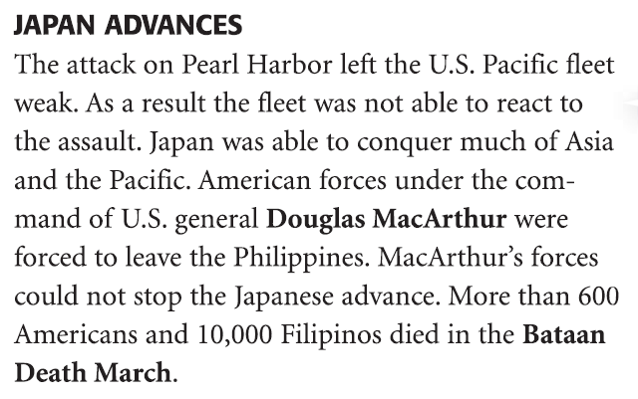
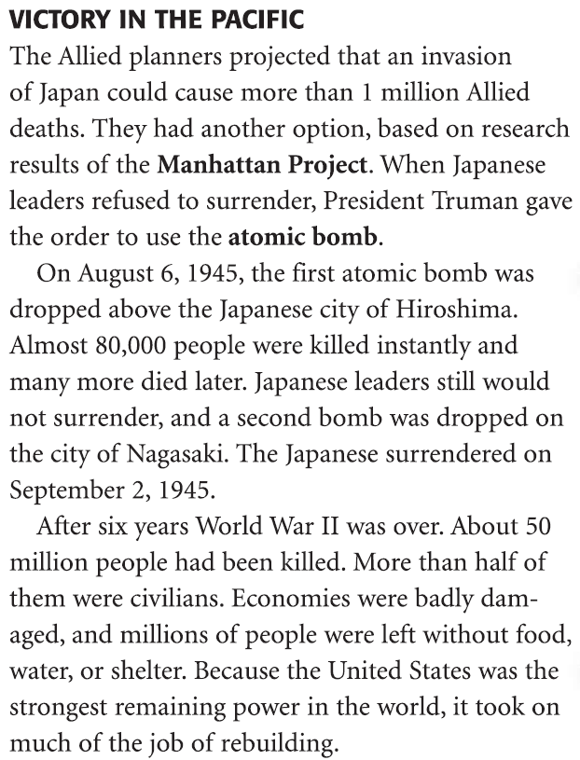
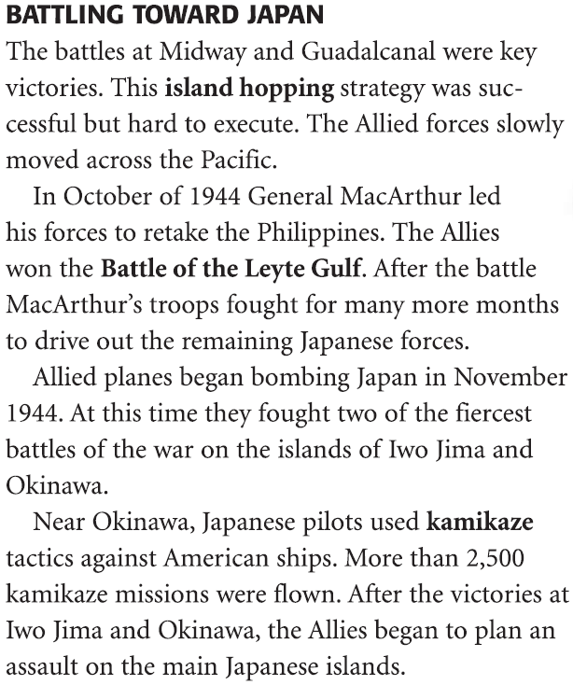
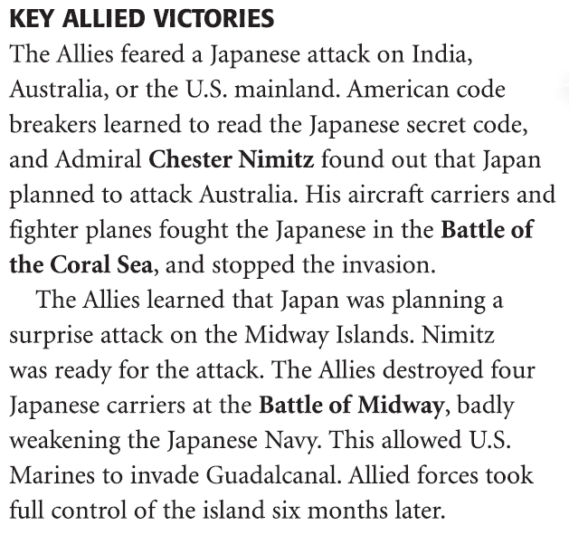
War in the Pacific
Why were the Japanese able to conquer much of the Pacific after the attack on Pearl Harbor?
What advantage did the American Pacific fleet have over the Japanese?

Slide 14
Manhattan Project
Why the bomb was needed or justified: The Japanese had demonstrated near-fanatical resistance, fighting to almost the last man on Pacific islands, committing mass suicide on Saipan and unleashing kamikaze attacks at Okinawa. Fire bombing had killed 100,000 in Tokyo with no discernible political effect. With only two bombs ready (and a third on the way by late August 1945) it was too risky to "waste" one in a demonstration over an unpopulated area such as Tokyo’s harbor. Only the atomic bomb could jolt Japan's leadership to surrender. An invasion of Japan would have caused casualties on both sides that could easily have exceeded the toll at Hiroshima and Nagasaki. Immediate use of the bomb convinced the world of its horror and prevented future use when nuclear stockpiles were far larger. | Why the bomb was not needed, or unjustified: Japan was ready to call it quits anyway. More than 60 of its cities had been destroyed by conventional bombing, the home islands were being blockaded by the American Navy, and the Soviet Union entered the war by attacking Japanese troops in Manchuria. American refusal to modify its "unconditional surrender" demand to allow the Japanese to keep their emperor needlessly prolonged Japan's resistance. A demonstration explosion over Tokyo harbor would have convinced Japan's leaders to quit without killing many people. The bomb was used partly to justify the $2 billion spent on its development

Slide 16
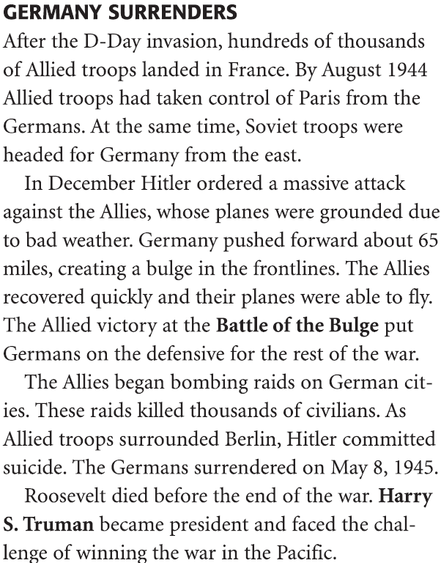
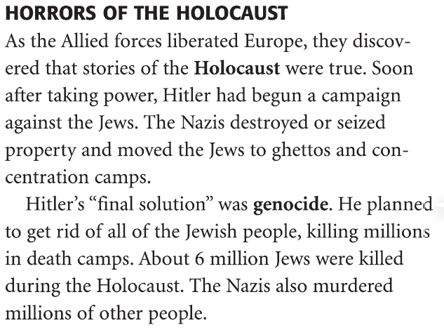
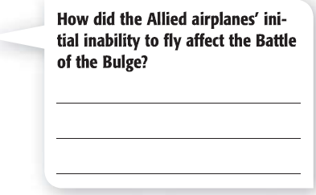
Holocaust
Which precedent was established by the Nuremberg war crimes trials?
National leaders can be held responsible for crimes against humanity.
Only individuals who actually commit murder during a war can be guilty of a crime.
Defeated nations cannot be forced to pay reparations.
Defeated nations can be occupied by the victors.
What happened at the Nuremberg Trials?
What did the International Military Tribunal for the Far East do?

Slide 17
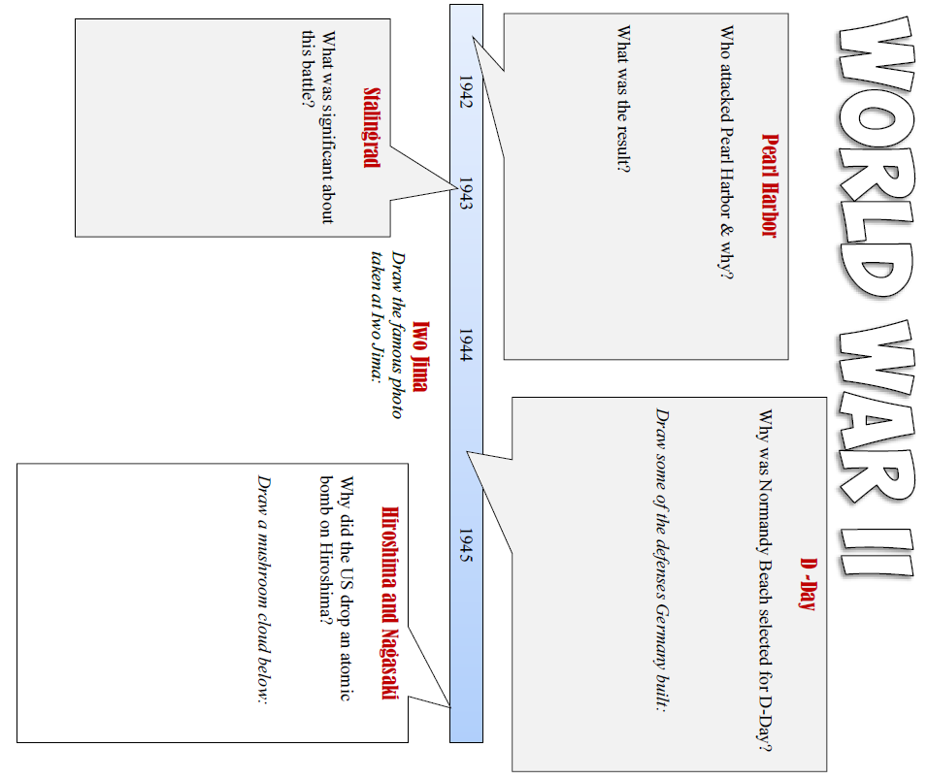

Slide 18
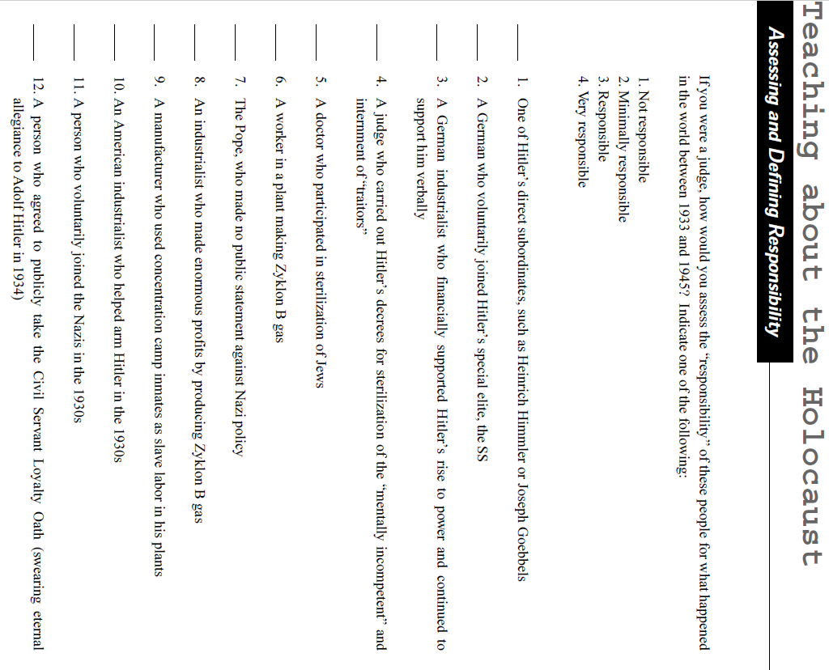

Slide 19
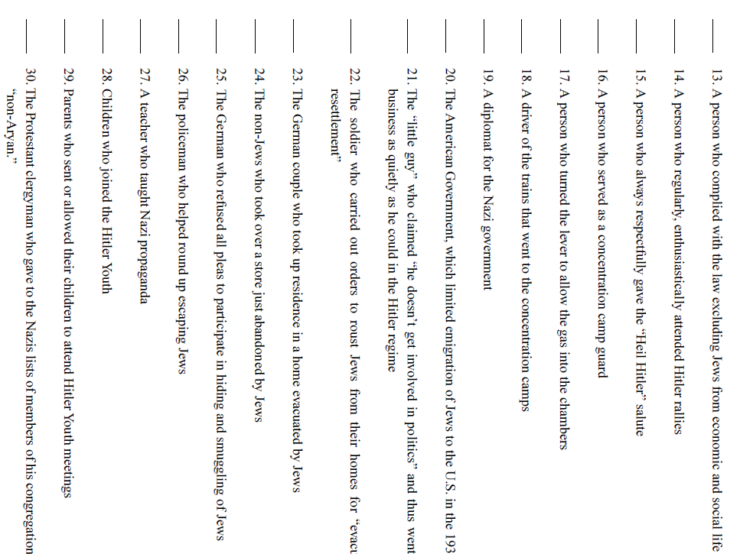

Slide 20
Effects of WWII
As World War II was ending, the United States decided to join the United Nations mainly because the United States
sought to meet the American public’s overwhelming demand for free-trade agreements
wanted to continue to play the same role it had in the League of Nations
recognized that efforts to achieve world peace required United States involvement
wanted to stop the growing influence of newly independent developing nations
President Harry Truman’s decision to use atomic bombs against Japan was primarily based on his belief that
an invasion of Japan would result in excessive casualties
Germany would refuse to surrender in Europe
an alliance was developing between Japan and the Soviet Union
Japan was in the process of developing its own atomic weapons

Slide 21
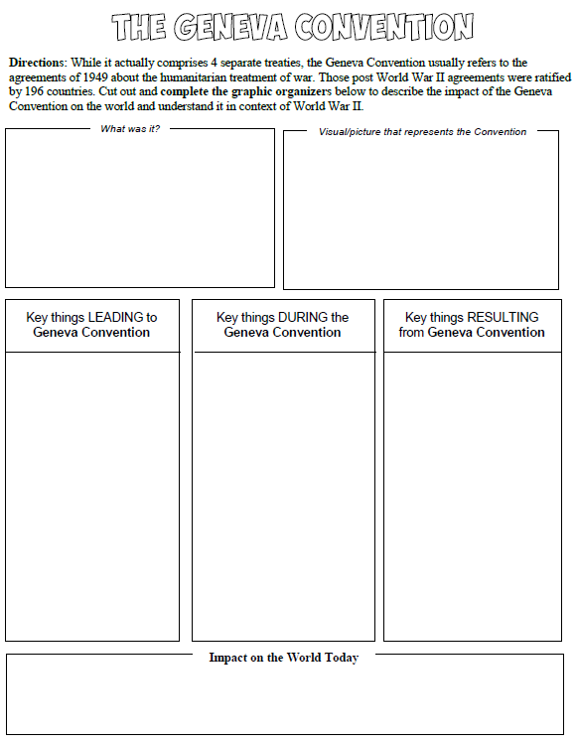

Slide 22
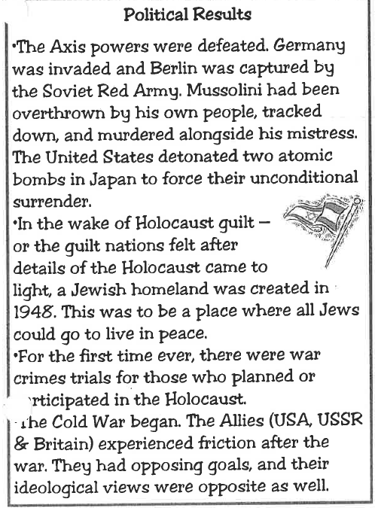
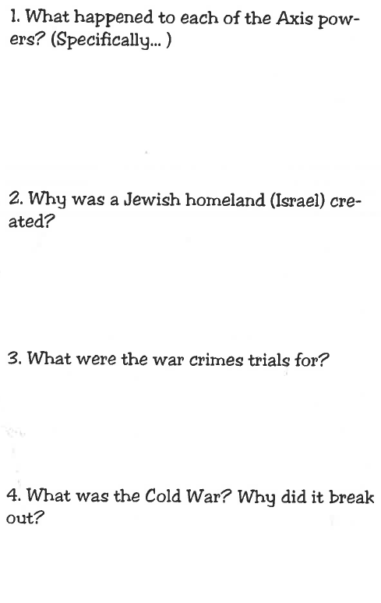
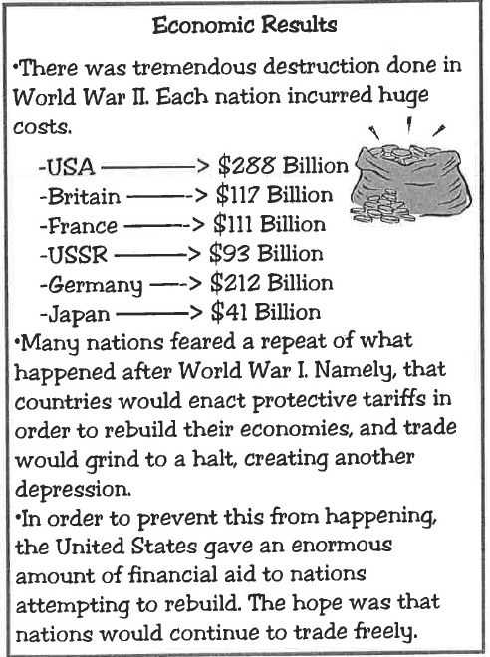
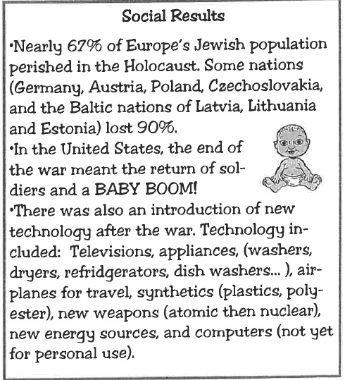
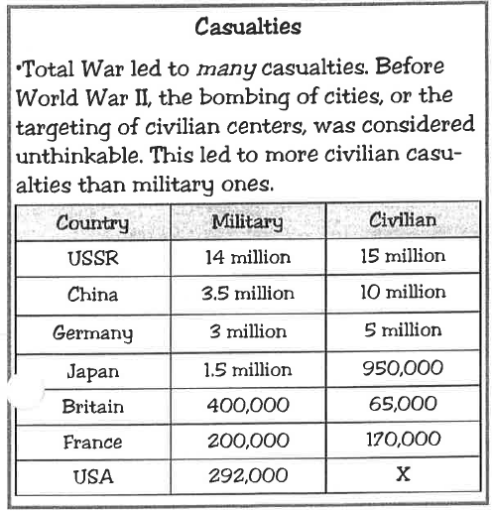

Slide 23
