Slide 1
SS Grade 8 Name: _________________________ Period:
MODULE: 6 – GREAT DEPRESSION & NEW DEAL
Objective: What were the causes and effects of the Great Depression?
Table of Contents
Date | Topic(s) | Page Numbers
Days 1 - 3 | Hoover’s Presidency | 2 - 7
Days 3 - 5 | Dust Bowl | 8 - 14
Days 4 - 7 | Roosevelt’s Presidency | 15 - 19
Days 8 | Relief New Deal | 20
Day 9 - 11 | Recovery New Deal | 21-23
Days 12 - 13 | Reform New Deal | 24 - 25
Day 12 -13 | Opponents of the New Deal | 26
Day 14-16 | Effects of The Great Depression | 27 - 29

Slide 2
CAUSES TO THE GREAT DEPRESSION (1929-1941)
Unit 6 Objective EQ 1: How did the prosperity of the 1920’s give way to the Great Depression?
Much of the economic growth of the 1920s was created by
rapid expansion of canal systems
increased government aid to farmers
sales of new consumer goods
government spending on defense
2. One reason the stock market collapsed in October 1929 was that
many stocks had been purchased on credit
the prices of most stocks were too low
banks refused to loan money to purchase stocks
throughout the 1920s many companies stopped selling shares of stock

Slide 3
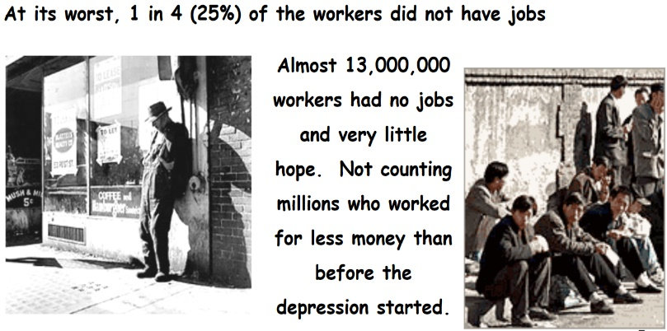
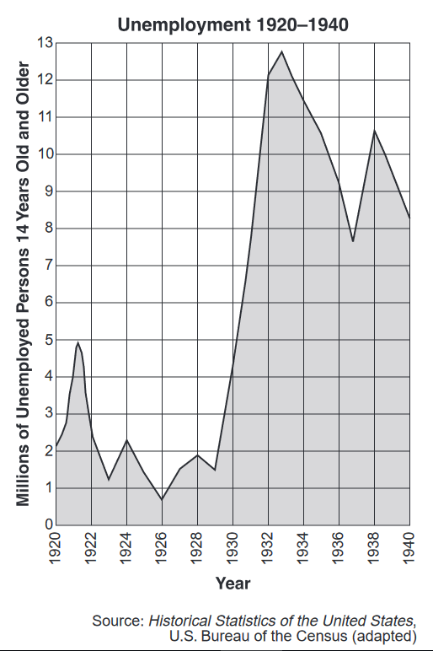
America: The Story of Us
Episode 9: Bust : Episode Summary: Boom turns to bust when the stock market crash ushers in the Great Depression.
Directions: Watch the video
https://www.youtube.com/watch?v=PoV7GGN-u7Q
Start – 6:00min
GREAT DEPRESSION IMPACTS:
Millions of Americans lost their jobs. Some people were able to keep their jobs part-time or at lower wages. There were long lines of hungry people. They would wait hours for bread, coffee, or soup from soup kitchens. Local governments and charities ran the soup kitchens. Some people tried to earn a few cents shining shoes or selling apples. Some homeless people had to use old boxes for shelter.
When several people grouped their box homes together, they became known as Hoovervilles. People were frustrated and angry that President Hoover had done nothing to help.
The 1920’s were boom time. In 1929, more money was spent on _____________________ than education.
2) In an age of consumerism and capitalism over $___billion goods are bought on credit
3) ___% of Americans had no savings.
4) In October 1929, the stock market loses _____ times more money in three weeks than the government spends in a year.
5) Only the ___% of Americans who owned stock were immediately affected by the stock market. The rest of them got on with their lives until the Bank of the U.S collapsed.
6) In the last 60 days of 1930, over _________(#) of banks closed nationwide. By 1933, there were ____ states without banks.
7) Unemployment in the United States went from ___ million 1930 to ___ million in 1932. Every day __________________ homes are repossessed.
1. Which event was a factor related to the rapid (Immediate) change in unemployment after 1929?
passage of the Smoot- Hawley Tariff
Drought in the Oklahoma
Overproduction of Farm Products
Stock Market Crash
Unit 6 Objective EQ 1: How did the prosperity of the 1920’s give way to the Great Depression?

Slide 4
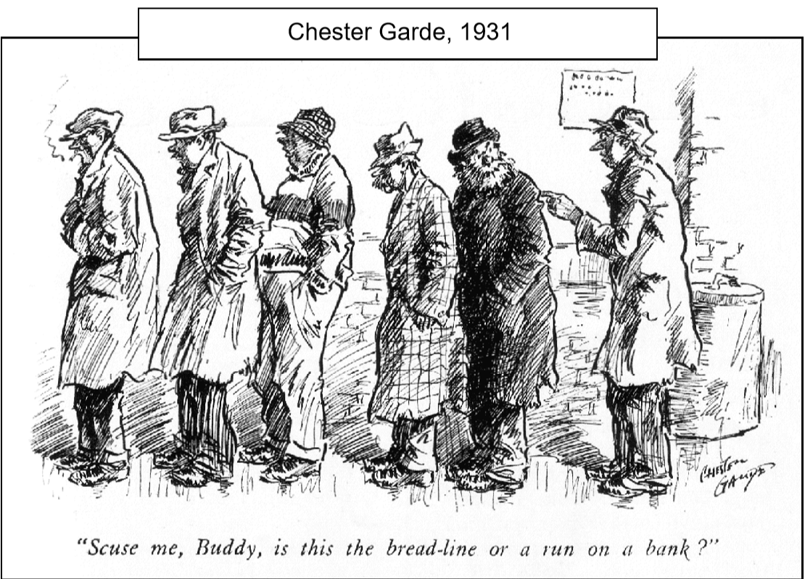
II. HOOVER’S ATTEMPT TO STOP THE DEPRESSION
Indirect Relief =
___________ __________ ___________
The Great Depression :
The economy in the United States crashed and stayed low for the next two years. The stock market crash was only part of the problem. Income from farm and major industries had begun to drop in the 1920s. Fewer orders for cars and construction were placed. Some Americans had lost much of their income. Therefore, spending was down. There was a large gap between the few Americans with wealth and the many Americans who lived in poverty.
_______________ $ to ___________________ to recover
Farmers, investors, and consumers had used credit for major purchases. The small banks suffered when people defaulted on loans, or failed to meet loan payments. Thousand of banks were forced to close over the next three years.
businesses __________________ the $
“… Republicans followed a trickle-down theory… They reasoned that, if government legislation protected the wealth of big corporations and the well-to-do, their continued investments would expand the economy and a better life would ‘trickle down’ to workers and consumers in general.
businesses will __________ and _________ __________
workers will have ___ to _________ products
CRQ1: What historical circumstances led thousands of banks to close in the early 1930s?TTQA ____________________________________________________________________________________________________________________________________________________________________________________________________________________________________________________________________________________________________________________________________________________________________________________________________________
this would ________________ businesses to ______________ ______________
government created some ________ ____________ jobs to _______ ________________
Unit 6 Objective EQ 1: How did the prosperity of the 1920’s give way to the Great Depression?

Slide 5
America: The Story of Us
Episode 9: Bust - Episode Summary: The Hoover Dam and an attempt at government assistance
Watch the Vide 6:00 min – 18:55
8) Hoover Dam, a public works project, provided employment for _____ men. It will provide water and electricity for the American southwest.
9) Hoover Dam creates the largest water reservoir in the U.S., Lake ________ and allows _____________ to produce more food than any other state in the U.S.
10) One side-effect of the Hoover Dam was that ________________________________________, a tiny nearby town of 5,000 boomed as construction workers traveled for parties and gambling. Today over _____ million people travel there every year.
https://www.youtube.com/watch?v=PoV7GGN-u7Q
The Depression in America affected other parts of the world. European countries needed to borrow money from American banks and sell products to American buyers. They needed the trade to repay loans from World War I. Other nations lost income without American loans.

Slide 6
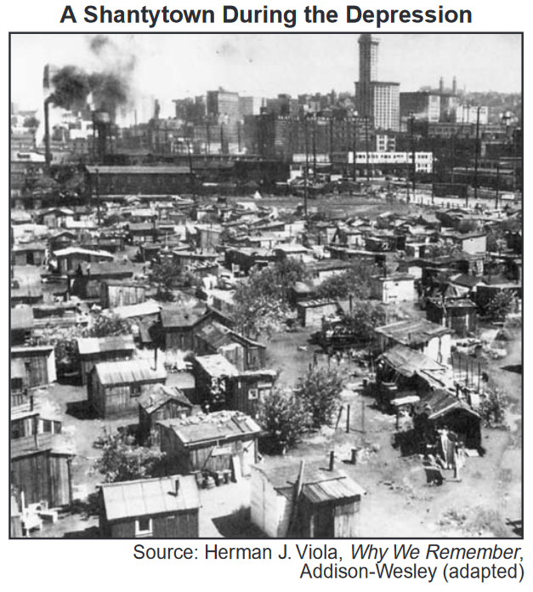
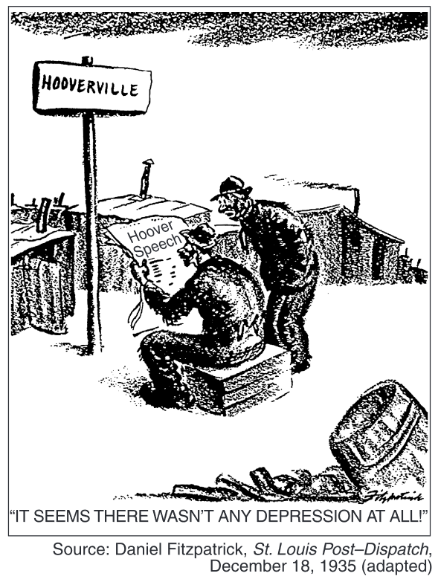
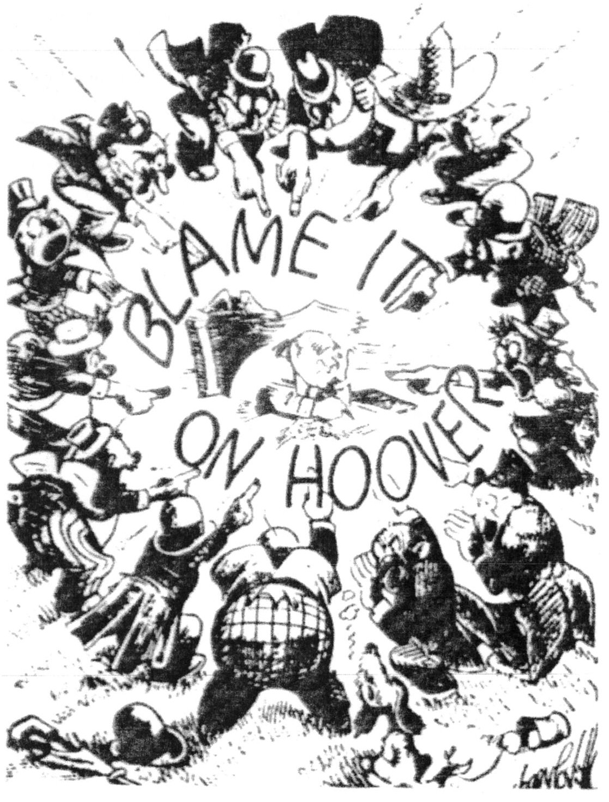
B. HOOVERVILLES = SHACKS HOMELESS PEOPLE LIVED IN DURING THE DEPRESSION
HW
Hoover and the Crisis:
President Hoover believed the poor economy was temporary. He thought the former prosperity would soon return. The president did not support a quick cure byvthe legislature. He called on businesses to not cut wages or production. President Hoover also called for voluntary action by individuals and local governments.
Many volunteers did try to provide relief, or aid to the needy, but the number of needy was just too overwhelming. President Hoover tried to help by allowing more money for public works, or projects such as highways, parks, and libraries. These projects would create more jobs. However, state and local governments ran out of money to support these efforts.
President Hoover also tried to help with the Reconstruction Finance Corporation (RFC). The RFC was to lend money to business or programs providing relief. The directors, however, did not want to grant risky loans, so much of the money went unused.
1. As a way of criticizing the federal government during the early 1930s, areas such as those showing this photograph were often referred to as
Tenements
Levittown’s
Ghettos
Hooverville’s
3. In the early 1930s, many communities of homeless Americans were referred to as “Hooverville’s” because President Herbert Hoover
grew up in a poverty-stricken area due to waterfall economics
guaranteed jobs to the unemployed under welfare economics
provided food and clothing for the poor under trickle-down economics
opposed direct federal aid for the unemployed under trickle-down economics
2. According to the political cartoon President Hoover
developed policies that effectively ended the Great Depression
blamed poor people for causing the Great Depression
failed to meet the needs of many Americans
supported the creation of more “Hooverville’s”
Unit 6 Objective EQ 1: How did the prosperity of the 1920’s give way to the Great Depression?

Slide 7
Directions: Watch the Bonus Army Video & Answer the Questions Below
C. BONUS ARMY OF 1932
______________________ wanted bonuses promised for service in _________
Congress votes ____________ the early bonus
U.S. Army breaks up Bonus Army
______________ ___________________ _____
https://www.youtube.com/watch?v=sNOsIB5VMSQ
1. What did the Bonus Army want from the government?
______________________________________________________________________________________________________________________________________________________________________________________________________________________________________________________________________________
2. What action did the U.S. Government take against the veterans marching for their bonus?
______________________________________________________________________________________________________________________________________________________________________________________________________________________________________________________________________________
3. What was the Historical Significance of the that action? __________________________________________________________________________________________________________________________________________________________________________________________________________________________________________________________________________________________________________________________________________________________________________________________
At the time of World War I, each veteran was promised a bonus of $1,000 to be paid in 1945. Many of those veterans wanted their bonuses immediately. The jobless veterans formed the Bonus Army. The Bonus Army marched to Washington, D.C., in protest. Congress and President Hoover refused to grant the money early. Most the veterans went home, but some refused to leave until they received their money.
There was violence when the police tried to break up the group. Two people were killed. Hoover called in the army. Troops burned the camps, and the veterans fled. Hoover declared that the United States had met a challenge to authority. Many Americans were shocked that the government had attacked its own veterans. Now many Americans were strongly against President Hoover. They were looking for a change in government.
Unit 6 Objective EQ 1: How did the prosperity of the 1920’s give way to the Great Depression?

Slide 8
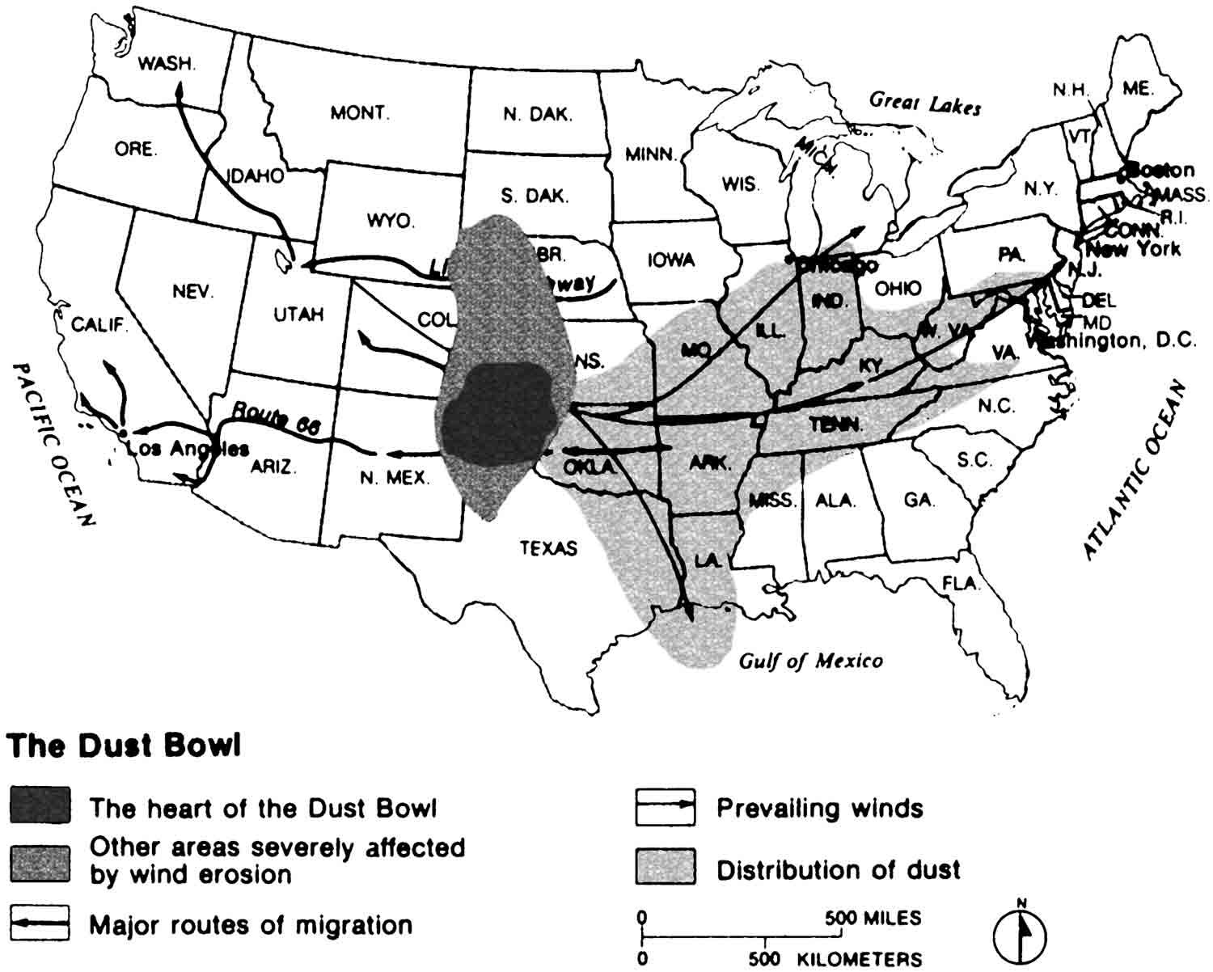
D. DUSTBOWL = FROM THE SOUTHWEST
caused from _____________
under prairie grass for crops
result = search for ____________________people could only wait for the ____________________ to end
most people from ________________ migrated to
_________________ looking for work a.k.a. ___________
influences John Steinbeck’s The Grapes of Wrath story about migrant ___________ living conditions
Oklahoma was the hardest state hit by the dustbowl –most Okies are met with hatred, violence, and discrimination in California – Okies were willing to work for less than the regulars, so businessmen tended to hire them – this is very similar to nativist reaction to immigrants
Complete farms were covered and destroyed by the dustbowl – this disaster, caused by overuse of land (abuse of resources) and severe drought conditions couldn’t have come at a worse time in American history – left, farms are completely covered by dust and debris
Unit 6 Objective EQ 1: How did the prosperity of the 1920’s give way to the Great Depression?

Slide 9
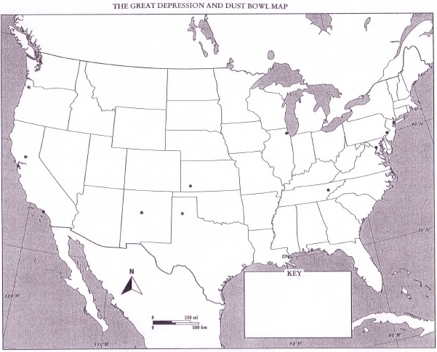
What are the names of the states that were damaged by the dust storms?
1.
2.
3.
4.
5.
6.
7.
8.
9.
10.
Unit 6 Objective EQ 1: How did the prosperity of the 1920’s give way to the Great Depression?

Slide 10
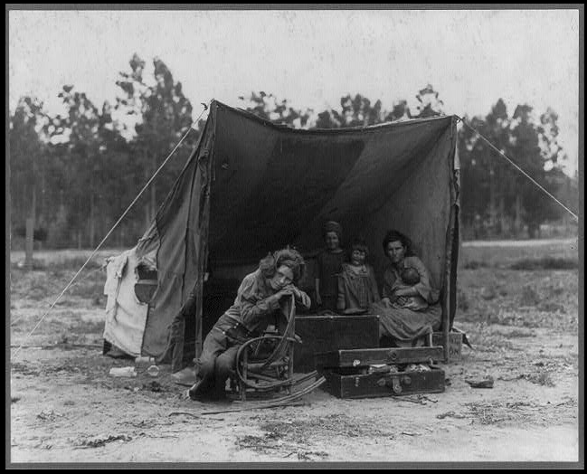
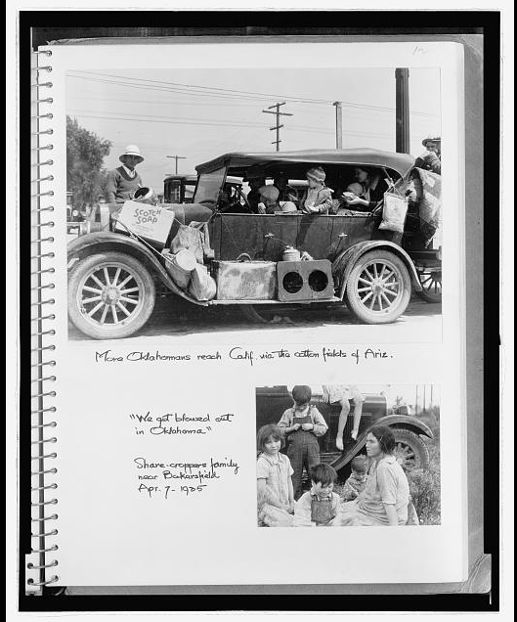
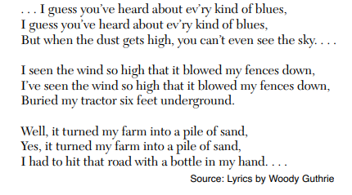
Caption: Migrant agricultural worker's family. Seven hungry children. Mother aged thirty-two. Father is native Californian. Taken in: Nipomo, California Photographer: Dorothea Lange Date: February 1936
Unit 6 Objective EQ 1: How did the prosperity of the 1920’s give way to the Great Depression?
Document set 1
Geographic Context
1) Explain the geographic circumstances that led to the migration of agricultural workers and their families in the 1930’s. ________________________________________________________________________________________________________________________________________________________________________________________________________________________________________________________________________________________________________________________________________________________________________________________________________

Slide 11
Document 2 The Harvest Gypsies was originally published in seven parts the San Francisco News, between October 5 and October 12, 1936. This excerpt comes from Eric Foner’s Voices of Freedom - Volume 2.
The drought in the middle west has driven the agricultural populations of Oklahoma, Nebraska and parts of Kansas and Texas westward. Their lands are destroyed and they can never go back to them. Thousands of them are crossing the borders in ancient rattling automobiles, destitute and hungry and homeless, ready to accept any pay so that they may eat and feed their children. And this is a new thing in migrant labor, for the foreign workers were usually imported without their children and everything that remains of their old life with them.
Thus, in California we find a curious attitude toward a group that makes our agriculture successful. The migrants are needed, and they are hated. Arriving in a district they find the dislike always meted out by the resident to the foreigner, the outlander. This hatred of the stranger occurs in the whole range of human history, from the most primitive village form to our own highly organized industrial farming. The migrants are hated for the following reasons, that they are ignorant and dirty people, that they are carriers of disease, that they increase the necessity for police and the tax bill for schooling in a community, and that if they are allowed to organize they can, simply by refusing to work, wipe out the season's crops. They are never received into a community nor into the life of a community. Wanderers in fact, they are never allowed to feel at home in the communities that demand their services.
As one little boy in a squatters camp said, "When they need us they call us migrants, and when we've picked their crop, we're bums and we got to get out."
2a) Based on this excerpt from Harvest Gypsises by John Steinbeck, Identify a common point of view concerning migrant field workers during the dustbowl. ________________________________________________________________________________________________________________________________________________________________________________________________________________________________________________________________________________________________________
Unit 6 Objective EQ 1: How did the prosperity of the 1920’s give way to the Great Depression?

Slide 12
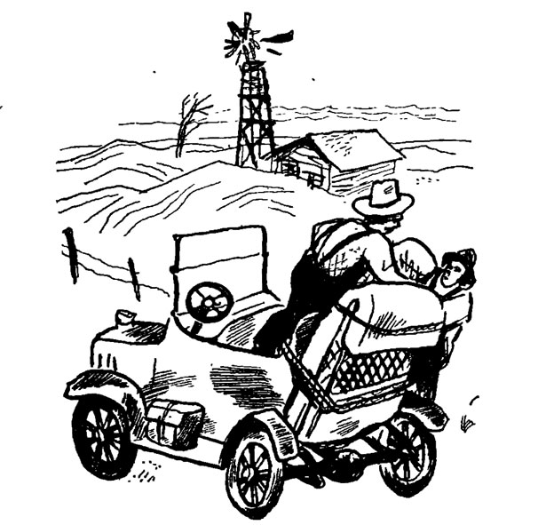
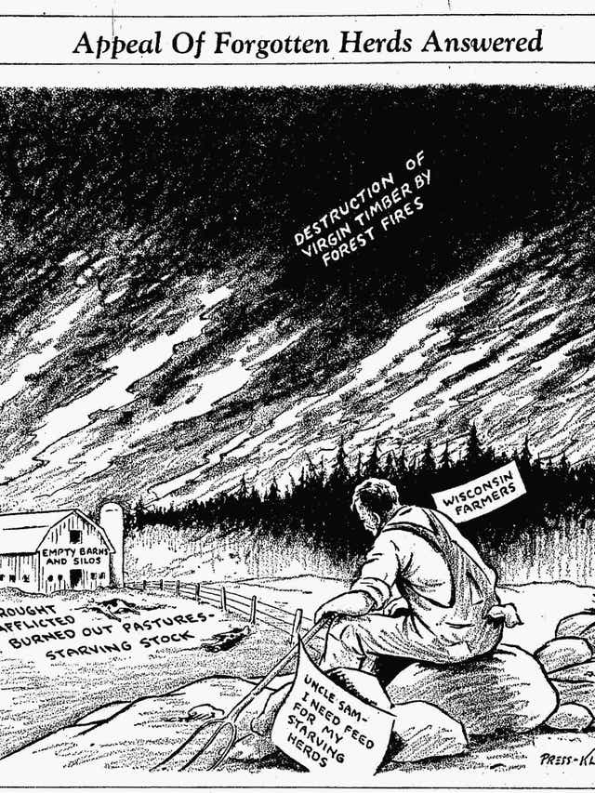
3a) Identify a similarity or a difference regarding the effects of the Dustbowl as expressed in documents 1 and 2. Be sure to use evidence from both documents 1 and 2 in your response.
______________________________________________________________________________________________________________________________________________________________________________________________________________________________________________________________________________________________________________________________________________________________________________________________________________________________________________________________________________________________________________________________________________________________________________________________________________________________________________________
Unit 6 Objective EQ 1: How did the prosperity of the 1920’s give way to the Great Depression?
In which area of the United States did the Dust Bowl of the 1930s occur?
Northeast
Great Plains
Southeast
Pacific Northwest

Slide 13
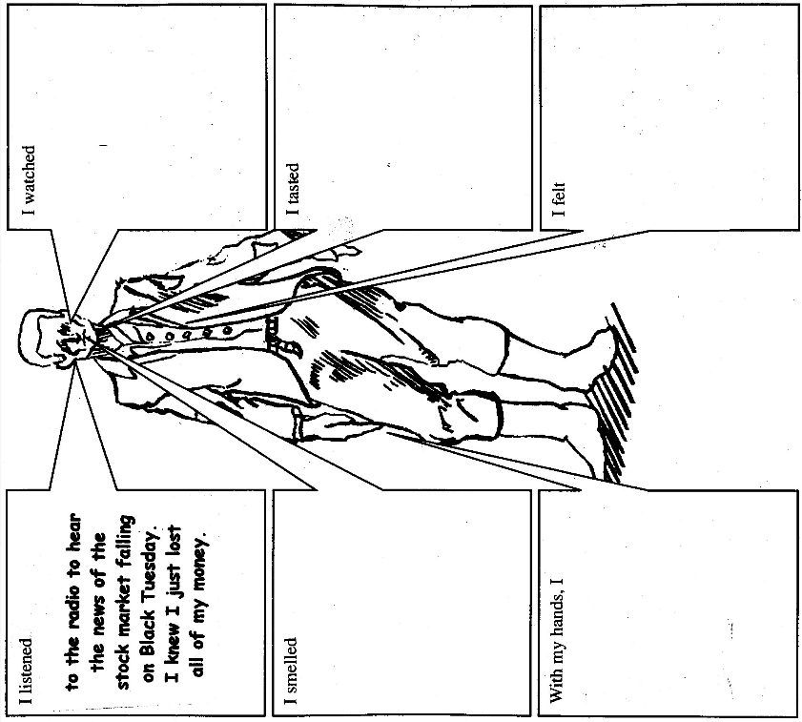
HW
Unit 6 Objective EQ 1: How did the prosperity of the 1920’s give way to the Great Depression?

Slide 14
Historical Post Card Mini- Project
Directions: For this assignment you will create 1 postcard that reflects o the importance of a historical event that had the most significant impact on present day American Society
The post card must contain
Visual that represents the chosen event
Detailed description of what it was like to experience the event
A statement explaining how this event impacted American Society
Unit 6 Objective EQ 1: How did the prosperity of the 1920’s give way to the Great Depression?

Slide 15
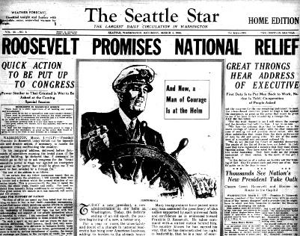
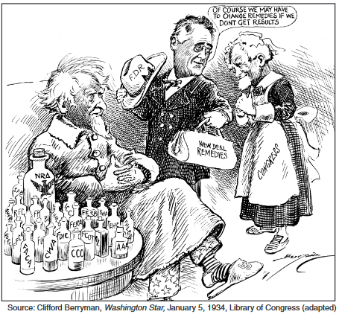
III. EFFECTS OF THE GREAT DEPRESSION
1. ______________, _________________________, _______________
2. ___________________________ ECONOMIC CRISIS
3. ELECTION OF _______________ __________________(FDR) AND HIS ______ ________ POLICIES
Franklin D. Roosevelt : The Democrats chose the governor of New York, Franklin D. Roosevelt, as their next presidential candidate. He came from a wealthy family, and President Theodore Roosevelt was a distant cousin. Franklin D. Roosevelt (also called FDR) married Eleanor Roosevelt, Theodore’s niece, who became a strong supporter for him.
Governor Roosevelt had served on the New York state senate and later was assistant secretary of the navy. In 1921 Roosevelt was struck with polio, and his legs became paralyzed. He eventually returned to politics, making an agreement with the press that he would never be photographed in his wheelchair or with leg braces.
As governor of New York, he became known as a reformer. He had a group of advisers made up of lawyers, economists, and social workers. These advisers were called the Brain Trust.
CRQ1: Who were Roosevelt’s advisers? TTQQA ______________________________________________________________________________________________________________________________________________________________________________________________________________________________________________________
Unit 6 Objective EQ 1: How did the prosperity of the 1920’s give way to the Great Depression?

Slide 16
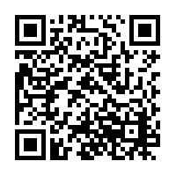
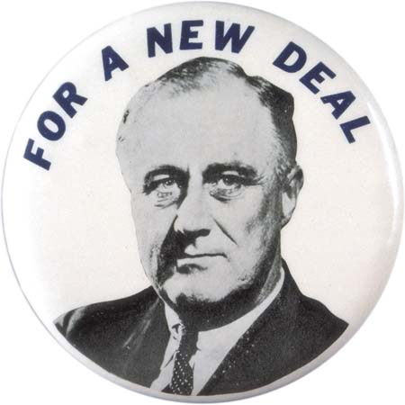
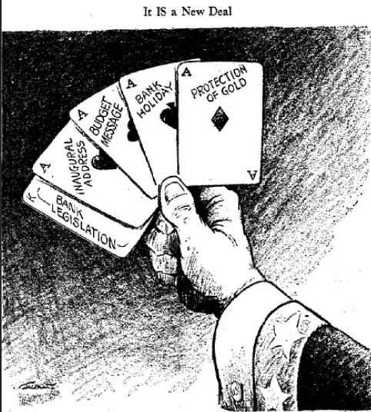
IV. THE NEW DEAL
FDR’S PROGRAMS TO END THE DEPRESSION
The Three R’s
R__________________ = ease suffering
R__________________ = create economic growth
R___________________= try to prevent future economic problems
The New Deal
History Brief : The following video provides a short introduction to Franklin Roosevelt's "New Deal" programs which he put in place after winning the presidency
Directions: Watch the video
https://www.youtube.com/watch?time_continue=1&v=0rjtOWn5mj0
Why did Roosevelt get elected?
In what two ways did Roosevelt achieve the 3 R’s?
Explain how the 1st and 2nd New Deals were different
Why was the FDIC so important in jump starting the New Deal?
The New Deal Takes Shape : The laws that were passed during the Hundred Days became known as the New Deal. The New Deal addressed banking, the stock market, industry, agriculture, public works, relief for the poor, and conservation of resources. President Roosevelt created work relief programs. These programs gave needy people government jobs.

Slide 17
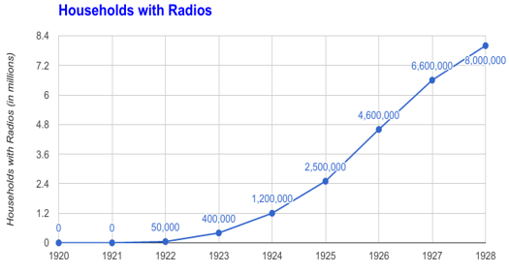
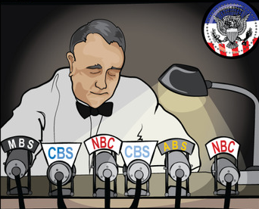
FIRESIDE CHATS
FDR’s radio program explaining his policies in a friendly way
Unit 6 Objective EQ 2: How did the New Deal attempt to address the problems of the Great Depression?
CRQ1: How many American households had a radio in 1928?
CRQ2: Why do you think President Roosevelt chose to do regular radio addresses during the Great Depression? TTQA
__________________________________________________________________________________________________________________________________________________________________________________________________________________________________________________________________________________________________________________
Roosevelt kept Congress in session, giving them 15 proposals to address the nation’s problems. Congress passed all of them. The special session took almost three months and became known as the Hundred Days. The fear and tension of President Hoover’s administration began to fade.
CRQ3 : What were fireside chats and why were they effective in reassuring Americans? _____________________________________________________________________________________________________________________________________________________________________________________________________________________________________________________________________________________________________________________________________________________________________________

Slide 18
How did President Franklin D. Roosevelt use fireside chats to inspire confidence during the Great Depression?
Year | Unemployment Rate | Per Capita Personal Income
1929 | 3.2% | $698
1930 | 8.9% | $619
1931 | 16.3% | $526
1932 | 24.1% | $399
1933 | 25.2% | $372
Unemployment Rate: The unemployment rate is the percentage of the labor force that is willing and able to work, does not currently have a job, and is actively looking for employment. The labor force consists of people ages 16 and over who are employed or actively seeking work
Per Capita Personal Income: Average income per person in a given area in a specific year, in this case years 1929 - 1933 in the United States.
Unemployment data from Gordon, Robert J. “Table A-1, Time Series Data for the U.S. Economy: 1875-1999.” Macroeconomics, 8th ed., Addison-Wesley, 2000. Per capita personal income from www.bea.gov/bea/regional/spi/.
Excerpt from FDR Fireside Chat - May 7, 1933 | First, we are giving opportunity of employment to one-quarter of a million of the unemployed, especially the young men who have dependents, to go into the forestry and flood prevention work. This is a big task because it means feeding, clothing and caring for nearly twice as many men as we have in the regular army itself. In creating this civilian conservation corps we are killing two birds with one stone. We are clearly enhancing the value of our natural resources and, second, we are relieving an appreciable amount of actual distress of unemployment.
Document 1 Historical Context
1) Explain the historical circumstances that led to the development of the Unemployment rate from 1929-1933. ____________________________________________________________________________________________________________________________________________________________________________________________________________________________________________________________________________________________________________________________________________________

Slide 19
How did President Franklin D. Roosevelt use fireside chats to inspire confidence during the Great Depression?
In spite of the fact that unemployment remains a serious problem here as in every other nation, we have come to recognize the possibility and the necessity of certain helpful remedial measures. These measures are of two kinds. The first is to create programs intended to relieve, to minimize and to prevent future unemployment; the second is to establish the practical means to help those who are unemployed in this present emergency...Therefore, let us keep our minds on two or three simple, essential facts in connection with this problem of unemployment. It is true that, while business and industry are definitely better, our relief rolls are still too large. However, for the first time in five years the relief rolls have declined instead of increased during the winter months. They are still declining. The simple fact is that many million more people have private work today than two years ago today or one year ago today, and every day that passes offers more chances to work for those who want to work.
The program for social security now pending before the Congress is a necessary part of the future unemployment relief... We must begin now to make provision for the future. That is why our social security program is an important part of the complete picture. It proposes, by means of old-age pensions, to help those who have reached the age of retirement to give up their jobs, and thus give to the younger generation greater opportunities for work, and to give to all a feeling of security as they look toward old age.
Source: Excerpt from FDR Fireside Chat - April 28th 1935
Document 2
2a) Based on this excerpt from FRD identify his point of view concerning the policies of the New Deal . ________________________________________________________________________________________________________________________________________________________________________________________________________________________________________________________________________________________________________________________________________________________________________________________________________________
3) Identify and explain a cause and effect relationship associated with the events or ideas in document 1- Unemployment and document 2- FDR Fire Side Chat . Be sure to use evidence from both documents 1 and 2 in your response.
___________________________________________________________________________________________________________________________________________________________________________________________________________________________________________________________________________________________________________________________________________________________________________________________________________________________________________________________________________________________________________________

Slide 20
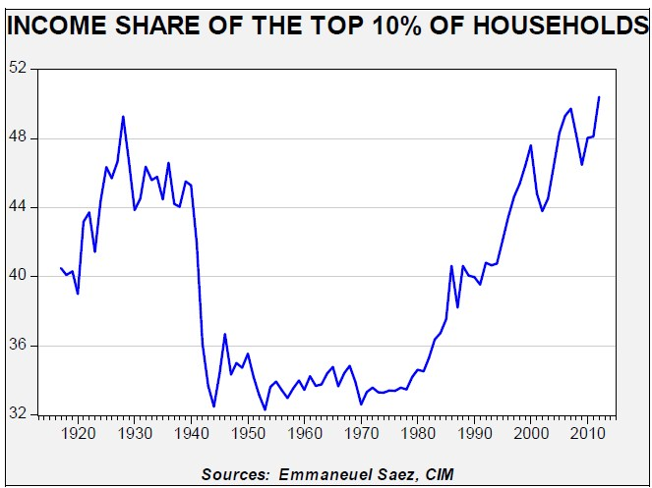
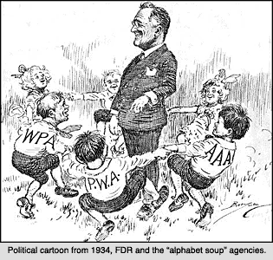
Unit 6 Objective EQ 2: How did the New Deal attempt to address the problems of the Great Depression?
Almost immediately after becoming president, Roosevelt closed all banks for four days. He then called a special session of Congress. Together they created the Emergency Banking Relief Act. It set up a system so the banks could reopen or reorganize. Roosevelt communicated with the public over the radio, assuring Americans that their money would now be safe in banks. People began depositing their money again the next day. This ended the banking crisis.
V. RELIEF LEGISLATION
Legislation | Action Taken
A. ________________ ________________ | Emergency Banking Act 1933 = closed the banks to stop people from withdrawing $ prevent collapse of banks only sound banks reopen
B. ____________ ____________ | Federal Emergency Relief Act = direct aid to help poor
C. ____________ ____________ | Public Works Administration = created construction projects
(PWA). The goal was to increase the economy with large public works projects that needed many workers. People had jobs working on roads,
shipyards, hospitals, city halls, and schools.

Slide 21
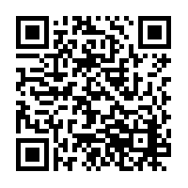
VI. RECOVERY LEGISLATION
Directions: Create an Instagram post for the CCC or the TVA. The post needs to include a description of the picture.
https://www.youtube.com/watch?time_continue=1&v=a3xgYIPpIQ4
https://www.youtube.com/watch?v=zaI7GsxdmvM
One program, the Civilian Conservation Corps (CCC), put millions of men to work. They planted trees, built levees for flood control, and improved national parks.
Recovery Legislation | Action Taken
A. __________ ____________ | Civilian Conservation Corps = provided jobs to build roads, landing fields, soil erosion, and flood control projects
B. _________ ____________ | Tennessee Valley Authority = provide jobs, electricity, and dams (control floods) in poor rural areas
Another bold program was the Tennessee Valley Authority (TVA). The TVA tried to control flooding, encourage conservation and development, and bring electricity to the area along the Tennessee River. Dams were built and improved. Hydroelectric power provided electricity to area homes for the first time. Some critics complained that the money for the TVA should be used nationwide. However, the system worked well when the rains came.

Slide 22
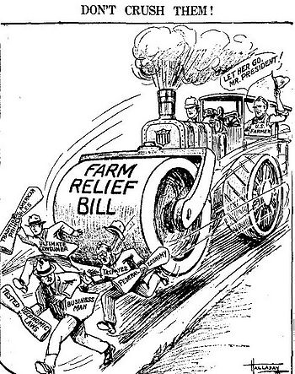
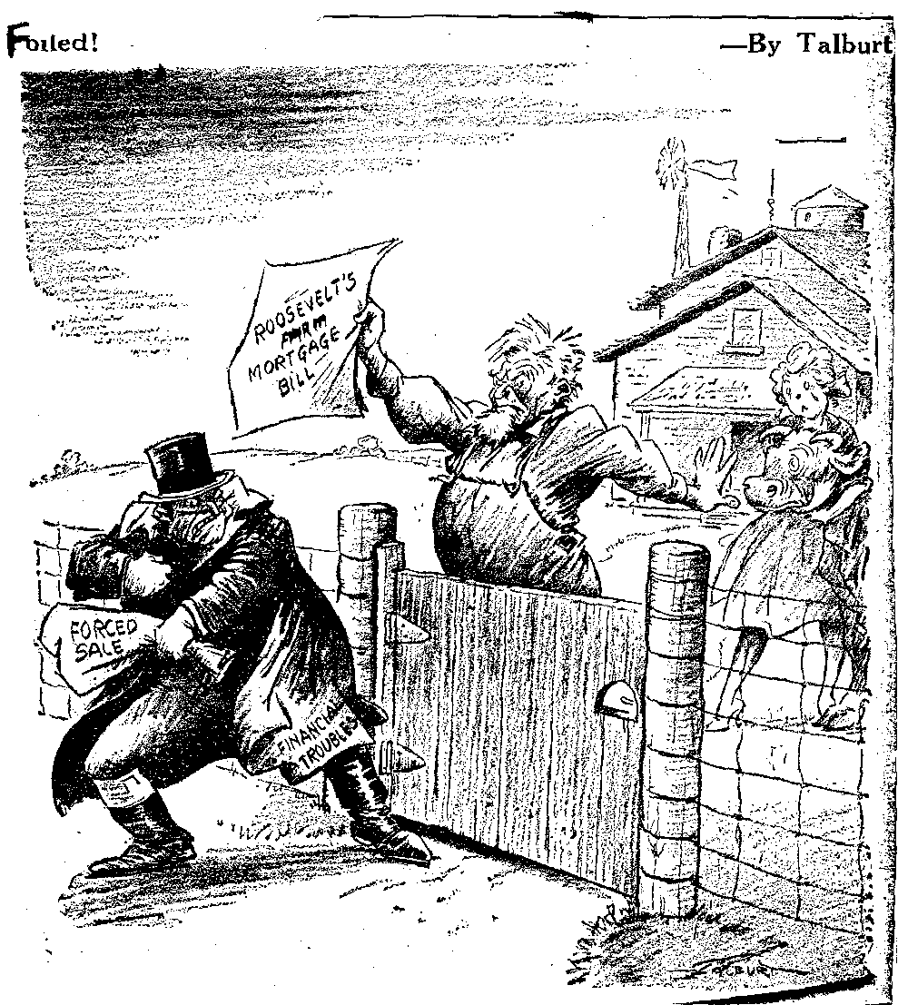
Unit 6 Objective EQ 2: How did the New Deal attempt to address the problems of the Great Depression?
VI. RECOVERY LEGISLATION
The Agricultural Adjustment Act (AAA) had two goals. It aimed to raise farm prices quickly and control production so prices could stay up. The only way the AAA could raise prices was if there was less produce. They paid farmers to destroy some of their produce or leave some of their land unfarmed. If market prices fell too low, the AAA would pay subsidies, or grants of money, to the farmers. The Supreme Court ruled that the AAA was unconstitutional.
S
P
A
M
Recovery Legislation | Action Taken
C. _______________ __________________ | Agricultural Adjustment Act Use subsidies – pay farmers not to grow control agricultural overproduction
D. ____________ ____________ | Farm Credit Administration = helped farmers get low-interest mortgages
S
P
A
M

Slide 23
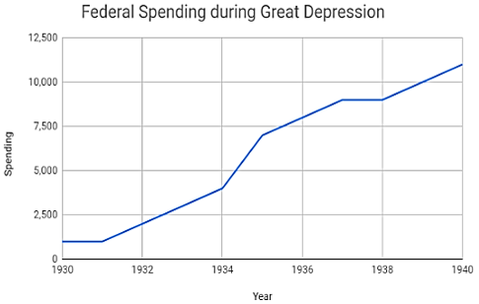
VI. Recovery Legislation
Unit 6 Objective EQ 2: How did the New Deal change the social, economic, and political landscape of the United States for future generations?
New Deal Opponents : Some portions of the New Deal involved business. Many businesspeople were against the New Deal because they believed it worked against free enterprise. Also, President Roosevelt was accused of spending too much government money in the New Deal programs. Some of the conservative critics of the New Deal formed the Liberty League. They wanted the government to be less involved in business. The League did not get very popular, but it did let Roosevelt know that big business was against his policies.
1. According to the text, what did critics of Roosevelt dislike about the New Deal Plan?
it was a danger to the free-enterprise system
Congress had too much power over the president
women should not be granted voting rights
the Supreme Court should develop govern-mental policies
Priming the Pump: Believed in pouring money into the economy to get it working again→ by putting government money into consumers’ hands, consumers would spend more, increasing the demand for products
3. According to the data from the Federal Spending Graph, what historical circumstances led opponents to criticize the new deal?
the government was spending too much money
too many Americans were overspending
social programs mainly benefited the rich
President Franklin D. Roosevelt was ignoring the needs of the people
2. Deficit spending by the Federal Government as a means of reviving the economy is based on the idea that
purchasing power will increase and economic growth will be stimulated
only the National Government can operate businesses efficiently
the National Government should turn its revenue over to the states
lower interest rates will encourage investment

Slide 24
VII. Reform Legislation = Second New Deal
Unit 6 Objective EQ 2: How did the New Deal change the social, economic, and political landscape of the United States for future generations?
Directions: Create an Instagram post for the FDIC or SEC. The post needs to include a description of the picture.
Reform Legislation | Action Taken
A. _____________ _________________ | = FDIC (Federal Deposit Insurance Corporation) = guaranteed deposits by insuring them
B. _______________ _________________ | Securities Exchange Commission regulate stock exchanges and investments stop stock fraud; proper info. given to investors
The Federal Deposit Insurance Corporation (FDIC) was started to protect bank deposits. Any bank insured by the FDIC was guaranteed that the money would be available if the bank failed. Finally, the Securities and Exchange Commission (SEC) gave the power to punish dishonest stockbrokers. All these New Deal programs did not end the Depression. They did, however, improve conditions and provide hope that times would get better.
CRQ1: Did the New Deal programs have the desired effect? Why or why not? ________________________________________________________________________________________________________________________________________________________________________________________________________________________

Slide 25
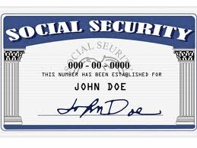
The Second New Deal : The Social Security Act created a tax on workers and employers. That money provided monthly pensions for retired people. Unemployment insurance taxed employers only. The money was used to pay people who had lost their jobs. The Social Security Act supported others in need of aid. It was the start of the American welfare system.
CRQ1 : What historical impact did the Social Security Act have? TTQA __________________________________________________________________________________________________________________________________________________________________________________________________________________________________________________________________________________________________________________
Unit 6 Objective EQ 2: How did the New Deal change the social, economic, and political landscape of the United States for future generations?
VII. REFORM LEGISLATION = SECOND NEW DEAL
Reform Legislation | Action Taken
C. _____________ _________________ | = public assistance insurance old age pension, unemployment insurance assist disabled, orphans, & widows
D. _______________ _________________ | = a.k.a. National Labor Relations Act unions were given the right to organize and bargain collectively, blacklists were illegal
E. _______________ _________________ | = set minimum wage and maximum work week
2. Which New Deal program still exists today?
Works Progress Administration
Federal Emergency Relief Administration
Civilian Conservation Corps
Social Security Administration
3. The power of labor unions increased during the New Deal mainly because
a new spirit of cooperation existed between employers and government
a shortage of skilled and unskilled laborers developed
management changed its attitude toward organized labor
Federal legislation guaranteed labor’s right to organize and bargain collectively

Slide 26
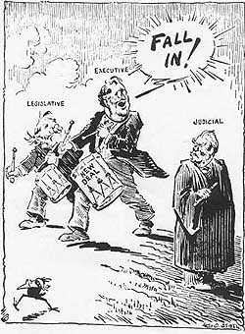
The Supreme Court
Critics of the New Deal tested the legality of many of its programs in court. They claimed the programs were unconstitutional. The Supreme Court ruled against the National Industrial Recovery Act, finding that it overused its power to regulate interstate commerce. The Agricultural Adjustment Act, the Wagner Act, the Social Security Act, and the Tennessee Valley Authority all came before the Supreme Court. All of these court cases threatened to end the New Deal.
During this time, President Roosevelt campaigned against Alfred M. Landon, the Republican governor from Kansas. Campaigning for the rights of the average American, President Roosevelt was reelected. Support came from liberals, the poor and unemployed, city workers, and African Americans. These groups made up the base of the Democratic Party.
In his next term, President Roosevelt wanted to stop the Supreme Court from destroying his New Deal. He pushed to increase the Supreme Court from 9 justices to 15. The president claimed that the current 9 justices were overworked. He, of course, would appoint the other 6 justices. President Roosevelt’s proposal was strongly opposed. Many people claimed the president was trying to “pack” the Court to win his New Deal. This court-packing would destroy the checks and balances guaranteed in the Constitution. After the Supreme Court ruled in favor of the Wagner Act and the Social Security Act, President Roosevelt ended his proposal to add more justices. His proposal to add Supreme Court justices had split the Democratic Party.
By 1937 the economy had finally improved. President Roosevelt tried to reduce the spending on some of the programs, and the economy worsened immediately. It was as bad as in the early Depression. Some people called it the Roosevelt Recession. The president stopped the recession by putting money back into public works programs, but he had already lost more supporters.
CRQ 2. : What historical circumstances led Roosevelt to attempt to “Pack the Court”? __________________________________________________________________________________________________________________________________________________________________________________________________________________________________________________________________________________________________________________________________________________________________________________________
The problem illustrated by the cartoon was the historical impact of the government trying to solve what dilemma?
preparing to enter World War II
cutting taxes for the wealthy
lowering the price of farm products
trying to solve problems created by the Great Depression

Slide 27
America: The Story of Us
Episode 9: Bust - Episode Summary: Dust storms blanket the Midwest in darkness.
Watch the Vide
19:00 min – end
The Effects of the New Deal
Mount Rushmore was built as part of President Franklin Delano Roosevelt’s government program called the ________ Deal.
Despite the public works programs, in 1936 1 in ___ Americans were still unemployed.
What event would it take to get the United States out the Great Depression? ______________
In 1936, African-American Joe Lewis would face off against German Max Schmeling for boxing’s heavy weight title. ____ million Americans would listen to the fight on the radio. Joe Lewis was the hope of African-Americas, about _____% of which were unemployed.
_______________________________ was the winner of the 1936 Heavyweight Title.
The rematch between Schmeling and Lewis was scheduled for June 22, 1938 at Yankee Stadium in New York. This fight would pit good vs. evil; democracy vs. __________________. ______ million Americans would listen to the fight, 100 million worldwide.
Joe Lewis won the rematch in only ______ seconds. The second quickest heavyweight title fight in history.
What was the symbolism of the Lewis/ Schmeling fight?
https://www.youtube.com/watch?v=PoV7GGN-u7Q

Slide 28
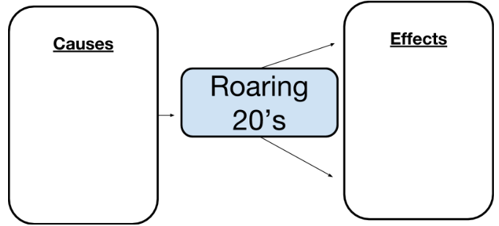
Expansion of buying goods on credit Isolation from foreign conflict Harlem Renaissance Palmer Raids Migration of farmers from Midwest to California President Hoover & Laissez Faire economic policy FDR elected in 1932 Great Depression Banking Holiday & Emergency Banking Act Unemployment reaches 20 - 22% New Deal Programs (AAA, TVA, WPA, FDIC, etc) Relief of poverty, doesn’t solve the Great Depression SEC and FDIC - Regulation of stock market and banks FDR attempts court packing Rise of feminism Red Scare Permanent government welfare programs Fireside chats to restore confidence in American Economy | Rise of American consumerism Great Migration Flappers Rise of speakeasies and black market liquor Debt culture in American economy (more debt than the economy or American citizens can really afford) Relaxed regulations on banks and industry Laissez Faire economics & President Coolidge Prohibition & Temperance Movement / 18th Amendment Stock market crashes Black Tuesday - October 29th 1929 Banking crisis Deficit spending continues through Clinton Administration Large volumes of loans made on credit unpaid Farmers unable to pay back loans on farming equipment and land Demand for grain falls and supply rises, causing prices and profits for farmers to fall Dust Bowl Immigration quotas of the 1920’s and 1930’s Expansion of federal government

Slide 29
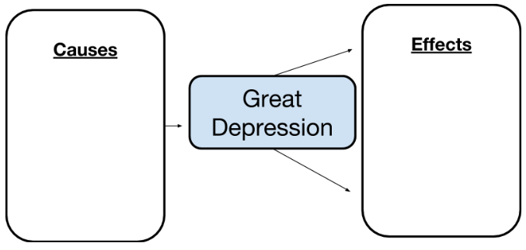
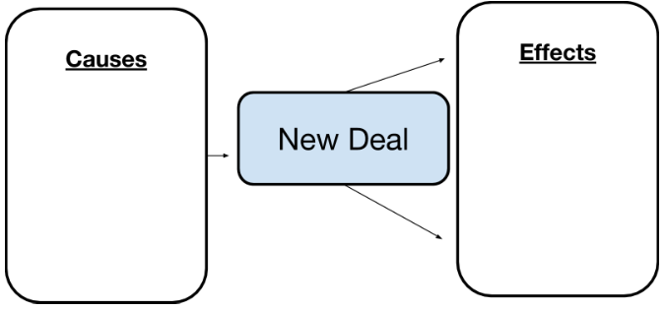

Slide 30
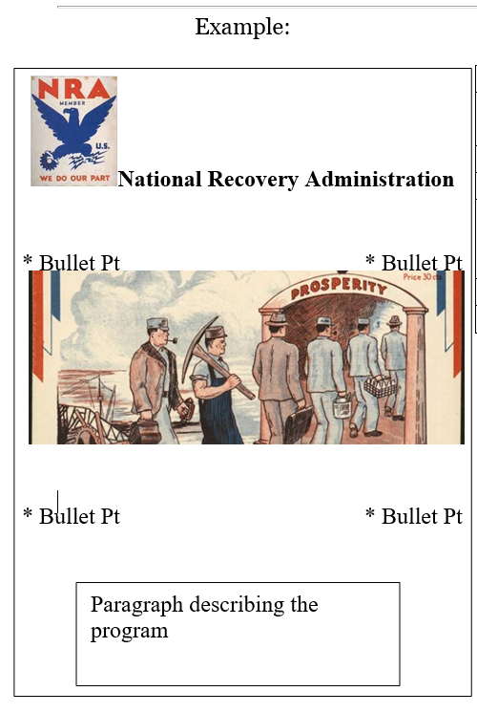
US History: New Deal mini Poster Project
Directions: You are an artist hired by President Roosevelt. FDR has asked you to create a poster that promotes one of his New Deal Programs. You need to have the following information on the poster:
Name of the New Deal program in large font at the top, the acronym for the program (i.e. Public Works Administration = PWA), and year.
Create your own official logo or seal of the New Deal Program.
A picture/cartoon/graphic describing the program (i.e., people being helped by the program, something created by the program, something the program does, etc).
Four one-sentence bullet points promoting the program
One paragraph at the bottom-center of the poster describing the reason for the program and what its goals are, include which of the 3 R’s it is.
Please choose from following the New Deal Programs:
Federal Deposit Insurance Corp (FDIC), Agricultural Adjustment Act (AAA), Tennessee Valley Authority (TVA), Civilian Conservation Corps (CCC), Public Works Administration (PWA), National Recovery Administration (NRA), Federal Housing Administration (FHA), Federal Emergency Relief Administration (FERA), Farm Security Administration (FSA), Works Progress Administration (WPA), National Youth Administration (NYA), National Labor Relations Board (NLRB), Social Security Administration (SSA), Rural Electrification Administration (REA)
1) Name of New Deal program & acronym | 15 points
2 )Logo or seal | 10 points
3) Picture describing the program | 10 points
* Bullet Pt * Bullet Pt 4) Four one-sentence bullet point promoting the program | 5 points each (20points)
5) Paragraph describing the program | 40 points
6) Neatness, originality, creativity | 5 points

