Slide 1
7th Grade SS Name: Period:
MODULE: Unit 1- AMERICAN GEOGRAPHY
Guiding Question: Why is understanding geography important to the study of history?
Table of Contents
Date | Topic(s) | Page Numbers
Days 1 - 3 | History & Geography | 1 - 3
Days 4 - 6 | Location | 4 - 8
Days 7 - 9 | Place / Region | 9 - 10
Days 10 - 12 | HEI & Movement | 11 - 12
Day 13 | Maps / TODALS | 13 - 15
Day 14 | Water / Wrap Up | 16 - 17
Days 15 - 17 | Review & Test

Slide 2
Unit 1 EQ: Why is understanding geography important to the study of history?
1. Geography of the America’s:
Understanding geography is important to our understanding of the past and present.
is linked to .
To understand history, you must understand Geography.
All of human history has taken place in our .
2. Geography:
Geography is the in which we all live and in which all past events have taken place.
: landforms & geographical features on the Earth’s surface such as mountains, rivers, lakes, and deserts.
: materials humans take from the environment to survive. Examples: Plants, Trees, Gold, Oil, Water, Sun
: The condition of the Earth’s atmosphere at a given time and place.
: The average weather of a place over a period of 20-30 years.
Made up of temperature and precipitation (rain, snow)
America’s Land & Water:
Almost every landform, or physical feature, or geographic feature, is to be found somewhere in the United States. Physical features and geographic features are the same thing as landforms. These three words have the same meaning. A landform is a feature of the earth’s surface. Examples include bodies of water, mountains, valleys, deserts, and plains. Our rivers, lakes, and other bodies of water are essential parts of our country. They supply water for drinking and farming and, in some cases, for running power plants. They are also natural highways upon which enormous amounts of goods are moved every year.
STOP CRQ: List examples of different landforms found in Upstate New York:

Slide 3
Unit 1 EQ Objective 1: What are the five themes of Geography?
Five Themes Rap
Jeanie Robinson
Here's a basic tool what can it be.
It's the five themes of geography.
Location and Place and Movement too,
What can Environments and Regions do?
What can they do?
What can they do?
They can tell us about our world you know.
Like where is a place and how can I go.
What is it like? Is it hot or cold?
Hot or cold.
Hot or cold.
Do I travel on a river?
or trek through the snow?
Can a take a plane or a car or a boat?
Do I wear a pair of shorts or a big heavy coat?
How do I know?
How do I know?
They tell you all the answers don't you see?
They're the five themes of geography!
Geography, GEOGRAPHY!
5 Themes of Geography

Slide 4
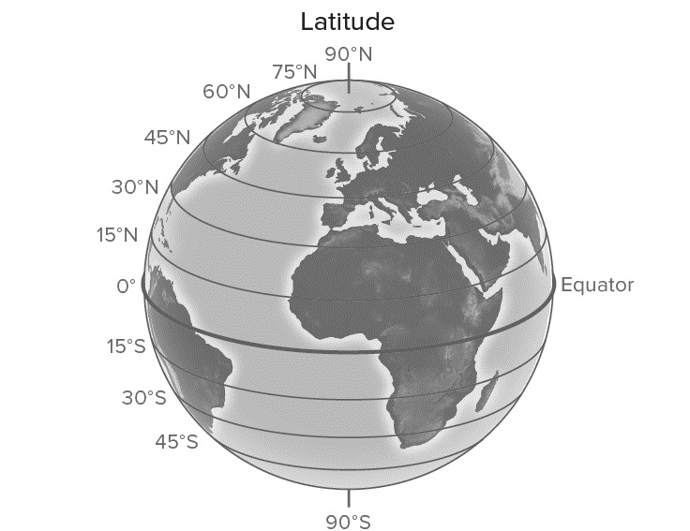
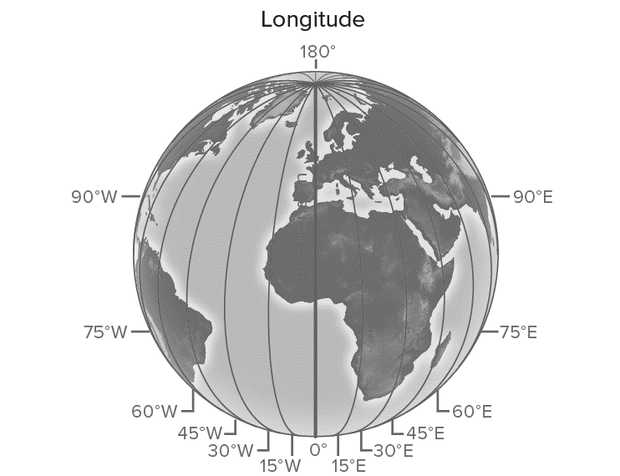
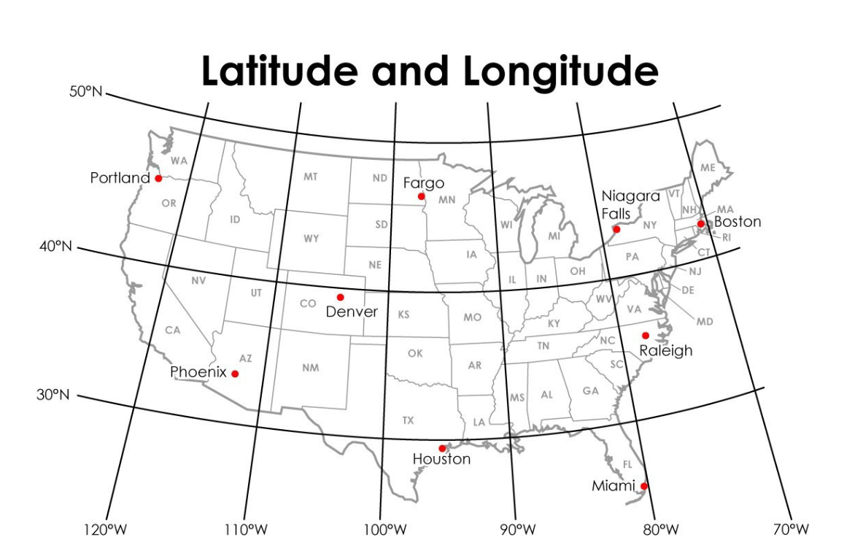
Unit 1 EQ, Objective 2: How do latitude and longitude help people to locate places in the world?
3. LOCATION:
A. :
Compared to other places (variable)
Changes dependent upon where you’re comparing it to.
Miles
Distance
Direction
B. :
exact location on Earth (Fixed)
Doesn’t change
Latitude/Longitude
Hemispheres
Grid System
Address
4. LATITUDE:
5. LONGITUDE:
Coordinate
Intersecting
latitude and longitude lines
Houston (29°N, 95°W)
Or
Houston (95°W, 29°N)

Slide 5
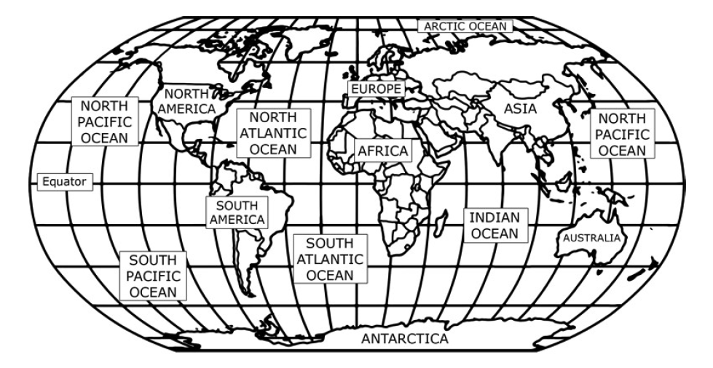
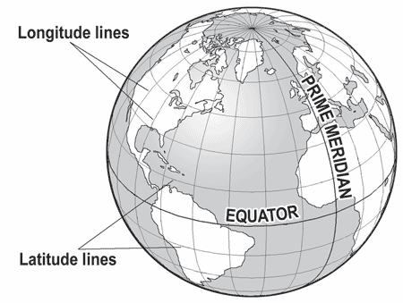
Unit 1 EQ Objective 2: How do latitude and longitude help people to locate places in the world?
Legend:
Equator
Prime Meridian
Latitude Lines
Longitude Lines
World Map

Slide 6
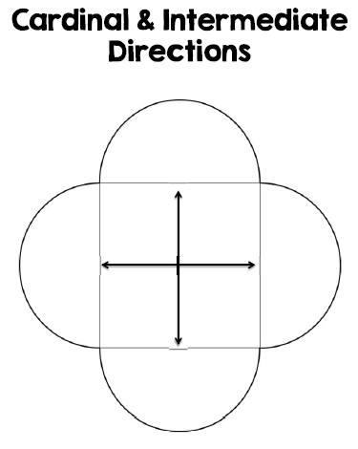
Unit 1 EQ Objective 2: How do latitude and longitude help people to locate places in the world?
DIRECTIONS: Answer the following questions using the Maps in the textbook
What is the name for 0° latitude line?
What is the name for 0° longitude line?
To measure distance north and south of the equator, you would use lines of
To measure distance east and west of the Prime Meridian, you would use lines of
Look at Map on Page A-9 If you were at 60°N, 100°E, on which continent would you be?
Look at Map on Page A-9 If you were at 15°N, 25°E in which country would you be?
Look at Map on Page A-3 What city is located at 40°N, 93°W?
Look at Map on Page A-3 What is the capital of the state you are in if you were at 35°N, 110°W
Look at Map on Page A-4. If you were at 40°N, 100°W which region of the United States would you be in?

Slide 7
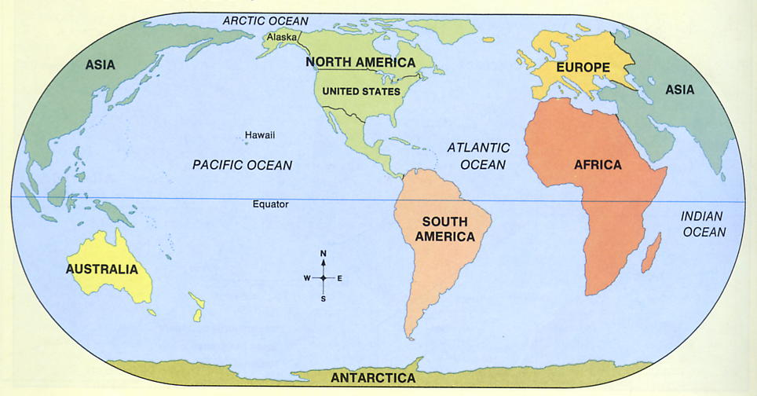
Unit 1 EQ Objective 3: What different types of maps would people use?
1
3
5
5
6. AMERICA’S LOCATION:
● The United States is part of
.
● North America is one of the
continents on the Earth.
1.
2.
3.
4.
5.
6.
7.
4
6
2
7
GLUE CONTINENTS
FOLDABLE HERE
The United States is a country on the North American continent. Not counting Alaska and Hawaii, the United States measures about 2,500 miles east to west and 1,500 miles north to south. The Continental United States is bordered on the north by Canada, on the south by Mexico and the Gulf of Mexico, on the east by the Atlantic Ocean, and on the west by the Pacific Ocean.

Slide 8
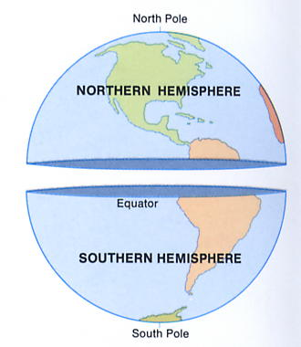
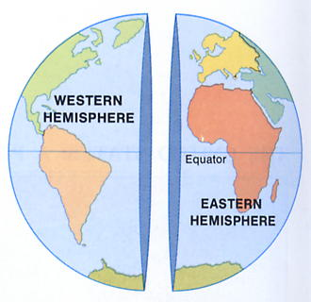
America’s location is in the and
Hemisphere’s.
HEMISPHERES: WHERE ARE YOU?
DIRECTIONS: Answer the following questions based on the globes and your geographic knowledge.
The United States is in the Northern Hemisphere, the half of the earth north of the equator. The United States is also in the Western Hemisphere, the half of the earth west of Europe and Africa. The United States, along with Canada and Mexico, makes up North America. In addition, Central America and South America are part of the Western Hemisphere. Until about 500 years ago, mapmakers did not know that the Western Hemisphere existed.
A line from the North Pole to the South Pole divides Earth into the Hemisphere and Hemisphere.
Both North and South America are in the Hemisphere.
Both Africa and Europe are in the Hemisphere.
The equator divides the globe into the and hemispheres.
People in the U.S. live in the and hemispheres.
In size, the United States is the 4th largest nation in the world. More than 285 million Americans live on the more than 3.6 million square miles that our country covers.
Unit 1 EQ Objective 1: What are the five themes of Geography?

Slide 9
Unit 1 EQ Objective: What are the five themes of Geography?
7. PLACE: Describes an area’s physical and human features. It is the environment in which we live.
A. PHYSICAL FEATURES:
B. HUMAN/ CULTURAL FEATURES
LANDFORM
https://www.thinglink.com/scene/1230163111059652615

Slide 10
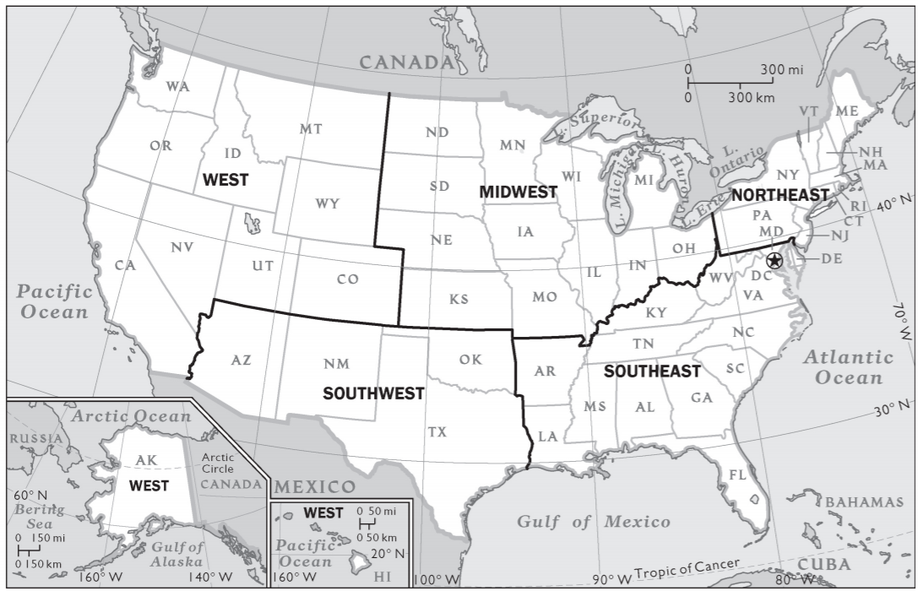
Unit 1 EQ Objective: What are the five themes of Geography?
REGION: ________________________________________________________________________________________________________
Climate
Location
Beliefs
Languages
Ethnicity/Race
There are 5 basic sections/ Regions in the United States. These include the Northeast, Southeast, Midwest, Southwest, and West. Not only can the United States be broken down into sections, but it can be broken down into land regions.
SHADE and
CREATE a LEGEND
__ __________________
__ __________________
__ ___________________
__ ___________________
__ ___________________

Slide 11
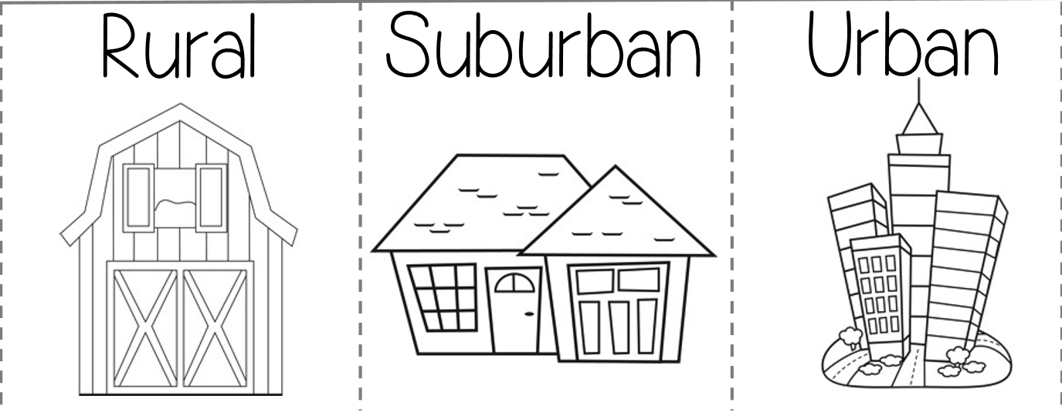
9. Human Environment Interaction:
ADAPT - People adapt to the environment by ___________________ ____ ____ ________ ________ in order to survive
MODIFY - People change the environment by __________________ ____________ it.
●As humans, we can either change our environment, or we have to change to fit into it.
Unit 1 EQ 1 Objective: What are the five themes of Geography?
Movement:

Slide 12
Comic Instructions – HEI FOLDABLE
1. In the 1st slide design a title and drawing for Human-Environment Interaction. (15 points)
2. In the 2nd slide explain to the reader what a human-environment interaction is, using examples you have learned in class. (20 points)
In boxes 3,4, Identify TWO instances of Human-Environment Interaction.
The pictures should be informational. You want to tell the reader basic information about this interaction.
(10 points each = 20 points total)
On the back of the comic List 2 pros and 2 cons for each interaction. These can be bulleted.
(20 points each interaction = 40 points total)
In the last box, write your name. You may also decorate this pane as well (5 points).
FOR TEACHER USE:
Box 1 (15 pts) | Box 2 (20 pts) | Box 3 (30 pts) | Box 4 (30 pts) | Box 5 (5 pts)
Title Image | Define HEI in your own words | Modification IMAGE Explain Pros & Cons | Adaptation IMAGE Explain Pro & Con | Name Date Class Period

Slide 13
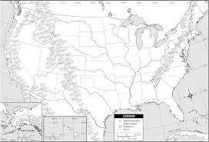
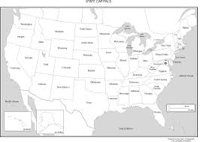
11. MAPS:
TYPES OF MAPS: There are 2 main types of maps; physical and political maps.
Unit 1 EQ 3 Objective: What different types of maps do people use?
A. Physical Map | B. Political Map

Slide 14
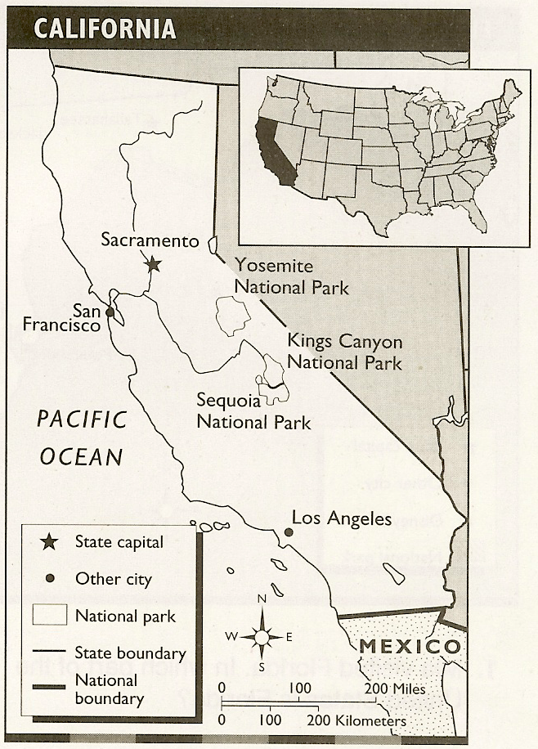
12. PARTS OF A MAP: All maps have 5 basic parts. TODALS
Unit 1 EQ 3 Objective: What different types of maps do people use?
T
O
D
A
L
S
2000
A. Marzus
LABEL THE MAP PARTS ON THE MAP TO THE RIGHT:

Slide 15
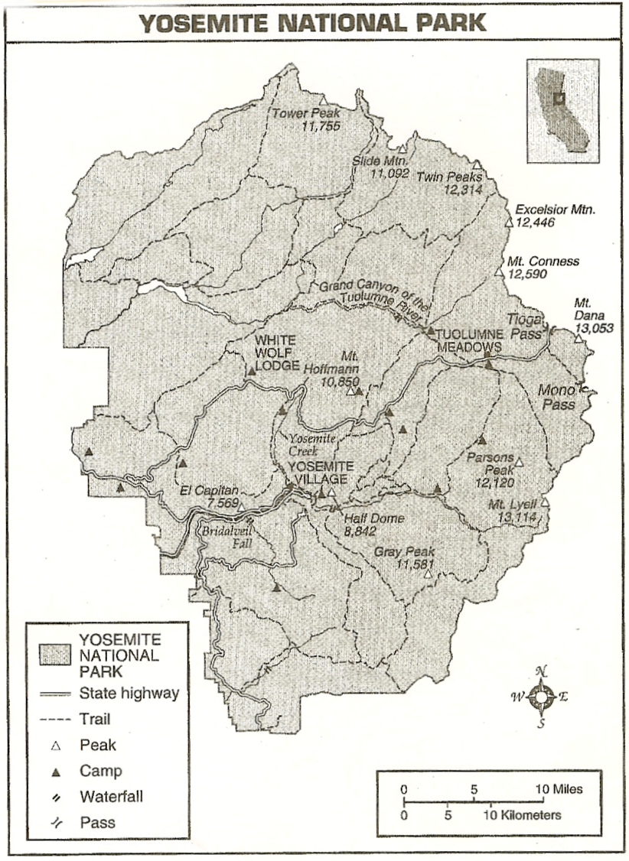
MAP SKILLS WORKSHEET: THE PARTS OF A MAP
DIRECTIONS: The map below provides information about the Yosemite National Park. Study the map and answer the questions.
1. What is the title of the map? _______________________________________________
_________________________________________________________________________
2. Draw the pattern that is used to show the following information:
a. Peak: c. State Highway:
b. Pass: d. Camp:
3. What is the part of the map called that is used to find this information?
_________________________________________________________________________
_________________________________________________________________________
4. About how many miles is it from Tioga Pass to Tuolumne Meadows?
_________________________________________________________________________
_________________________________________________________________________
5. What is the part of the map called that you used to determine this distance?
_________________________________________________________________________
_________________________________________________________________________
6. In what direction would you be traveling if you went from Mono Pass to White Wolf Lodge? ______________________________________________________________
_____________________________________________________________________________________________________________________________________________
7. What part of the map is used to tell direction? _____________________________________________________________________________________________________
_____________________________________________________________________________________________________________________________________________

Slide 16
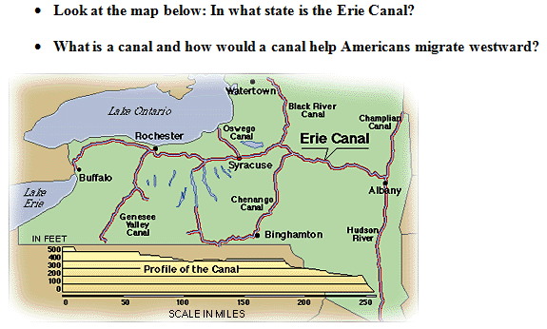
12. WATER: How do rivers and lakes benefit the economy of the United States?
______________________________________________________________________________________________________________________________
Unit 1 EQ 4 Objective: How do rivers and lakes benefit the economy of the United States?

Slide 17
Unit 1 EQ 4 Objective: How do rivers and lakes benefit the economy of the United States?
The Great Lakes &
St. Lawrence Sea Way
H.O.M.E.S
https://www.thinglink.com/scene/1223687788235325445

Slide 19
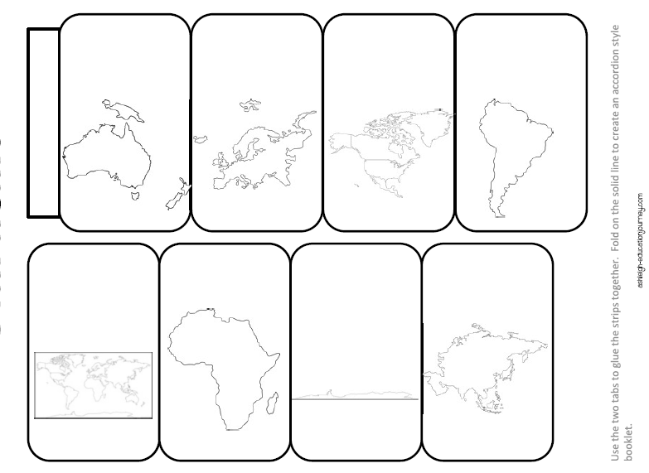
____
____
____
____
7 Continents
5 Oceans
____
____
____
____

