Slide 1
Social Studies Assignments 4/7 – 4/15
Lesson 1 | Use Unit 1 Vocabulary 2 Bingo Boards - Terms & Definitions | Due 4/7/2020
Lesson 2 | Use Unit 2 Vocabulary 6 Acrostics | Due 4/8/2020
Lesson 3 | Use Unit 3 Vocabulary Crossword Puzzle & Key | Due 4/9/2020
Lesson 4 | Use Unit 4 Vocabulary Hash Tags | Due 4/10/2020
Lesson 5 | Use Unit 5 Vocabulary 6 Slide Comic Strip | Due 4/13/2020
Lesson 6 | Practice Map of the 50 states | Due 4/14/2020
Lesson 7 | Practice Map of the 50 states Abbreviations | Due 4/15/2020
Name: ____________________________________

Slide 2
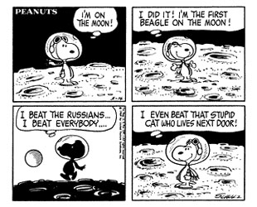
Comic Strip Unit 5 Vocab
Use Unit 5 Vocabulary
Index Cards & News Letters
Class Website www.Voliverushistory.weebly.com
TEAMS
Create 1 Comic Strip
Pick 6 Vocab Words from Unit 5
One word in each box with a cartoon/ comic

Slide 3
Comic Strip

