Slide 1
Social Studies Assignments 4/7 – 4/15
Lesson 1 | Use Unit 1 Vocabulary 2 Bingo Boards - Terms & Definitions | Due 4/7/2020
Lesson 2 | Use Unit 2 Vocabulary 6 Acrostics | Due 4/8/2020
Lesson 3 | Use Unit 3 Vocabulary Crossword Puzzle & Key | Due 4/9/2020
Lesson 4 | Use Unit 4 Vocabulary Hash Tags | Due 4/10/2020
Lesson 5 | Use Unit 5 Vocabulary 6 Slide Comic Strip | Due 4/13/2020
Lesson 6 | Practice Map of the 50 states | Due 4/14/2020
Lesson 7 | Practice Map of the 50 states Abbreviations | Due 4/15/2020
Name: ____________________________________

Slide 2
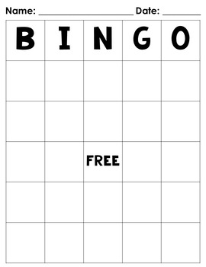
Unit 1 Vocab Bingo Board Directions
Use Unit 1 Vocabulary
Index Cards & News Letters
Class Website www.Voliverushistory.weebly.com
TEAMS
Create 2 Bingo Boards using the 5x5 Grid
Board 1 Vocab words
Board 2 Definitions

Slide 3
Type Here
Type Here
Type Here
Type Here
Type Here
Type Here
Type Here
Type Here
Type Here
Type Here
Type Here
Type Here
Type Here
Type Here
Type Here
Type Here
Type Here
Type Here
Type Here
Type Here
Type Here
Type Here
Type Here
Type Here
Type Here

Slide 4
Type Here
Type Here
Type Here
Type Here
Type Here
Type Here
Type Here
Type Here
Type Here
Type Here
Type Here
Type Here
Type Here
Type Here
Type Here
Type Here
Type Here
Type Here
Type Here
Type Here
Type Here
Type Here
Type Here
Type Here
Type Here

