Slide 1
Cold War Gallery # 8
Vietnam War
After the Second World War, France attempted to re-establish control over Vietnam. The French and the North Vietnamese led by Ho Chi Minh fought until 1954 when the French were forced to surrender. Members of the U.S, the Soviet Union, Great Britain and France met to decide the fate of Vietnam. After much negotiation the following was agreed:
(1) Vietnam would be divided at the 17th parallel;
(2) North Vietnam would be ruled by Ho Chi Minh; communist
(3) South Vietnam would be ruled by Ngo Dinh Diem, democrat
The split of Vietnam was necessary because the U.S saw Asia as a domino theory; if one country were to fall to communism all Asian countries could fall. The US stood behind Diem but in November 1963, Diem was overthrown and killed. Ho Chi Minh and the North were now pressing the South into changing to a communist government. Minh supported the National Front of Liberation (NLF) or Viet Cong, and the United States did not want the NLF supported at all because of their terrorist activities.

Slide 2
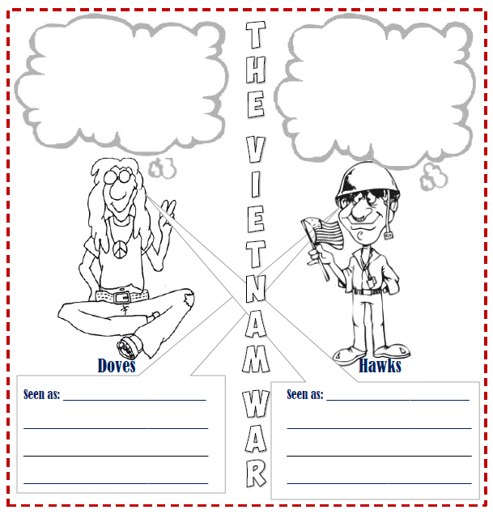
VIETNAM WAR
https://www.youtube.com/watch?v=25cmARm05qs

Slide 3
Gulf Of Tonkin Resolution
In the Gulf of Tonkin, the U.S was to send destroyers into North Vietnamese waters to obtain information on their naval defenses. On August 2, 1964, a US destroyer was fired upon in the Gulf of Tonkin. In retaliation, the U.S fired back and the conflict began.
Lyndon Johnson ordered the bombing of North Vietnamese torpedo-boat bases and oil-storage depots. The United States started to organize troops to send into Vietnam. On March 8, 1965 troops began arriving. The war was long a dragged out for many years. The U.S people hated the war and did a lot to try to stop the war. The United States was tired of fighting the war and eventually called it quits. The U.S could no longer help the South Vietnamese and left the war.
The NLF arrived in Saigon on April 30, 1975. After declaring that Vietnam was now a united country, Saigon was renamed Ho Chi Minh City. The Socialist Republic of Vietnam was established in July 1976. Communist governments were also set-up in Laos and Cambodia.
https://youtu.be/crALHjTiXbk

Slide 4
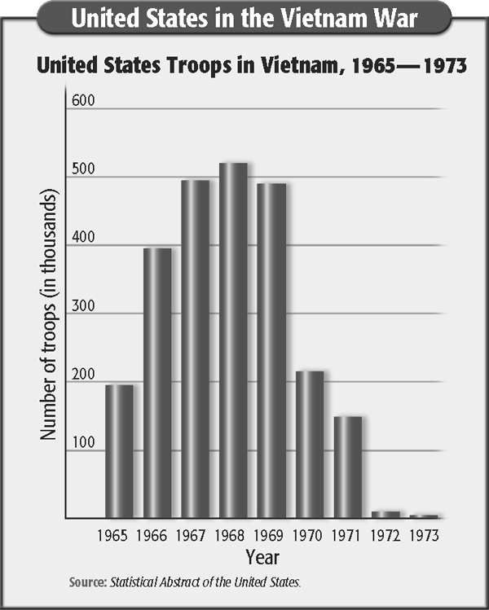
The Tet offensive
https://youtu.be/ezuFR5OwHU8
The Tet offensive caused more opposition to the war and to President Johnson by Americans at home. Americans and South Vietnamese may have won the battle, but they were losing support in the United States. Television played an important role during the Vietnam years. People at home watched in horror as images of Vietcong guerrillas killing Americans in the United States embassy flashed across the screen. The Johnson administration was openly criticized in newspapers and magazines for handling the war poorly. Most Americans believed that America was losing the war. The Johnson administration faced a credibility gap. Few people believed anything the administration said about the war.
Between 1961 and 1975 an estimated 10% of the people living in Vietnam, Cambodia and Laos had died. In the same period, 56,869 US troops were killed and another 153,329 were seriously wounded. The long-term psychological damage to the three million soldiers who fought in Vietnam and the resulting social problems are still being counted

Slide 5
The Media and the War
https://youtu.be/QAT1KA3Xjbs
Johnson was also losing the support of his political party. Eugene McCarthy, a Democratic senator from Minnesota, announced his candidacy for the Democratic Party’s presidential nomination in late 1967. He did so in protest of the war. He surprised many people by taking 42 percent of the popular vote in the New Hampshire primary in March. He was not well-known, so people believed he had very little chance of winning the nomination. Johnson won the primary, but McCarthy’s results showed that people were against the war in Vietnam. Robert F. Kennedy, the brother of President John F. Kennedy, also announced his candidacy for president. Robert Kennedy was a Democratic senator from New York and had served as attorney general when his brother was president.
General William Westmoreland, the American commander in Vietnam, asked for additional troops after the Tet offensive. President Johnson and his advisers thought about the opposition to the war and the upcoming election. Johnson decided not to run for reelection. On television, Johnson announced a new plan for peace in Vietnam. He decided to stop the bombing in North Vietnam. He asked the North Vietnamese to stop the attacks and begin discussions to end the war in Vietnam.

