Slide 1
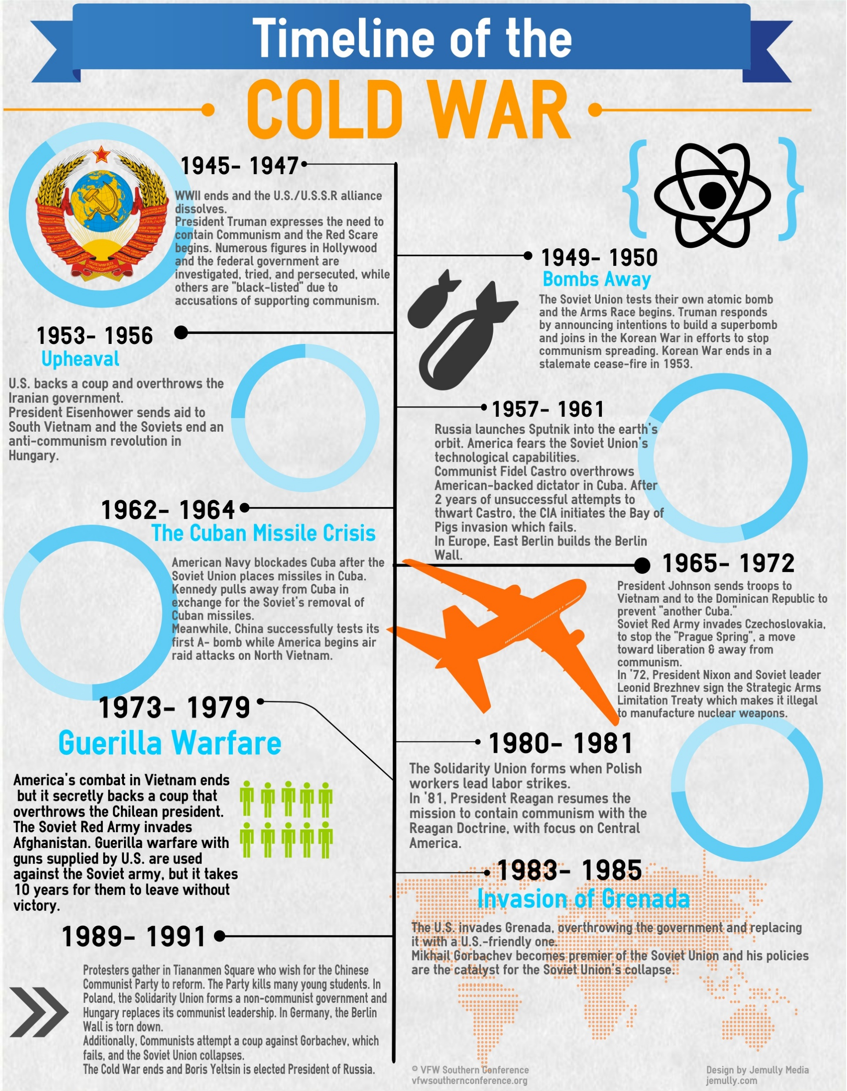

Slide 2
Cold War Gallery # 7
Arms Race
http://en.wikipedia.org/wiki/U-2_Crisis_of_1960
Each side in the Cold War armed itself to withstand an attack by the other. At first, the United States, which had the atomic bomb, held an advantage. But Stalin’s top scientists were under orders to develop an atomic bomb. When they succeeded in 1949, the arms race was now on.
For four decades, the superpowers spent billions of dollars to develop new, more deadly nuclear and conventional weapons. As the money spent on new military equipment and new ways of using these weapons, the global powers were now in a state of global terror.

Slide 3
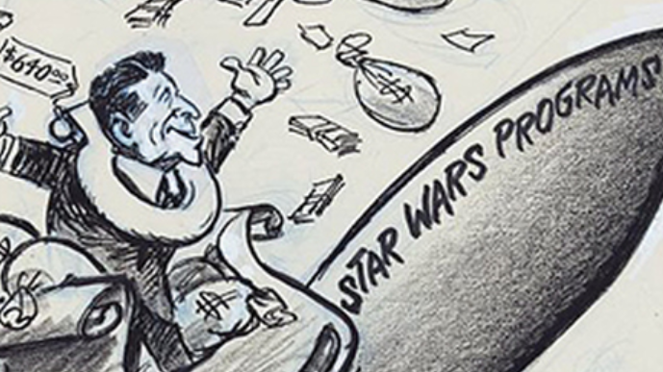
Space Race
https://www.youtube.com/watch?v=xvaEvCNZymo
World War II proved to be a conflict in which the world's technological abilities were put to the test. Following the conclusion of this conflict, the United States and the USSR began doing long-range missile testing. As a result of this, Sputnik was launched. The launch of Sputnik proved to be a significant victory for the Soviets during the Space Race. In 1958, the United States put a satellite in orbit. Several years later, John F. Kennedy set a goal of landing a man on the moon and returning him safely to the earth. On July 20, 1969, Neil Armstrong took mankind's first steps on another heavenly body. In the following two and a half years, twelve American men would set foot on the moon. Not only did these landings represent a US victory over the Soviets, but also a technological triumph that proved to the US and the rest of the world that anything was possible with technology
Star Wars
By the 1980's both the U.S. and the U.S.S.R. were mostly done with stockpiling weapons. One plan of action was the Strategic Defense Initiative (SDI) or “Star Wars”. This plan was to have several laser satellites orbit the planet that could shoot down any missiles launched at the US. The United States pooled billions of dollars into this project, and the Soviets followed suit. However, the project proved impossible. Both the United States and Soviet governments lost billions, resulting in economic recessions for each. However, with the US's superior economy, it was able to escape the recession virtually unscathed. The U.S.S.R. could not pull out of this economic slump, and the nation collapsed.
http://www.history.com/topics/space-race/videos/the-space-race

