Slide 1
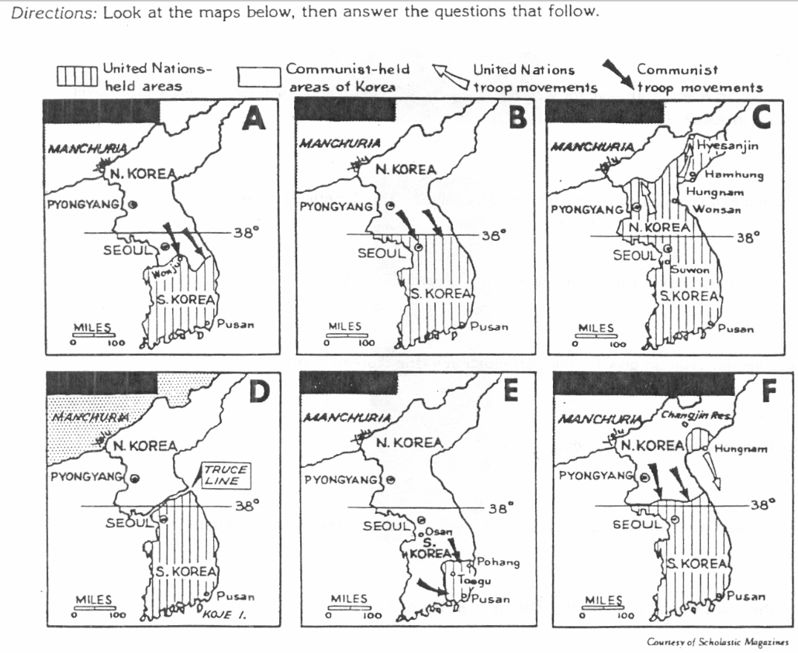
Cold War Gallery # 6
Korean War
At the end of World War II, Korea was divided at the 38th parallel into Soviet (North Korean) and U.S. (South Korean) zones of occupation. On June 25, 1950, North Korean forces invaded South Korea. The North Koreans wanted to unify all of Korea under communism. On June 27, U.S. President Truman authorized the use of American land, sea, and air forces in Korea.
This war was fought for a little over three years but after much difficulty and nuclear threats by Eisenhower, an armistice agreement was signed on July 27, 1953. Casualties in the war were heavy. U.S. losses were placed at over 54,000 dead and 103,000 wounded, while Chinese and Korean casualties were each at least 10 times as high.
https://youtu.be/yxaegqvl4aE

Slide 2
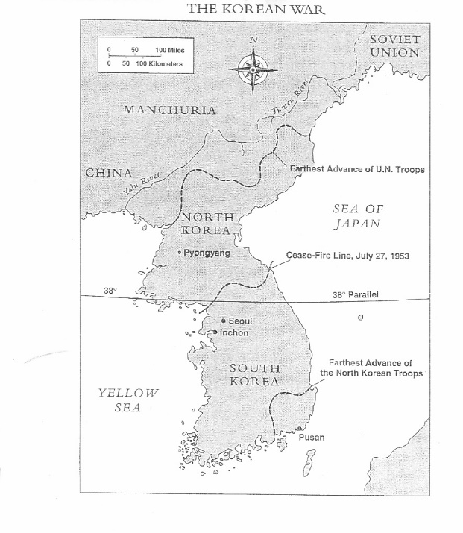
Invasion ; On June 25, 1950, the North Korean army surprised the world, even possibly Moscow, by invading South Korea. Truman took immediate action, applying his containment policy to this latest crisis in Asia. He called for a special session of the U.N. Security Council. Taking advantage of a temporary boycott by the Soviet delegation, the Security Council under U.S. leadership authorized a U.N. force to defend South Korea against the invaders. Although other nations participated in this force, U.S. troops made up most of the U.N. forces sent to help the South Korean army. Commanding the expedition was General Douglas MacArthur. Congress supported the use of U.S. troops in the Korean crisis but failed to declare war, accepting Truman's characterization of U.S. intervention as merely a "police action.
Counterattack : At first the war in Korea went badly, as the North Koreans pushed the combined South Korean and American forces to the tip of the peninsula. However, General MacArthur reversed the war by a brilliant amphibious assault at Inchon behind the North Korean lines. U.N. forces then proceeded to destroy much of the North Korean army, advancing northward almost as far the Chinese border. MacArthur failed to heed China's warnings that it would resist threats to its security. In November 1950, masses of Chinese troops crossed the border into Korea, overwhelmed U.N. forces in one of the worst defeats in U.S. military history, and drove them out of North Korea.
Armistice : In Korea, the war was stalemated along a front just north of the 38th parallel. At Panmunjom, peace talks began in July 1951. The police action dragged on for another two years, however, until an armistice was finally signed in 1953 during the first year of Eisenhower's presidency. Before the fighting ended, more than 54,000 Americans had died in Korea.
Political consequences : From the perspective of the grand strategy of the Cold War, Truman's containment policy in Korea worked. It stopped Communist aggression without allowing the conflict to develop into a world war. The Truman administration used the Korean War as justification for dramatically expanding the military, funding a new jet bomber (the B-52), and stationing more U.S. troops in overseas bases. The Republicans, however, were far from satisfied. In fact, the stalemate in Korea and the loss of China provided Republican politicians with plenty of material to characterize Truman and the Democrats as "soft on communism."

