Slide 1
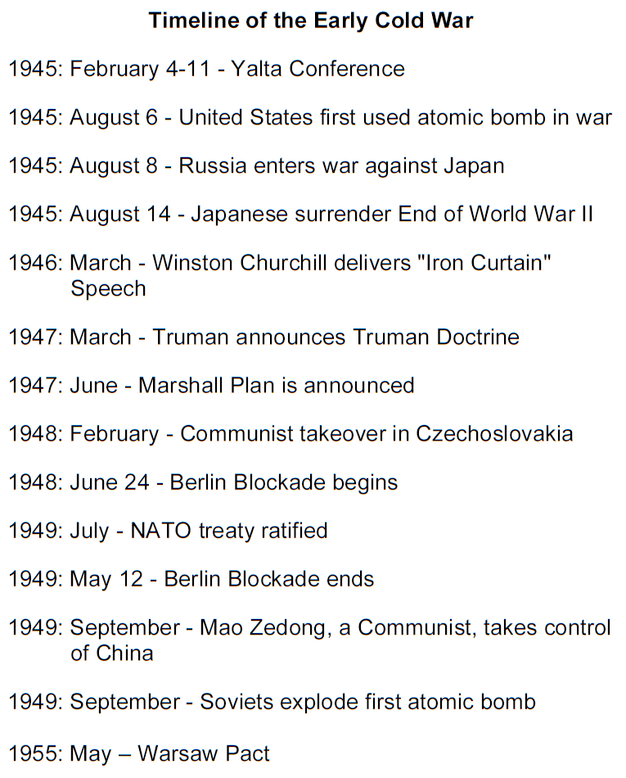

Slide 2
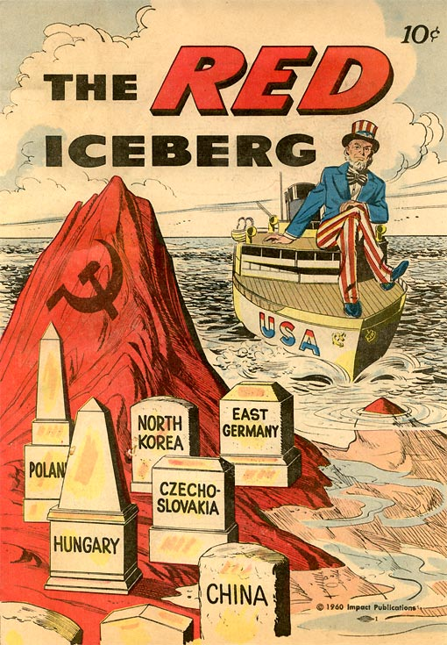
Cold War Gallery # 5
In the 1940s and '50s, the Cold War was fought through fear and persecution on both sides of the globe. In the United States, anti-communism became harsh. A politician named Joseph McCarthy led a campaign against Communist rebellion in the early 1950s. He accused many people of being communists, but his accusations were never validated. His accusations made many people believe that the U.S was full of communists. He ruined many careers because of his allegations but none of them were proven. He did however scare the people of the U.S into thinking that many people were communist sympathizers.
Cold War Fears :
During the Cold War, Americans were afraid of communist sabotage, or subversion. In the late 1940s, this fear was fueled by stories of stolen papers and spies. Anti- Communist feelings became stronger after the Soviets invented an atomic bomb in 1949. Americans were afraid that Communist spies were trying to weaken the government. This fear was called the Red Scare.
Many politicians accused others of being disloyal to the United States. They tried to uncover Communists in America. Political parties accused each other of being unpatriotic. Truman was accused by the Republicans of being too easy on the Communists. Truman ordered an investigation of the backgrounds of all federal workers. The FBI investigations and security checks uncovered little evidence of spying, or espionage. The investigation resulted in many lost jobs, however.
Other groups and organizations joined the hunt for Communists. Some required workers to sign loyalty oaths to the United States. The McCarren Act of 1950 required all Communist organizations to register with the government and provide a membership list. Congress overrode Truman’s veto of the act. Truman opposed punishing peoples’ opinions rather than their behavior.

Slide 3
The House Un-American Activities Committee (HUAC)
The Rosenberg’s
The Rosenberg case was a lengthy and controversial espionage case in U.S. history. In 1950, the FBI arrested Julius Rosenberg and his wife Ethel they were indicted for conspiracy to transmit classified military information to the Soviet Union. Both Julius and Ethel Rosenberg were found guilty and received the death sentence. The Rosenberg’s were executed on June 19, 1953. They became the first U.S. civilians to suffer the death penalty and although some were sympathetic to the Rosenberg’s this case helped focus attention on a possible internal communist threat.
The House Un-American Activities Committee (HUAC) held publicized hearings. They continued to investigate subversive communist activities. There was anti-Communist hysteria in the United States. The Hollywood film industry was a famous target of the HUAC. Many people in the film industry refused to testify at the hearings. They did not believe the government had the right to ask questions about their political beliefs or colleagues. The “Hollywood Ten” went to jail for refusing to answer questions about their political opinions. Hollywood kept lists of people suspected of being disloyal to the United States. These blacklists prevented people from getting jobs in Hollywood.
Whitaker Chambers admitted to selling secrets to the Soviet Union in the 1930s. He said that a former State Department official, Alger Hiss, gave him secret government documents in 1937 and 1938. Hiss denied the charges. Hiss was sent to prison for perjury, or lying under oath. Julius and Ethel Rosenberg, members of the Communist Party, were convicted of planning to give the Soviets secret information about the atomic bomb. They were executed in 1953. They proclaimed their innocence to the end.

