Slide 1
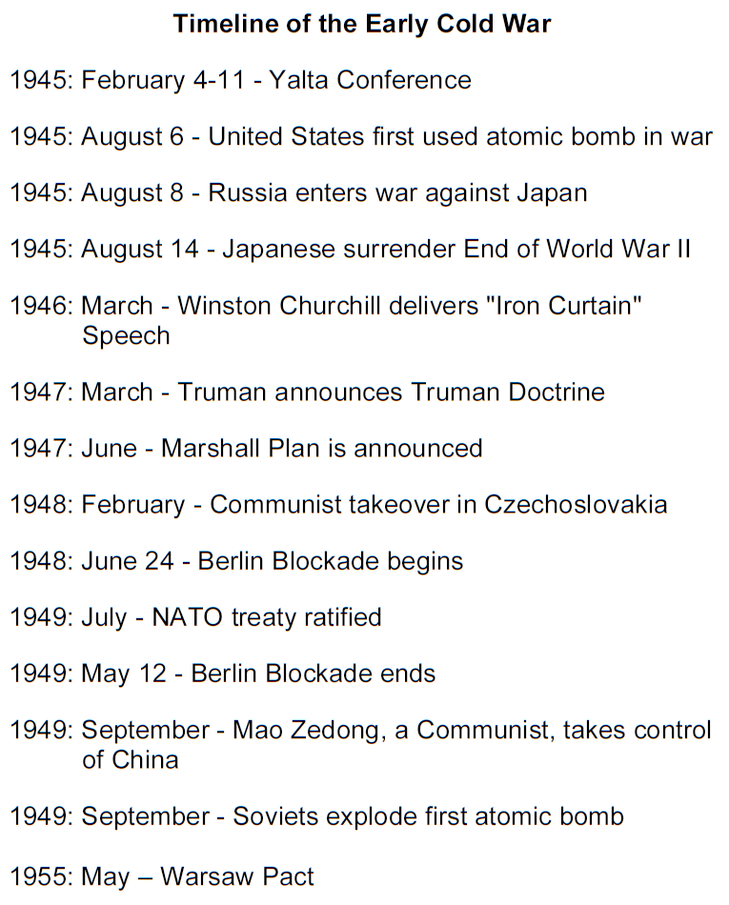

Slide 2
Cold War Gallery # 4
Division in Germany
Berlin Airlift
After World War II Germany became another focus of the Cold War. Germany was split into four parts. The Soviet Union controlled the East, which included Berlin. The other parts were given to France, Great Britain and the U.S. The Western democracies put their three parts together as one united part. The Russians forced Germans in the east to dismantle factories and other resources. The western democracies however united their zones and encouraged the Germans to rebuild industries. Germany was therefore divided.
Stalin’s resentment at western moves to rebuild Germany prompted a crisis over Berlin. All four Allies occupied the former capital even though it lay in the Soviet zone. In 1948, Stalin tried to force the Allies out of Berlin by sealing off all railroads and highways into the western sector of Berlin. The western powers responded with around-the-clock airlifts. For almost a year cargo planes supplied West Berliners food and fuel. The success of the airlift forced the Soviets to stop the blockade.

Slide 3
Nikita Khrushchev the Premier of Russia, issued an ultimatum to the three western powers, giving them six months to turn West Berlin into a “demilitarized free city ", if they did not he would sign a separate peace treaty with East Germany. The border between East and West Berlin is opened and daily half a million people cross the border from one part of the city into the other. The leaders of the Communist parties decide to close the open border between East and West Berlin.
In the afternoon of August 12 at 4 p.m. they closed the border. The next Sunday at midnight the army, police began to wall the city. The wall was entirely for domestic use, being designed not to stop people getting in but to prevent them getting out. The wall took more than 28 years to build.
Berlin Wall
https://youtu.be/naqS-BlpfU4

