Slide 1
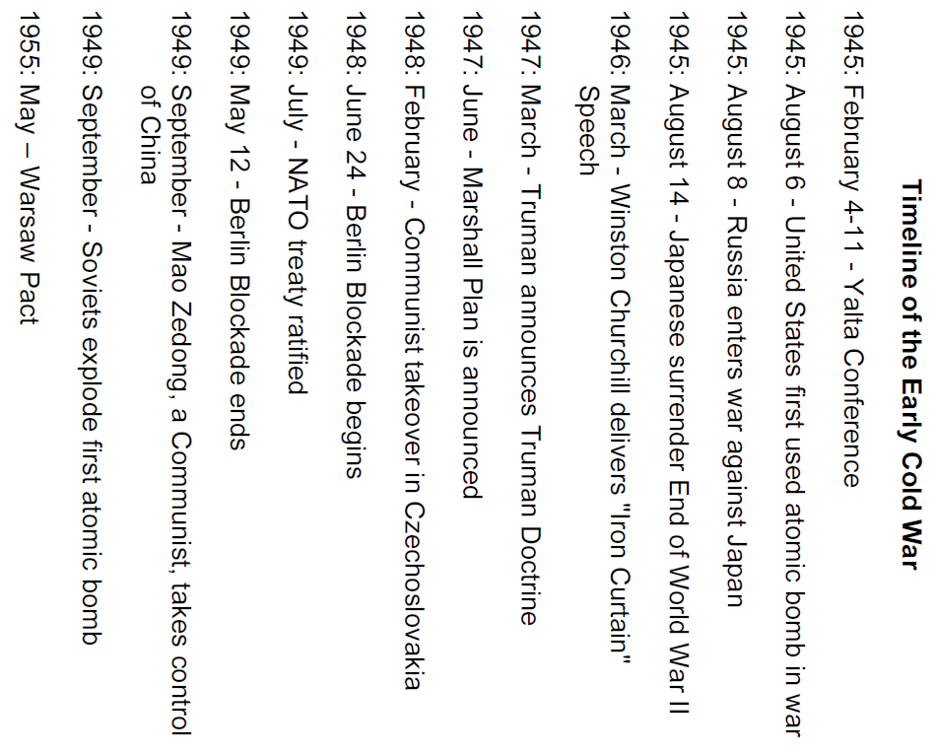

Slide 2
Cold War Gallery 1
The Crumbling Alliance
Origins of the Cold War
Stalin wanted to spread Communism into Eastern Europe. He also wanted to create a buffer zone as a defense against Germany. Stalin was always worried about Germany’s military power. Russia has had a history of being attacked from the east, and at the end of World War II Russian soldiers forced Germany out of the east. By doing this Stalin was leaving behind occupying forces.
Roosevelt and Churchill did not agree to this and made him promise that “free elections” would take place in Eastern Europe. Stalin ignored this request and installed Communist governments in Poland, Czechoslovakia and other Eastern European countries. By 1946, almost all of Eastern Europe was under Stalin’s control.
After World War II two powers, the United States and the Soviet Union became the world superpowers. These two countries had the economic resources and military force to dominate the globe.
During the war, the Soviet Union and the west had cooperated to defeat Nazi Germany. By 1945 this wartime alliance was crumbling. Conflicting ideologies and mutual distrust divided the Allies and would lead to a state of tension and hostility among nations without armed conflict also called a Cold War.

Slide 3
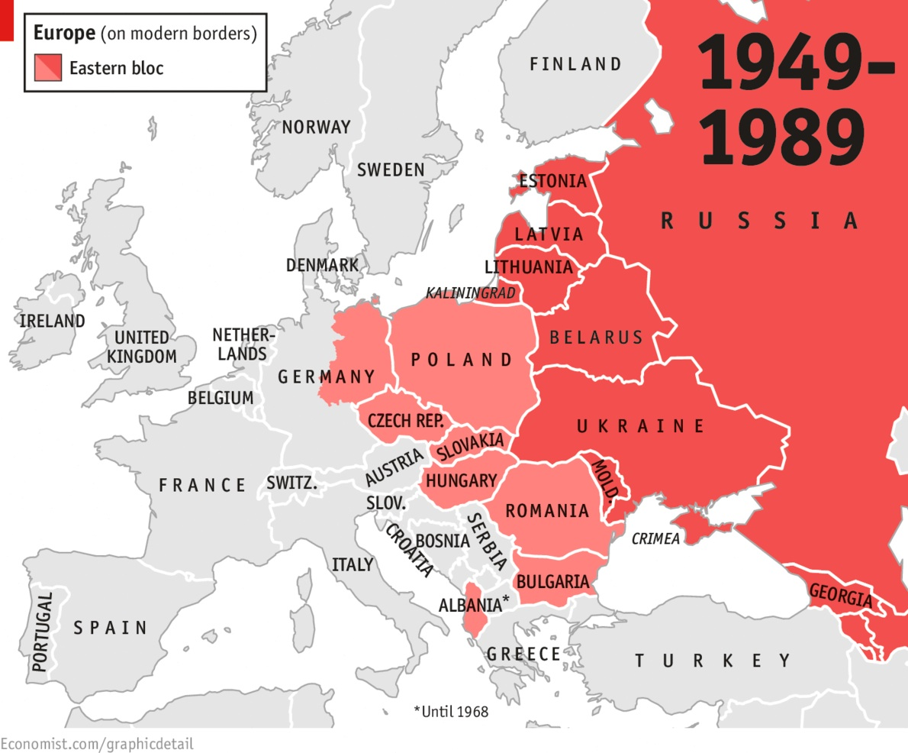
Cold War Gallery 1
The Cold War Heats Up
Winston Churchill had long distrusted Stalin. Early in 1946, on a visit to the United States, he warned of the new danger facing the world, and that was Stalin and his communist allies. Churchill’s “iron curtain” of soviet satellites became a symbol of the Cold War. It expressed the growing fear of Communism. More important it described the division of Europe into an “eastern” and “western” bloc. In the East were the Soviet-dominated, communist countries of Eastern Europe. In the West were the western democracies, led by the United States.

