Slide 1
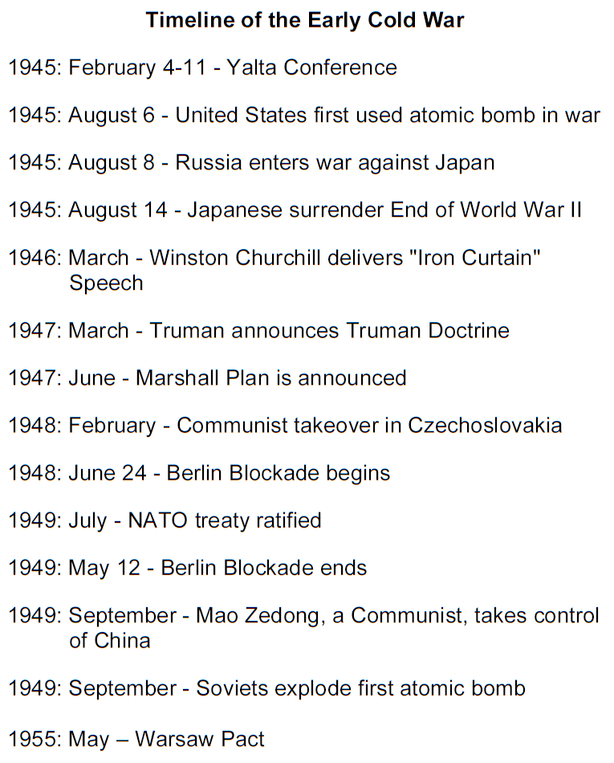

Slide 2
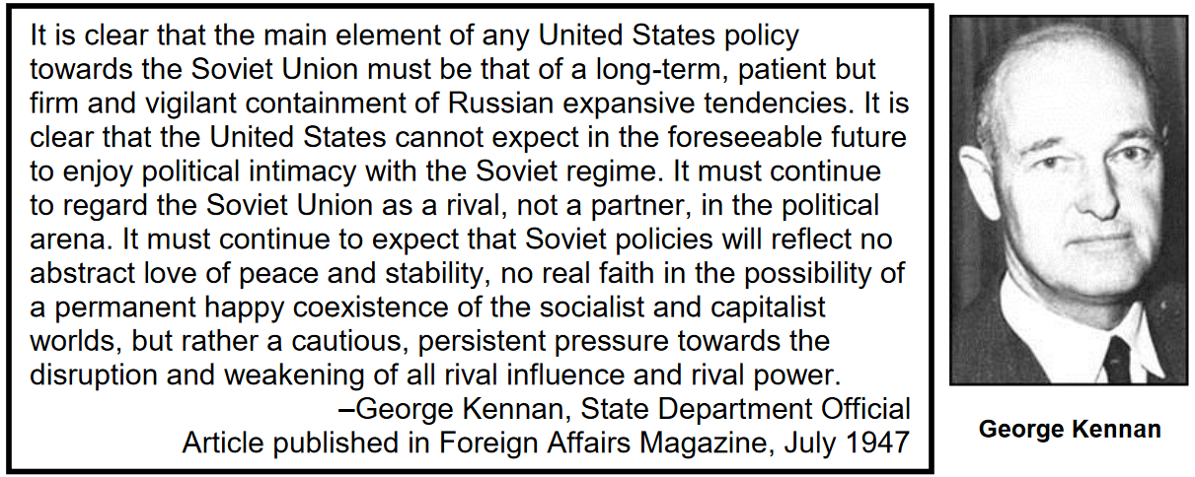
Cold War Gallery 2
President Truman saw communism as an evil force threatening countries around the world. To deal with the threat of communism, the U.S abandoned its policy of isolationism. Unlike WWI where the U.S withdrew from global affairs, the Cold War put the U.S in the leading role on the world stage. On March 12, 1947, Truman outlined the Truman Doctrine
“I believe that it must be the policy of the United States to support free people who are resisting attempted subjugation by armed minorities or by outside pressures…The free peoples of the world look to us for support in maintaining their freedom.”
This document made it clear that the United States would resist Soviet expansion in Europe or elsewhere in the world. Truman sent military and economic aid to the countries that the Soviet Union was pressuring into joining them. Truman also came up with the idea of containment, which limited communism to the areas already under Soviet control.
Containment

Slide 3
