Slide 1
SS Grade 7 Name: _________________________ Period:
MODULE: Unit 5- Revolution
Objective: What were the political, Economic, and social causes to the American Revolution?
Table of Contents
Date | Topic(s) | Page Numbers
Days 1 - 3 | French and Indian War | 2 - 10
Days 4 - 8 | American Grievances | 11-12
Days 9-11 | Boston Massacre | 13 - 23
Days 12-13 | Boston Tea Party | 24-25
Days 14 - 16 | Battle Lexington & Concord | 26
Day 17 - 19 | Advantages & Disadvantages | 28 – 33
Day 20 - 21 | Battles Time Line | 34 - 36

Slide 2
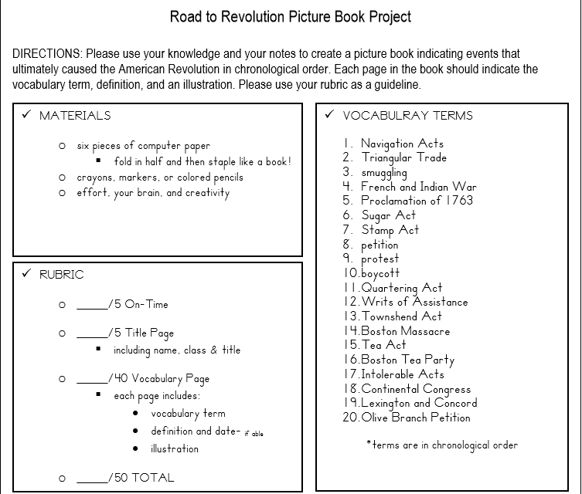

Unit 5 Objective 3: What were the political, Economic, and social causes to the American Revolution?

Slide 3
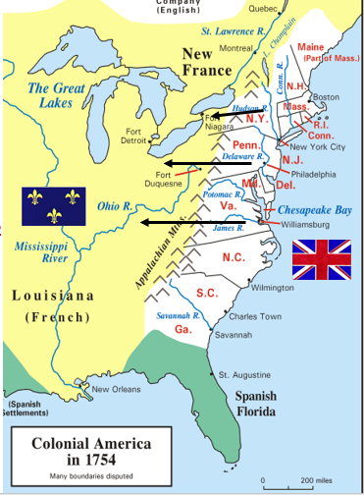
I. FRENCH AND INDIAN WAR:
1754-1763
The English wanted to push _____________________ but the French blocked them.
The war started over _____________ __________________ between the two nations.
Each side used ________________ ___________________ to help fight the war.
British-French Rivalry
The British and French had been rivals for centuries. As the British moved closer to French-held territories in North America, tensions between the British and French colonists increased. The French did not want British land companies or colonists to share in the profits of their fur trade in the Ohio River valley. In the 1740s, British fur traders built a fort at Pickawillany in Ohio country. The French attacked them and drove them out.
The French then built forts along the rivers in the upper Ohio Valley, close to the British colonies. The French also attacked Nova Scotia in present-day Canada, which was controlled by Great Britain. New Englanders captured the French fortress, Louisbourg, on Cape Breton Island north of Nova Scotia, but Britain later returned it to France.
Unit 5 Objective 1: How did the rivalry of Britain and France lead to war in North America?
CRQ: Why did the French not want westward expansion past the Appalachian Mountains? TTQA ____________________________________________________________________________________________________________________________________________________________________________________________________________________________________________________________________

Slide 4
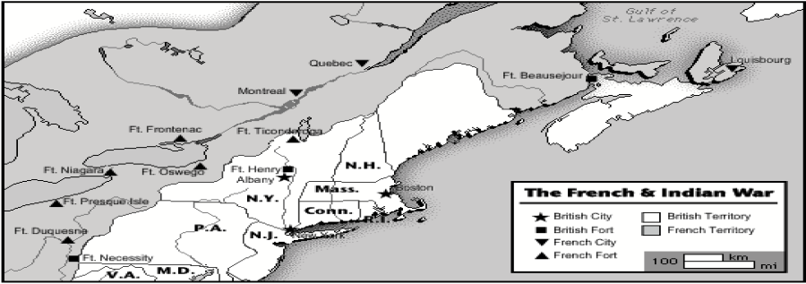
I. FRENCH AND INDIAN WAR:
What British Fort protected Albany, New York from Attack?
How many French Forts were located on Great Lakes?
British soldiers sailed from Boston to Ft. Beausejour. About how many miles did they travel?
According to this map, which French Fort was built inside British controlled territory?
The English & English Colonists… | The French & French colonists…
Want to use your land for fur trading and farming Think that Native Americans are “savages” Want to expand their territory further to the West Have a steadily growing population in America | Want to use your land for fur trading Have married Native Americans and raised families with them in America Have many missionaries living in the west that try to convert Native Americans to Christianity Have a relatively small population in America
Which side will you choose?
In the 1750s war was about to break out between the French and the English, and Native American tribes were faced with a tough choice. Which side would they choose? ________________________________________________________________________________________________________________________________________________________________________________________________________________________________________________________________________________

Slide 5
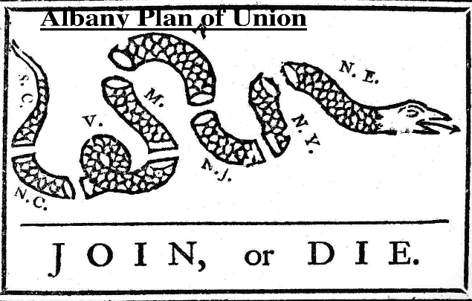
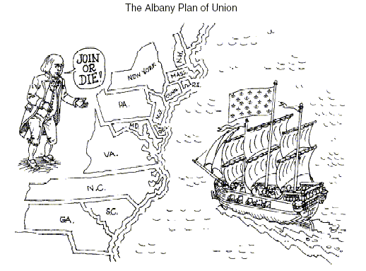
2. British Colonies Prepare for War:
Albany Plan (1754):
Ben Franklin’s plan to ___________ _____ ________ _____ ____________ _____________ __ ______________________
(join or die).
Wanted to form ____ ____________ __________ to defend against the French.
Result: The plan was ______ ________________ by the ____________ ___________________: they feared the _____ ________________ would be _____ ______________ for Parliament to control.
Delegates from New England, New York, Pennsylvania, and Maryland met in Albany, New York, to discuss the threat of war and plan their defense. They also wanted to sway the Iroquois to become their allies against the French. Benjamin Franklin’s plan, called the Albany Plan of Union, was adopted by the delegates. It called for a general government for the American colonies. It further proposed an elected legislature with the power to collect taxes, establish an army, and regulate trade. None of the colonies approved the plan or united to fight the French. A series of battles and a war followed, called the French and Indian War. The British were fighting the French and their Native American allies.
CRQ: What was the goal of the Albany Plan of Union? TTQA _____________________________________________________________________________________________________________________________________________________________________________________________________________________________________________________________________________________________
Unit 5 Objective 1: How did the rivalry of Britain and France lead to war in North America?

Slide 6
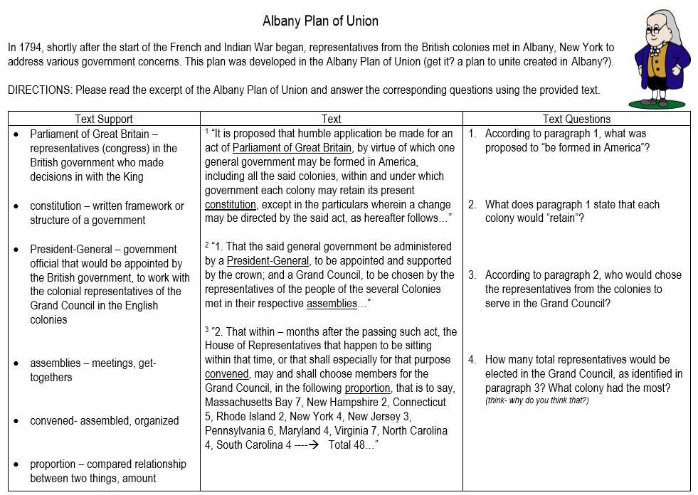
HW
Unit 5 Objective 1: How did the rivalry of Britain and France lead to war in North America?

Slide 7
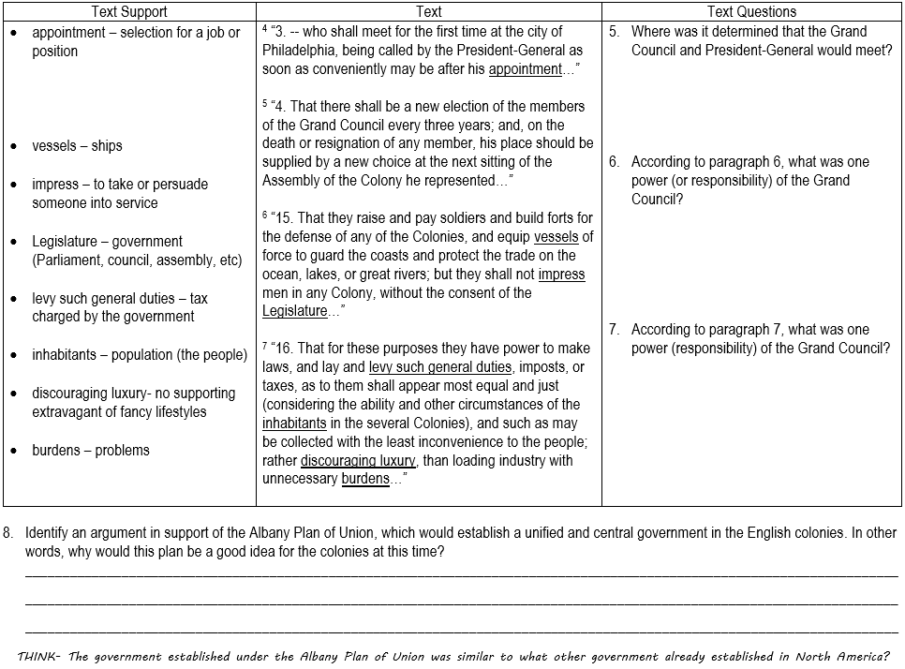

Slide 8
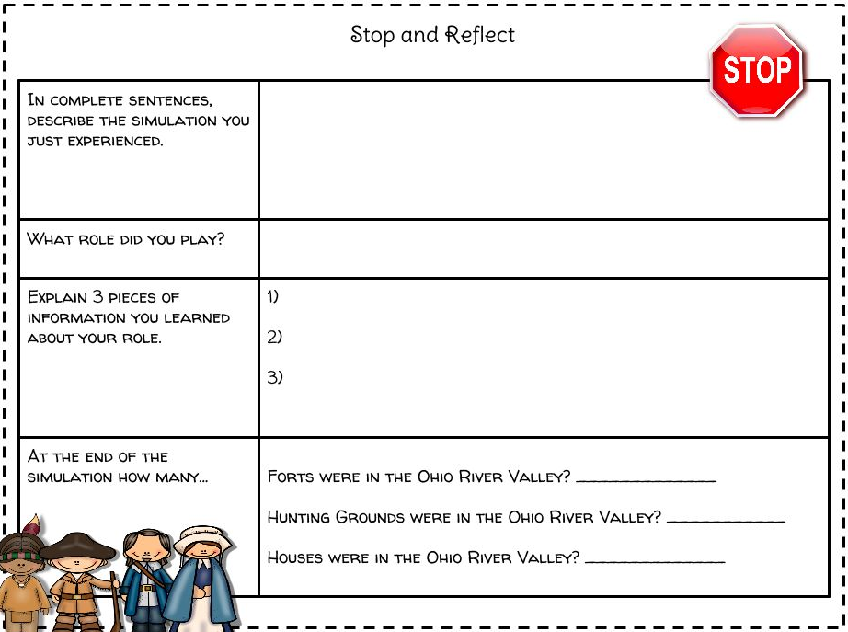
Unit 5 Objective 1: How did the rivalry of Britain and France lead to war in North America?

Slide 9
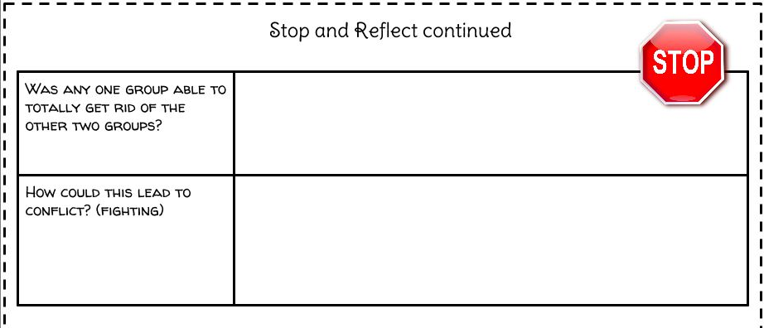
Unit 5 Objective 1: How did the rivalry of Britain and France lead to war in North America?
French fur traders and British colonists needed Native American allies to help them establish control of North America. The French had better relations with Native Americans because they did not try to take Native American land or change their way of life. Native Americans helped the French in the wars between Great Britain and France by raiding British settlements.
The Iroquois Confederacy, the most powerful group of Native Americans in the East, was a union of many different groups of Native Americans. They traded with both the British and French and dominated the Great Lakes region. When the British moved into the Ohio Valley, the Iroquois Confederacy became their allies and gave them trading rights. As a result, the British had more power than the French.
CRQ 1. Why was the Ohio Valley important to both the French and the British? ____________________________________________________________________________________________________________________________________________________________________________________________________________________________________________________________________________________________________________

Slide 10
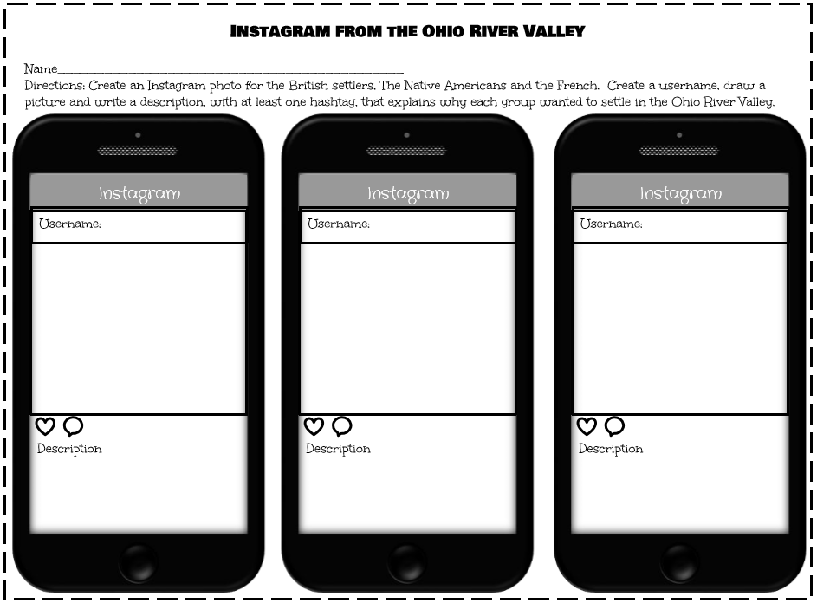

Slide 11
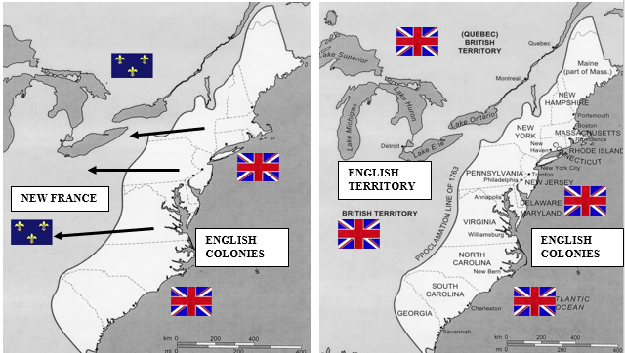
3. British Colonies win the War:
North America: 1750’s
England and France had colonies.
English colonists wanted to push west.
The French blocked them.
North America: 1765
The British wins the war and gains control of the French colonies.
War was very expensive for the British.
Treaty of Paris (1763):
Britain won _____________ & _______________________
France ________ their __________ ________________empire.
Britain became the ________ __________________country in the world.
Proclamation Line of (1763):
The British agreed _______________ would remain ___________ of the _______________ __________________
Many colonists ignored the law and moved west.
1. The Proclamation Line of 1763 shown on this map separated what two groups of people? ____________________________________________________________________________________________________________________________________________________________
Who created the Proclamation Line of 1763? ________________________________________________________
3. What was the purpose of the Proclamation Line of 1763?
____________________________________________________________________________________________________________________________________________________________
Unit 5 Objective 2: How did the French and Indian War affect the British colonies?

Slide 12
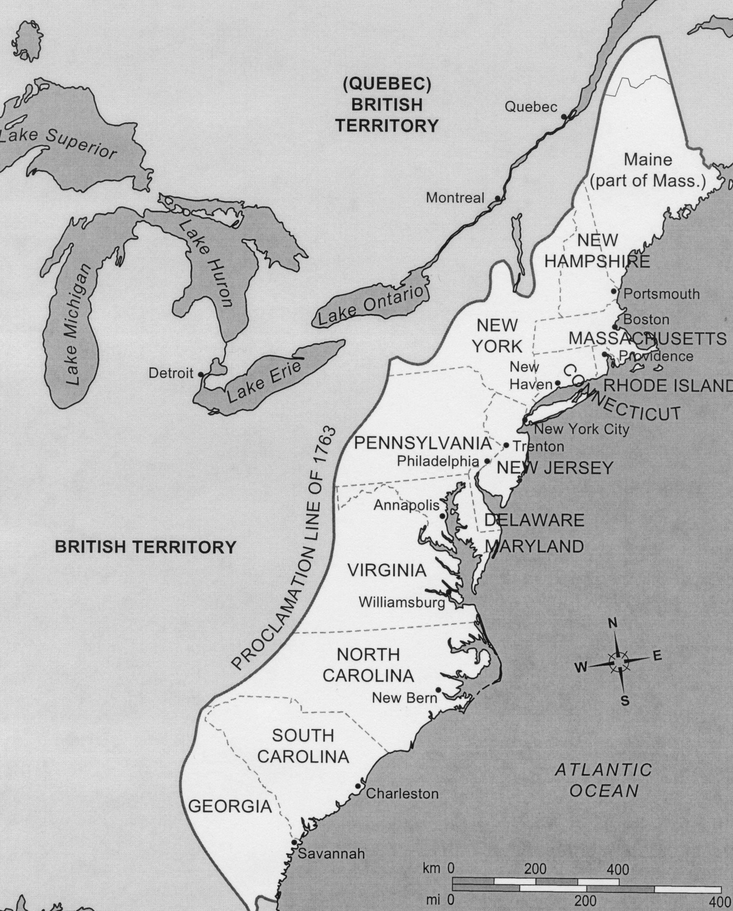
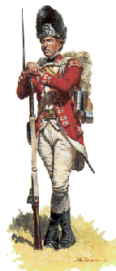
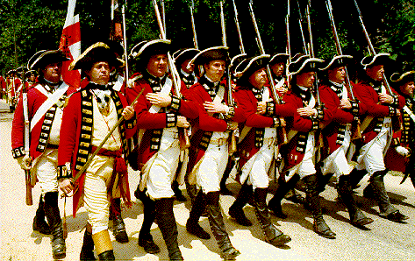
4. BRITISH GOVERNMENT PASSES LAWS AND TAXES ON THE COLONIES
Proclamation Line of 1763: Colonists could not cross line and move into Indian land. 10,000 soldiers sent to colonies to enforce the law. Colonists hated England for doing this. Many colonists ignore the law and move into new lands.
The French & Indian War doubled the British national debt.
Results:
Britain decided to ___________ __________ ________________ ____________________ to help _______________ ______ ____________.
British Parliament passed a series of ______________ on products sold in the colonies.
Proclamation Line
The Stamp Act : In 1765 Parliament passed the Stamp Act, a law that taxed almost all printed material in the colonies. Colonists united against the British for taxing them directly without the consent of the colonial legislatures. Patrick Henry persuaded members of the Virginia House of Burgesses to pass a resolution, or formal opinion, which stated that only they could levy taxes on their citizens.
Samuel Adams and the Sons of Liberty protested the Stamp Act in Boston by burning effigies, life-size rag figures representing the hated tax collectors. They marched through the streets and raided and destroyed the homes of royal officials. Colonists refused to use the stamps. They boycotted, or refused to buy or use, imported British or European goods and signed nonimportation agreements pledging not to use goods from Britain.
Unit 5 Objective 3: What were the political, Economic, and social causes to the American Revolution?
CRQ 1: How did the colonists protest the Stamp Act? TTQA ____________________________________________________________________________________________________________________________________________________________________________________________________________________________________________________________________________________________________________
CRQ 2: What were effigies used to represent? TTQA ____________________________________________________________________________________________________________________________________________________________________________________________________________________________________________________________________________________________________________

Slide 13
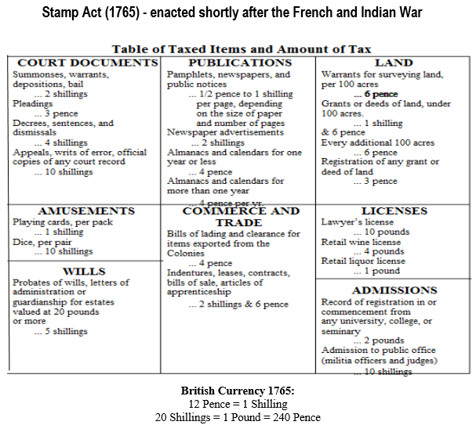
4. BRITISH GOVERNMENT PASSES LAWS AND TAXES ON THE COLONIES
CRQ 1: What historical circumstances led to the enactment of the Stamp Act? TTQA
________________________________________________________________________________________________________________________________________________________________________________________________________________________________________________
Unit 5 Objective 3: What were the political, Economic, and social causes to the American Revolution?

Slide 14
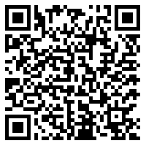


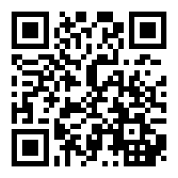
https://www.brainpop.com/socialstudies/ushistory/causesoftheamericanrevolution/
5. AMERICAN COLONISTS TAKE ACTION:
Colonists very angry over new taxes and laws.
Colonists felt that ____________________________ and the king did not have the right to _____________ the colonists without colonial representation.
“NO ___________________ WITHOUT _____________________”
.
Unit 5 Objective 3: What were the political, Economic, and social causes to the American Revolution?
Directions: Using the Thing Link Complete the Grievances | ________________ colonists must house British troops | __________________ British punished the colonists and placed military rule over Boston, Massachusetts | ____________________ placed a tax on sugar goods | ___________________ no paper money
 | ____________________ import tax on tea arriving in colonies | __________________ no trading with other countries | _____________________ No search warrant needed | _____________________ Necessary items from England were directly taxed at ports. (ex: lead, glass, cloth)
https://www.thinglink.com/scene/1281215051243454465

Slide 15
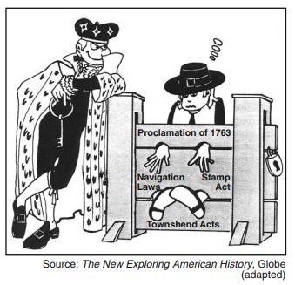
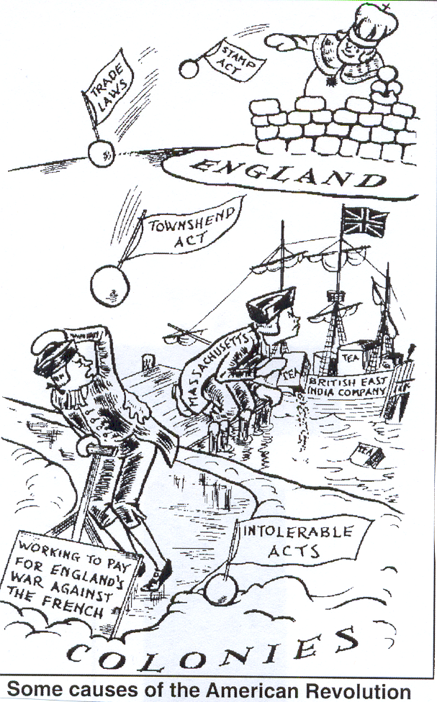
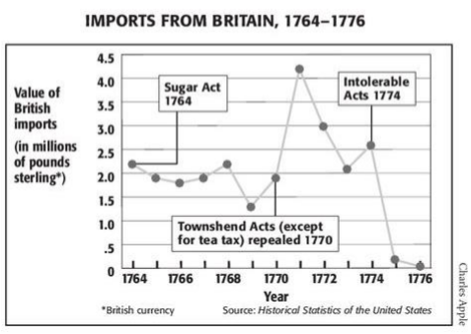
According to the political cartoon, what was the historical impact of the British taxation?
  The colonists were restricted by the laws passed by the British government.
  The King of England wanted the colonists to have a greater voice in government.
  King George III put many American colonists in stocks.
  Repeal of unpopular laws was the only way out of the stocks.
What historical circumstances caused the imports from Great Britain to the colonies decline?
When did the greatest increase in British imports occur? What historical circumstances caused the dramatic increase?

Slide 16
5. AMERICAN COLONISTS TAKE ACTION:
New Taxes : Parliament understood that the colonists wanted to govern themselves and decide on any taxes forced on the colonies. Hoping to avoid the kinds of problems caused by the Stamp Act, Parliament passed a new set of laws in 1767, known as the Townshend Acts. These acts taxed imported goods at the port of entry. The imported goods that were now taxed included basic items the colonists needed because they did not produce them.
At this point, colonists opposed any taxes enforced by Parliament. Once again, the colonists boycotted imported goods. Women organized groups called the Daughters of Liberty that supported the boycott of British goods. They began to make their own fabrics and other goods previously imported from Britain so they would not have to rely on Britain for anything.
CRQ 1: How did the colonists react to the Townshend Acts? ________________________________________________________________________________________________________________________________________________________________________________________________________________________________________________________________________________________________
Historical Circumstance
Colonists held the __________________
(October 1765) and boycotted British goods.
Historical Impact
Parliament ____________________
but replaced it with the
____________________ (1767)
that taxed glass, lead, paper, paint, and tea.
2. What was the major effect of the Stamp Act (1765) on colonial trade?
  The British refused to sell certain products to the colonists.
  The law led to a decline in the value of colonial currency.
  The colonists no longer needed British goods.
  Many colonists boycotted British goods.
Unit 5 Objective 3: What were the political, Economic, and social causes to the American Revolution?

Slide 17
5. AMERICAN COLONISTS TAKE ACTION:
Unit 5 Objective 3: What were the political, Economic, and social causes to the American Revolution?
Historical Circumstances
___________________ against corrupt customs officials and seizure of John Hancock’s boat Liberty.
Trouble in Boston Parliament sent British troops, known as redcoats, to Boston, worried that the colonists were planning a rebellion. The soldiers were rude and, at times, violent. This made the colonists even angrier. The people of Boston hated the redcoats.
A fight broke out between redcoats and townspeople. People from Boston marched toward the customhouse, picking up any weapons they could find, such as stones, sticks, and shovels. The soldier on duty called for help and seven soldiers responded.
The crowd screamed and threw things at the soldiers, daring them to fire their guns. When a soldier was knocked down, several shots were fired, killing five colonists, including Crispus Attucks, an African American who may have led the crowd. This event became known as the Boston Massacre.
CRQ1 : Why did the Boston Massacre occur? Cite Evidence ____________________________________________________________________________________________________________________________________________________________________________________________________________________________
Historical Impact
The governor __________________ the Massachusetts legislature and 4,000 British troops were sent to Boston.
6. BOSTON MASSACRE: March 5, 1770
Started as a _____________ against British government by colonists.
Colonists threw snowballs at soldiers and taunted them by calling them names.
Soldiers fired on crowd killing 5 colonists. Someone from the crowed yelled “fire.”
______________ _________________, member of the Sons of Liberty, wrote about the event and called it the “_______________ _______________.”

Slide 18
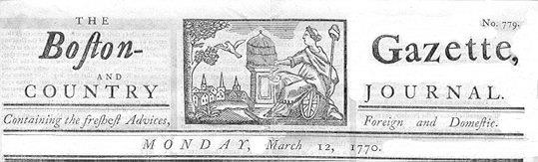
SET A) Document #1
Excerpt of Article from The Boston Gazette
Boston Colonists: Edward Archbald, William Merchant, Francis Archbald, John Leech, John Hicks, Samuel Atwood
On the evening of Monday, being the fifth current, several soldiers of the 29th Regiment were seen parading the streets with their drawn cutlasses and bayonets, abusing and wounding numbers of the inhabitants.
A few minutes after nine o'clock four [colonists], named Edward Archbald, William Merchant, Francis Archbald, and John Leech… [were walking through a] narrow alley leading to Murray's barrack (housing for soldiers) [where] a soldier brandishing a broad sword of an uncommon size against the walls…. A person of mean countenance (expression) armed with a large cudgel (club) [was in his] company. … the soldier turned round and struck E. Archbald on the arm, then pushed at Merchant and pierced through his clothes inside the arm close to the armpit and grazed the skin. Merchant then struck the soldier with a short stick he had; and the other [soldier] ran to the barrack and brought with him two soldiers, one armed with a pair of tongs (gripping tool), the other with a shovel. He with the tongs pursued Archbald back through the alley, collared (grabbed at the neck) and laid him over the head with the tongs.
The noise brought people together; and John Hicks, a young [colonist] coming up, knocked the soldier down but let him get up again; and more lads (men) gathering, drove them back to the barrack where the boys stood some time as it were to keep them in. In less than a minute ten or twelve of [the soldiers] came out with drawn cutlasses (short swords), clubs, and bayonets and set upon the unarmed boys and young folk who stood them a little while but, finding the inequality of their equipment, dispersed (spread out/left).
[continue on next page]

Slide 19
On hearing the noise, …Samuel Atwood came up to see what was the matter; and entering the alley from dock square, heard the latter part of the combat; and when the boys had dispersed he met the ten or twelve soldiers…rushing down the alley…and asked them [the soldiers] if they intended to murder [the colonists]? They answered, by G-d, root and branch! With that [one] of the soldiers] struck...Atwood with a club which was repeated by another; and being unarmed, [Atwood] turned to go off and received a wound on the left shoulder which reached the bone and gave him much pain. Retreating a few steps,…Atwood met two officers and said, gentlemen, what is the matter? They answered, you'll see by and by.
Immediately after, those heroes [soldiers] appeared in the square, asking where were the boogers? Where were the cowards? But notwithstanding their fierceness…one of them advanced towards a [young colonist] who had a [club] in his hand and said, damn them, here is one of them. But the young [colonist] seeing a [soldier] near him with a drawn sword and good cane ready to support him, held up his [wooden board] in defiance (non-cooperation); and they quietly passed by him up the…alley by … where [the soldiers] attacked single and unarmed [colonists] till they raised much clamour (loud noise), and then turned down [another street], insulting all they met in like manner and pursuing some to their very doors.
Thirty or forty [colonists], mostly lads, being by this means gathered in King Street, [Captain] Preston with a party of men [soldiers] with charged bayonets, … took place by the custom house [building used by British tax collectors] and, continuing to push to drive the people off, pricked some in several places, on which [the colonists] were clamorous (loud) and, it is said, threw snow balls. On this, the Captain commanded [the soldiers] to fire; and more snow balls coming, he again said, damn you, fire, be the consequence what it will! One soldier then fired, and a [colonist] with a cudgel (club) struck him over the hands with such force that he dropped his firelock; and, rushing forward, aimed a blow at the Captain's head which grazed his hat and fell pretty heavy upon his arm. However, the soldiers continued the fire successively till seven or eight or, as some say, eleven guns were discharged.
By this fatal maneuver three men laid dead on the spot and two more were struggling for life; but what showed a degree of cruelty unknown to British troops, was an attempt [of the soldiers] to fire upon or push with their bayonets the persons who tried to remove the slain [murdered] and wounded!

Slide 20
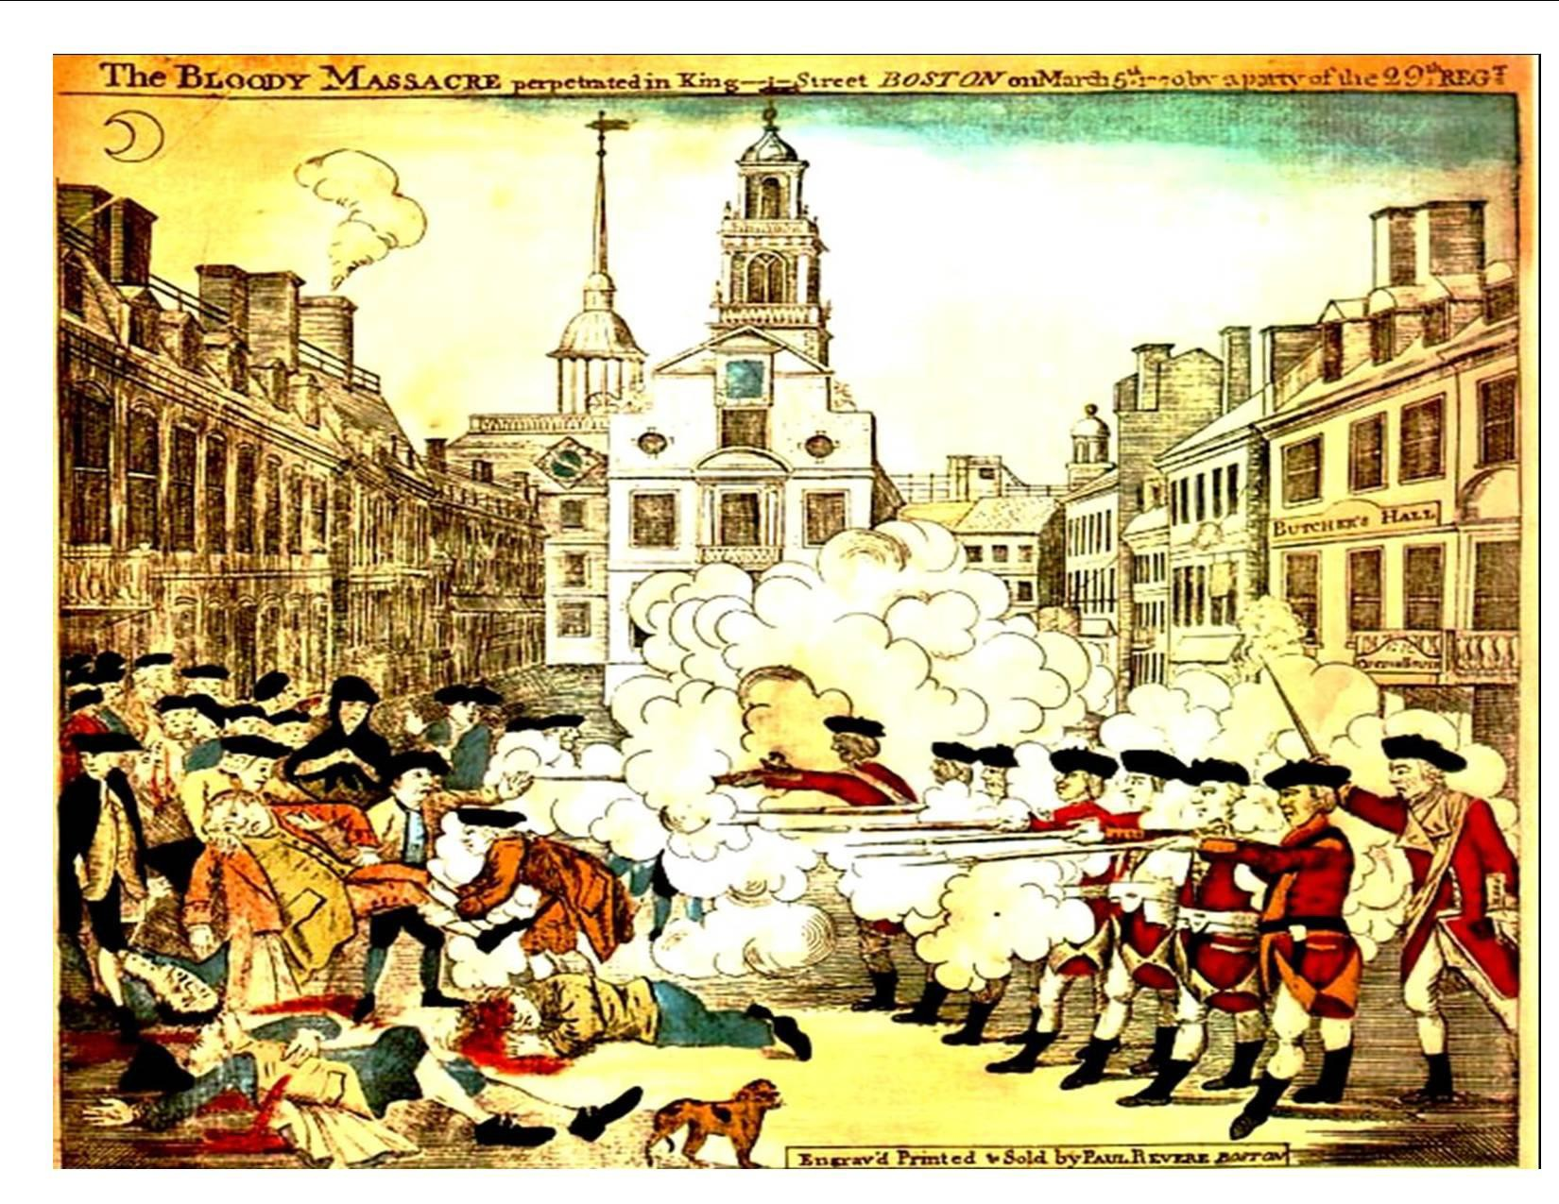
SET A : Document #2
The Bloody Massacre- engraving by Paul Revere, 1770
S
P
A
M
This image, created by Paul Revere, makes the colonists look innocent and the British guilty. This image created hatred towards the British by the colonists.

Slide 21
A.
Document #1 | From whose perspective was this article written? (the colonists or the British) After reading the article, who was at fault for the incident? Provide two details from the article to support your answer to question #2.
Document #2 | 4. What conclusions can you make after viewing the illustration in Document #2? (what do you see?) 5. From whose perspective was this illustration created?
Main Idea What conclusion can you make from the documents? | 6. After analyzing both documents, create a statement reflecting the main idea.

Slide 22
SET B: Document #3
Excerpt of Captain Preston's Account of the Boston Massacre
On Monday night about 8 o'clock two soldiers were attacked and beat. But the party of the townspeople in order to carry matters to the utmost length, broke into two meeting houses and rang the alarm bells, which I supposed was for fire as usual, but was soon undeceived (informed). About 9 some of the guard came to and informed me the town inhabitants (people living there) were assembling to attack the troops, and that the bells were ringing as the signal for that purpose and not for fire, and the beacon (guiding light) intended to be fired to bring in the distant people of the country. This, as I was captain of the day, occasioned my repairing (fixing) immediately to the main guard.
In my way there I saw the [colonists] in great commotion, and heard them use the most cruel and horrid threats against the troops. In a few minutes after I reached the guard, about 100 people passed it and went towards the custom house [building where British tax collectors worked] where the king's money is lodged. They immediately surrounded the sentry (guard) posted there, and with clubs and other weapons threatened to execute their vengeance on him. I was soon informed by a townsman their intention was to carry off the soldier from his post and probably murder him. On which I desired him to return for further intelligence, and he soon came back and assured me he heard the mobb declare they would murder him. This I feared might be a prelude to their plundering (robbing) the king's chest. I immediately sent a non-commissioned officer and 12 [soldiers] to protect both the sentry and the king's money, and very soon followed myself to prevent, if possible, all disorder, fearing lest (in case) the officer and soldiers, by the insults and provocations (baiting) of the rioters, should be thrown off their guard and commit some rash (reckless) act.
[The soldiers] soon rushed through the people, and by charging their bayonets in half- circles, kept them at a little distance. Nay, so far was I from intending the death of any person that I suffered the troops to go to the spot where the unhappy affair took place without any loading in their pieces; nor did I ever give orders for loading them…The mob still increased and were more outrageous, striking their clubs or bludgeons one against another, and calling out, come on you rascals, you bloody backs, you lobster scoundrels, fire if you dare, G-d damn you, fire and be damned, we know you dare not, and much more such language was used. At this time I was between the soldiers and the mob, parleying (negotiating) with, and endeavouring all in my power to persuade them to retire peaceably, but to no purpose. They advanced to the points of the bayonets, struck some of them and even the muzzles of the pieces, and seemed to be endeavouring to close with the soldiers. On which some well-behaved persons asked me if the guns were charged. I replied yes.
They then asked me if I intended to order the men to fire. I answered no,… continue on next page]

Slide 23
…my giving the word fire under those circumstances would prove me to be no officer. While I was thus speaking, one of the soldiers having received a severe blow with a stick, stepped a little on one side and instantly fired, on which turning to and asking him why he fired without orders, I was struck with a club on my arm, which for some time deprived me of the use of it, which blow had it been placed on my head, most probably would have destroyed me.
On this a general attack was made on the men by a great number of heavy clubs and snowballs being thrown at [the soldiers], by which all our lives were in imminent danger, some [colonists were]… calling out, damn your bloods-why don't you fire. Instantly three or four of the soldiers fired, one after another, and directly after three more in the same confusion and hurry. The mob then ran away, except three unhappy men who instantly expired, in which number was Mr. Gray at whose rope-walk the prior quarrels took place; one more is since dead, three others are dangerously, and four slightly wounded.
The whole of this melancholy (depressing) affair was transacted in almost 20 minutes. On my asking the soldiers why they fired without orders, they said they heard the word fire and supposed it came from me. This might be the case as many of the mob called out fire, fire, but I assured the men that I gave no such order; that my words were, don't fire, stop your firing. In short, it was scarcely possible for the soldiers to know who said fire, or don't fire, or stop your firing.
On the people's assembling again to take away the dead bodies, the soldiers supposing them coming to attack them, were making ready to fire again, which I prevented by striking up their firelocks with my hand. Immediately after a townsman came and told me that 4 or 5000 people were assembled in the next street, and had sworn to take my life with every man's with me. On which I judged it unsafe to remain there any longer, and therefore sent the [soldiers] and sentry to the main guard…

Slide 24
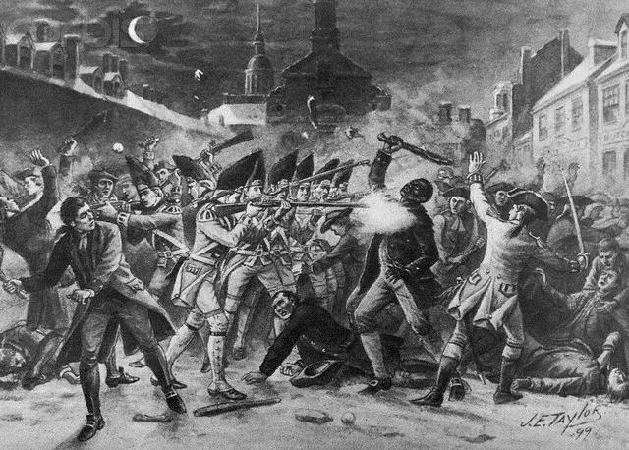
SET B: Document #4
Crispus Attucks was a Boston colonists, who was one of the five colonists killed on March 5, 1770.
S
P
A
M
Death of Crispus Attucks, Boston Massacre- painting by J.E. Taylor, 1899
This image shows a more accurate story of what happened. The colonists were more aggressive towards the British than shown in Revere’s image.

Slide 25
B.
Document #3 | From whose perspective was this article written? (the colonists or the British) After reading the article, who was at fault for the incident? Provide two details from the article to support your answer to question #2.
Document #4 | 4. What conclusions can you make after viewing the illustration in Document #4? (what do you see?) 5. From whose perspective was this illustration created?
Main Idea What conclusion can you make from the documents? | 6. After analyzing both documents, create a statement reflecting the main idea.

Slide 26
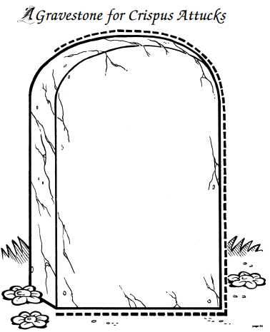
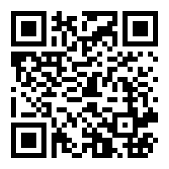
https://www.youtube.com/watch?v=5ZIkQGFcI1E&t=30s
Epitaph: a phrase or form of words written in memory of a person who has died, especially as an inscription on a tombstone.

Slide 27
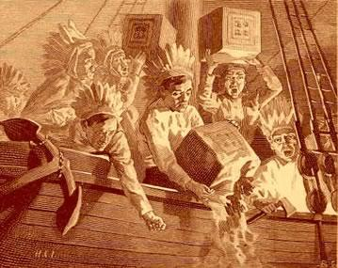
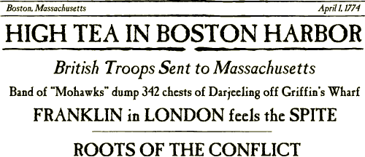
7. BOSTON TEA party: 1773
A Crisis Over Tea
Parliament passed the Tea Act of 1773 to save the British East India Company from financial ruin. The Tea Act allowed the company to ship tea to the colonies without paying most of the taxes. It also allowed them to sell directly to shops that made their price cheaper than the colonists’ tea.
The British East India Company had an unfair advantage, which further enraged colonial merchants. Colonists promised to prevent company ships from unloading their tea.
_____________________________(1773):
British Parliament passes law which lowers the price of tea, but still leaves the tax on the tea.
Colonists see law as a way of hurting American _________________.
In several cities, the Sons of Liberty did things to protest this law. In Boston, the Sons of Liberty held the ________________ ___________ ____________.
______________________________(1773)
_______________ of __________________, dressed as Mohawk Indians, boarded ships in Boston Harbor.
They dumped crates of tea into harbor as a protest against Tea Act.
The Boston Tea Party: This was done by the Sons of Liberty to protest the tax on tea and other British laws.
Tea was one of the most popular and widely consumed drinks in the colonies. The tax on tea effected everyone.
The Daughters of Liberty passed out pamphlets supporting a boycott. Some women marched and burned their tea. Colonists succeeded in turning company ships away from their ports in every city except Boston.
The royal governor would not let the company ships turn around and leave. Samuel Adams and members of the Sons of Liberty, dressed as Mohawks, boarded the East India Company ship one night and dumped 342 chests of tea overboard in protest. This event became known as the Boston Tea Party.
Unit 5 Objective 3: What were the political, Economic, and social causes to the American Revolution?

Slide 28
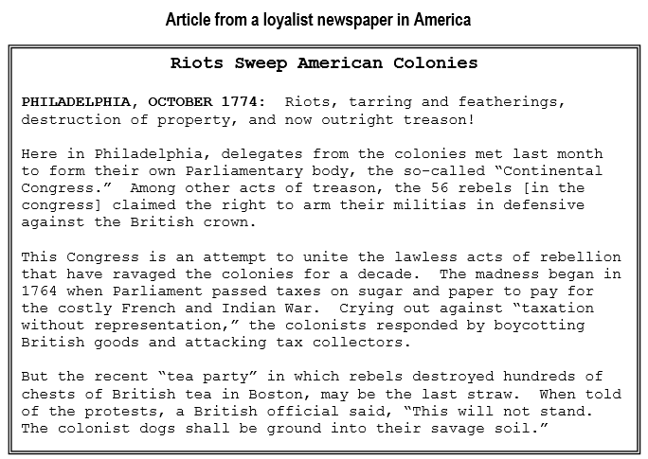
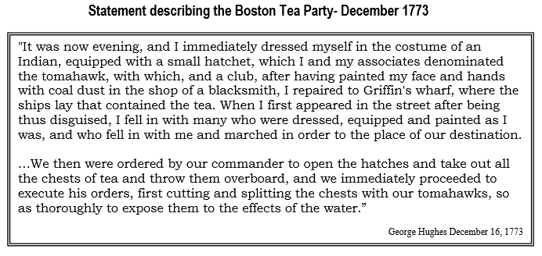
CRQ 1: What historical impact did British taxation have according to the Loyalist Newspaper?
_____________________________________________________________________________________________________________________________________________________________________________________________________________________________________________________________________________________________________________________________________________
CRQ 2: What historical circumstances led the colonists to dump the tea into Boston Harbor?
________________________________________________________________________________________________________________________________________________________________________________________________________________________________________________________________________________________________________________________

Slide 29
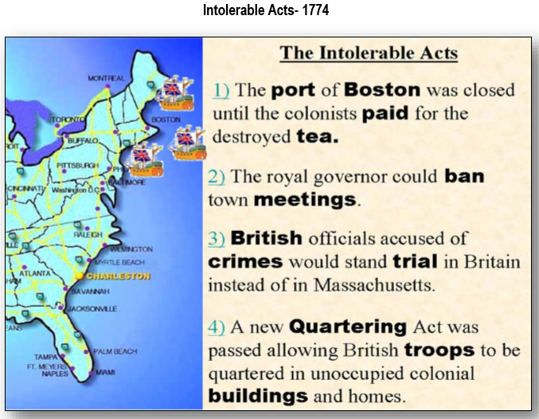
7. BOSTON TEA party: 1773
Unit 5 Objective 3: What were the political, Economic, and social causes to the American Revolution?
_____________________________________(1774): British Parliament passes laws as a way of punishing the colonies for the Boston Tea Party and other acts of the Sons of Liberty.
Closed port of __________________.
______________________________: Law requiring colonists to provide food/shelter for British soldiers.
British troops sent to colonies to enforce laws.
CRQ1: What were the Intolerable Acts a Historical Impact of? TTQA __________________________________________________________________________________________________________________________________________________________________________________________________________________________________________________________________________________________________________________________________
CRQ 2: What was the purpose of the Intolerable Acts? TTQA
________________________________________________________________________________________________________________________________________________________________________________________________________________________________________________________________________________________________

Slide 30
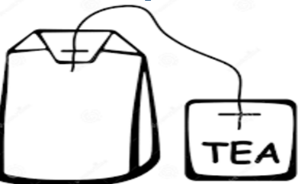

Effects
Causes

Slide 31
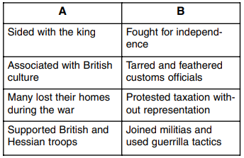
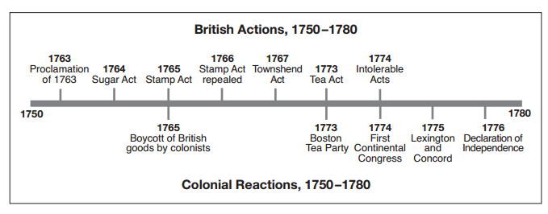
Which conclusion is best supported by the information on the timeline?
Britain eventually granted the colonies representation in Parliament
Only elected British officials had the right to levy taxes
Britain’s efforts to increase control over the colonies were not successful
Creation of the First Continental Congress was an immediate reaction to the passage of the Stamp Act
Which statement is most consistent with the views of Loyalists in the 1770s?
  The colonists should be grateful to be under British rule and protection.
  Taxation without representation is tyranny.
  Citizens, under British rule, have the right to declare independence.
  The king is violating the rights of British citizens.
The slogan “No taxation without representation” referred to taxes enacted by
  colonial legislators
  town meetings
  the English Parliament
  the First Continental Congress
What did the Olive branch Petition state
The colonists were loyal to King George as long as he gave them a voice in Parliament
The colonies were in rebellion
The colonists were ready “to die freemen rather than live as slaves”
Colonies were loyal to George Washington
Colonists resent the Tea Act because
It established a monopoly on tea
It lowered the price of tea
It increased the price of tea
It forced tea to be shipped from India to Britain

Slide 32


Becoming a Detective
Who fired the first shot at the Battle of Lexington and Concord?
There are a series of documents that follow. It is your job to determine the type of evidence included within this file, the credibility of each piece of evidence and how the evidence fits together. Finally, you will be asked to come up with a plausible explanation of who fired the first shot at the Battle of Lexington and Concord and how you came to that particular conclusion.
Cracking the Case Based on your analysis of the documents and citing evidence to support your answer, please write a paragraph answering the following question: Who fired the first shot at the Battle of Lexington and Concord?
Guiding Questions
1. Who wrote it? When? Why?
2. Who does it identify as firing the first shot?
3. Is it reliable? Why?

Slide 33
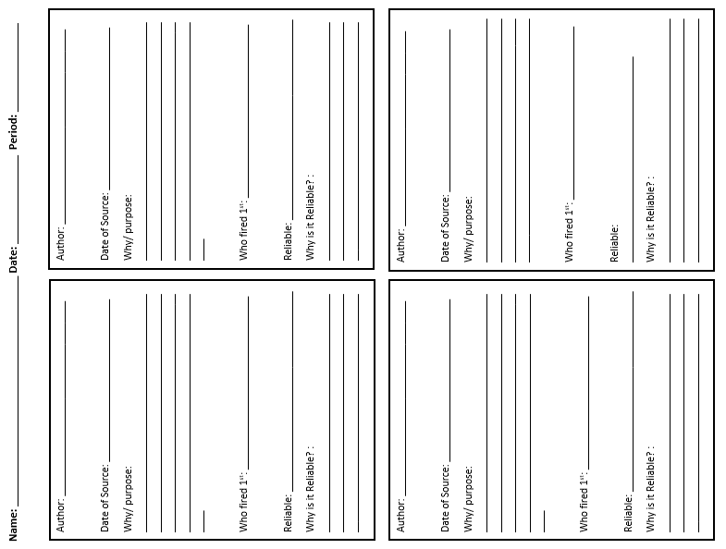
C
D
A
B

Slide 34
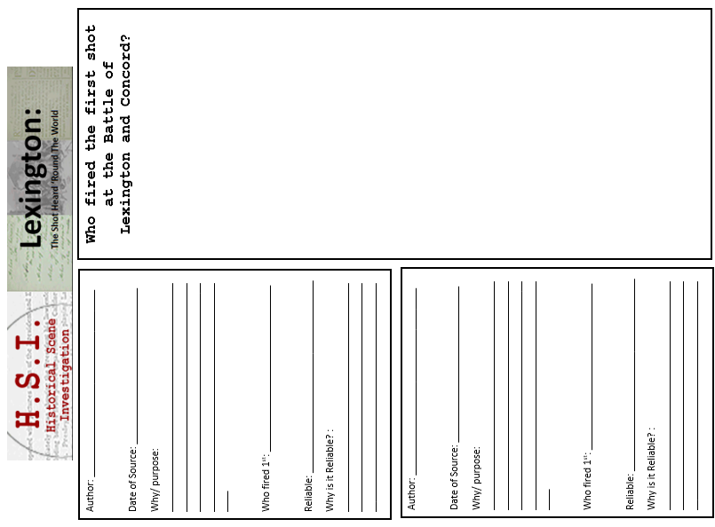
E
F

Slide 35
HW
Unit 5 Objective 3: What were the political, Economic, and social causes to the American Revolution?

Slide 36
HW

Slide 37
Text Support |  | Text Excerpts | Text Questions
abdicated= abandoned, plundered= raided mercenaries= soldiers desolation=unhappiness tyranny (tyrant)= oppression, domination, cruel/unjust/unfair leadership perfidy= dishonesty, disloyal barbarous=cruel, brutal, viscous redress= damages Lexington and Concord- 1775 oppressions=persecution, unjust treatment |  | 5 “He has abdicated Government here, by declaring us out of his Protection and waging War against us. He has plundered our seas, ravaged our Coasts, burnt our towns, and destroyed the lives of our people. He is at this time transporting large Armies of foreign Mercenaries to complete the works of death, desolation and tyranny, already begun with circumstances of Cruelty & perfidy scarcely paralleled in the most barbarous ages, and totally unworthy the Head of a civilized nation…” 6 “In every state of these Oppressions We have Petitioned for Redress in the must humble terms: Our repeated Petitions have been answered only by repeated injury. A Prince who character is thus marked by every act which may define a Tyrant, is unfit to be the ruler of a free people…” | 8.. According to Jefferson in section 5, what actions has King George III taken against the colonies? 9. According to section 6, how have the colonies initially respond to the British actions? 10. Why does Jefferson refer to King George III as a tyrant?
HW

Slide 38
HW

Slide 39
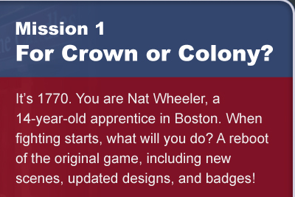
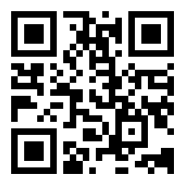
Purpose: Experience life in colonial New England on the eve of the Revolution.
Directions: Follow these directions to set up your Mission.
https://www.mission-us.org/
Step 1: Go to website
Step 2: Click on register in the top right corner
Step 3: Create an account
Make up a Username & Password
Username: _________________________
Password: __________________________
.
Step 4: Click Play and Select Mission 1
Step 5: Choose to Play Online
Step 6: Click New Game
Step 7: Click Prologue
Step 8: Complete each part of the mission and answer the questions in this packet as you complete them

Slide 40
Purpose: Experience life in colonial New England on the eve of the Revolution.
https://www.mission-us.org/
Directions: Answer the following questions as you play through or after you finish part 1
Part 1
Why is J. Langdon's Dry Goods store closed for business? (Try to visit the store during part 1.) It can be found in North End.
Who are the Sons of Liberty?
Why do so many people dislike the Boston Gazette?
4. What is a patriot?
5. Why do some people in Boston refuse to work with each other?
6. Did you doff your hat to the British official? Why or why not?

Slide 41
Purpose: Experience life in colonial New England on the eve of the Revolution.
https://www.mission-us.org/
Directions: Answer the following questions as you play through or after you finish part2
Part 2
What is the difference between a patriot and a loyalist?
8. Why are people so angry at Theophilus Lillie?
What happened to Christopher Seider?
What do the Sons of Liberty want to do in response to Seider?
Part 3
9. Who would you say is more responsible for the tension in the city - the Sons of Liberty or the British soldiers? Explain.
10How do you feel about your boss, Mr. Edes?

Slide 42
Purpose: Experience life in colonial New England on the eve of the Revolution.
https://www.mission-us.org/
Directions: Answer the following questions as you play through or after you finish part2
Part 4/5
11. Who did you choose to join? Why?
12. What happened to you next?
Epilogue
13. Do you think the patriots reacted properly to the events of these 5 days? Explain.
14. What is one choice in the game you wish you had made differently? Explain.
15. After playing through the game are you more or less convinced that going to war with Britain was the right choice? Explain.

Slide 43
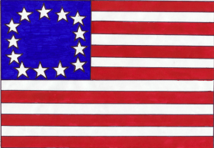
THE AMERICAN REVOLUTION:
-The American Army: (____________________ Army, _____________________ Army)
In the beginning, the Continental Army was made up of ___________________, frontiersmen, and ___________________ who left their homes to fight the British. Many believed the war would be short.
At first, they had to provide their own __________________, ammunition, and uniforms.
Over time, they would be formed into regular units with uniforms and proper equipment.
The Betsy Ross Flag: One of the first flags used in the United States.
American Advantages: | American Disadvantages:
1. | 1.
2. | 2.
3. | 3.
4. | 4.
5. | 5.
6. | 6.
7. | 7.

Slide 44
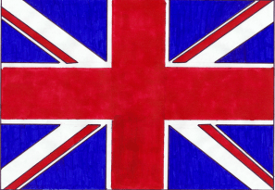
THE AMERICAN REVOLUTION:
The British Army: (_________________, ________________)
The British Army was made up of ___________________ soldiers. They were highly ____________________ and the best equipped army in the world.
They believed the war would be short.
The British would hire German ________________________ to help fight the war.
The British flag was known as the “Union Jack.”
British Advantages: | British Disadvantages:
1. | 1.
2. | 2.
3. | 3.
4. | 4.
5. | 5.
6. | 6.
7. | 7.

Slide 45
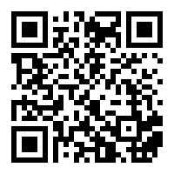
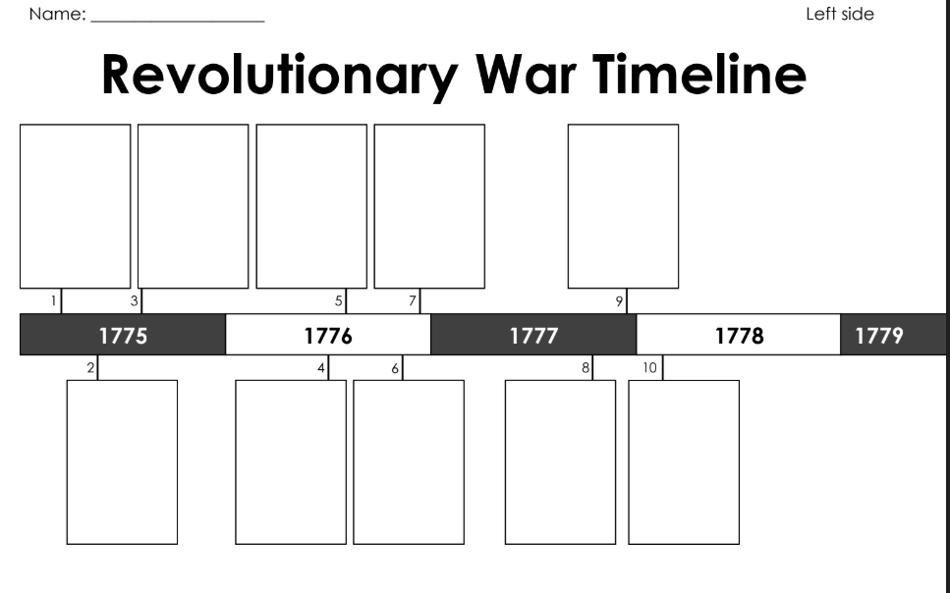
Directions: Watch the Video & place the timeline events in the correct order on the Time Line.
https://www.youtube.com/watch?v=JeqtkPR9l_0

Slide 46
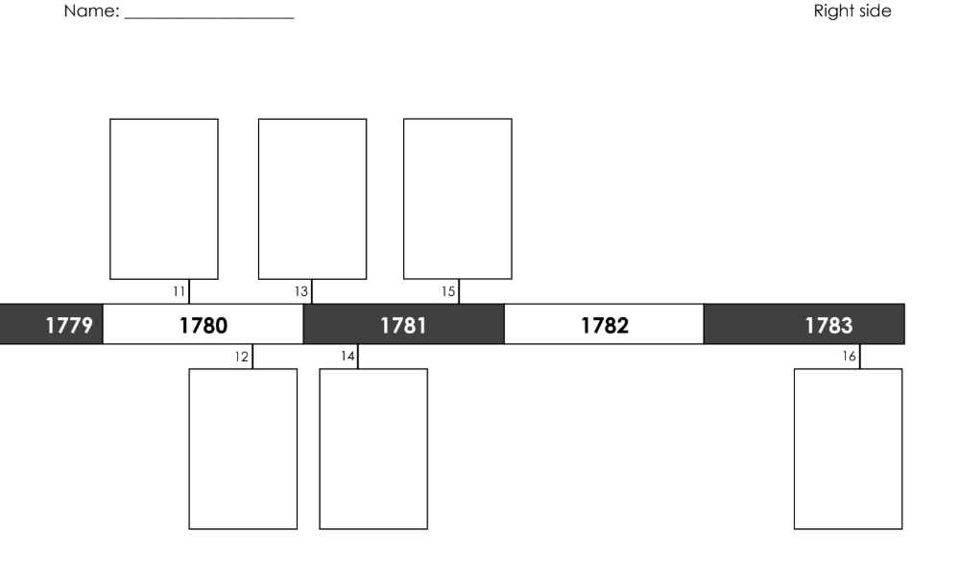

Slide 47
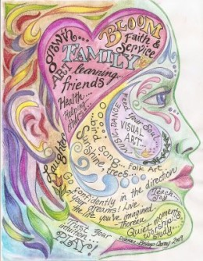

Create a graffiti poster that illustrates various causes/ or events of the American Revolution. Your poster should include ten facts about the causes of the American Revolution.
On a separate sheet of paper

