Slide 1
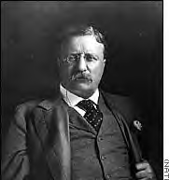
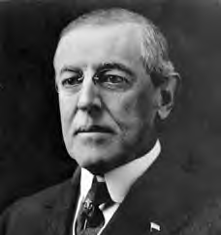
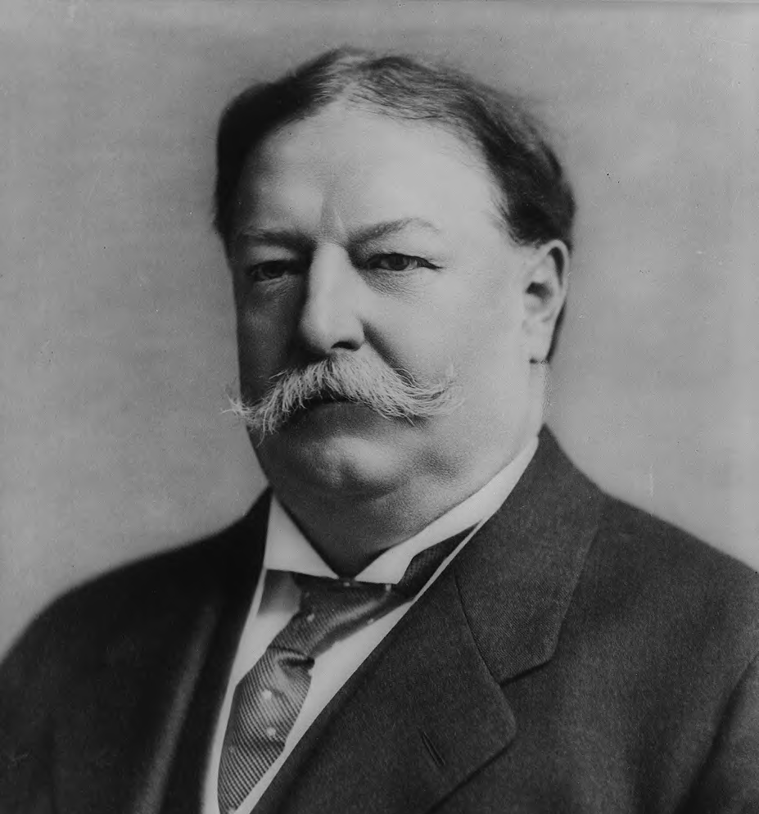
Progressive Presidents Unit 5 Part 2.2

Slide 2
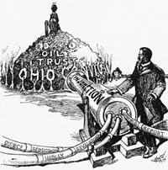
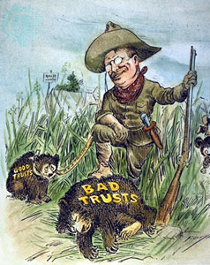
I. Theodore Roosevelt (1901-1909) 1. a.k.a. “The Trust Buster”
good trusts = efficient, ⇓ costs

Slide 3
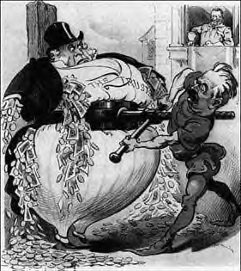
bad trusts = create monopoly to ⇓ competition / ⇑ prices
T.R. broke up bad trusts

Slide 4
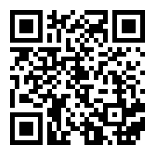
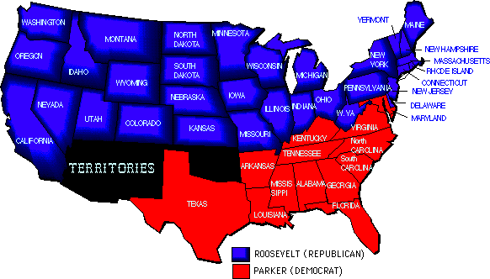
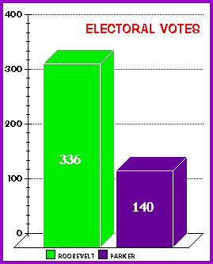
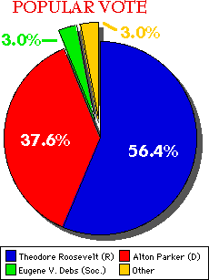
1904 Election Results
Roosevelt VIDEO

Slide 5
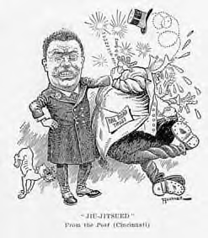
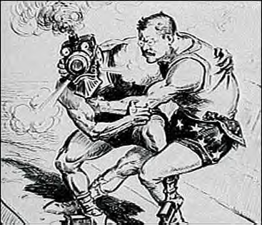
2. 1st Trust Busting Case

Slide 6
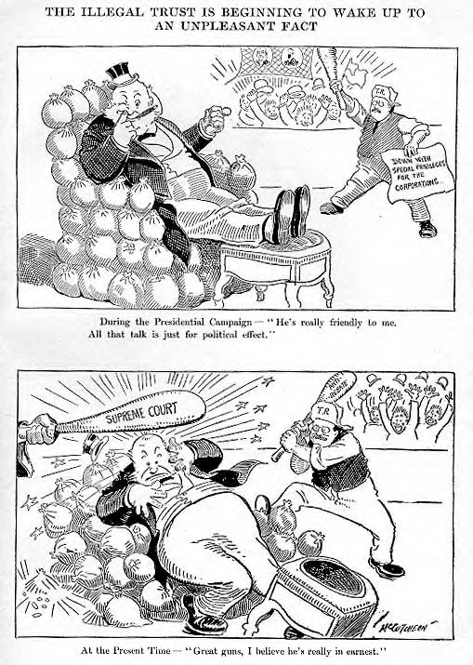
Northern Securities vs. U.S.
T.R. used Sherman Antitrust Act to break up trust and won

Slide 7
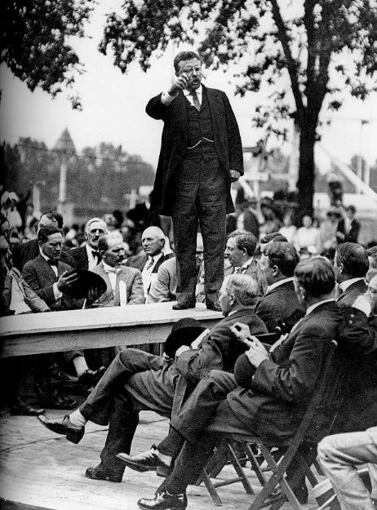
3. Political Platform
Square Deal
do what’s best for the people / do what’s right & fair

Slide 8
4. Expanded Interstate Commerce Act 1887
Elkins Act 1903 = RR’s can’t give refunds to preferred customers
Hepburn Act 1906 = government could cut RR rates if too ⇑

Slide 9
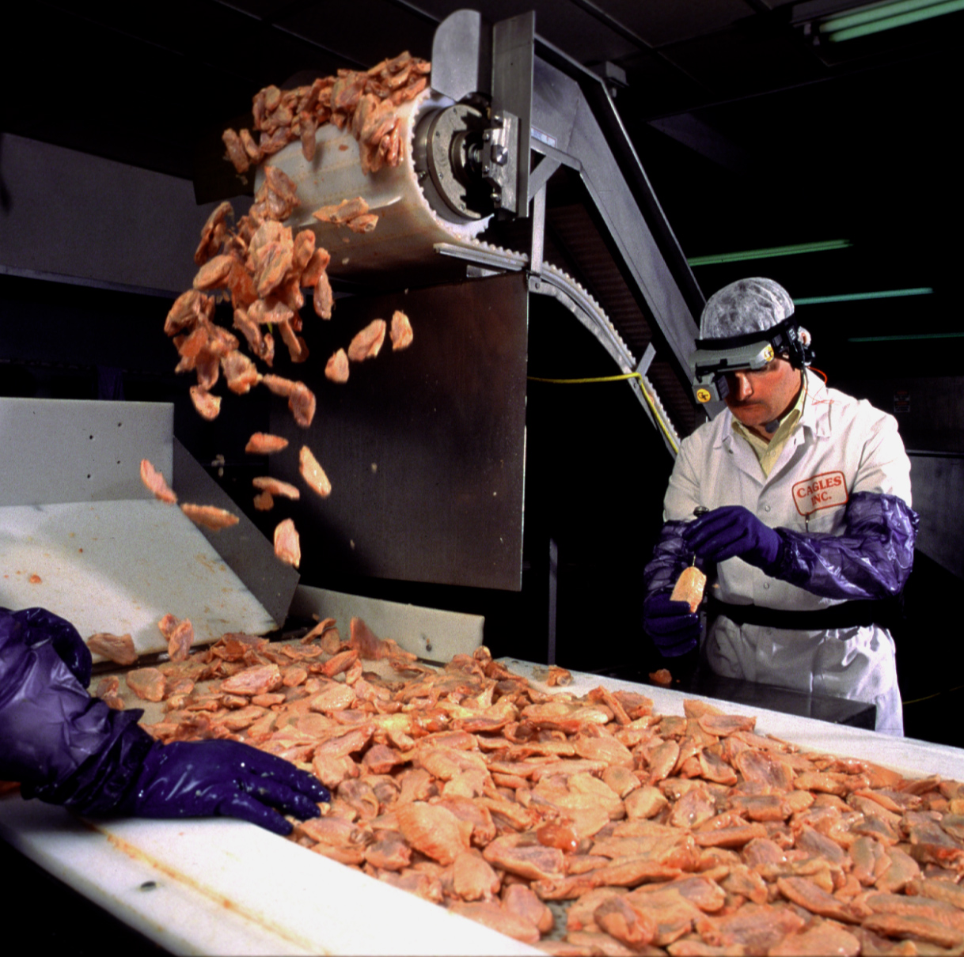
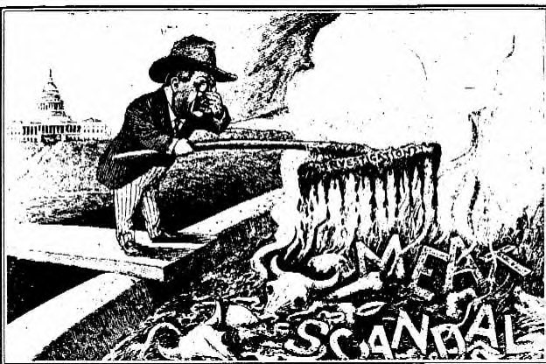
5. Meat Inspection Act 1906
influenced by Upton Sinclair’s The Jungle
government could inspect meat shipped across state lines

Slide 10
6. Pure Food & Drug Act 1906
government banned dangerous drugs and poorly prepared foods

Slide 11
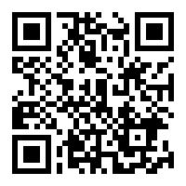
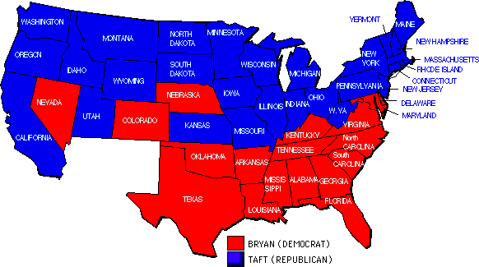
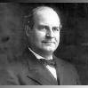
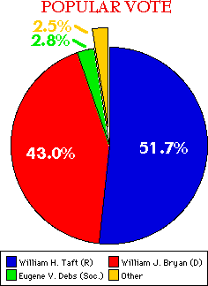
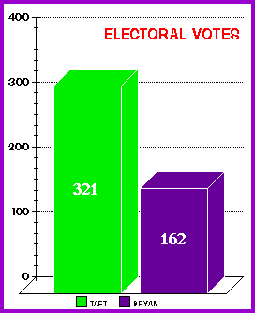
1908 Election Results
Bryan
Howard TAFT - Video

Slide 12
II. William Taft 1. Poor Politician
wanted to ⇓ tariffs, but instead ⇑ them
Payne-Aldrich Act 1909

Slide 13
2. Taft’s Accomplishments
16th amendment was put up for adoption to the Constitution – graduated income tax
Manns-Elkins Act 1910 = ICC could regulate telephone & telegraph companies
created Department of Labor = look after needs of workers
governmental employees = 8 hour work day

Slide 14
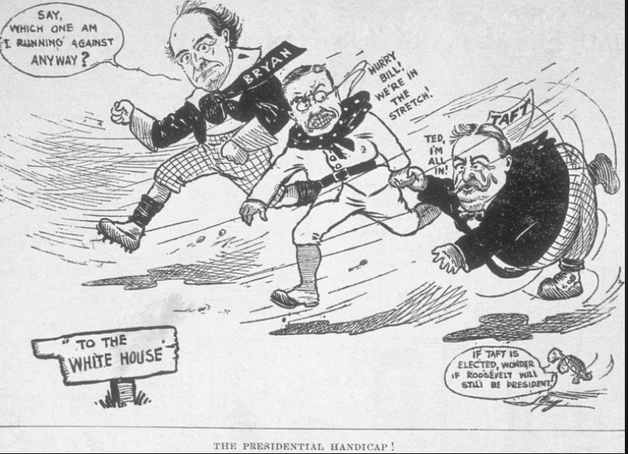
Progressive Presidents
CRQ: What historical circumstances led Roosevelt to run against Taft in the election of 1914?

Slide 15
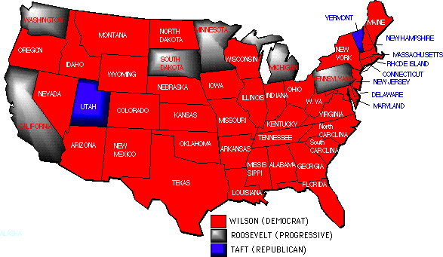
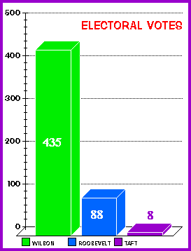
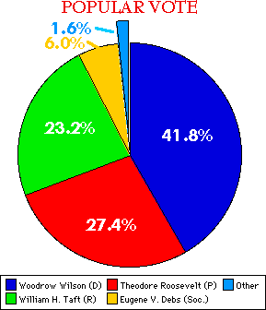
1912 Election Results
Woodrow Wilson - Video

Slide 16
TR-to-Wilson
Election of 1904
Election of 1908
Election of 1912

Slide 17
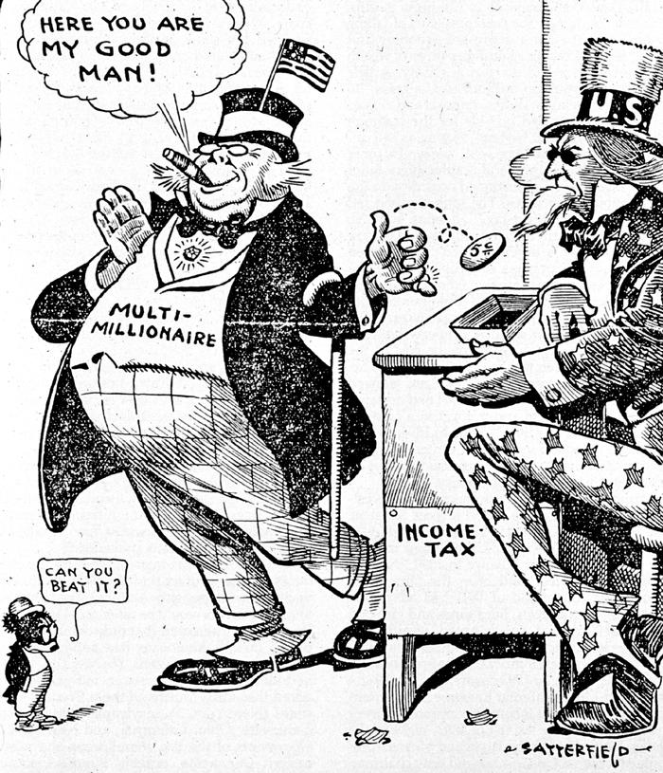
III. Woodrow Wilson (1913-1921)
new freedom = protect small businesses from large companies

Slide 18
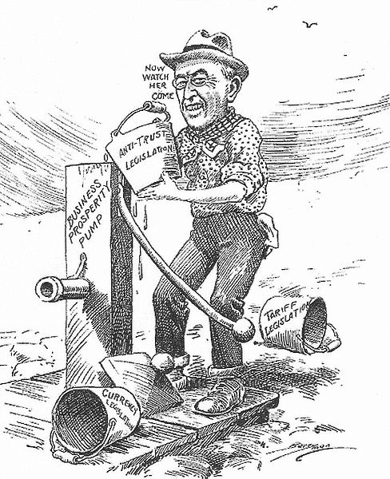
1. Accomplishments
Underwood Tariff = ⇓ tariff rates
Graduated Income Tax
Federal Reserve Act 1913

Slide 19
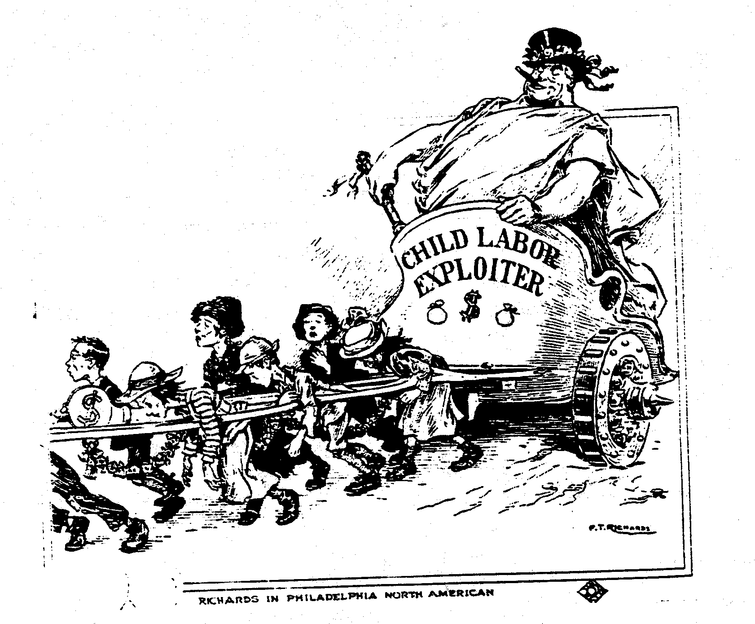
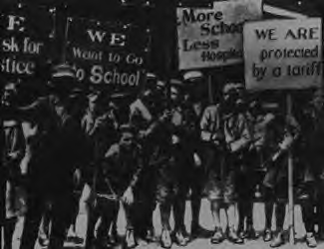
2. Keating-Owen Child Labor Act 1916
prevent interstate commerce between states from products made by children
Declared Unconstitutional

Slide 20
1. Accomplishments
d. Clayton Antitrust Act 1914
E. Federal Trade Commission Act 1914

Slide 21
IV. Conservation
T.R. known as conservation president
placed national forests under Federal Government control
set aside landmarks as national monuments
Wilson’s National Park Service Act 1916 = oversee national parks

Slide 22
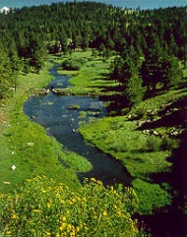
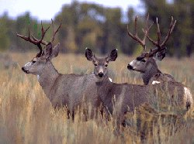

Slide 23
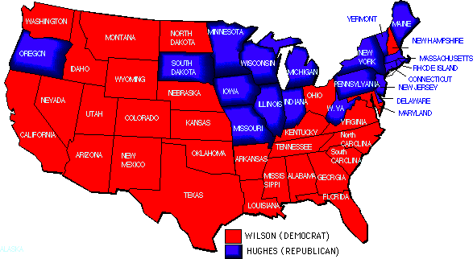
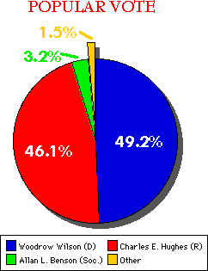
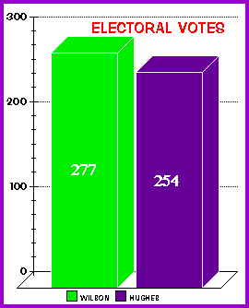
Results of 1916 Election

