Slide 1
Great Depression & New Deal Part 2
How did the New Deal change the social, economic, and political landscape of the United States for future generations?

Slide 2
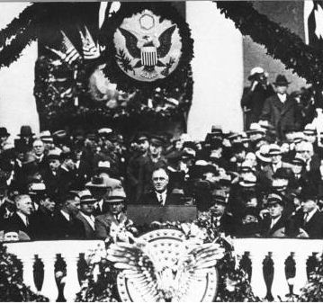
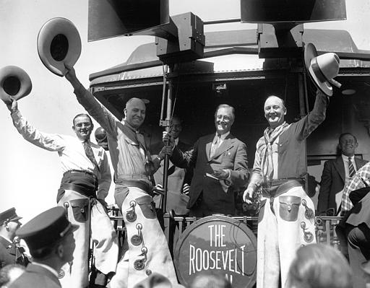
IV. The New Deal
FDR’s programs to end the Great Depression
Relief = ease suffering
Recovery = create economic growth
Reform = try to prevent future economic problems
How did the New Deal attempt to address the problems of the Great Depression?

Slide 3
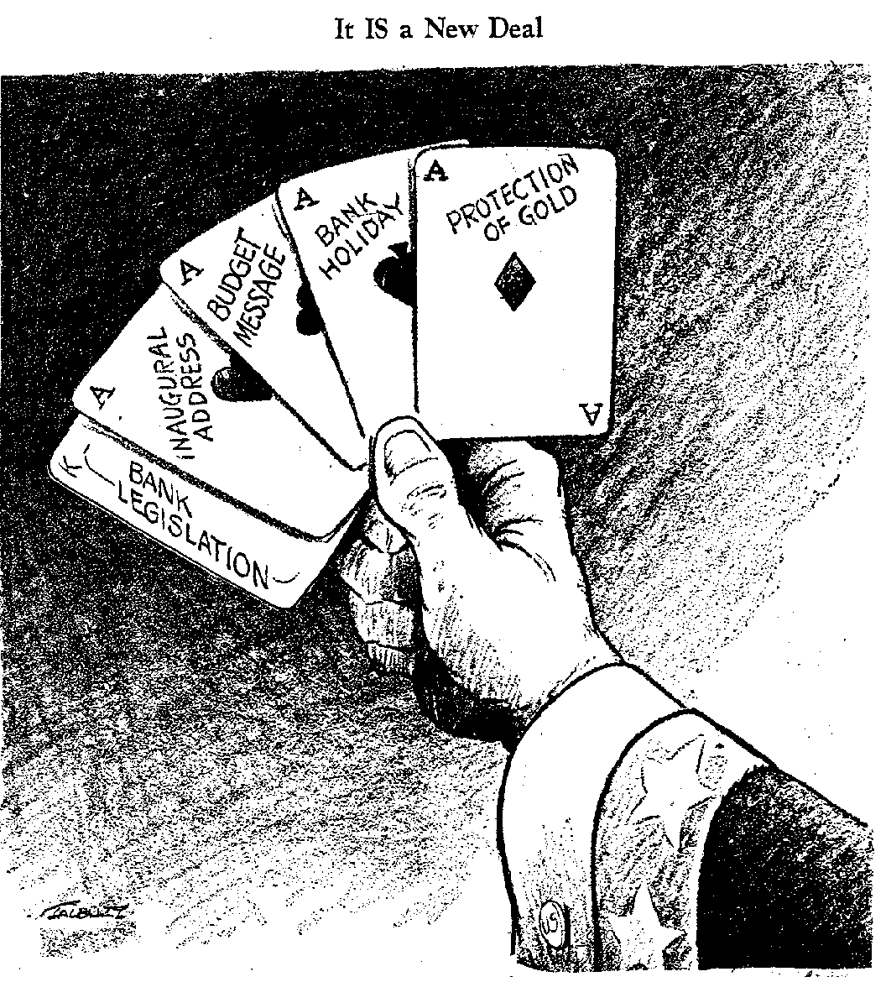
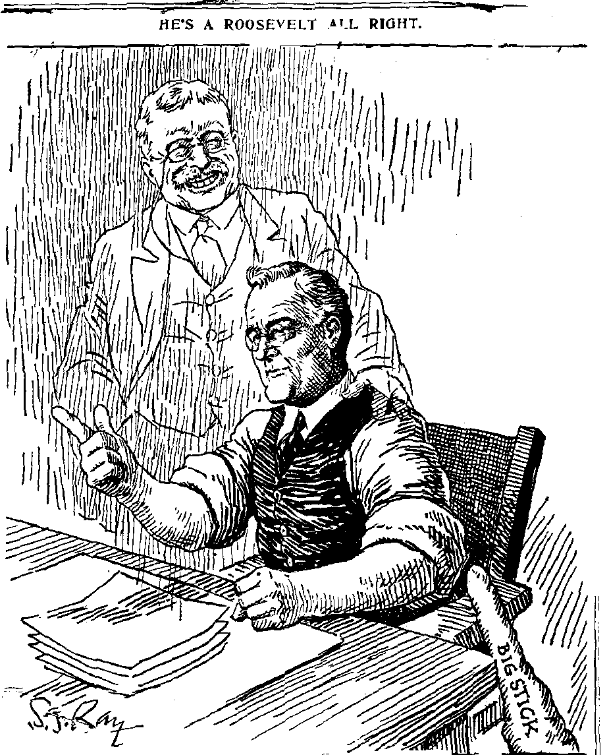

Slide 4
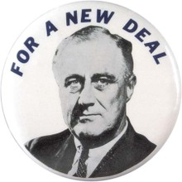
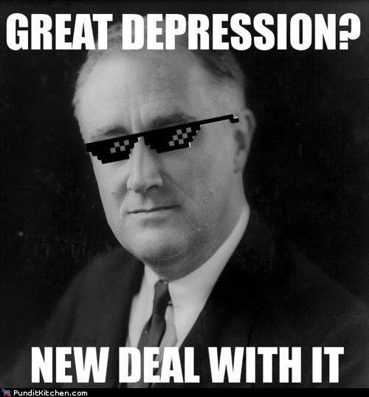
IV. The New Deal
FIRESIDE CHATS = FDR’s radio program explaining his policies in a friendly way

Slide 5
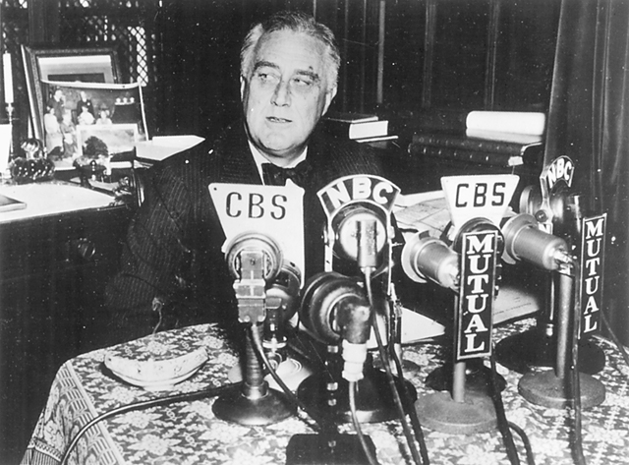
FIRESIDE CHATS
FDR’s radio program explaining his policies in
Unit 6 Objective EQ 2: How did the New Deal attempt to address the problems of the Great Depression?
CRQ1: How many American households had a radio in 1928?
CRQ2: Why do you think President Roosevelt chose to do regular radio addresses during the Great Depression? TTQA

Slide 6
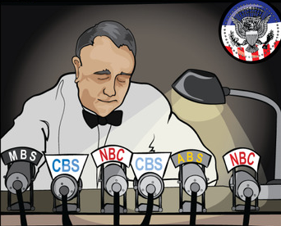
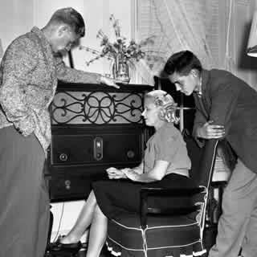
Unit 6 Objective EQ 2: How did the New Deal attempt to address the problems of the Great Depression?
FIRESIDE CHATS
CRQ 3: What were fireside chats and why were they effective in reassuring Americans?

Slide 7
How did President Franklin D. Roosevelt use fireside chats to inspire confidence during the Great Depression?
Year | Unemployment Rate | Per Capita Personal Income
1929 | 3.2% | $698
1930 | 8.9% | $619
1931 | 16.3% | $526
1932 | 24.1% | $399
1933 | 25.2% | $372
Unemployment Rate: The unemployment rate is the percentage of the labor force that is willing and able to work, does not currently have a job, and is actively looking for employment. The labor force consists of people ages 16 and over who are employed or actively seeking work
Per Capita Personal Income: Average income per person in a given area in a specific year, in this case years 1929 - 1933 in the United States.
Unemployment data from Gordon, Robert J. “Table A-1, Time Series Data for the U.S. Economy: 1875-1999.” Macroeconomics, 8th ed., Addison-Wesley, 2000. Per capita personal income from www.bea.gov/bea/regional/spi/.
Excerpt from FDR Fireside Chat - May 7, 1933 | First, we are giving opportunity of employment to one-quarter of a million of the unemployed, especially the young men who have dependents, to go into the forestry and flood prevention work. This is a big task because it means feeding, clothing and caring for nearly twice as many men as we have in the regular army itself. In creating this civilian conservation corps we are killing two birds with one stone. We are clearly enhancing the value of our natural resources and, second, we are relieving an appreciable amount of actual distress of unemployment.
Document 1 Historical Context
1) Explain the historical circumstances that led to the development of the Unemployment rate from 1929-1933. ____________________________________________________________________________________________________________________________________________________________________________________________________________________________________________________________________________________________________________________________________________________

Slide 8
How did President Franklin D. Roosevelt use fireside chats to inspire confidence during the Great Depression?
In spite of the fact that unemployment remains a serious problem here as in every other nation, we have come to recognize the possibility and the necessity of certain helpful remedial measures. These measures are of two kinds. The first is to create programs intended to relieve, to minimize and to prevent future unemployment; the second is to establish the practical means to help those who are unemployed in this present emergency...Therefore, let us keep our minds on two or three simple, essential facts in connection with this problem of unemployment. It is true that, while business and industry are definitely better, our relief rolls are still too large. However, for the first time in five years the relief rolls have declined instead of increased during the winter months. They are still declining. The simple fact is that many million more people have private work today than two years ago today or one year ago today, and every day that passes offers more chances to work for those who want to work.
The program for social security now pending before the Congress is a necessary part of the future unemployment relief... We must begin now to make provision for the future. That is why our social security program is an important part of the complete picture. It proposes, by means of old-age pensions, to help those who have reached the age of retirement to give up their jobs, and thus give to the younger generation greater opportunities for work, and to give to all a feeling of security as they look toward old age.
Source: Excerpt from FDR Fireside Chat - April 28th 1935
Document 2
2a) Based on this excerpt from FRD identify his point of view concerning the policies of the New Deal . ________________________________________________________________________________________________________________________________________________________________________________________________________________________________________________________________________________________________________________________________________________________________________________________________________________
3) Identify and explain a cause and effect relationship associated with the events or ideas in document 1- Unemployment and document 2- FDR Fire Side Chat . Be sure to use evidence from both documents 1 and 2 in your response.
___________________________________________________________________________________________________________________________________________________________________________________________________________________________________________________________________________________________________________________________________________________________________________________________________________________________________________________________________________________________________________________

Slide 9
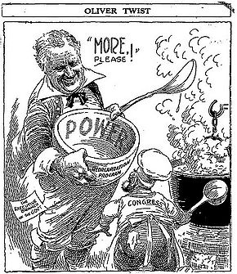
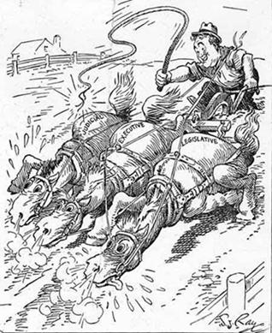
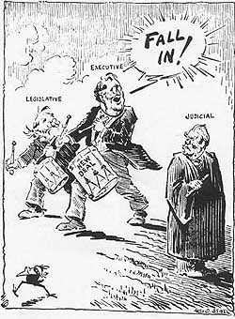

Slide 10
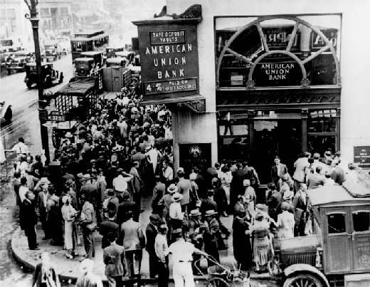
V. Relief Legislation
Bank Holiday
Emergency Banking Act 1933
closed the banks to stop people from withdrawing $
Unit 6 Objective EQ 2: How did the New Deal attempt to address the problems of the Great Depression?

Slide 11
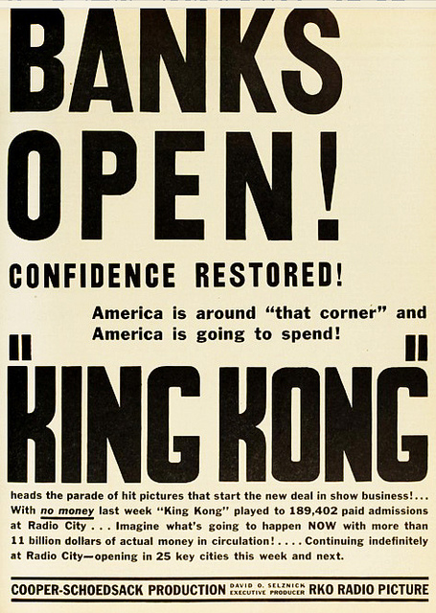
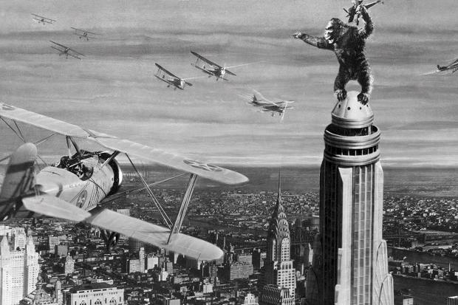
V. Relief Legislation
A. Bank Holiday
prevent collapse of banks
only sound banks reopen
Unit 6 Objective EQ 2: How did the New Deal attempt to address the problems of the Great Depression?

Slide 12
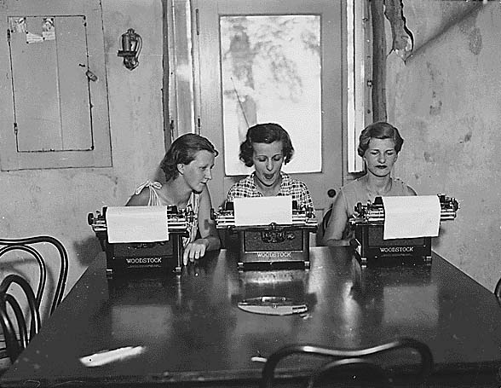
V. Relief Legislation
B. FERA 1933
Federal Emergency Relief Act
direct aid to help poor
Unit 6 Objective EQ 2: How did the New Deal attempt to address the problems of the Great Depression?

Slide 13
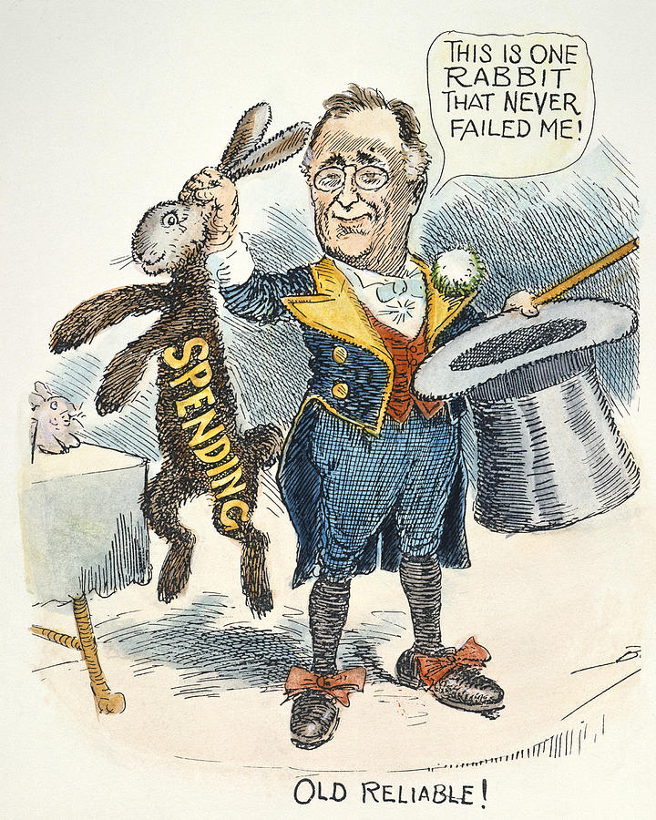

Slide 14
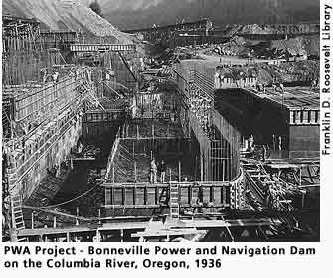
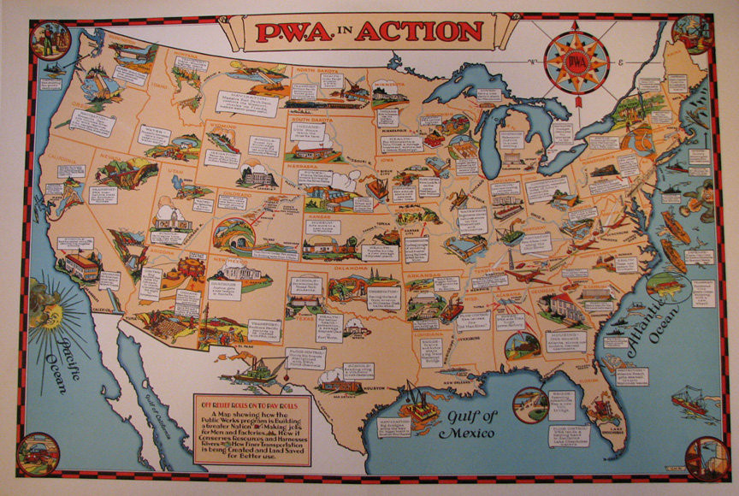
V. Relief Legislation
C. PWA 1933
Public Works Administration
created construction projects
Unit 6 Objective EQ 2: How did the New Deal attempt to address the problems of the Great Depression?

Slide 15
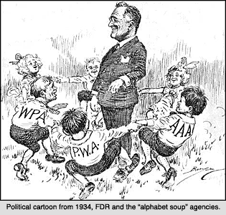

Slide 16
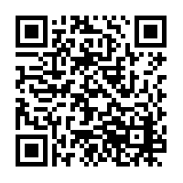
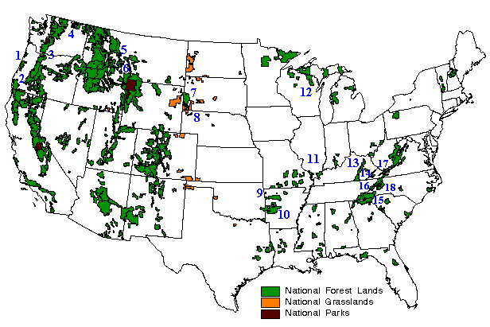
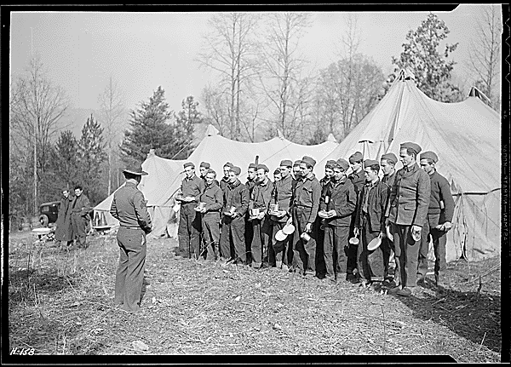
VI. Recovery Legislation
CCC 1933
Civilian Conservation Corps
provided jobs to build roads, landing fields, soil erosion, and flood control projects
https://www.youtube.com/watch?time_continue=1&v=a3xgYIPpIQ4

Slide 17
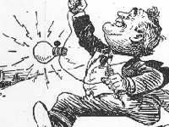
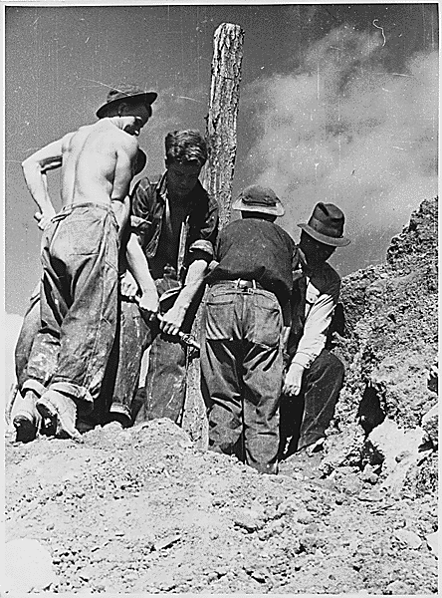
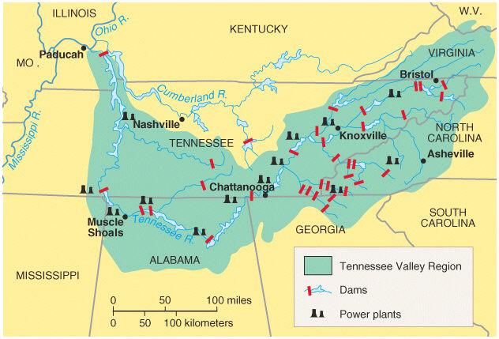
VI. Recovery Legislation
B. TVA 1933
Tennessee Valley Authority
provide jobs, electricity, and dams (control floods) in poor rural areas
https://www.youtube.com/watch?v=zaI7GsxdmvM

Slide 18
Directions: Create an Instagram post for the CCC or the TVA. The post needs to include a description of the picture

Slide 19
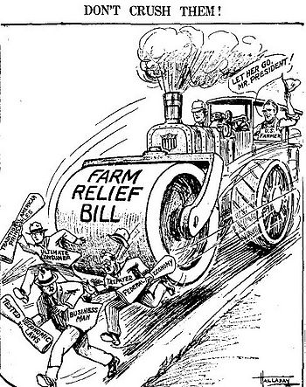
VI. Recovery Legislation
Unit 6 Objective EQ 2: How did the New Deal attempt to address the problems of the Great Depression?
C. AAA 1933
Agricultural Adjustment Act
Use subsidies – pay farmers not to grow
control agricultural overproduction

Slide 20
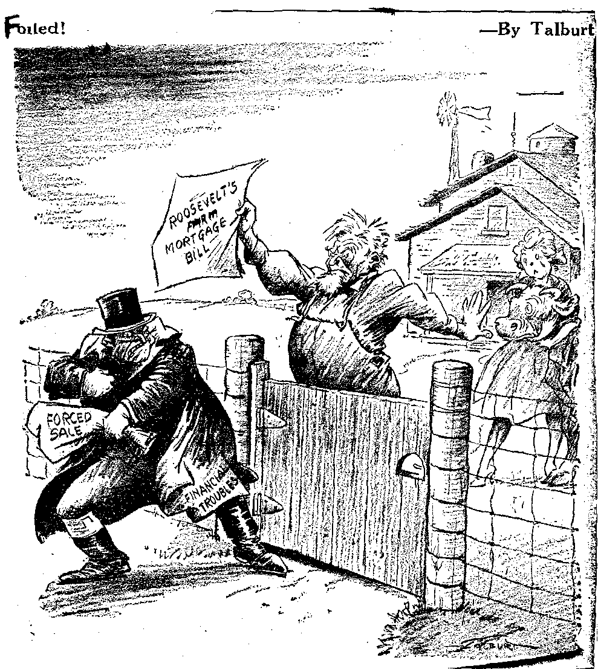
VI. Recovery Legislation
Unit 6 Objective EQ 2: How did the New Deal attempt to address the problems of the Great Depression?
D. FCA 1933
= Farm Credit Administration
helped farmers get low-interest mortgages

Slide 21
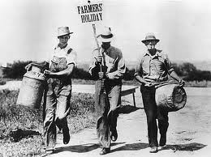
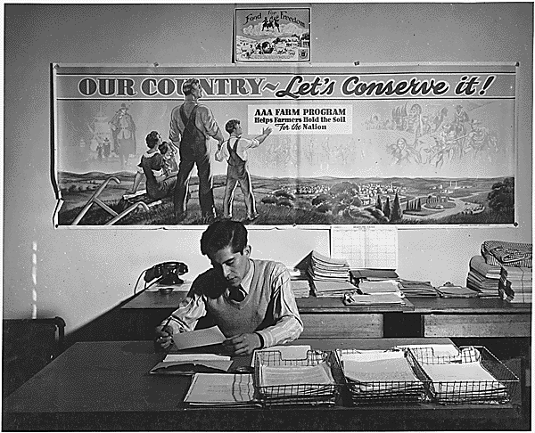
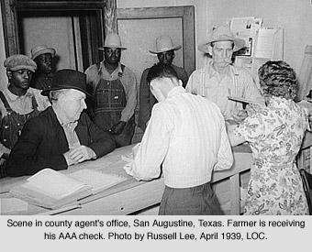

Slide 22
VII. Reform Legislation
Unit 6 Objective EQ 2: How did the New Deal attempt to address the problems of the Great Depression?
A. Glass-Steagall Banking Act 1933
FDIC (Federal Deposit Insurance Corporation)
guaranteed deposits by insuring them

Slide 23
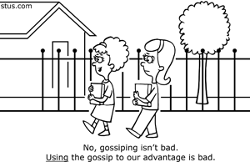
VII. Reform Legislation
Unit 6 Objective EQ 2: How did the New Deal attempt to address the problems of the Great Depression?
B. SEC 1933
Securities Exchange Commission
regulate stock exchanges and investments
stop stock fraud; proper info. given to investors

Slide 24
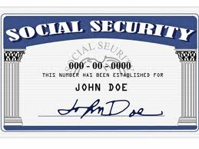
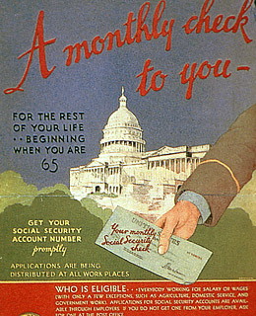
VII. Reform Legislation
Unit 6 Objective EQ 2: How did the New Deal attempt to address the problems of the Great Depression?
C. Social Securities Act 1935
public assistance insurance
old age pension
unemployment insurance
assist disabled, orphans, & widows
https://video.search.yahoo.com/yhs/search?fr=yhs-mozilla-002&hsimp=yhs-002&hspart=mozilla&p=us+history+video+clips+new+deal#id=40&vid=8d89ec28f80f0f7d45c17f87d7334cbd&action=view

Slide 25
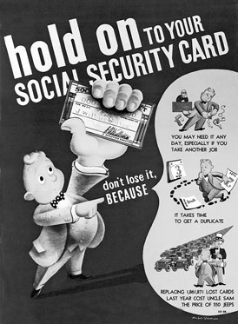
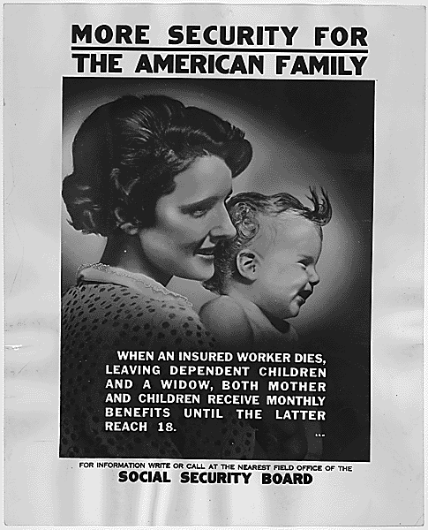

Slide 26
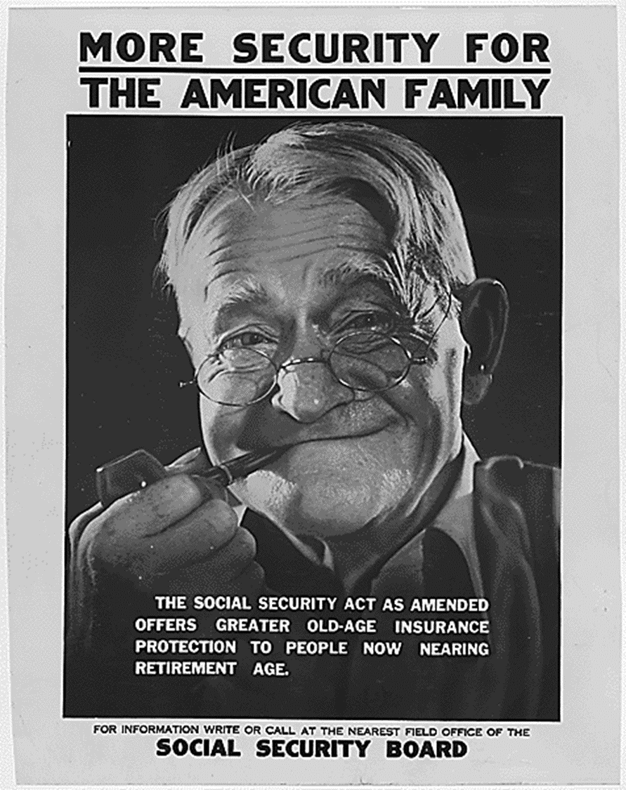
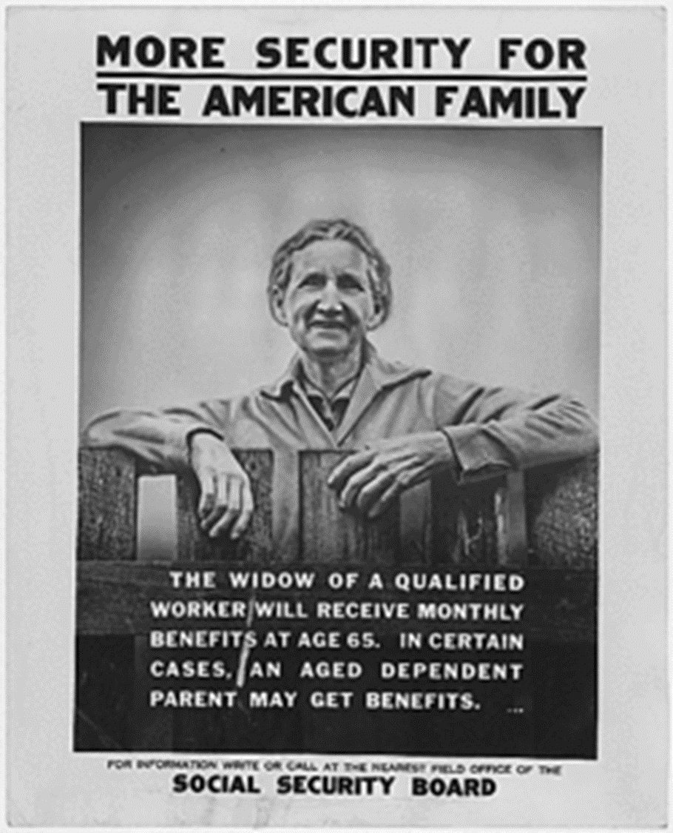

Slide 27
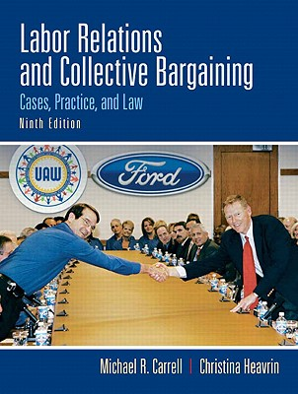
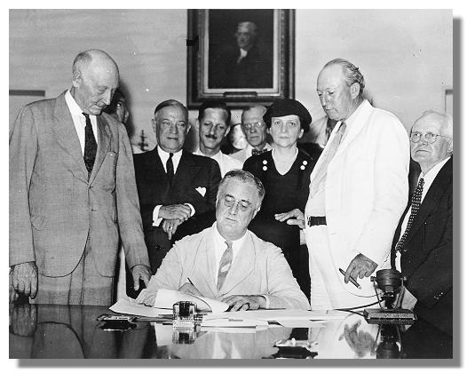
VII. Reform Legislation
Unit 6 Objective EQ 2: How did the New Deal attempt to address the problems of the Great Depression?
D. Wagner Act 1935
a.k.a. National Labor Relations Act
unions were given the right to organize and bargain collectively
blacklists were illegal

Slide 28
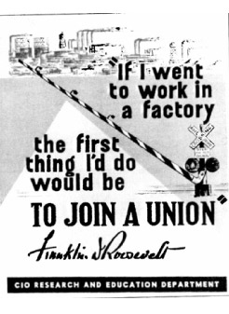
VII. Reform Legislation
Unit 6 Objective EQ 2: How did the New Deal attempt to address the problems of the Great Depression?
E. Fair Labor Standards Act 1938
set minimum wage and maximum work week

Slide 29
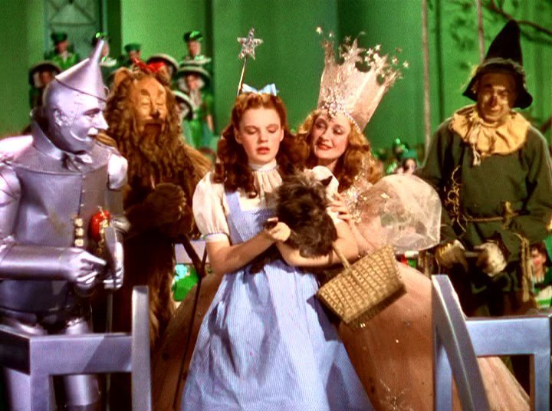
VI. Effects of the New Deal
How did the New Deal change the social, economic, and political landscape of the United States for future generations?
Federal Government Power ⇑
power of the President ⇑
workers can join unions and bargain collectively
conservation of resources ⇑
new faith in democracy
Federal Social Programs

Slide 30
America: The Story of Us
Episode 9: Bust - Episode Summary: Turning Point
19:00 min – end
Mount Rushmore was built as part of President Franklin Delano Roosevelt’s government program called the ________ Deal.
Despite the public works programs, in 1936 1 in ___ Americans were still unemployed.
What event would it take to get the United States out the Great Depression? ______________
In 1936, African-American Joe Lewis would face off against German Max Schmeling for boxing’s heavy weight title. ____ million Americans would listen to the fight on the radio. Joe Lewis was the hope of African-Americas, about _____% of which were unemployed.
_______________________________ was the winner of the 1936 Heavyweight Title.
The rematch between Schmeling and Lewis was scheduled for June 22, 1938 at Yankee Stadium in New York. This fight would pit good vs. evil; democracy vs. __________________. ______ million Americans would listen to the fight, 100 million worldwide.
Joe Lewis won the rematch in only ______ seconds. The second quickest heavyweight title fight in history.
What was the symbolism of the Lewis/ Schmeling fight?
https://www.youtube.com/watch?v=PoV7GGN-u7Q

