Slide 1
Unit 5 Part 2 – Industrial Businesses

Slide 2
I. Captains of Industry (Robber Barons)
RR’s, oil refining, steel, and meat packing

Slide 3
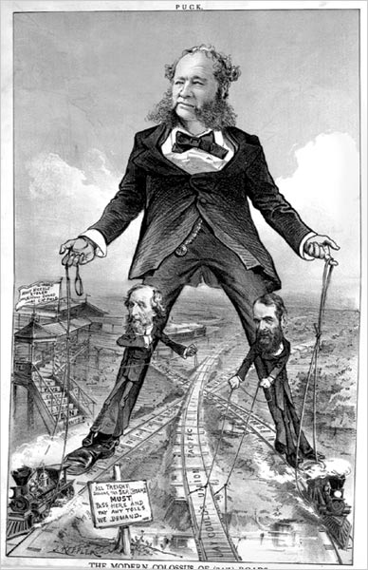
Increased Transportation = growth of RR’s in the US
created giant companies
⇑ labor force
⇑ immigration
caused pollution
⇑ migration west
removed NA from land
towns & cities grew
⇑ need for steel
set up time zones

Slide 4
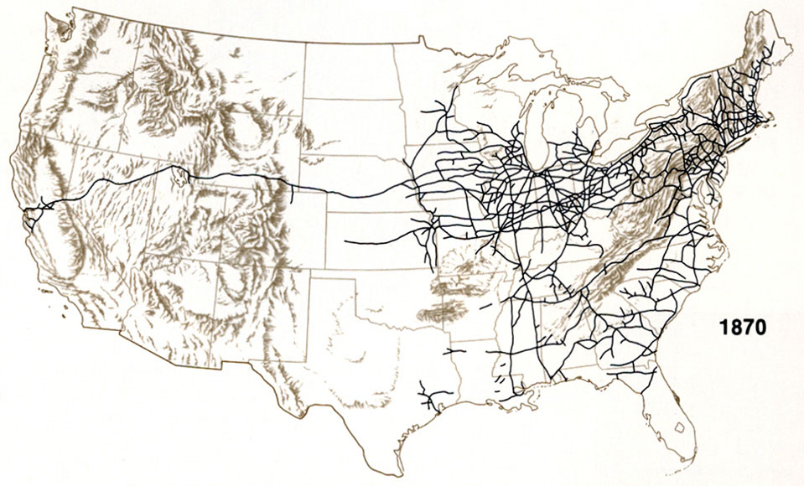

Slide 5
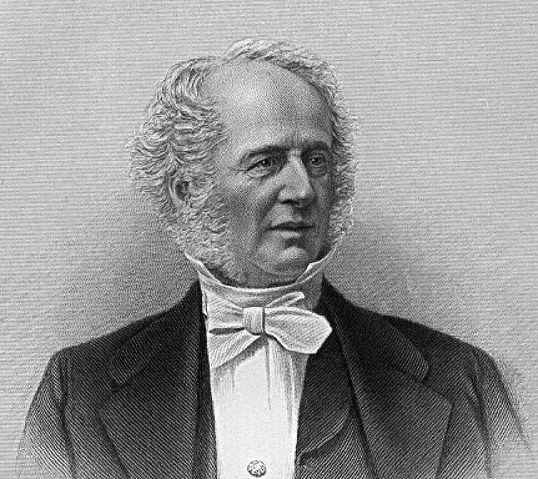
A. Railroads
Cornelius Vanderbilt = major leader of RR industry
raised several million $’s to build RR’s and upkeep RR’s
hired managers to control sections of RR’s

Slide 6
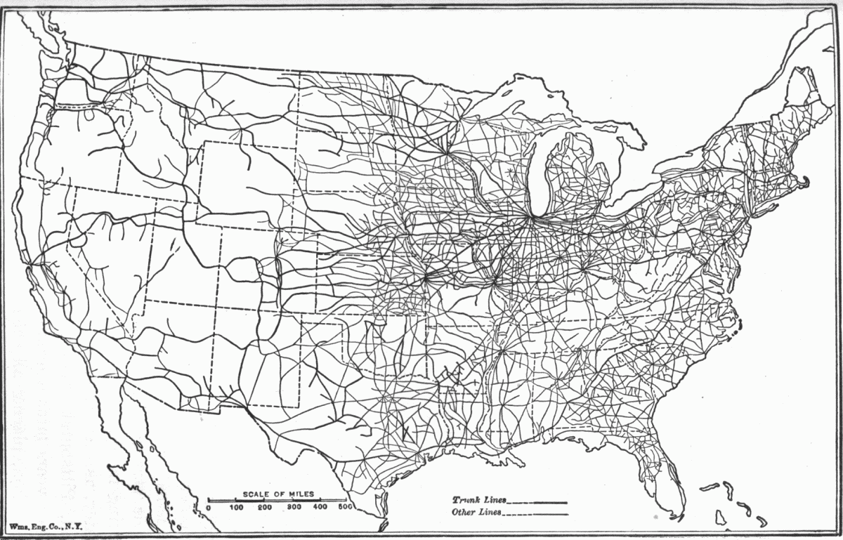
1860 = 30,000 miles of track
1900 = over 193,000 miles of track
famous RR’s = Union Pacific, Santa Fe, Central Pacific & Great Northern

Slide 7
America exported grain, steel, and textiles in huge amounts and became a world economic power.
Mechanization of farming meant fewer farmers were needed to produce food.
Many Americans moved to cities to find work.
Notes:
7

Slide 8
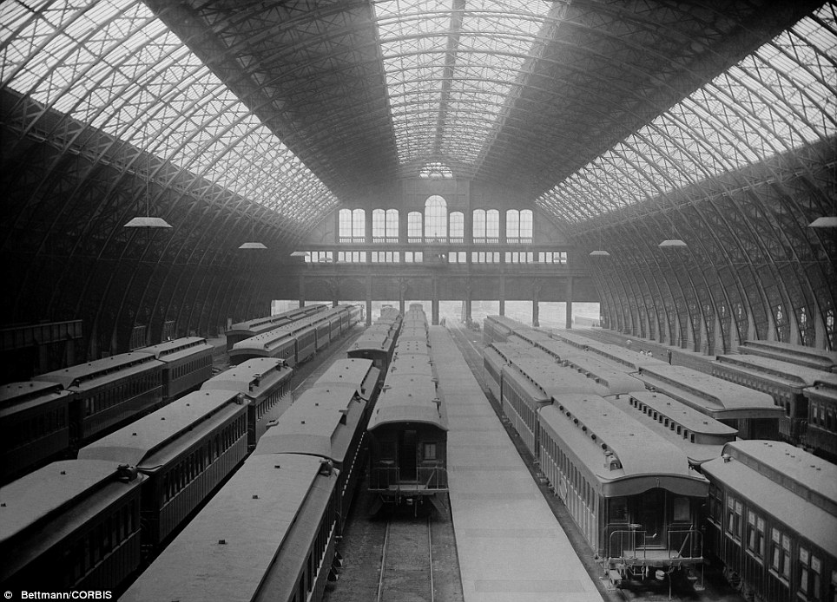
Railroads change the country.
Tied the nation together
Moved products and people
Spurred industrial development
Stimulated the growth of towns and cities
Encouraged settlers to continue to move west
Notes:
8

Slide 9
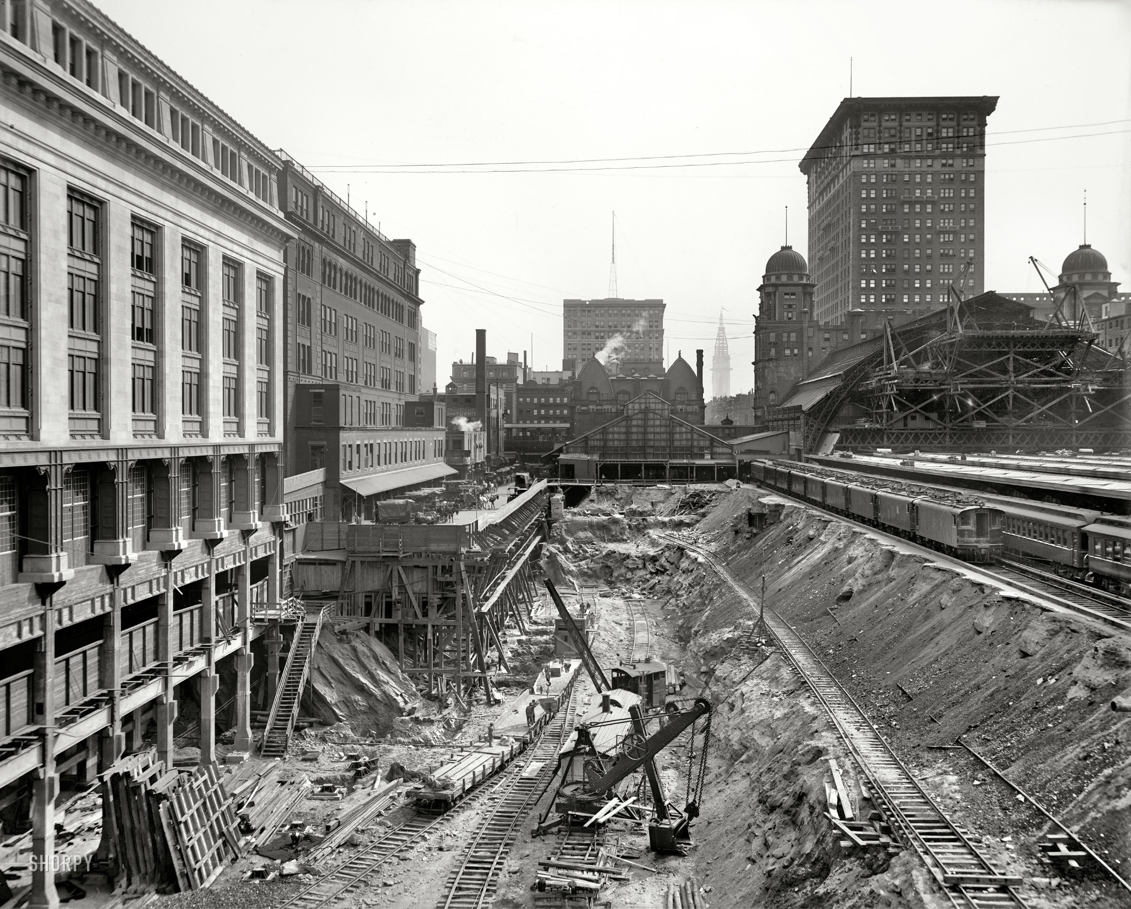

Slide 10
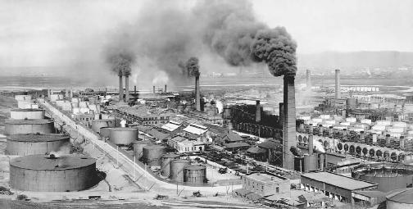
B. Oil Refining
John D. Rockefeller
developed oil refineries in Cleveland
formed the Standard Oil Company 1867
built his own warehouses, barrels, and pipelines
received shipping deal from RR’s
result = cheaper to produce / ship oil = cheaper to sell oil = controlled 90% of the oil refining business

Slide 11
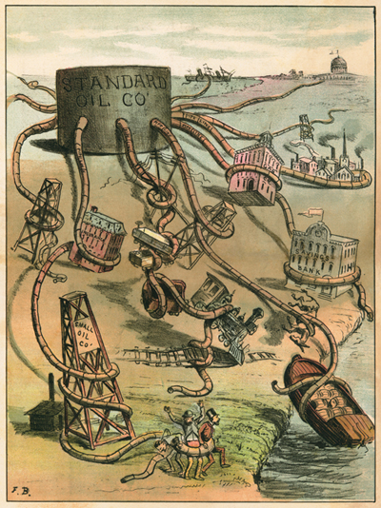
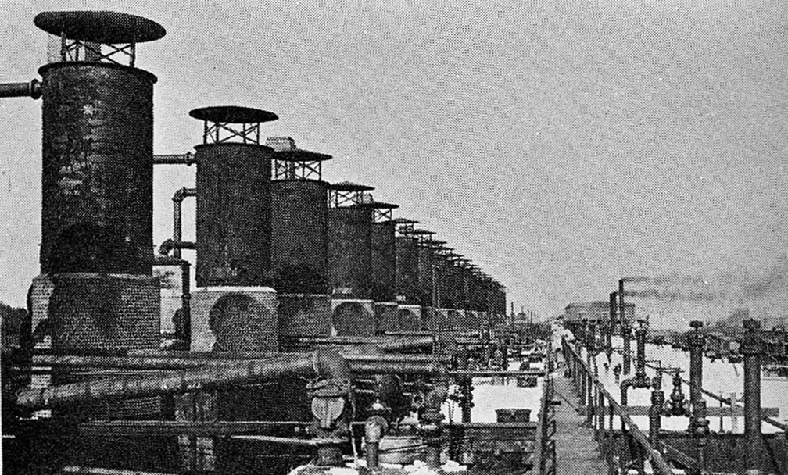
People began to wonder—Is big business bad for small businesses?
Or is big business good for the nation?
provides jobs
allows for product innovations
financially supports universities, libraries, and museums
Notes:
11

Slide 12
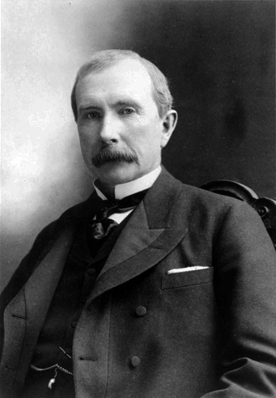
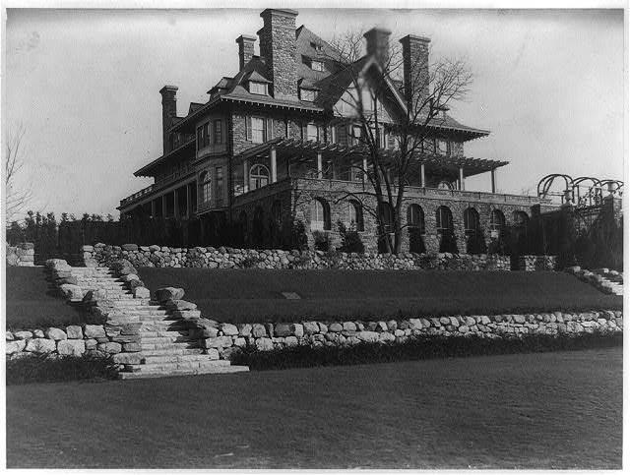
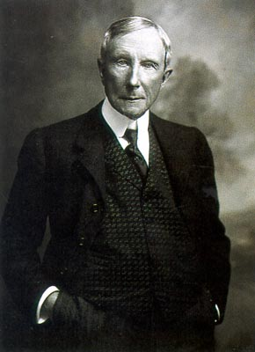

Slide 13
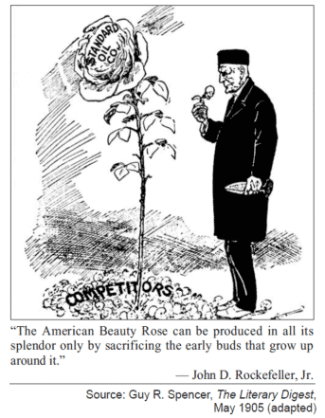

Slide 14
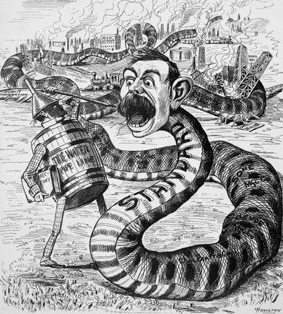
How did Rockefeller become the leader of the oil industry?

Slide 15
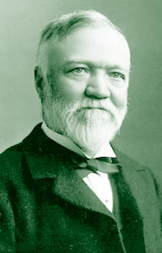
C. Steel Industry
Andrew Carnegie
used technology & latest equipment to make steel
bought iron ore mines, boats & RR’s for shipping
result
cheaper to produce and ship steel
cheaper to sell steel
controlled the US steel industry
became the first billion $ company

Slide 16
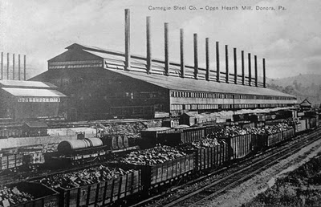

Slide 17
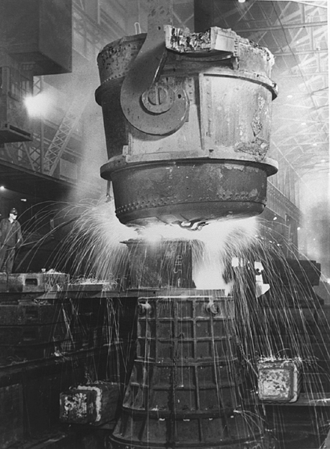
Bessmer Process
Before the Civil War, skilled workers used a slow and costly process to produce iron, which tended to be soft and malleable.
The development of Henry Bessemer's converter aided the search for a more durable metal.

Slide 18
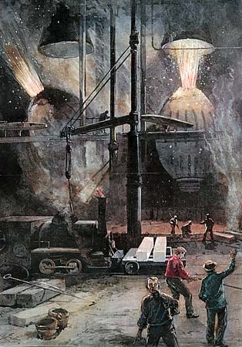
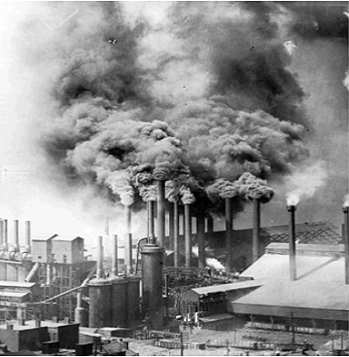
The Bessemer process transformed iron into steel by injecting air into it, thereby reducing the amount of carbon.
The process is credited with launching the steel industry and cheapening the cost of production because it was no longer necessary to employ highly paid skilled workers.

Slide 19
D. Meat-Packing Industry
prior to 1860, cattle shipped to cities ⇒ slaughtered ⇒ sold
Gustavus Swift
developed the refrigerator RR car
meat was now slaughtered then shipped
result = cheaper to produce and ship meat = cheaper to sell meat = controlled the meat packing industry

Slide 20
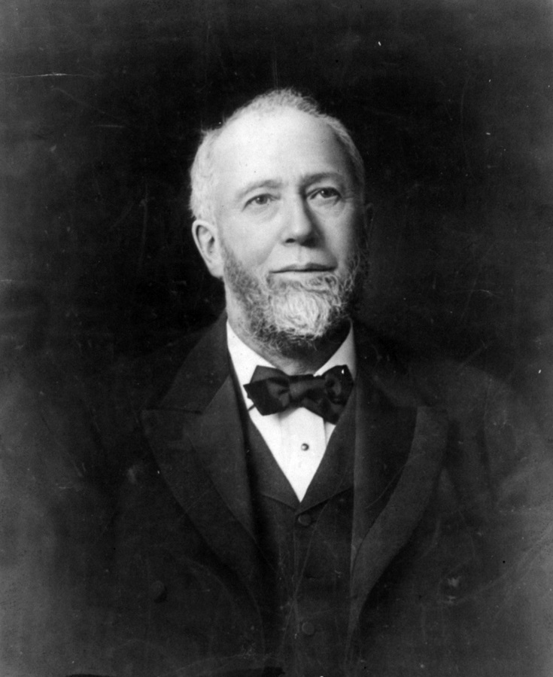
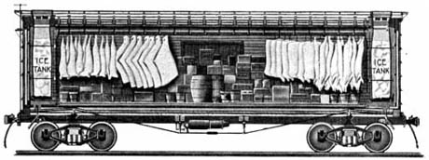

Slide 21
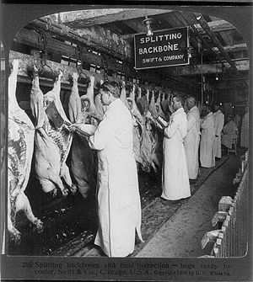
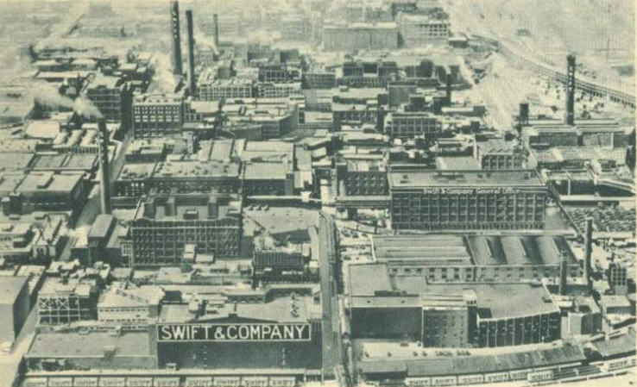
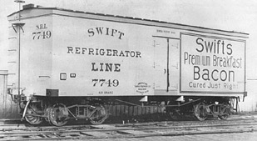

Slide 22
E. Philosophy of Business
laissez-faire = government does not make rules or control business
Gospel of Wealth = big business owners use part of their wealth for the good of society (philanthropist)
social Darwinism = survival of the fittest

Slide 23
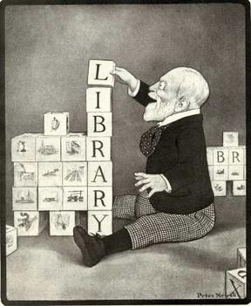
Philanthropy

Slide 24
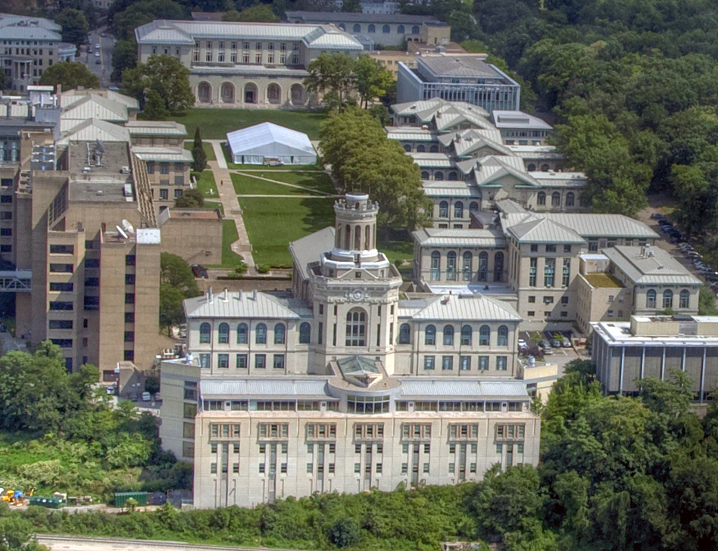
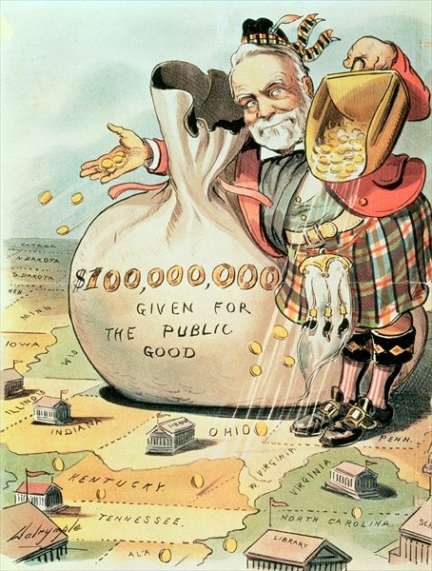
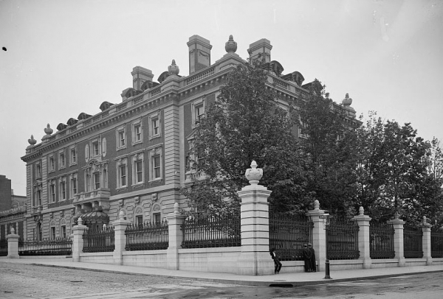

Slide 25
Theory of Survival of the Fittest is Used to Defend Big Business
Charles Darwin’s idea of evolution of species
applied to American capitalism
becomes Social Darwinism
This is the belief that wealth was a measure of a person’s value and those who had wealth were the most “fit.”

Slide 26
Americans who worried about the methods of industrialists called for federal regulation of business practices.
Social Darwinists believed government should stay out of private business and thought it was wrong to use public funds to assist the poor.
Notes:
26

Slide 27
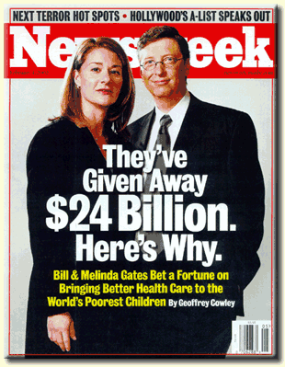
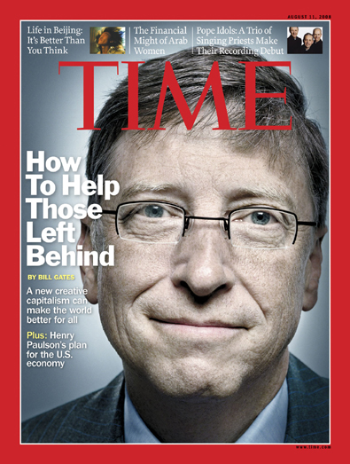

Slide 28
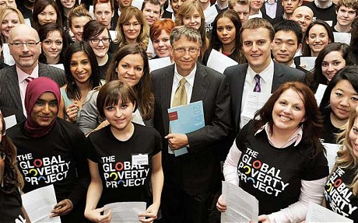

Slide 29
