Slide 1
Unit 2 Industry & Big Business
Unit 2 Part 1 – 8th Grade Social Studies

Slide 2
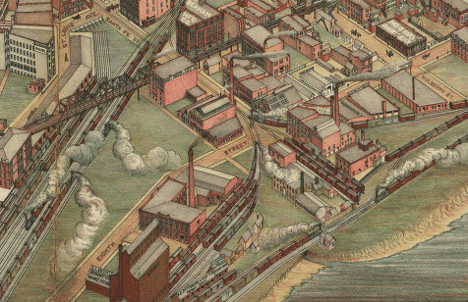
I. RISE OF INDUSTRY IN AMERICA
Unit 2 EQ 1: What conditions spurred the growth of industry?
https://www.brainpop.com/socialstudies/ushistory/industrialrevolution/

Slide 3
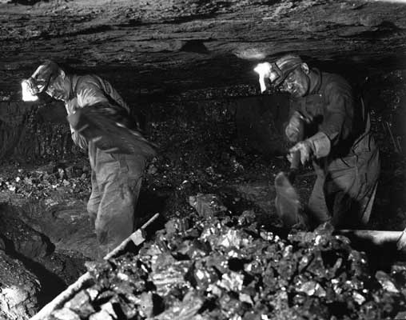
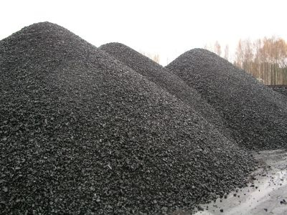
A. NATURAL RESOURCES
Unit 2 EQ 1: What conditions spurred the growth of industry?
coal - power steam engines / machines
large coal deposits found in Pennsylvania, Kentucky & Ohio

Slide 4
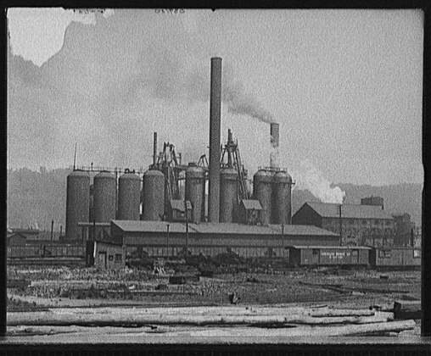
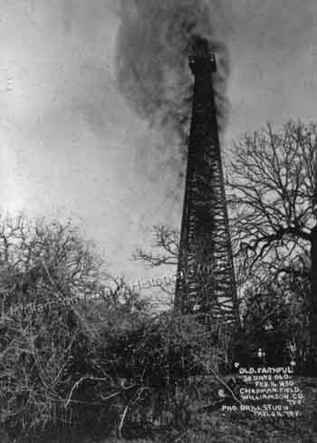
A. NATURAL RESOURCES
Unit 2 EQ 1: What conditions spurred the growth of industry?
oil
lubricate machines
fuel lamps
found in Ohio & Penn

Slide 5
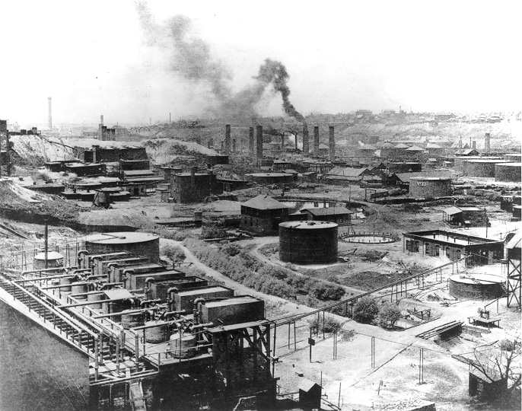
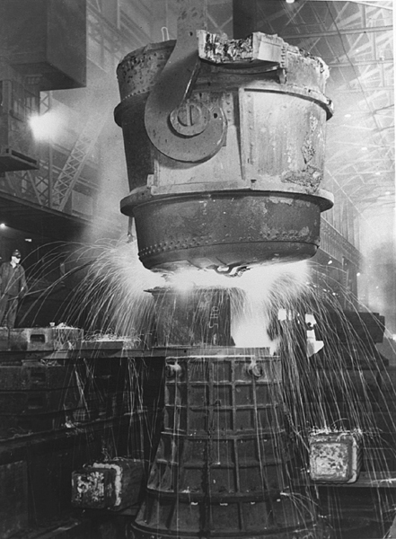
A. NATURAL RESOURCES
Unit 2 EQ 1: What conditions spurred the growth of industry?
iron ore
make steel
found in Minnesota & Pittsburgh

Slide 6
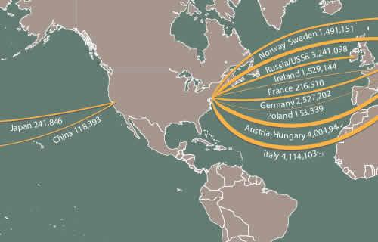
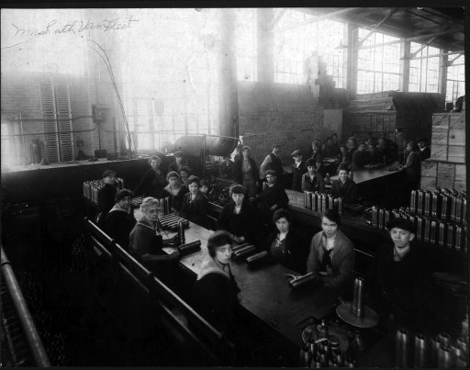
B. INCREASED LABOR FORCE
Unit 2 EQ 1: What conditions spurred the growth of industry?
14 million immigrants
many Americans gave up farming to work in factories

Slide 7
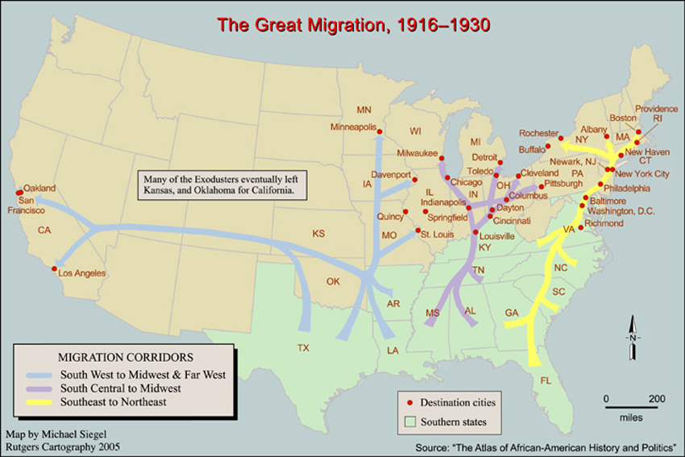
B. INCREASED LABOR FORCE
Unit 2 EQ 1: What conditions spurred the growth of industry?
large number of African Americans move to cities
increased
number of
consumers

Slide 8
C. INCREASED CAPITAL
Unit 2 EQ 1: What conditions spurred the growth of industry?
Investors seek to make money by investing in companies (buying stock) result
companies have more capital ($) to spend on labor and raw materials

Slide 9
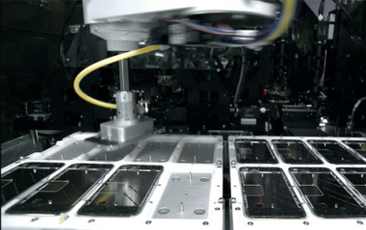
Unit 2 EQ 1: What conditions spurred the growth of industry?

Slide 10
CRQ1: How did people raise enough money to expand their businesses in the 19th century?
Unit 2 EQ 1: What conditions spurred the growth of industry?

Slide 11
D. INCREASED TRANSPORTATION = growth of RR’s in the US
Unit 2 EQ 1: What conditions spurred the growth of industry?
created giant companies
⇑ labor force
⇑ immigration
caused pollution
⇑ migration west
removed NA from land
towns & cities grew
⇑ need for steel
set up time zones

Slide 12
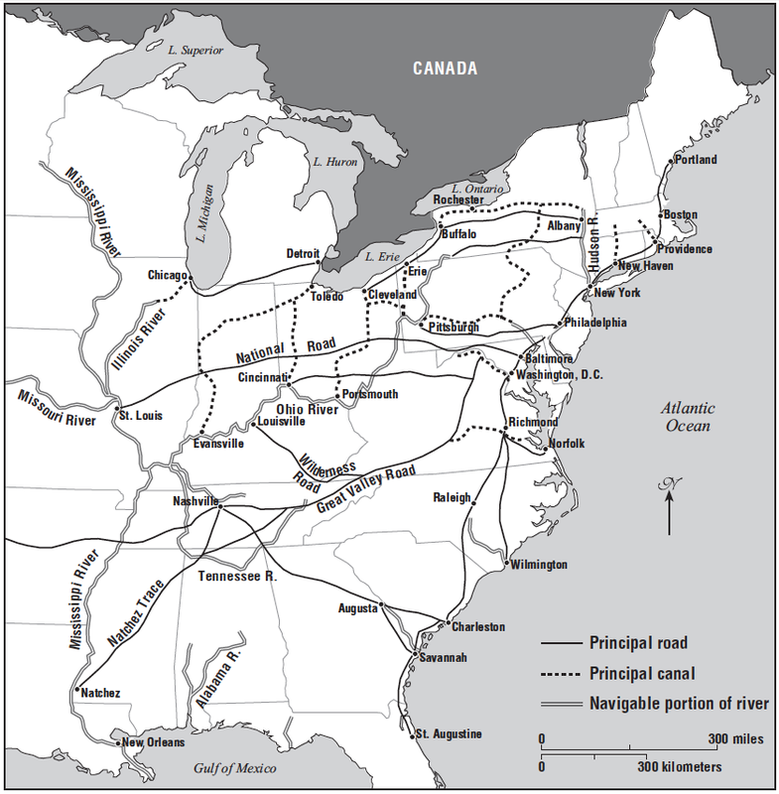
CRQ: Why did the roads and canals go through major cities such as Chicago, New York, Baltimore and Charleston?

Slide 13
II. FREE ENTERPRISE
. free enterprise = individuals & private business are free to organize and operate for profit in competition with others
supply and demand
⇑ supply ⇓ demand / ⇓ supply ⇑ demand

Slide 14
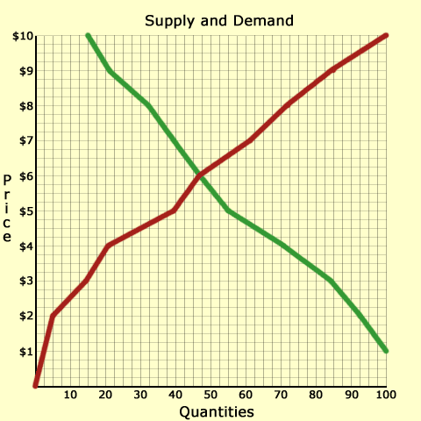
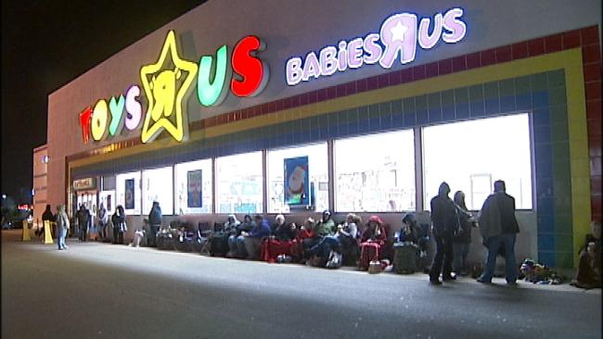

Slide 15
II. FREE ENTERPRISE
C. Entrepreneurs
people who assume the risks for success or failure of the business enterprise
leaders that organize NR and labor, adopt new technology and inventions, and raise capital

Slide 17
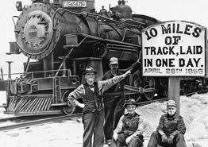
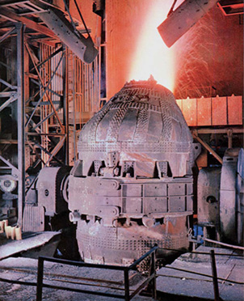
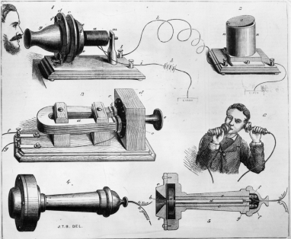
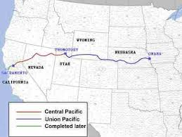
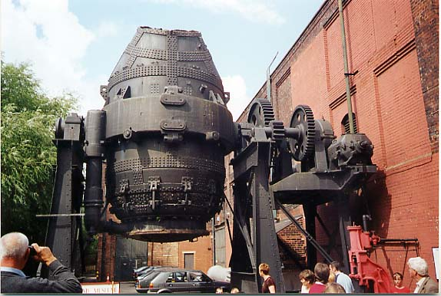
Unit 2 EQ 1: What conditions spurred the growth of industry?
Review the graphic organizers. When you are done, in the appropriate spaces below, explain
HOW natural resources, transportation, and technology supported the post Civil War Industrial Revolution in the United States.
Make one claim each for how natural resources, transportation, and technology supported the post Civil War Industrial Revolution
Support each claim with examples from the graphic organizers
Transportation
Natural Resources
Technology
Industrialization in the United States
Late 1800’s - Early 1900’s

Slide 18
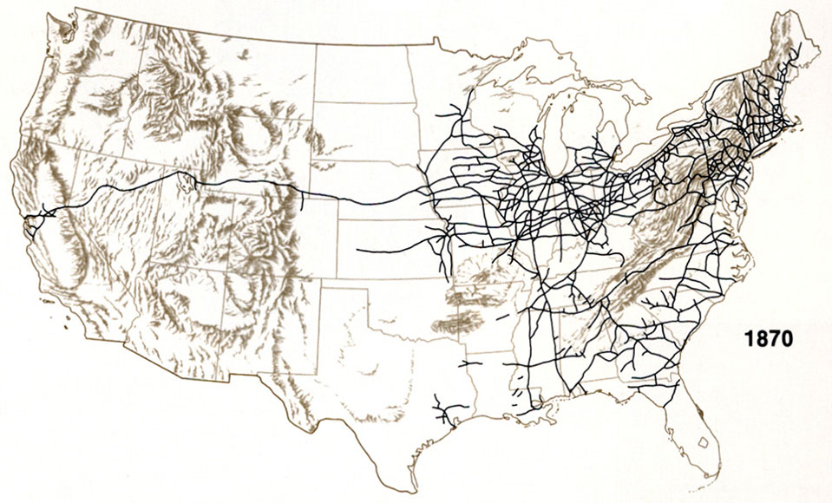
Unit 2 EQ 1: What conditions spurred the growth of industry?

