Slide 1
Unit 3 Part1 Progressive Era

Slide 2
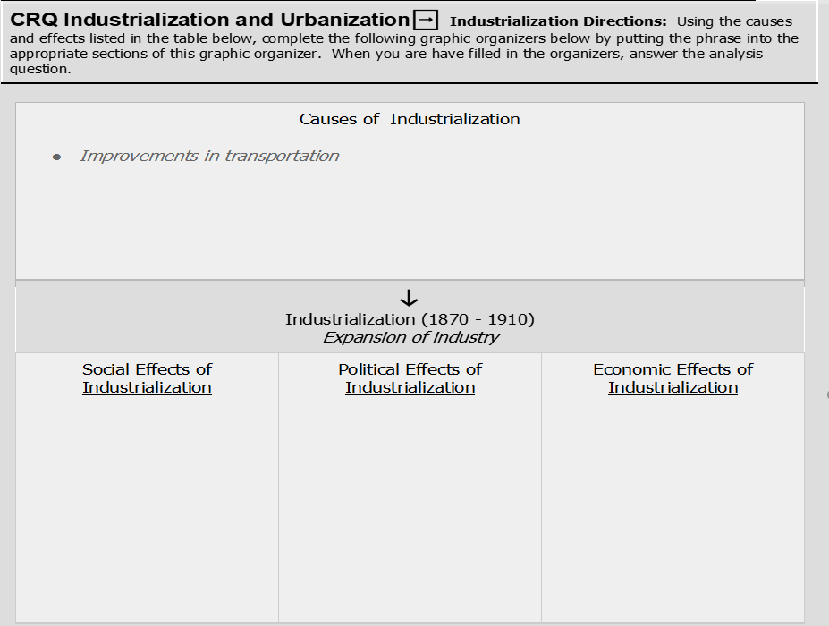
Innovations in technology
Shift from agriculture to manufacturing
Growth of railroads = #1 employer
Discovery of Coal, Oil & Iron
Urbanization shift of people form rural to urban areas
Immigrants to the United States increase as a result of available jobs
Urban areas struggle to provide basic government services
Labor Unions form to protect the rights of workers
Rise of Capitalism = major force
Wealth gap between the rich and poor widens

Slide 3
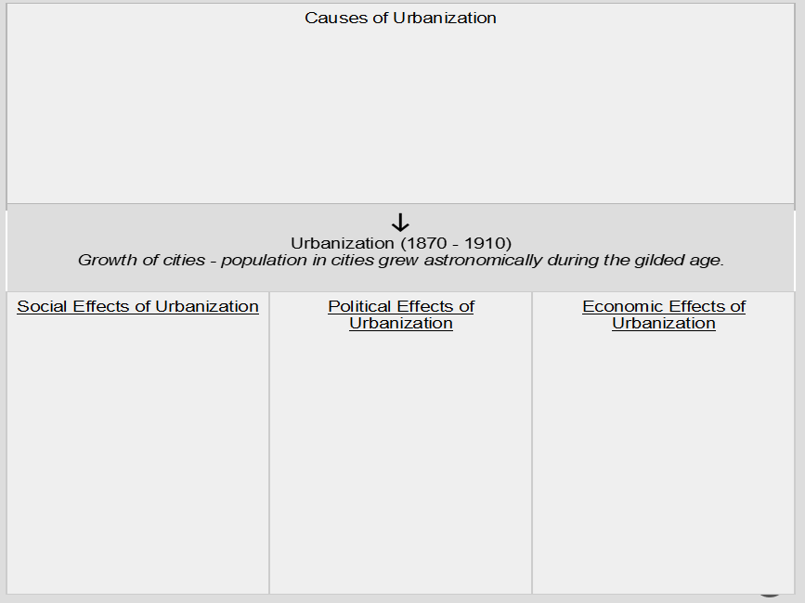
Industrialization
Increase of European immigrants to America
Migration to cities amongst Americans for factory jobs
American Economy shift from Agriculture to Manufacturing
Electric subways and street cars to support growing population
Unsanitary conditions
Tainted water
Industries buy political influence = Government Corruption
Tensions between African Americans and Immigrants
Tenements/ housing for growing population
Environmental pollution
Increase in # of sweatshops
Child labor
Steel and lumber demand increases to build skyscrapers

Slide 4
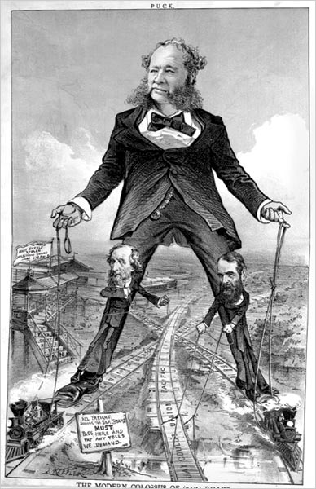
I. Progressivism
reform movement to solve problems of the late 1800’s

Slide 5
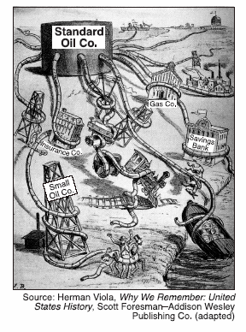
II. Causes of Progressivism
monopolies restricting competition = ⇑ prices
economic depression of 1890’s
corruption in gov’t = political bosses (Boss Tweed)
gap in standard of living = difference between rich & poor

Slide 6
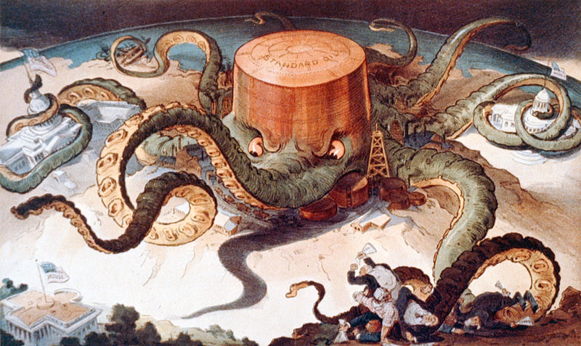
II. Causes of Progressivism
abuse of natural resources
unsafe working conditions
poor sanitation, overcrowding, crime in cities
Influence of the muckrakers

Slide 7
II. Causes of Progressivism
A goal of the Progressive movement was to
reduce the government’s involvement in social issues
correct the problems caused by industrialization
promote laissez-faire policies
promote settlement of land west of the Mississippi River

Slide 8
III. Political Bosses
as cities grew, they needed to expand services
Sewers
garbage collection,
Road construction
city politicians took bribes and were purposefully overcharged for construction projects

Slide 9
III. Political Bosses
3. city bosses were popular with the poor and immigrants
they provided jobs
made loans
gave extra coal in winter
turkeys on Thanksgiving
All in exchange for their vote

Slide 10
Boss William Tweed (Tammany Hall) stole $75 - $200 Million from NYC taxpayers during the 1860’s-1870’s

Slide 11
III. Political Bosses
Reformers of the early 20th century frequently attacked political machines because the politicians in these organizations often
denied voting rights to the poor
accepted bribes in return for favors
wasted money on military spending
discriminated against migrant workers

Slide 12
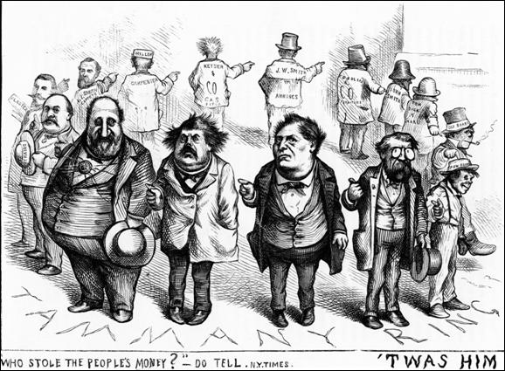

Slide 13
III. Political Bosses
CRQ 1: Which presidents wanted to change the civil service by eliminating patronage?

Slide 14
III. Political Bosses

Slide 15
III. Political Bosses

Slide 16
IV. Muckrakers
= writers & journalists who exposed corruption and injustice in business & politics
Intro Video

Slide 17
V. Changes in the City
End of corruption and political machines
. City Commissioners = run utilities
. City Council = makes laws
. City Manager = direct / guide city

Slide 18
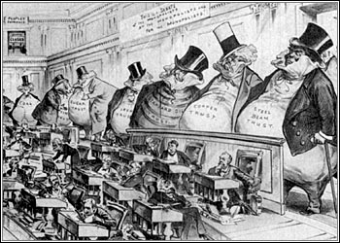
VI. Changes in the Court
Sherman Antitrust Act
= broke up monopolies
2. Interstate Commerce Act (ICC) = regulated RR rates

Slide 20
Initiative

Slide 21
1. The initiative and referendum are considered democratic reforms because they
permit citizens to have a more direct role in lawmaking
let all registered voters select their state’s mayor
Permit the corruption of the presidential candidates
extend the right to vote to 18-year-old citizens

Slide 22
“Governor Defeated in Recall Election”
“Referendum Held on Term Limits”
“Conservationists Propose Initiative on National Parks”
2. These headlines are all examples of Progressive Era reforms designed to
place more power in the hands of the voters
strengthen the power of state legislatures
decrease States rights and increase federal power
exclude specific ethnic groups from the political process

Slide 23
Document 1
Unit 3 EQ 2 What Political Reforms occurred in the progressive era?
Expanding Democracy The governor of Wisconsin in the early 1900s was Robert La Follette. He supported reform and brought changes to the state. He raised taxes for corporations and improved the civil service. He especially brought changes to the electoral process in the state. Candidates had been chosen at state conventions. Party bosses ran the conventions. La Follette started the direct primary. This allowed the voters to choose the candidate for their party. The state of Oregon also made reforms and started the initiative, which allowed citizens to place a measure or an issue on the ballot in a state election. The referendum was established, letting voters accept or reject measures that the state legislature enacted. Voters were able to remove unsatisfactory elected officials from their jobs by the recall. Progressive supporters wanted people to vote for their senators directly. The Constitution gave the state legislature that responsibility. Party bosses and businesses often controlled the selection. The Seventeenth Amendment gave the people a chance to vote for their representatives directly.
1) Explain the historical circumstances that led to the development of the Progressive Political Reforms.__________________________________________________________________________________________________________________________________________________________________________________________________________________________________________________________________________________________________________________________________________________________________________________________

Slide 24
Document 2
Unit 3 EQ 2 What Political Reforms occurred in the progressive era?
“First, we must understand that the character of our citizens is essential to society. In a free and compassionate society, the public good depends on private character. That character is formed and shaped in institutions like family, faith, and…many …social and civic organizations...The future success of our nation depends on our ability to understand the difference between right and wrong and to have the strength of character to make the right choices. Government cannot create character, but it can and should respect and support the institutions that do.”
– Pres. George W. Bush, Calvin College, Grand Rapids, Michigan, May 2005
***Progressives believed that the public interest should guide all government actions
2) Based on this excerpt from President George W. Bush identify his/her point of view concerning the policies of Progressives in the 21st century. ________________________________________________________________________________________________________________________________________________________________________________________________________________________________________________________________________________________________________________

Slide 25
“First, we must understand that the character of our citizens is essential to society. In a free and compassionate society, the public good depends on private character. That character is formed and shaped in institutions like family, faith, and…many …social and civic organizations...The future success of our nation depends on our ability to understand the difference between right and wrong and to have the strength of character to make the right choices. Government cannot create character, but it can and should respect and support the institutions that do.” – Pres. George W. Bush, Calvin College, Grand Rapids, Michigan, May 2005
Expanding Democracy The governor of Wisconsin in the early 1900s was Robert La Follette. He supported reform and brought changes to the state. He raised taxes for corporations and improved the civil service. He especially brought changes to the electoral process in the state. Candidates had been chosen at state conventions. Party bosses ran the conventions. La Follette started the direct primary. This allowed the voters to choose the candidate for their party. The state of Oregon also made reforms and started the initiative, which allowed citizens to place a measure or an issue on the ballot in a state election. The referendum was established, letting voters accept or reject measures that the state legislature enacted. Voters were able to remove unsatisfactory elected officials from their jobs by the recall. Progressive supporters wanted people to vote for their senators directly. The Constitution gave the state legislature that responsibility. Party bosses and businesses often controlled the selection. The Seventeenth Amendment gave the people a chance to vote for their representatives directly.
3) Identify and explain a cause and effect relationship associated with the events or ideas in documents 1 and 2. Be sure to use evidence from both documents 1 and 2 in your response.
____________________________________________________________________________________________________________________________________________________________________________________________________________________________________________________________________________________________________________________________________________________________________________________________________________________________________________________________________________________________________________________________________________________________________________________________________________________________________________________________________________________________________________
Unit 3 EQ 2 What Political Reforms occurred in the progressive era?

Slide 26
I. Progressives and Amendments A. 16th Amendment
Progressive Income Tax (1913)
tax people heavier with greater incomes
Result = tax $ from the wealthy was spent to benefit all people

Slide 27
B. 17th Amendment
Direct Election of Senators (1913)
Lead to a cut down on corruption
Worked to end state legislatures taking bribes
gave the people more power

Slide 28
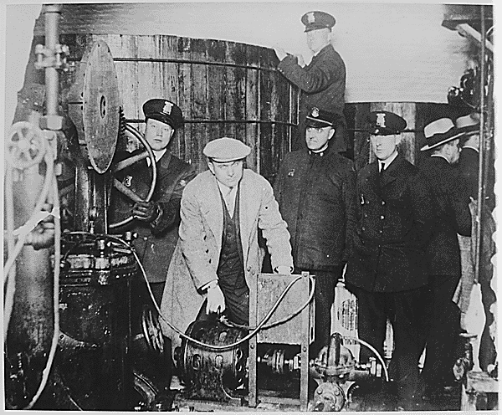
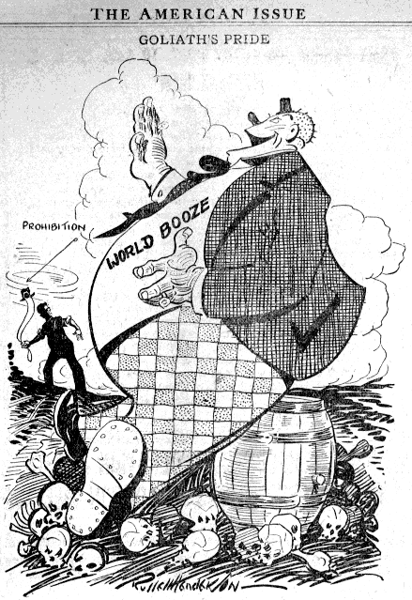
C. 18th Amendment
Prohibition (1919)
made the sale of alcohol illegal
Why was it created?
= workers were less productive
= factories lost $
= families had to deal with drunk behavior

Slide 29
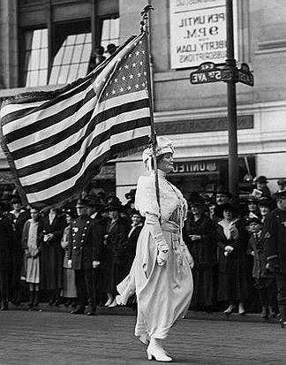
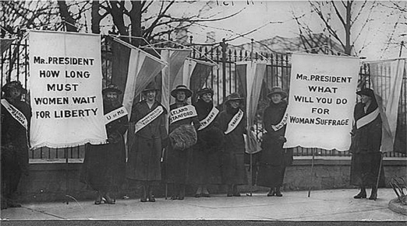
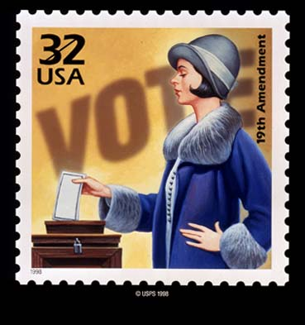
D. 19th Amendment
Women’s Suffrage (1920)
= equal rights
= began when Women’s National Rights Convention was formed in Seneca Falls, NY

