Slide 1
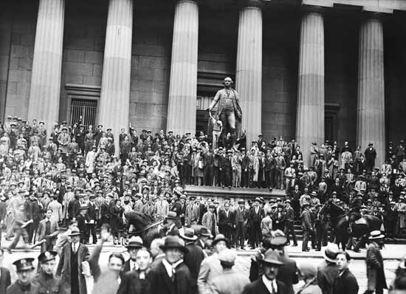
I. Causes to the Great Depression (1929-1941)
unequal distribution of wealth
high tariffs - Smoot-Hawley Tariff 1930 - highest tariff in history
Unit 6 Objective EQ 1: How did the prosperity of the 1920’s give way to the Great Depression?

Slide 2
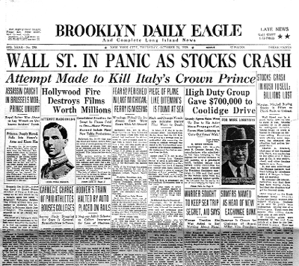
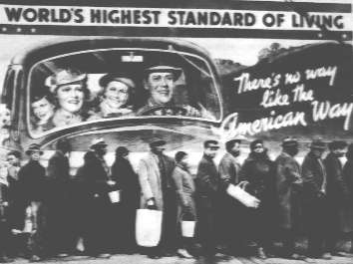
I. Causes to the Great Depression (1929-1941)
war debts from WWI
overproduction both in industry and agriculture
Unit 6 Objective EQ 1: How did the prosperity of the 1920’s give way to the Great Depression?

Slide 3
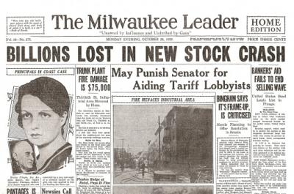
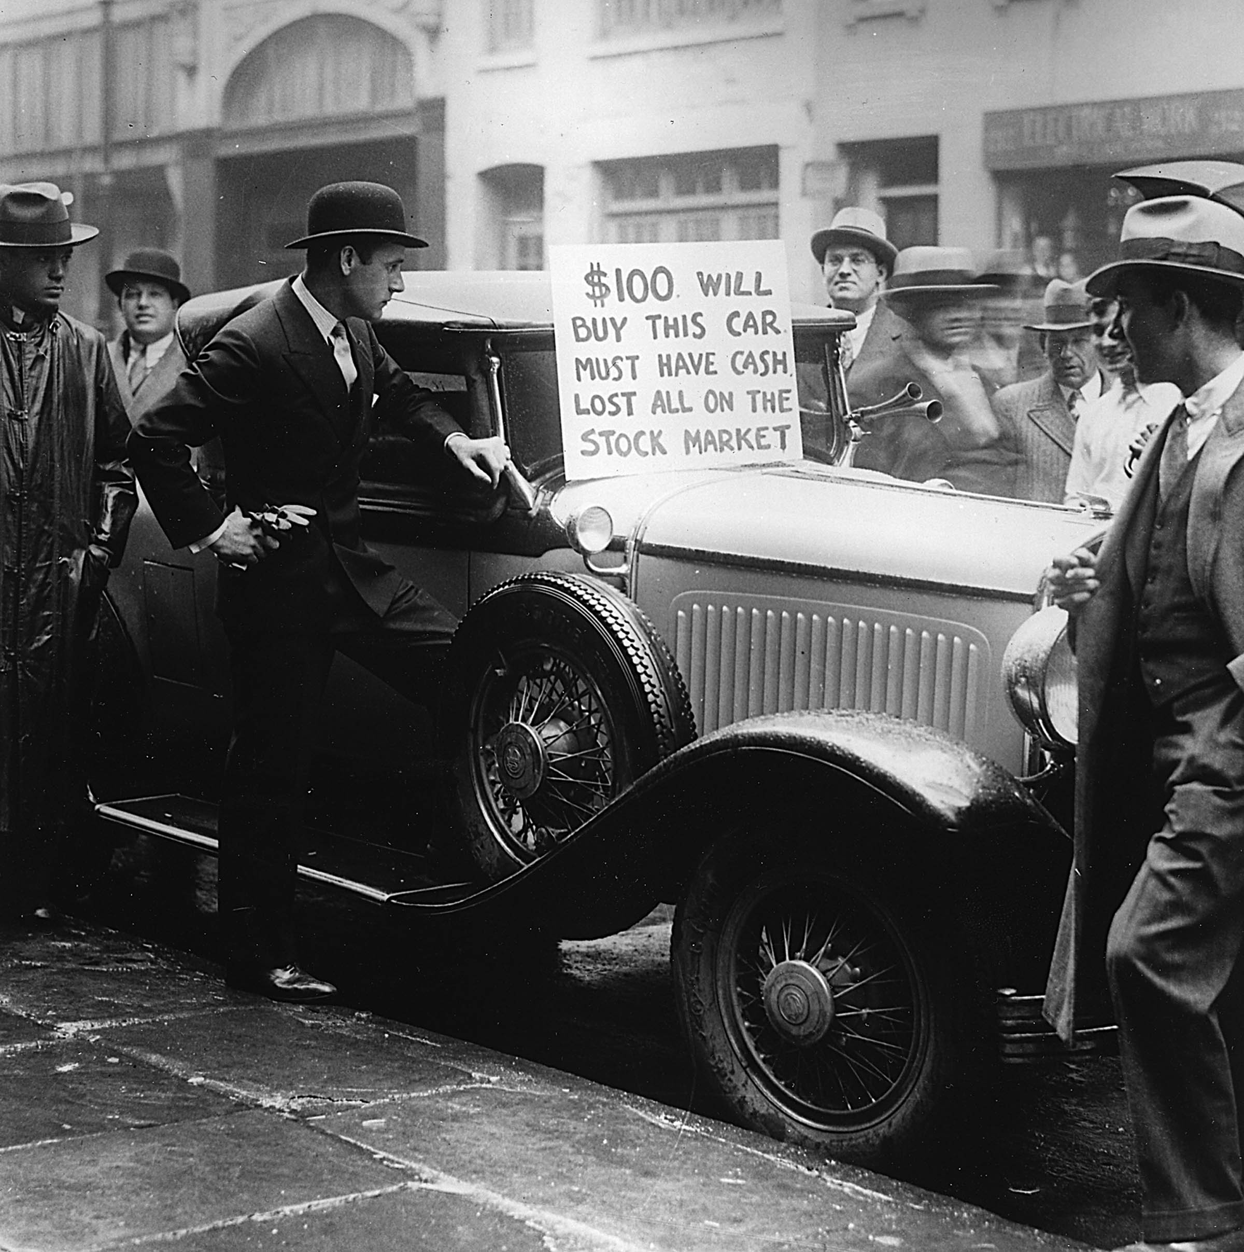
I. Causes to the Great Depression (1929-1941)
weak banking system - not regulated
stock market crash - Black Tuesday, Oct. 29th, 1929
Unit 6 Objective EQ 1: How did the prosperity of the 1920’s give way to the Great Depression?

Slide 5
America: The Story of Us
Episode 9: Bust : Episode Summary: Boom turns to bust when the stock market crash ushers in the Great Depression.
Directions: Watch the video
https://www.youtube.com/watch?v=PoV7GGN-u7Q
Start – 6:00min
The 1920’s were boom time. In 1929, more money was spent on _____________________ than education.
2) In an age of consumerism and capitalism over $___billion goods are bought on credit
3) ___% of Americans had no savings.
4) In October 1929, the stock market loses _____ times more money in three weeks than the government spends in a year.
5) Only the ___% of Americans who owned stock were immediately affected by the stock market. The rest of them got on with their lives until the Bank of the U.S collapsed.
6) In the last 60 days of 1930, over _________(#) of banks closed nationwide. By 1933, there were ____ states without banks.
7) Unemployment in the United States went from ___ million 1930 to ___ million in 1932. Every day __________________ homes are repossessed.
Unit 6 Objective EQ 1: How did the prosperity of the 1920’s give way to the Great Depression?

Slide 6
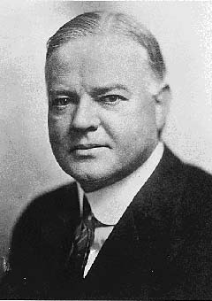
II. Hoover’s Attempt to Stop the Depression
Indirect Relief
a.k.a. Trickle Down Theory
lend $ to business recovery
business invest the $
Unit 6 Objective EQ 1: How did the prosperity of the 1920’s give way to the Great Depression?

Slide 7
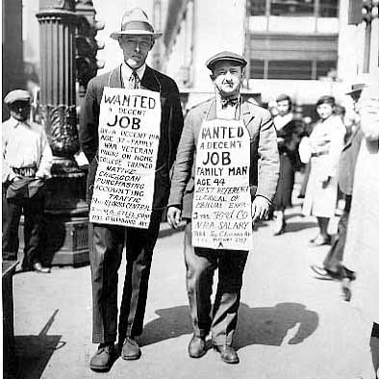
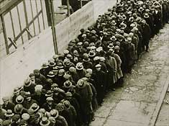
II. Hoover’s Attempt to Stop the Depression
Indirect Relief
businesses will expand and hire workers
workers will have $ to buy products
this would stimulate business to increase employment
Unit 6 Objective EQ 1: How did the prosperity of the 1920’s give way to the Great Depression?

Slide 8
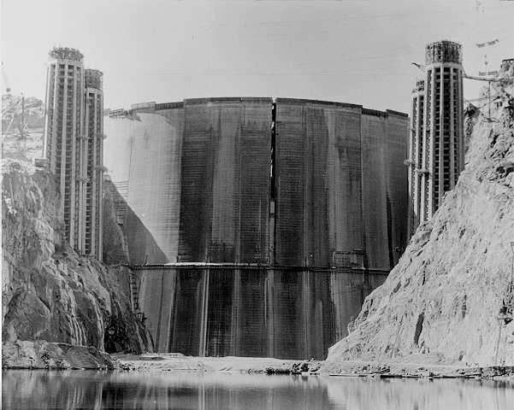
II. Hoover’s Attempt to Stop the Depression
Indirect Relief
government created some work project jobs to ⇓ unemployment
Unit 6 Objective EQ 1: How did the prosperity of the 1920’s give way to the Great Depression?

Slide 9
CRQ1: What historical circumstances led thousands of banks to close in the early 1930s?TTQA
Unit 6 Objective EQ 1: How did the prosperity of the 1920’s give way to the Great Depression?

Slide 10
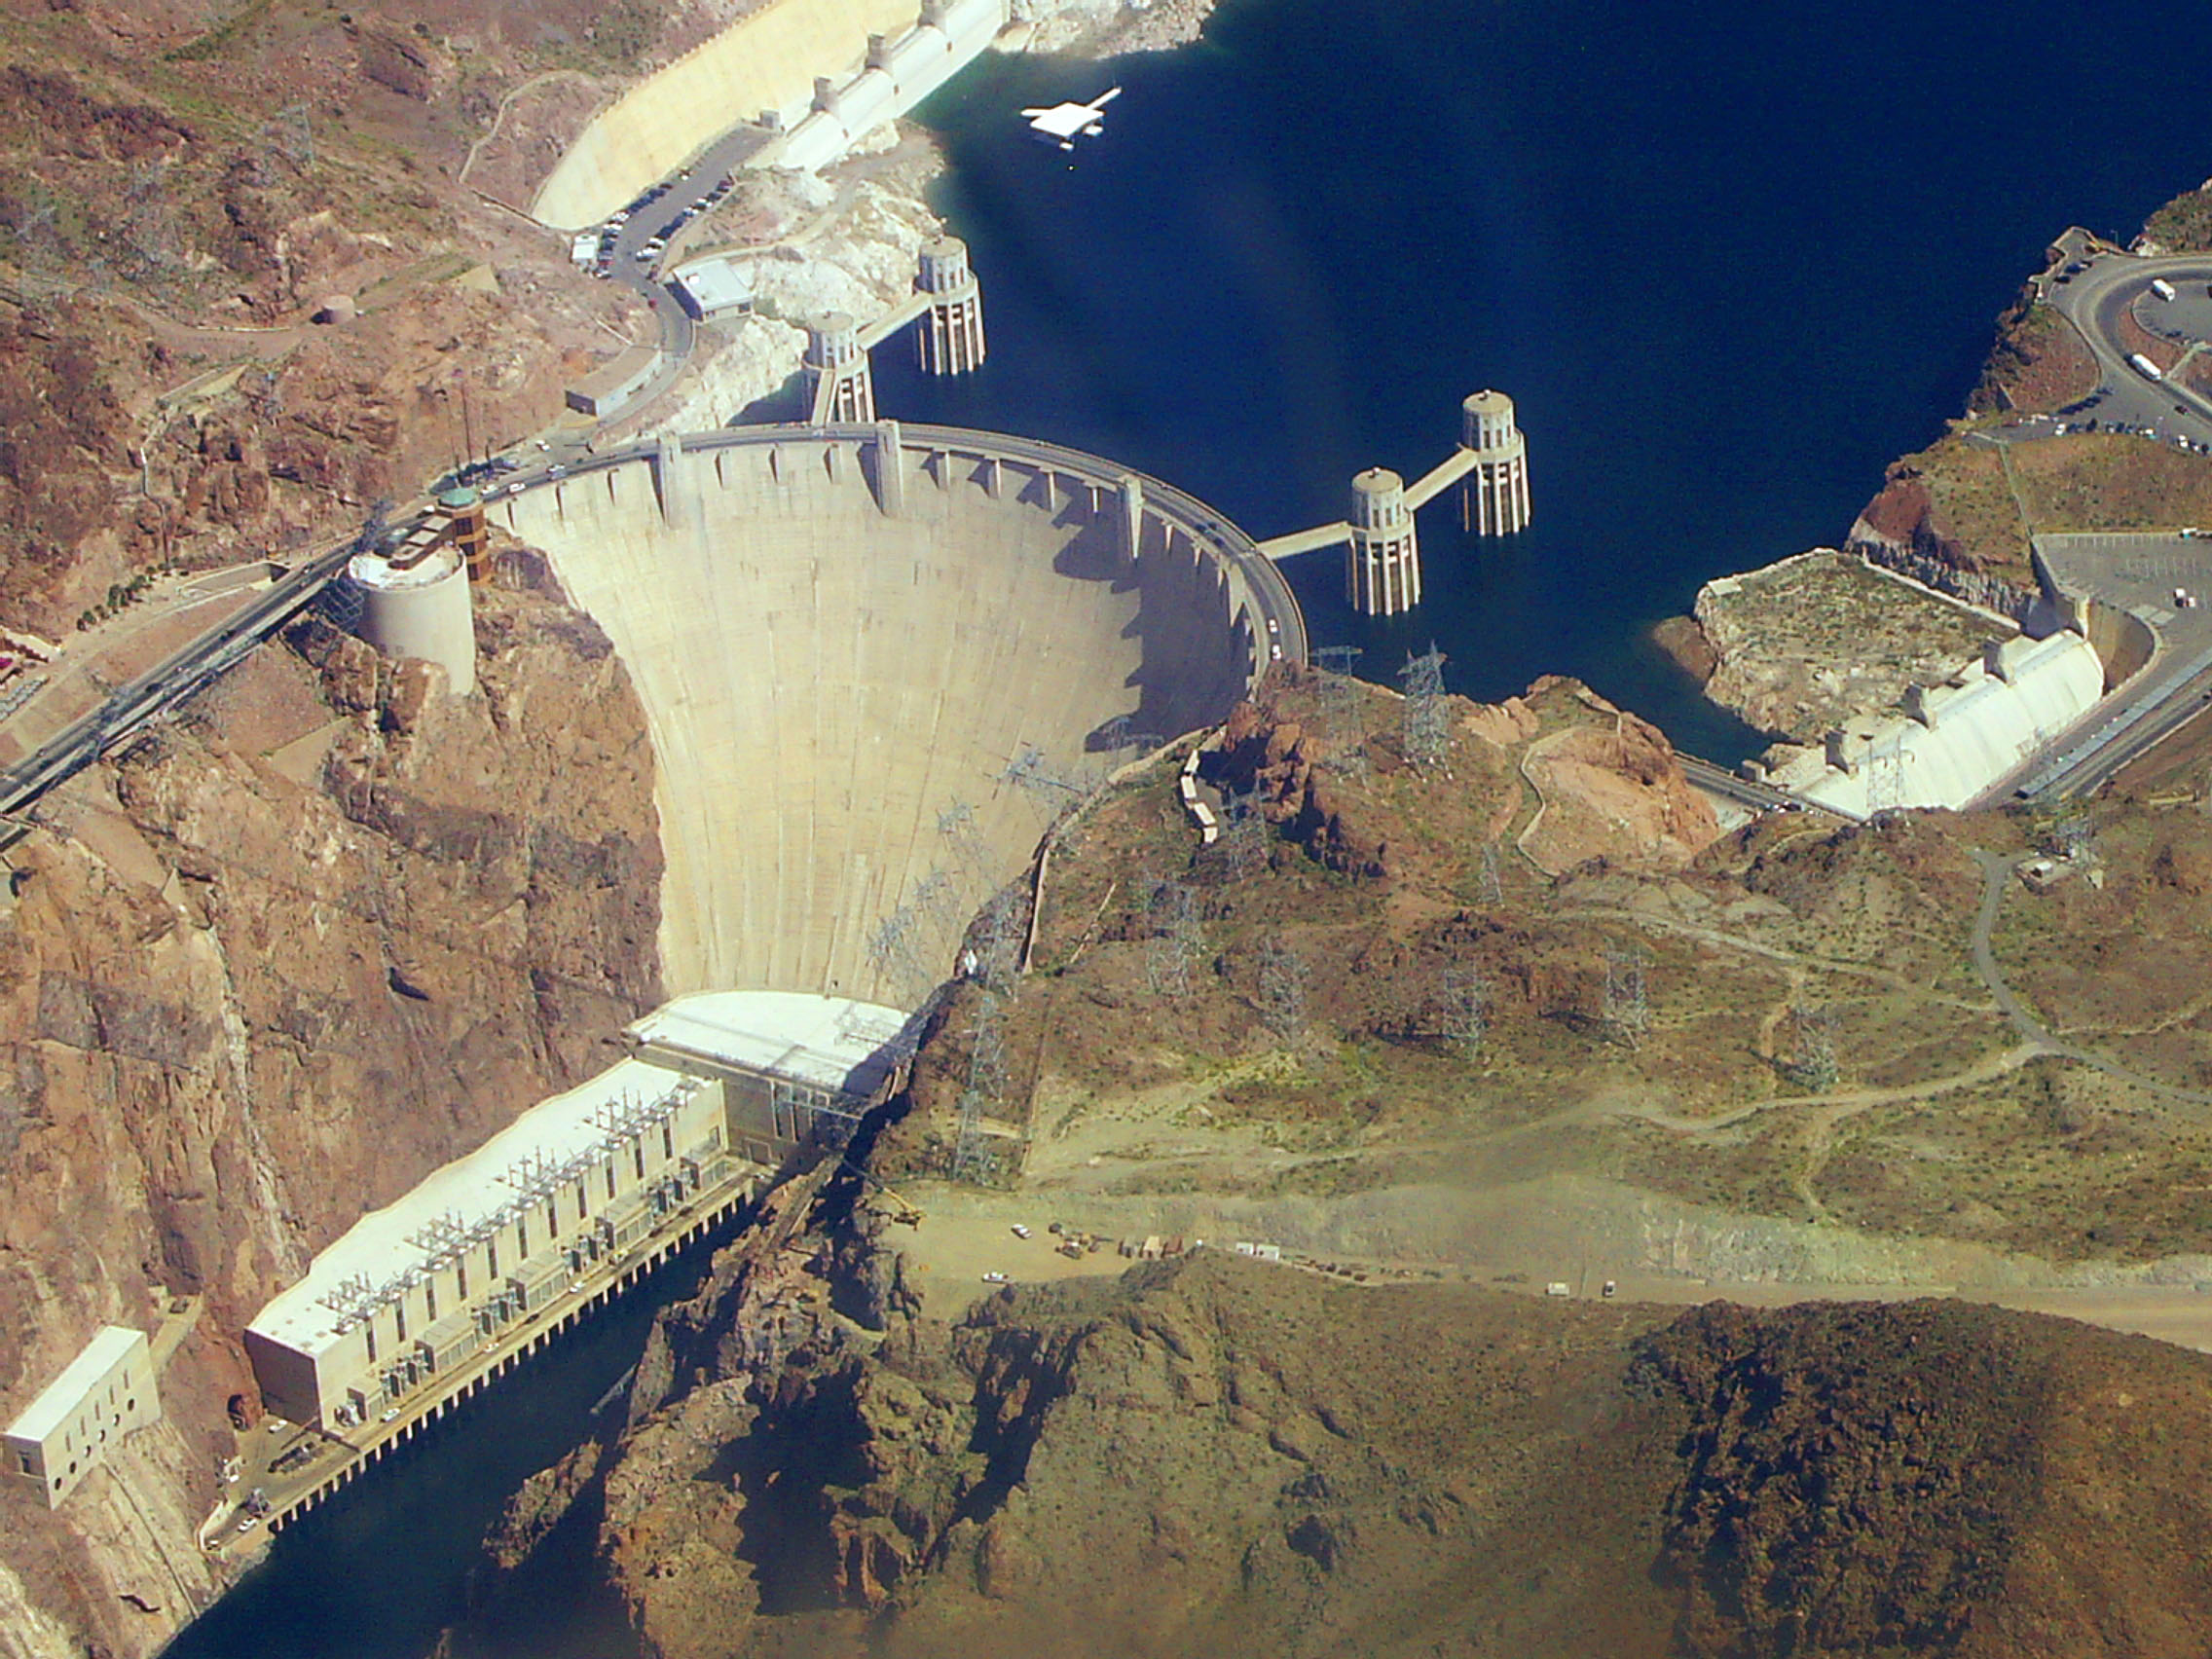
America: The Story of Us
Episode 9: Bust - Episode Summary: The Hoover Dam and an attempt at government assistance Watch the Vide 6:00 min – 18:55
8) Hoover Dam, a public works project, provided employment for _____ men. It will provide water and electricity for the American southwest.
9) Hoover Dam creates the largest water reservoir in the U.S., Lake ________ and allows _____________ to produce more food than any other state in the U.S.
10) One side-effect of the Hoover Dam was that ________________________________________, a tiny nearby town of 5,000 boomed as construction workers traveled for parties and gambling. Today over _____ million people travel there every year.
https://www.youtube.com/watch?v=PoV7GGN-u7Q

Slide 11
B. Hoovervilles = shacks homeless people lived in during the Depression
Unit 6 Objective EQ 1: How did the prosperity of the 1920’s give way to the Great Depression?
1. As a way of criticizing the federal government during the early 1930s, areas such as those showing this photograph were often referred to as
A. Tenements
B. Levittown’s
C. Ghettos
D. Hooverville’s

Slide 12
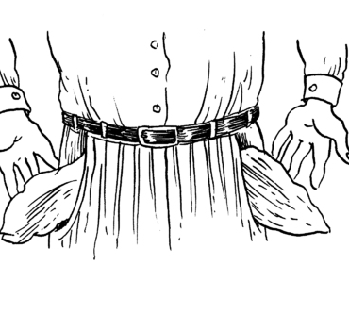
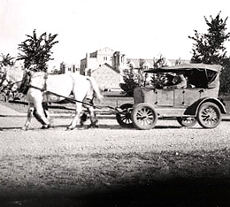

Slide 13
B. Hoovervilles = shacks homeless people lived in during the Depression
Unit 6 Objective EQ 1: How did the prosperity of the 1920’s give way to the Great Depression?
2. According to the political cartoon President Hoover
A. developed policies that effectively ended the Great Depression
B. blamed poor people for causing the Great Depression
C.failed to meet the needs of many Americans
D. supported the creation of more “Hooverville’s”

Slide 14
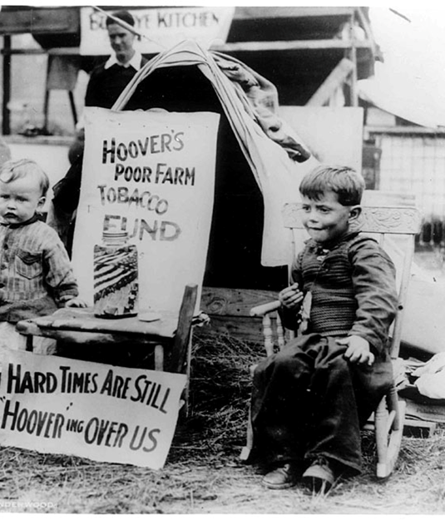
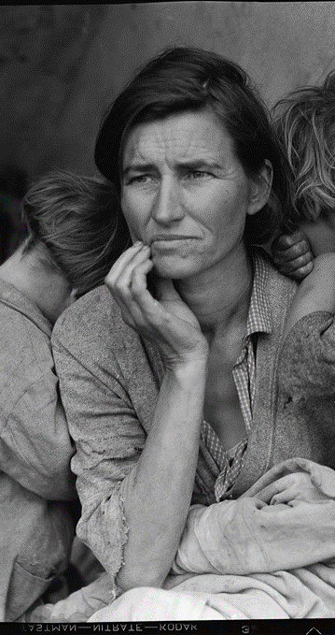

Slide 15
B. Hoovervilles = shacks homeless people lived in during the Depression
Unit 6 Objective EQ 1: How did the prosperity of the 1920’s give way to the Great Depression?
3. In the early 1930s, many communities of homeless Americans were referred to as “Hooverville’s” because President Herbert Hoover
A. grew up in a poverty-stricken area due to waterfall economics
B. guaranteed jobs to the unemployed under welfare economics
C. provided food and clothing for the poor under trickle-down economics
D. opposed direct federal aid for the unemployed under trickle-down economics

Slide 17
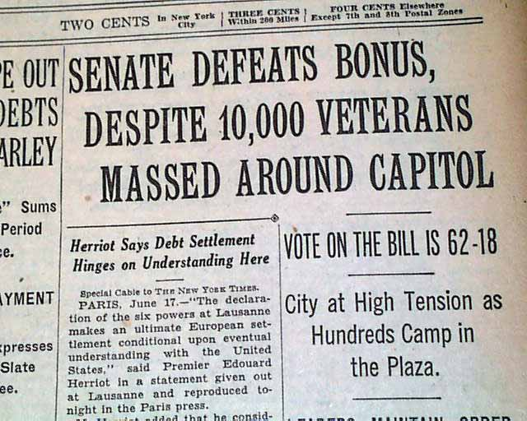
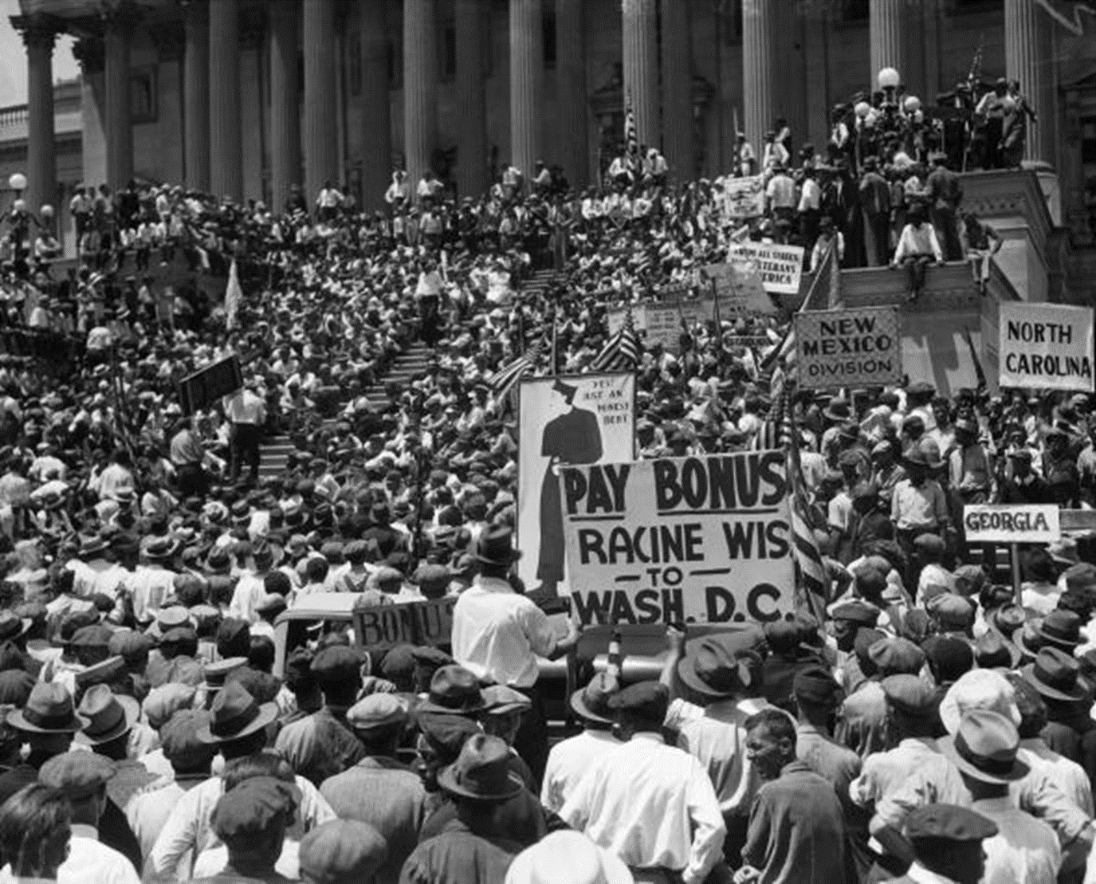
C. Bonus Army of 1932
II. Hoover’s Attempt to Stop the Depression
WWI veterans wanted bonuses promised for service in WWI
Congress votes against the early bonus
Unit 6 Objective EQ 1: How did the prosperity of the 1920’s give way to the Great Depression?

Slide 18
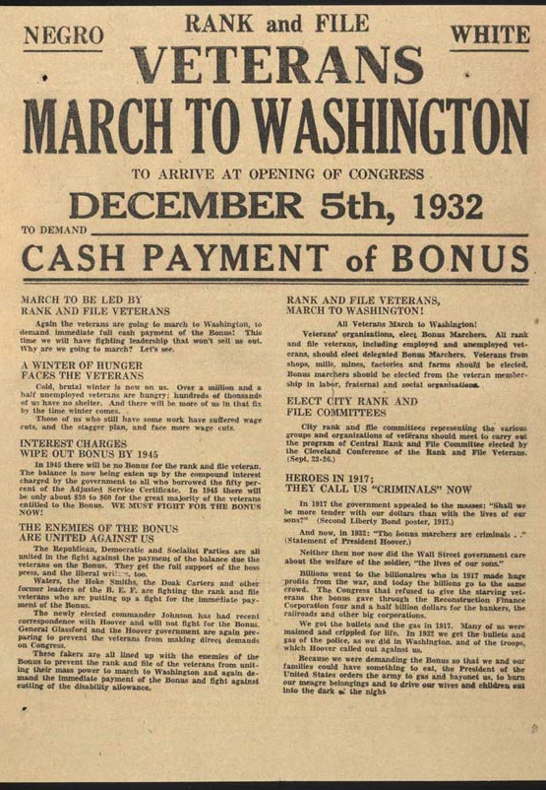
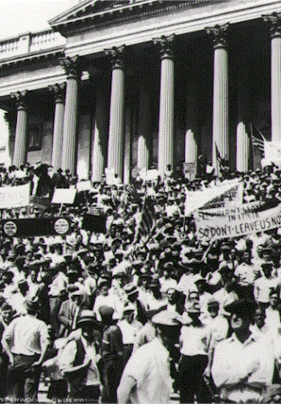

Slide 19
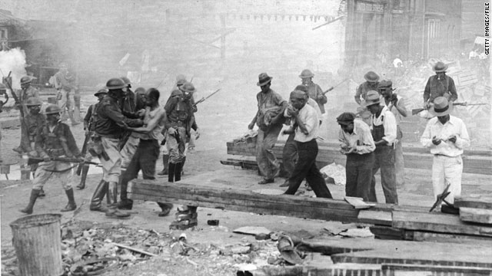
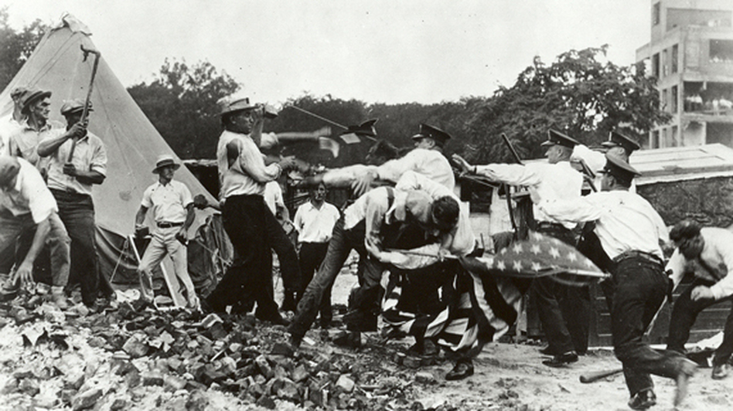
C. Bonus Army of 1932
II. Hoover’s Attempt to Stop the Depression
U.S. Army breaks up Bonus Army
Hoover’s popularity ⇓
Unit 6 Objective EQ 1: How did the prosperity of the 1920’s give way to the Great Depression?

Slide 20
C. Bonus Army of 1932
Directions: Watch the Bonus Army Video & Answer the Questions Below
1. What did the Bonus Army want from the government?
2. What action did the U.S. Government take against the veterans marching for their bonus?
3. What was the Historical Significance of the that action?
https://www.youtube.com/watch?v=sNOsIB5VMSQ
Unit 6 Objective EQ 1: How did the prosperity of the 1920’s give way to the Great Depression?

Slide 21
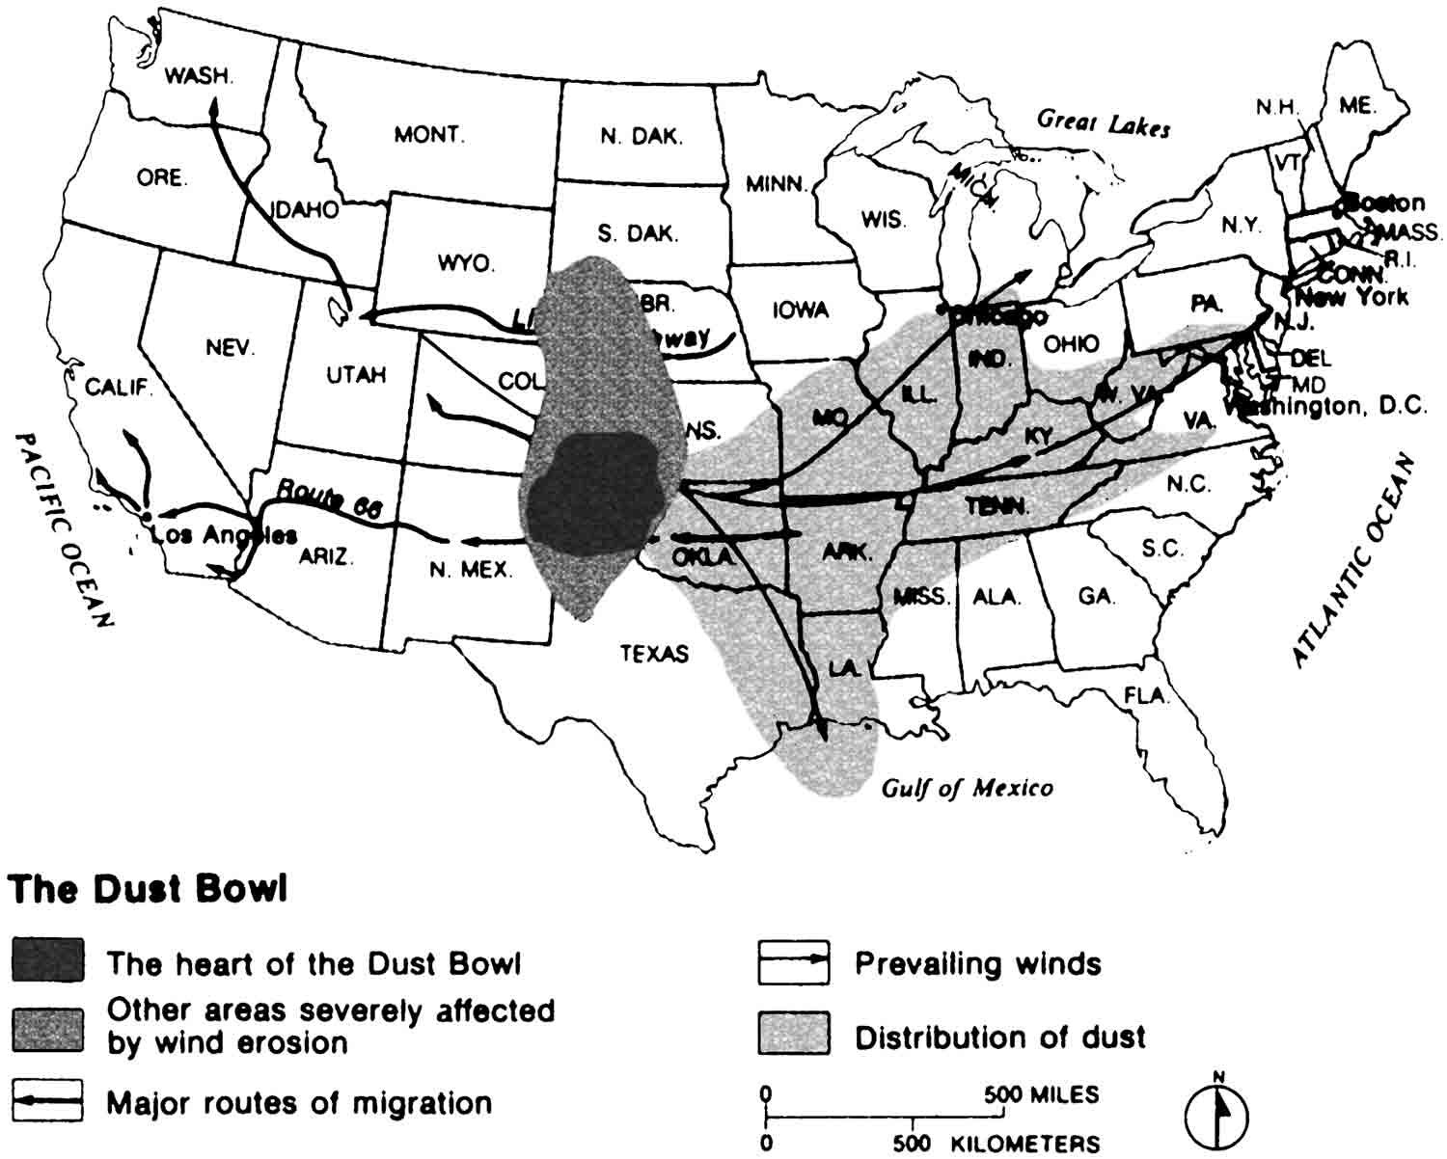
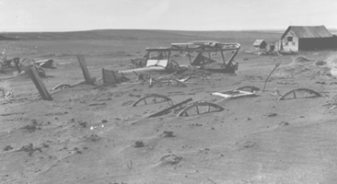
D. Dust Bowl- from the Southwest
II. Hoover’s Attempt to Stop the Depression
caused from plowing under prairie grass for crops
most people from Oklahoma migrated to California looking for work
Unit 6 Objective EQ 1: How did the prosperity of the 1920’s give way to the Great Depression?

Slide 22
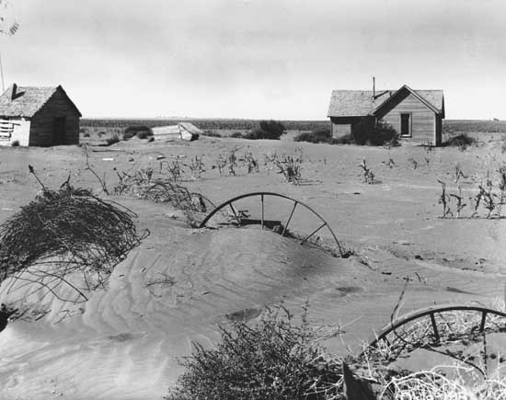
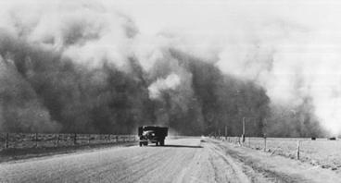
D. Dust Bowl- from the Southwest
a.k.a. Okies
influences John Steinbeck’s book The Grapes of Wrath
story about migrant Okies living conditions
search for employment
result = people could only wait for the depression to end

Slide 23
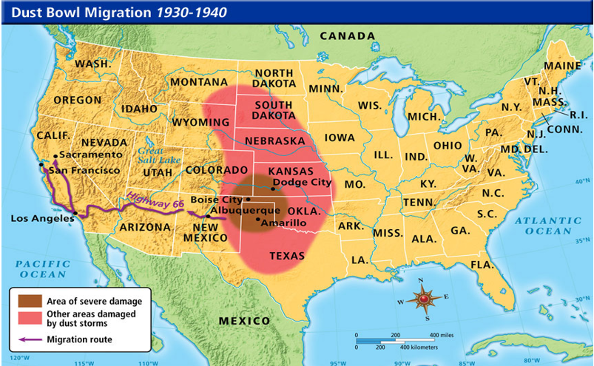

Slide 24
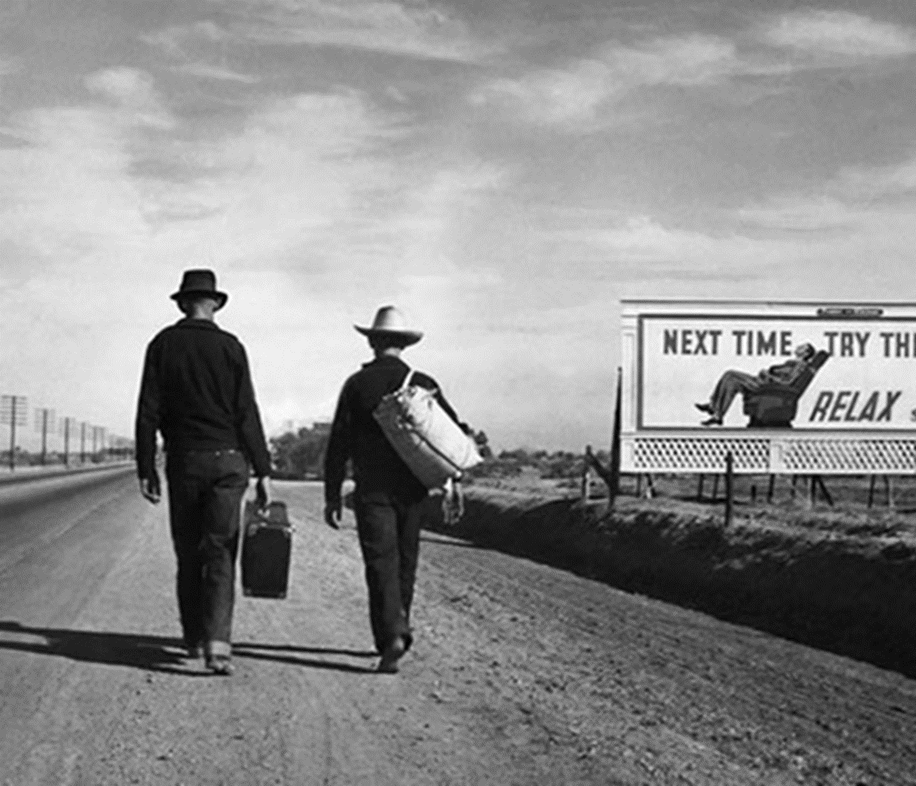
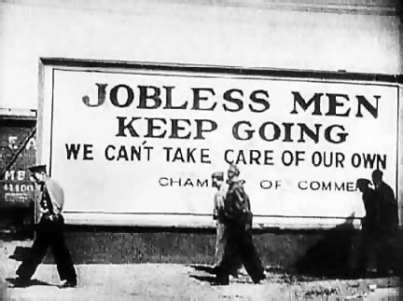

Slide 25
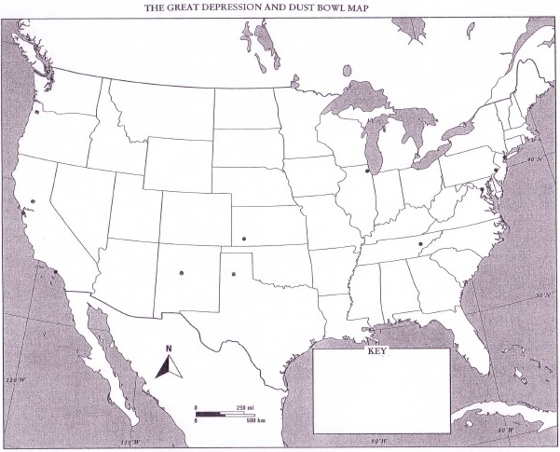
What are the names of the states that were damaged by the dust storms?
1.
2.
3.
4.
5.
6.
7.
8.
9.
10.
Unit 6 Objective EQ 1: How did the prosperity of the 1920’s give way to the Great Depression?

Slide 26
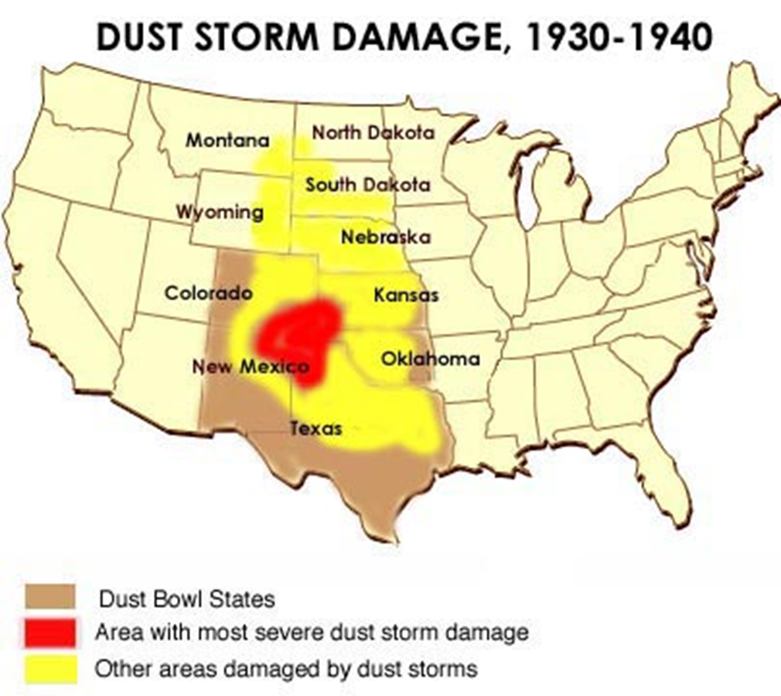
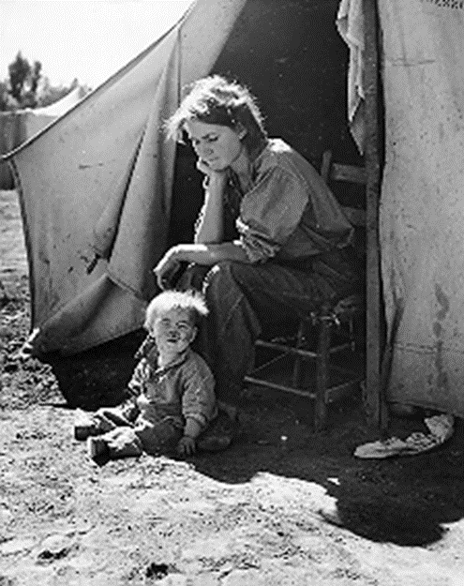

Slide 27
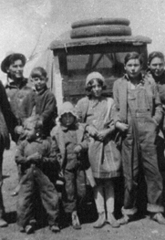
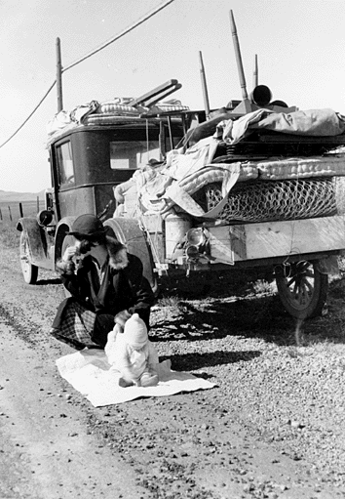

Slide 28
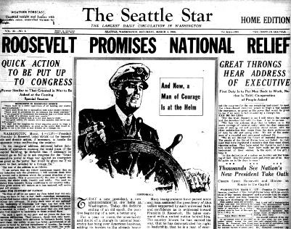
III. Effects of the Great Depression
Hunger, Poverty, Unemployment
Worldwide Economic Crisis
Election of Franklin Roosevelt (FDR) and his New Deal Policies
Unit 6 Objective EQ 2: How did the New Deal attempt to address the problems of the Great Depression?

Slide 29
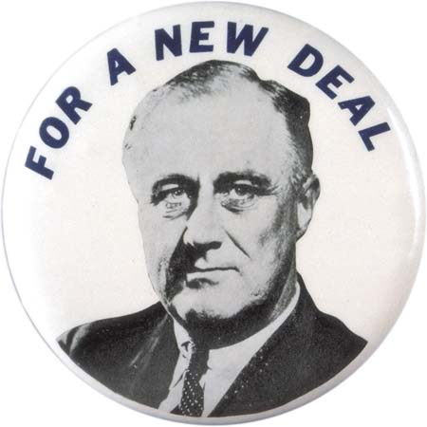
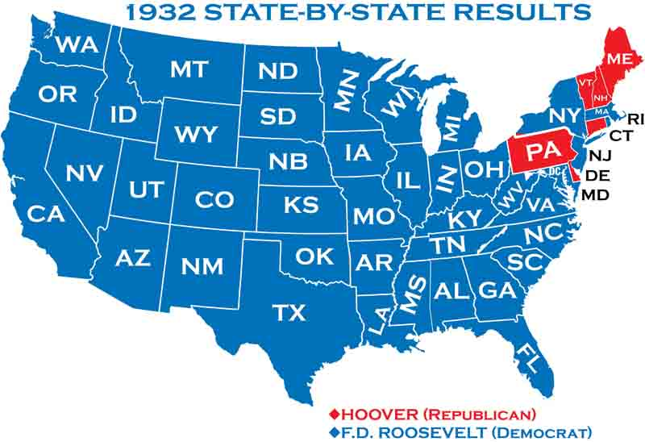
IV. The New Deal
Why did Roosevelt get elected?
In what two ways did Roosevelt achieve the 3 R’s?
Explain how the 1st and 2nd New Deals were different
Why was the FDIC so important in jump starting the New Deal?
The New Deal
History Brief : The following video provides a short introduction to Franklin Roosevelt's "New Deal" programs which he put in place after winning the presidency
Directions: Watch the video
https://www.youtube.com/watch?time_continue=1&v=0rjtOWn5mj0

