Slide 1
SS Grade 7 Name: _________________________ Period:
MODULE: Unit 6 Part 1- Articles of Confederation
Objective: What were the Strengths and Weaknesses of the Articles of Confederation?
Table of Contents
Date | Topic(s) | Page Numbers
Days 1 - 2 | Intro to the Articles of Confederation | 2-5
Days 3 - 8 | Weaknesses of the Articles of Confederation | 6 -18
Days 9-11 | Shay’s Rebellion | 19 - 24
Days 12 | North West Ordinance | 25

Slide 2
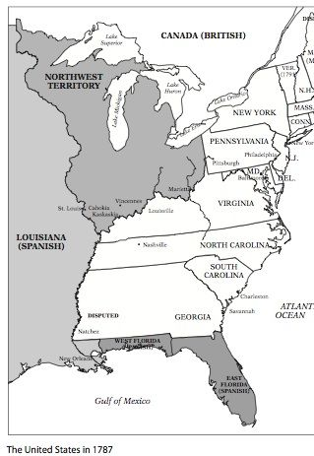
I. Articles of Confederation (1777-1789):
What were the Articles of Confederation?
a plan to resolve the slavery conflict
a plan for central government
a plan for state government
a plan for the government of the Northwest Territory
America’s system of __________________ during most of the _________________ _______________ & _____ ___________ __________.
Established a ________________/ friendship between the 13 free and _____________________ ________________.
Established only a ________________________ or _________ ____________-making body (Congress) of government.
Results:
The Articles of Confederation would last for ____ years.
America’s 1st system of government ______________.
Objective: What were the Strengths and Weaknesses of the Articles of Confederation?

Slide 3
Articles of Confederation Over Simplified
Directions: Watch the Video & Answer the questions 9:30 min
https://www.youtube.com/playlist?list=PLhyKYa0YJ_5A9iLoiK_KYiCNVsCT11vZ9
What historical circumstance led the radicals and the loyalists to work together in order to get the British to remove the intolerable acts?
What did the Olive Branch petition attempt to do?
How did the Loyalists and Colonists view about a state militia (army) disagree?
What did 3 plans did the Continental Congress have for the newly independent Colonies?
6. What historical impact did the Haudenosaunee have on the new government ?
7. Why did states not support the Plan of Union?
8. Under the Articles of Confederation does the congress have power over the states?
Objective: What were the Strengths and Weaknesses of the Articles of Confederation?

Slide 4
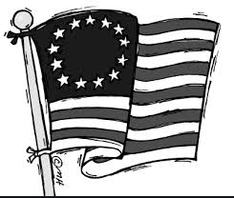
Articles of Confederation
Power Stations:
1
The A of C | First attempt at Government Answers
During what event were the Articles created?
What was the purpose of the document?
What period of history were the Articles of Confederation used?
Where is the majority of the power? Why?
Structure of the Confederation Government
Objective: What were the Strengths and Weaknesses of the Articles of Confederation?

Slide 5
Articles of Confederation
Power Stations:
2
Which of the following was established by the Declaration of Independence?
A new Country
A representative Government
A monetary system
The right to vote?
To Pass a law under the Articles of Confederation, Congress must pass it with
A minimum of a 9/13 vote.
A minimum of a 11/13 vote.
Unanimously
A minimum of a 7/13 vote.
What factor convinced the framers of the Articles of Confederation to create a weak central government?
The division between revolutionaries and loyalists
Distrust between Northern and Southern States
The States unwillingness to limit their own authority
Cultural differences between Americans and Europeans
Place the following events in sequence: A) Declaration of Independence is signed; B) Shays' Rebellion; C) Articles of Confederation are written; D) Revolutionary War ends.
( C,A,B,D)
( A,C,D,B)
(A,B,D,C)
(C,B,A,D)
KEY TO UNLOCK NEXT PUZZLE PIECE
_____ _____ _____ _____
1 2 3 4
https://www.brainpop.com/socialstudies/ushistory/articlesofconfederation/
Objective: What were the Strengths and Weaknesses of the Articles of Confederation?

Slide 6
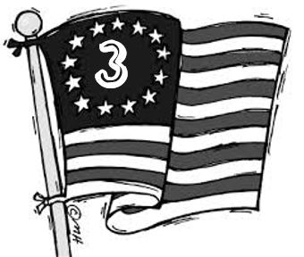
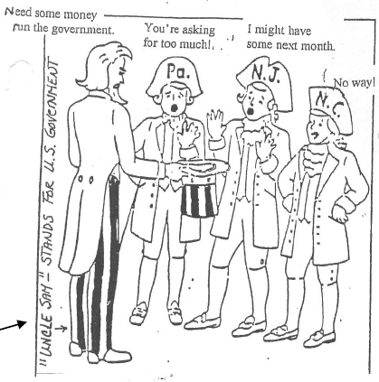
II. WEAKNESSES UNDER THE ARTICLES OF CONFEDERATION:
https://www.thinglink.com/scene/1293682326777102338
National (Federal) Government Lacked the Power to Tax
Historical Circumstances | Historical Impact
America owed ______________________ & foreign nations _______________________from the American Revolution. To get __________________ ($) the federal government had to ___________________ money from the states. | Congress asked for $_________ million from states and received less than $________ million. The U.S. was deeply in ____________. The U.S. could not fund an ___________ or ___________.
Objective: What were the Strengths and Weaknesses of the Articles of Confederation?

Slide 7
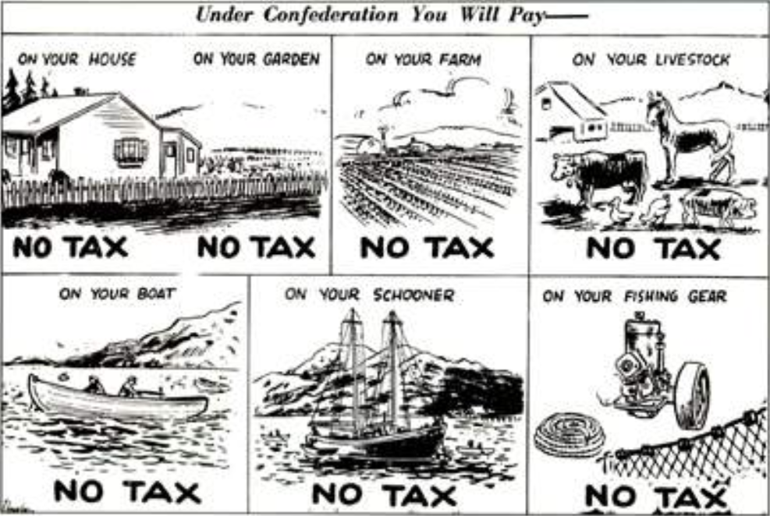
II. WEAKNESSES UNDER THE ARTICLES OF CONFEDERATION:
National (Federal) Government Lacked the Power to Tax
The Confederation government did not have the power to deal with the country’s financial problems. Problems continued with Britain and Spain over land and trade issues. The Continental Congress owed other countries and many citizens a lot of money after the war
By 1781 money printed during the Revolutionary War had fallen in value, or depreciated, and was almost worthless. Congress and the states printed paper money without the gold and silver to back it up. Neither had the power to tax the citizens.
A. One of the biggest issues facing the states after the war was
Overseeing the return of runaway slaves.
Dealing with the massive war debts they had incurred.
Meeting their responsibility under the Treaty of Paris to identify all British graves.
Deciding whether to grant camp followers war pensions.
B. The Articles of Confederation gave the states
no power.
the same power as the national government.
less power than the national government.
more power than the national government
KEY TO UNLOCK NEXT PUZZLE PIECE
_____+ ____ = ______
Objective: What were the Strengths and Weaknesses of the Articles of Confederation?

Slide 8
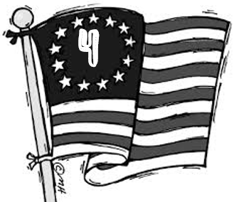
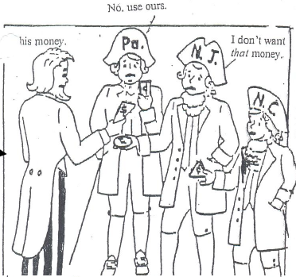
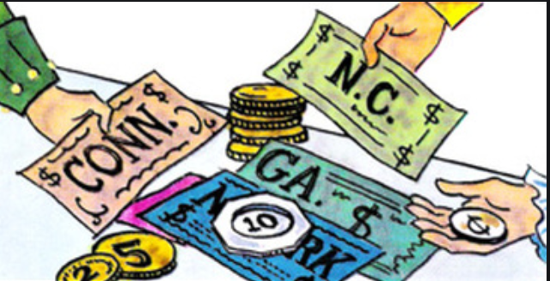
II. Weaknesses Under The Articles of Confederation:
Individual States had different currency
Historical Circumstances | Historical Impact
Each _____________ used ________________ money. | Money had a different _________ in each state. Some states would ______ ___________ other states’ money.
Objective: What were the Strengths and Weaknesses of the Articles of Confederation?

Slide 9
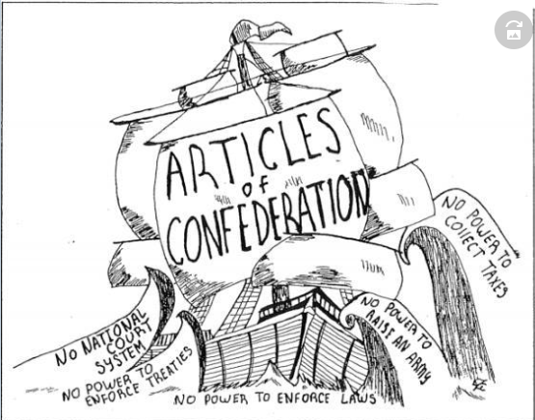
S
P
A
M
According to the political cartoon, which of the following was a problem resulting from the weakness of the central government under the Articles of Confederation?
The confederation government was so powerful it threatened individual liberty
The confederation could not prevent the outbreak of civil war among the states over the issue of slavery
The central government could not force state governments to contribute money to pay off the nation's war debt.
d. The state governments under the confederation were too weak
II. WEAKNESSES UNDER THE ARTICLES OF CONFEDERATION:
Objective: What were the Strengths and Weaknesses of the Articles of Confederation?

Slide 10
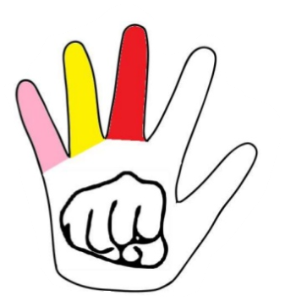
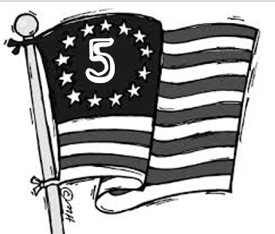
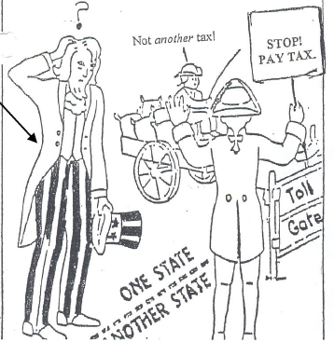
II. WEAKNESSES UNDER THE ARTICLES OF CONFEDERATION:
States Controlled Interstate & Foreign Commerce (Trade):
Historical Circumstances | Historical Impact
_____________ ______________ = trading with other ______________ _____________ ______________ = trading with other ______________ States taxed ____________ and _____________ when traveling through their state with products/produce. States made ____________ ________ _______________ or policies with foreign nations | In many cases it was ______________ to ship products /produce to _______________ _____________. Some merchants & farmers began ________________ goods across state borders.
Objective: What were the Strengths and Weaknesses of the Articles of Confederation?

Slide 11
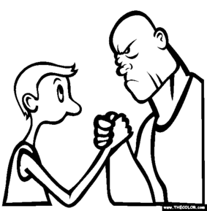
II. WEAKNESSES UNDER THE ARTICLES OF CONFEDERATION:
Americans slowly began to realize that the United States government needed to be given more power. In order to prevent westward expansion, Spain blocked the lower Mississippi River to American shipping in 1784. This cut off the Americans’ trade. In 1786 Spain agreed with America on the border between Georgia and Spanish Florida. In return, Americans agreed to limit shipping on the Mississippi River. Leaders, including George Washington, were worried about the future of America.
CRQ 1. What was one historical circumstance for the failure of the American economy after the American Revolution? TTQA
________________________________________________________________________________________________________________________________________________________________________________________________________________________________________
States
Congress
1. According to the political cartoon, who had the greater power under the Articles of Confederation?
States
Federal Government
Colonies
British
KEY TO UNLOCK NEXT PUZZLE PIECE
______________
Objective: What were the Strengths and Weaknesses of the Articles of Confederation?

Slide 12
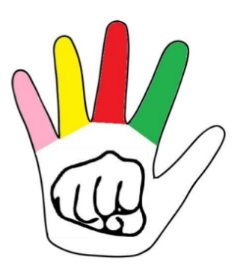
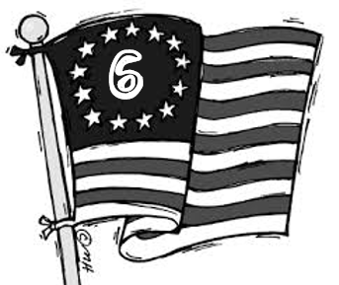
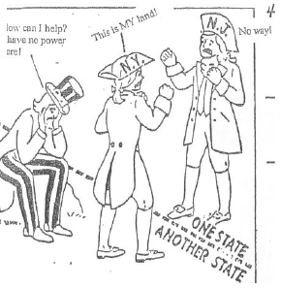
II. WEAKNESSES UNDER THE ARTICLES OF CONFEDERATION:
States Acted as Independent Countries:
Historical Circumstances | Historical Impact
States drafted their own __________ & ________ agreements with foreign nations. States argued over _____________ land claims and other land disputes. ____ ______ ____________ to make important decisions during ________________ or help settle problems ____________ _________ __ __________ _____________ Federal government ______ pass __________, but _____ _______________ them. | Foreign nations had to deal with 13 _______________ countries (states) to secure trade agreements with the U.S. New York and New Hampshire almost went to _____ _________ ___________. 7 of the 13 states had ____________ ____________ __________________. Maryland refused to join the U.S. if Virginia and others did not _______ (give up) there western land claims. If an emergency occurred the federal government could ______ ______________ _______________.
Objective: What were the Strengths and Weaknesses of the Articles of Confederation?

Slide 13
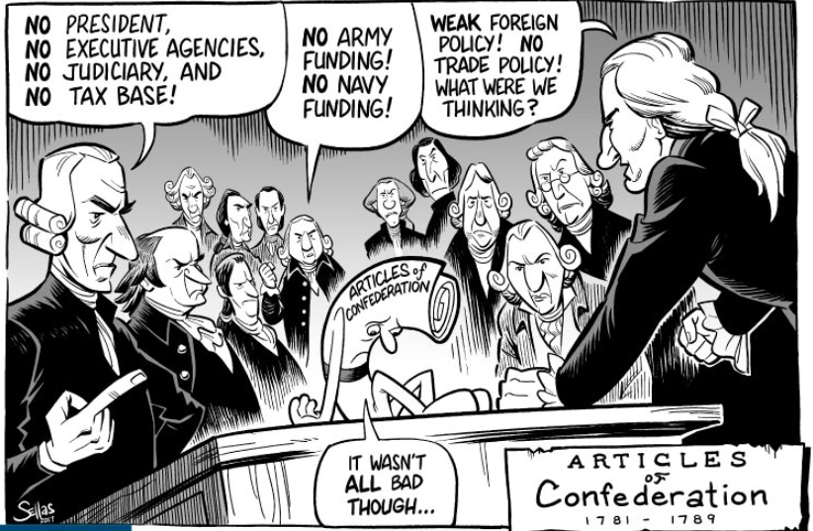
S
P
A
M
According to the political cartoon, what statement was true about the Articles of Confederation?
America was ruled very well under the Articles of Confederation
The Articles of Confederation called for a strong central government
The Articles of Confederation did not work well in governing the new nation and a new form of government was needed.
Most people did not want to see the Articles of Confederation work.
II. WEAKNESSES UNDER THE ARTICLES OF CONFEDERATION:
Objective: What were the Strengths and Weaknesses of the Articles of Confederation?

Slide 14
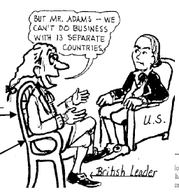
II. WEAKNESSES UNDER THE ARTICLES OF CONFEDERATION:
In May 1776, the Americans were busy forming their own governments. Each state organized their government and adopted a constitution, or plan that explains how the government will operate.
By 1780 Connecticut and Rhode Island were the only states that followed their colonial charters instead of creating new constitutions. Most states included provisions to prevent abuses of power. Most constitutions included provisions for two-house, or bicameral, legislatures. The legislatures, made up of elected representatives of the people, were the most powerful branch of government.
Pennsylvania replaced the office of governor with an elected 12-member council. In order to vote, one had to be at least a 21 year old male and own property or pay taxes. Most states limited voting to white males, but a few permitted free black males to vote. There were disagreements as each state became self-governing.
S
P
A
M

Slide 15
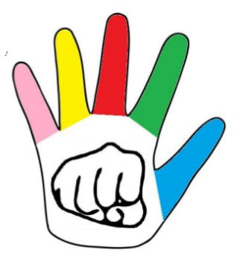
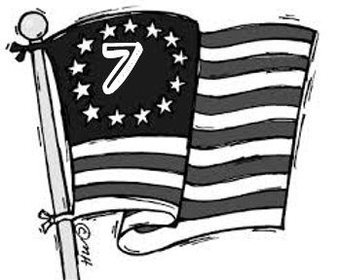
II. WEAKNESSES UNDER THE ARTICLES OF CONFEDERATION:
Each State Only Received 1 Vote
Historical Circumstances | Historical Impact
Each state received only ___ ________ ______________ of their ______________. Laws had to pass with at least ___/___ votes. | Very _______ laws were _____________. Americans were ___________ _____________ _____________________. Example: Delaware, had the least amount of people, while Virginia had the largest amount of people. However, both states received the _________ number of _________________.
“ So long as any individual state has power to defeat the measures of the other twelve, our pretended union is but a name, and our confederation a cobweb.”
Noah Webster, ca. 1780
Objective: What were the Strengths and Weaknesses of the Articles of Confederation?

Slide 16
II. WEAKNESSES UNDER THE ARTICLES OF CONFEDERATION:
Problem #1
Massachusetts is in extreme debt. In order to keep their government operating, they have imposed very high taxes on farmland. Farmers have rebelled against the government and fighting has taken place. Massachusetts has a small state militia (army), but they are losing control of the situation.
They are asking Congress:
-To send troops to help control the situation (9/13 votes required)
-To raise a force of 1000 troops and $2000 (each state decides what to send)
Problem #2
Part of New York under the leadership of Ethan Allen is demanding that they become a new state called Vermont. They are threatening to ally themselves with Great Britain if Congress does not grant them statehood.
Congress must decide:
-Should we allow Vermont to become a state (requires 9/13 votes to become a state)?
Problem #3
Georgia is charging South Carolina merchants extremely high taxes to buy their products. South Carolina farmers are threatening to riot if the South Carolina government cannot convince Georgia to lower its taxes. Georgia says that it must charge high taxes because their economy is doing terribly since the war.
South Carolina is asking Congress to:
Change the Articles to make it illegal for one state to tax another (Requires 13/13 votes).
Articles of Confederation Mock Congress
Objective: What were the Strengths and Weaknesses of the Articles of Confederation?

Slide 17
Discussion Questions:
Did this system work well for your state? Explain your answer.
2. What were the advantages of this system of government?
3. What were the disadvantages?
4. Is this a strong or weak central government? Why?
5. What improvements would you make to this system?
Objective: What were the Strengths and Weaknesses of the Articles of Confederation?

Slide 18
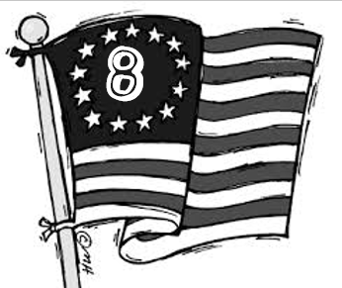
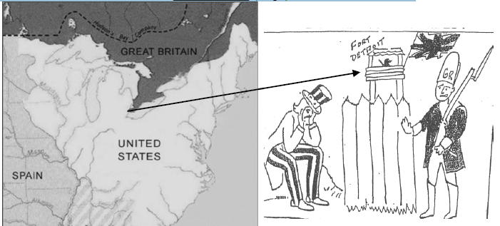
II. WEAKNESSES UNDER THE ARTICLES OF CONFEDERATION:
Each State Only Received 1 Vote
Historical Circumstances | Historical Impact
U.S. could _____ _________ or maintain a standing ________ or ___________. | _________________ refused to allow American farmers access to the ____________________ __________. The __________army refused to __________________ ______________ from forts on ______________ ________. Barbary _________________ attacked and ________________ American trade _________________(ships) off the coast of Africa (Mediterranean Sea).
Objective: What were the Strengths and Weaknesses of the Articles of Confederation?

Slide 19
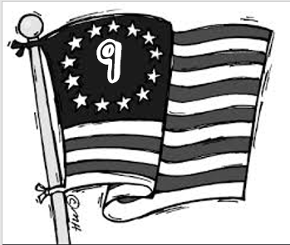
Shays Rebellion (1786):
Who was involved in the rebellion? | Daniel Shays, a Massachusetts farmer and American __________________________________________________________ More than 1,000 ____________________________________________
Where did the Rebellion take place?
When did the rebellion take place?
What was the problem? Why did the rebellion happen? | In an effort to _________________________________________________________, Massachusetts ________________________________________________________ _____________________________________. Many farmers _______________________________________________________their taxes and ______________________________________________________________
What occurred? | Shay’s led an ______________________________________________________. attacked and closed _________________________________________________ for 6 months.
Why is this event so significant? | The rebellion convinced leaders that the _________________ _________________________________ especially the poor economy that resulted could lead to _______________ (loss of order) and the ___________________________________________.
https://www.youtube.com/watch?time_continue=195&v=1pbJHH9F9-Q&feature=emb_logo

Slide 20
Document A – Excerpts of Letters Written by George Washington in Response to Shays’ Rebellion
Source: The George Washington Papers at the Library of Congress, 1741- 1799. American Memory, Library of Congress. Washington, D.C. Accessed 8/5/14. http://lcweb2.loc.gov/cgibin/query/r?ammem/mgw:@field(DOCID+@lit(gw290026)) :
Objective: What were the Strengths and Weaknesses of the Articles of Confederation?

Slide 21
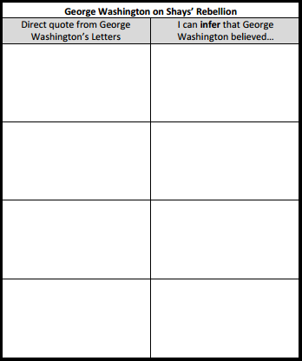
Purpose for reading: Interpret specific words and phrases in the letters written by George Washington and the letters written by Thomas Jefferson to determine each author’s point of view on the rebellion.

Slide 22
Document B – Excerpts of Letters Written by Thomas Jefferson in Response to Shays’ Rebellion
Source: Jefferson, Thomas to William Smith, November 13, 1787. Library of Congress, Manuscript Division. Washington, D.C. Accessed 8/6/14. http://www.loc.gov/exhibits/jefferson/105.html
Objective: What were the Strengths and Weaknesses of the Articles of Confederation?

Slide 23
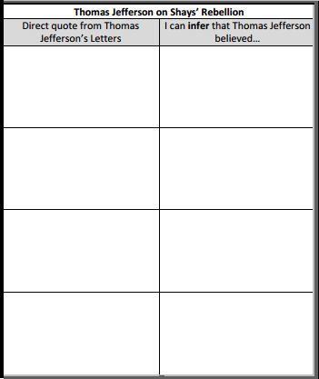
Purpose for reading: Interpret specific words and phrases in the letters written by George Washington and the letters written by Thomas Jefferson to determine each author’s point of view on the rebellion.

Slide 24
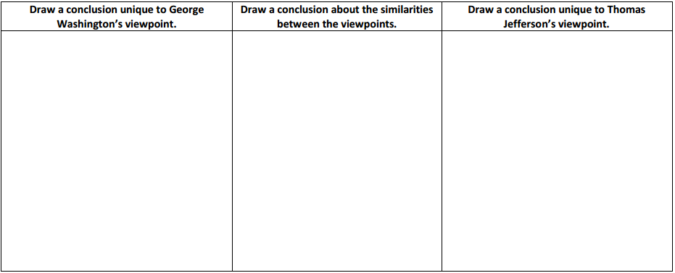
Analysis: Compare and contrast Washington’s and Jefferson’s viewpoints on the rebellion.

Slide 25
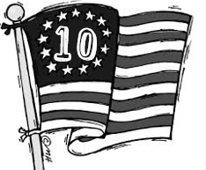
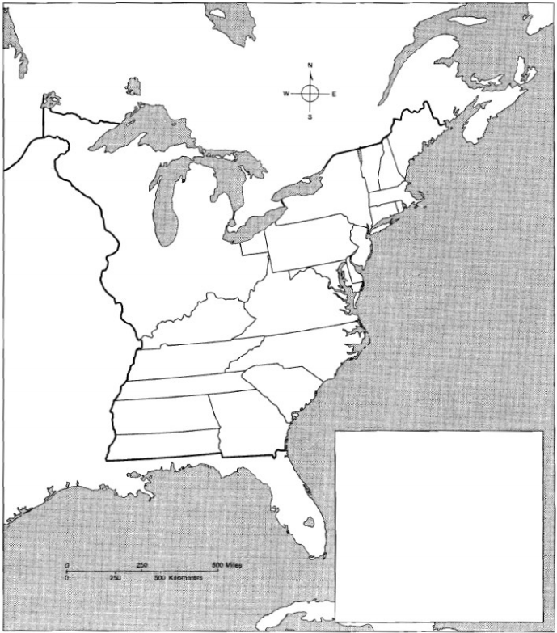
III - IMPACTS OF ARTICLES OF CONFEDERATION:
2. Northwest Ordinance (1787):
HISTORICAL CIRCUMSTANCES
Divided the Northwest ____________________ into separate territories for future ___________________.
Outlawed _____________________ in the Northwest Territory.
Provided a method to admit new _____________ into the __________________.
HISTORICAL IMPACT
New states needed at least _________,_________________ free settlers and a state _______________________.
Eventually, free (non-slave) states, _________________, Indiana, Illinois,
Michigan, and Wisconsin were created from the Northwest Territory
Objective: What were the Strengths and Weaknesses of the Articles of Confederation?

