Slide 1
I. Articles of Confederation (1777-1789):
America’s system of government during most of the American Revolution & 6 years after.
Established a league/friendship between the 13 free and independent states.
Established only a legislative or law-making body (Congress) of government.

Slide 2
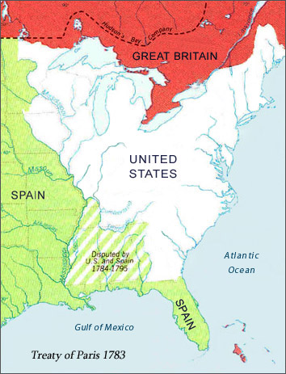
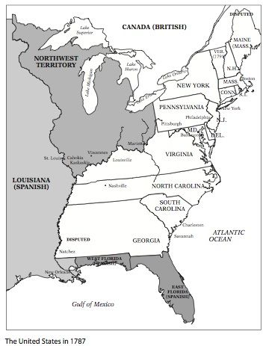
I. Articles of Confederation (1777-1789):

Slide 3
I. Articles of Confederation (1777-1789):
Results:
The Articles of Confederation would last for 12 years.
America’s 1st system of government failed.

Slide 4
Articles of Confederation Over Simplified
Directions: Watch the Video & Answer the questions 9:30 min
https://www.youtube.com/playlist?list=PLhyKYa0YJ_5A9iLoiK_KYiCNVsCT11vZ9
What historical circumstance led the radicals and the loyalists to work together in order to get the British to remove the intolerable acts?
What did the Olive Branch petition attempt to do?
How did the Loyalists and Colonists view about a state militia (army) disagree?
What did 3 plans did the Continental Congress have for the newly independent Colonies?
6. What historical impact did the Haudenosaunee have on the new government ?
7. Why did states not support the Plan of Union?
8. Under the Articles of Confederation does the congress have power over the states?

Slide 5
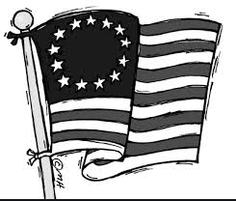
Articles of Confederation
Power Stations:
1
Station 1 Matching
Directions : using the 10 Question and answer cards match the correct question with the correct answer.
Get checked by the teacher
Copy the correct responses
Receive the Next Envelope and Puzzle Piece

Slide 6
During what event were the Articles created? | American Revolution
What period of history were the Articles of Confederation used during? | 1777-1789
Where is the majority of the power? Why? | With the states because People were scared of powerful governments
What was the purpose of the document | To provide a central government
Structure of the Confederation Government | League of friendship. 1 branch = congress 1 vote per state

Slide 7
Articles of Confederation
Power Stations:
2
Station 2 Brain POP
Directions : using the Brain pop Video answer the questions about the Articles of Confederation
Get checked by the teacher and receive the Next Envelope and Puzzle Piece
Username: mehawks
Password: info4u

Slide 8
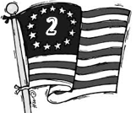
Which of the following was established by the Declaration of Independence?
A civil war
A representative Government
A monetary system
The right to vote
To Pass a law under the Articles of Confederation, Congress must pass it with
A minimum of a 9/13 vote.
A minimum of a 11/13 vote.
Unanimously
A minimum of a 7/13 vote.
What factor convinced the framers of the Articles of Confederation to create a weak central government?
The division between revolutionaries and loyalists
Distrust between Northern and Southern States
The States unwillingness to limit their own authority
Cultural differences between Americans and Europeans
Place the following events in sequence: A) Declaration of Independence is signed; B) Shays' Rebellion; C) Articles of Confederation are written; D) Revolutionary War ends.
( C,A,B,D)
( A,C,D,B)
(A,B,D,C)
(C,B,A,D)
KEY TO UNLOCK NEXT PUZZLE PIECE
__B__ __A__ __C__ __B___
1 2 3 4

Slide 9
Articles of Confederation
Power Stations:
3
Station 3
Thing Link
Directions : using the Thing Link collect the notes on the Weakness of the
Articles of Confederation by clicking on the correct symbol
Get checked by the teacher for the Weakness
Receive a Puzzle Piece
______drafts of the Articles of Confederation were prepared before they were adopted by Congress on November 15, 1777.
Directions: Add the answers of the two questions on page 7 to complete the “ Did You Know” fact

Slide 10
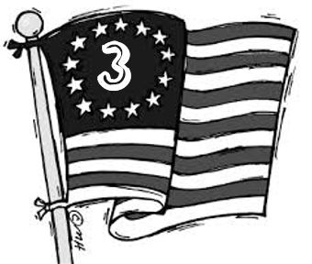
KEY TO UNLOCK NEXT PUZZLE PIECE
___2__+ _ 4___ = ___6___
Question A – 2
Question B – 4
Answer = 6
______drafts of the Articles of Confederation were prepared before they were adopted by Congress on November 15, 1777.
Directions: Add the answers of the two questions on page 7 to complete the “ Did You Know” fact

Slide 11
1. National (Federal) Government Lacked the Power to Tax: Historical Circumstances
America owed soldiers & foreign nations money from the American Revolution.
To get funds ($) from the federal government had to request money from the states.

Slide 12
1. National (Federal) Government Lacked the Power to Tax: Historical Impacts
Congress asked for $45 million from states and received less than $2 million.
The U.S. was deeply in debt.
The U.S. could not fund an army or navy.

Slide 13
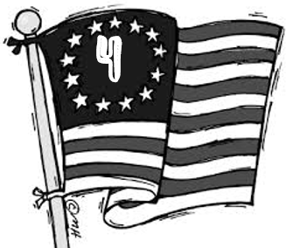
Articles of Confederation
Power Stations:
Station 4
Thing Link
Directions : using the Thing Link collect the notes on the Weakness of the
Articles of Confederation by clicking on the correct symbol
Get checked by the teacher for the Weakness
Receive a Puzzle Piece
__________ of the signers of the Articles of Confederation were all in the same _____________ at the same ______________
Directions: Using the letter of the correct answer on page 9 select the correct response key to fill in the “Did You Know”
A. All, town, restaurant
B. None, village, building
C. None, room, time
D. All, house, time

Slide 14
2. States Used Different Currency: Historical Circumstances & Impacts
CIRCUMSTANCES
Each state used different money.
IMPACTS
Money had a different value in each state.
Some states would not accept other states’ money.

Slide 15
Station 4
__________ of the signers of the Articles of Confederation were all in the same _____________ at the same ______________
Using the letter of the correct answer on page 9 select the correct response key to fill in the “Did You Know”
C. None, room, time

Slide 16
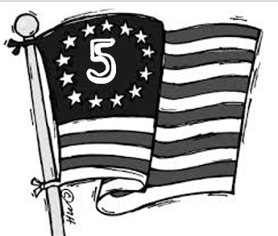
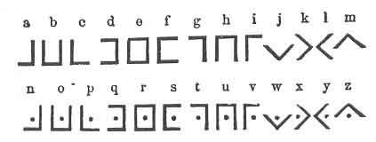
Articles of Confederation
Power Stations:
Station 5 Thing Link
Directions : using the Thing Link collect the notes on the
Weakness of the
Articles of Confederation by clicking on the correct symbol
Get checked by the teacher for the Weakness
Receive a Puzzle Piece
It took _________years to get all of the needed signatures on the Articles of Confederation
Directions: Using the correct answer on page 11 select the correct response by “Breaking the Code” to figure out the # number of years.

Slide 17
3. States Controlled Interstate & Foreign Commerce (Trade): Historical Circumstances
Interstate Commerce = trading with other states
Foreign Commerce = trading with other countries
States taxed merchants and farmers when traveling through their state with products/produce.
States made separate trade agreements/policies with foreign nations.

Slide 18
3. States Controlled Interstate & Foreign Commerce (Trade): Historical Impacts
In many cases it was cheaper to ship products/produce to European nations.
Some merchants & farmers began smuggling goods across state borders.

Slide 19
Station 5
Directions: Using the correct answer on page 11 select the correct response by “Breaking the Code” to figure out the # number of years.
1
2
3
It took _________years to get all of the needed signatures on the Articles of Confederation

Slide 20
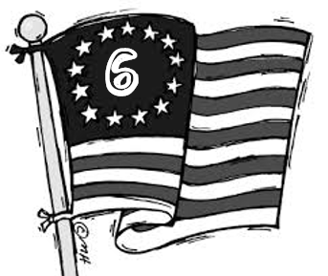
Articles of Confederation
Power Stations:
Station 6 Thing Link
Directions : using the Thing Link collect the notes on the
Weakness of the
Articles of Confederation by clicking on the correct symbol
Get checked by the teacher for the Weakness
Receive a Puzzle Piece
Virginia was the 1st state to ratify the Articles of Confederation on
Dec. 1 6 1 7 7 7
Directions: Using the correct answer on page 12 select the correct response by “Breaking the Code” to figure out the date.
A. Dec. 16 1778
B. Dec. 18 1878
C. Dec. 16 1777
D. Dec. 18 1877

Slide 21
4. States Acted as Separate Countries: Historical Circumstances
States drafted their own treaties & trade agreements with foreign nations.
States argued over western land claims and other land disputes.
No one person to make important decisions during emergencies or help settle problems between states or other countries.
Federal government could pass laws, but not enforce them.

Slide 22
4. States Acted as Separate Countries: Historical Circumstances
Foreign nations had to deal with 13 separate countries (states) to secure trade agreements with the U.S.
New York and New Hampshire almost went to war over Vermont.
7 of the 13 states had western land claims.
Maryland refused to join the U.S. if Virginia and others did not cede (give up) there western land claims.
If an emergency occurred the federal government could not respond quickly.

Slide 23
Station 6
Virginia was the 1st state to ratify the Articles of Confederation on Dec. 1 6 1 7 7 7
1 1
2 2
3 3
4 4
5 5
6 6
7 7
8 8
9 9
Directions: Using the correct answer on page 12 select the correct response by “Breaking the Code” to figure out the date.
A. Dec. 16 1778
B. Dec. 18 1878
C. Dec. 16 1777
D. Dec. 18 1877

Slide 24
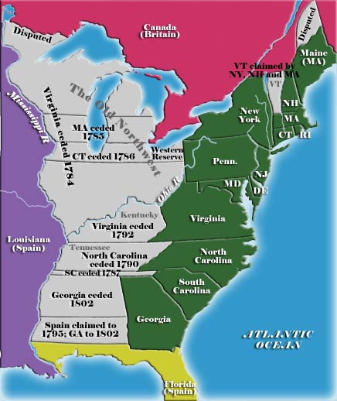

Slide 25
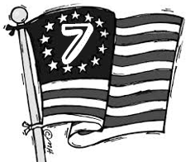
Articles of Confederation
Power Stations:
Station 7 Thing Link
Directions : using the Thing Link collect the notes on the
Weakness of the
Articles of Confederation by clicking on the correct symbol
Get checked by the teacher for the Weakness
Receive a Puzzle Piece
Articles of Confederation Mock Congress

Slide 26
5. Each State Only Received 1 Vote:
CIRCUMSTANCS
Each state received only 1 vote regardless of their population.
Laws had to pass with at least 9/13 votes.
IMPACTS
Very few laws were passed.
Americans were not equally represented.
Example: Delaware, had the least amount of people, while Virginia had the largest amount of people. However both states received the same number of votes.

Slide 27
Articles of Confederation Mock Congress
Powers of Congress | Powers of the State
To pass a law or make a decision 9/13 votes are required To change the Articles of Confederation 13/13 votes are required Congress can declare war Congress can raise an army Congress cannot tax citizens Can allow new states with 9/13 vote | States get one vote in Congress States can tax their citizens States can create taxes on trade with other states States do not have to follow the orders of Congress States can give money and troops to Congress if they choose States cannot wage war without the agreement of Congress

Slide 28
Articles of Confederation
Power Stations:
8
Station 8 Thing Link
Directions : using the Thing Link collect the notes on the Weakness of the Articles of Confederation by clicking on the correct symbol
Get checked by the teacher for the Weakness
Receive a Puzzle Piece

Slide 29
6. Lacked Funds for Army & Navy:
CIRCUMSTANCES
U.S. could not fund or maintain a standing army or navy.
IMPACTS
Spain refused to allow American farmers access to the Mississippi River.
The British army refused to withdraw troops from forts on American soil.
Barbary pirates attacked and seized American trade vessels (ships) off the coast of Africa (Mediterranean Sea).

Slide 31
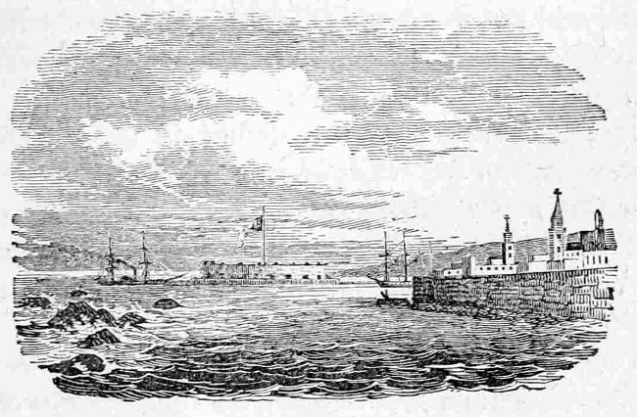

Slide 32
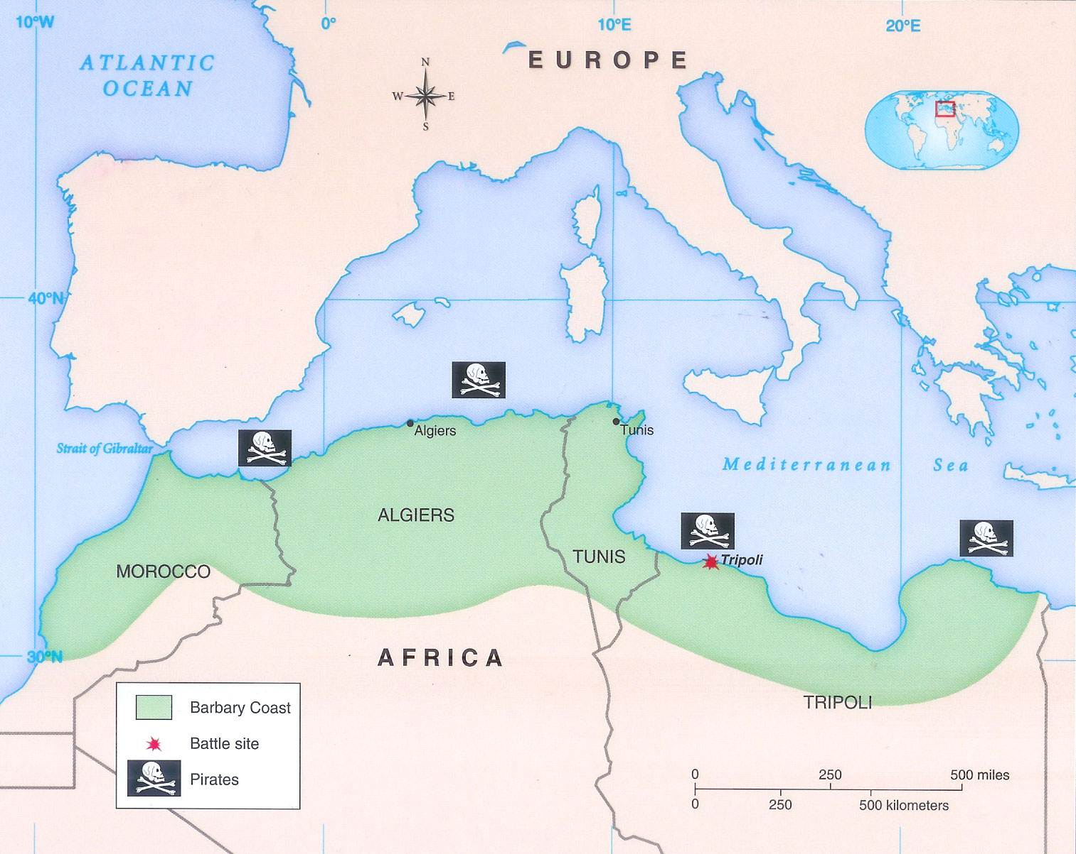

Slide 33
Articles of Confederation
Power Stations:
9
https://www.youtube.com/watch?time_continue=195&v=1pbJHH9F9-Q&feature=emb_logo
Station 9 Shays Rebellion
Directions : using the Documents collect the notes on the Impacts of the Articles of Confederation.
Read and annotate and letters by George Washington and Thomas Jefferson in response to Shay’s Rebellion.
Fill out the Graphic Organizers
Get checked by a teacher and Receive a Puzzle Piece

Slide 34
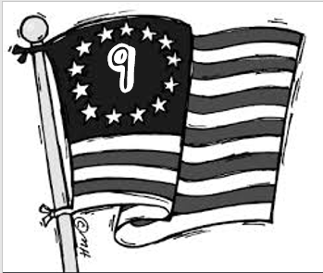
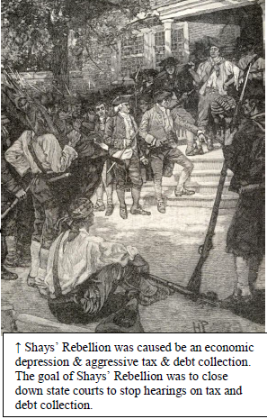
III - IMPACTS OF ARTICLES OF CONFEDERATION:
1. Shays Rebellion (1786):
During the American Revolution, the states and the Continental Congress had borrowed large sums of money from wealthy merchants. After the war, the merchants demanded that they be repaid, but the national government under the Articles of Confederation had no power to raise money. The states had to repay their own debts, and the only way for them to raise the money was to tax their citizens heavily.
Many farmers in the western part of Massachusetts had an especially hard time paying their bills at this time. The Massachusetts farmers, many of whom were war veterans who had never been paid, owed about one-third of their income for state taxes, and the Massachusetts legislature refused to issue paper money as other states had done. Those farmers who could not pay their taxes had their farms taken away by state courts. Court officials then auctioned off the farms and used the money from the sale to pay the taxes. Farmers who could not pay their personal debts were often put into prison.
The farmers asked the Massachusetts legislature to lower taxes and let them pay taxes and other debts with farm produce. They begged the legislature to stop jailing people who could not pay their debts. Instead the legislature listened to merchants and bankers to whom the farmers owed money. It refused to pass laws to help the farmers.

Slide 35
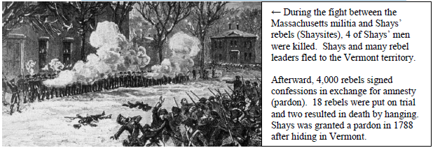
III - IMPACTS OF ARTICLES OF CONFEDERATION:
1. Shays Rebellion (1786):
Because they could not get help through legal means, a group of farmers decided they had no choice but to rebel. Their leader was Daniel Shays, a former Revolutionary War captain. In the fall of 1786, Shays led armed farmers in marches outside county courthouses in Springfield, Northampton and other towns in western Massachusetts. The purpose was to keep the courts from meeting. If the courts did not meet, bankers and others to whom farmers owed money could not take away their farms.
In January 1787, Shays’ men attacked a Springfield building where they government stored guns. Wealthy merchants from as far away as Baltimore, Maryland paid to raise a militia and the governor of Massachusetts sent the soldiers to fight the rebels. The soldiers shot and killed four men, and soon the rest of Shays’ followers fled. Several rebel leaders were caught. The men were brought to trial, found guilty, and sentenced to death. Later the court set them all free, including Shays.
Shays’ Rebellion did not succeed. For many, the rebellion symbolized a fatal weakness of the national government under the Articles of Confederation. Because Congress had no power to raise money, it could not help the states pay off their war debts, which forced the states to tax their citizens heavily. Moreover, Congress could not raise a national army without unanimous consent of the states, so it was unable to act in time to assist Massachusetts. The realization of this weakness helped spur the events of the summer of 1787, when the Constitutional Convention that met in Philadelphia wrote a constitution that defined a stronger and more capable federal government.

Slide 36
Shays Rebellion (1786):
Who was involved in the rebellion? | Daniel Shays, a Massachusetts farmer and American Revolution war Veteran More than 1,000 armed Farmers
Where did the Rebellion take place? | Springfield Massachusetts
When did the rebellion take place? | 1787
What was the problem? Why did the rebellion happen? | In an effort to pay off war debts, Massachusetts raised taxes without consent of the citizens. Many farmers were not able to pay their taxes and state courts seized their farms.
What occurred? | Shay’s led an armed rebellion. attacked and closed state court houses for 6 months.
Why is this event so significant? | The rebellion convinced leaders that the weaknesses of the Articles, especially the poor economy that resulted could lead to anarchy (loss of order) and the failure of the New Nation

Slide 37
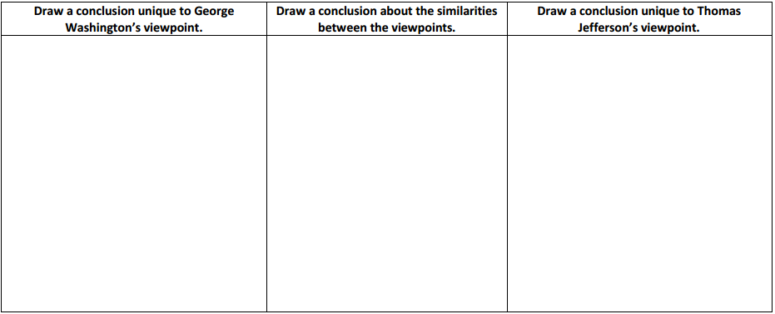
Analysis: Compare and contrast Washington’s and Jefferson’s viewpoints on the rebellion.
George Washington was extremely embarrassed that it appeared that Americans were unable to govern themselves well.
He was unhappy with the lack of a strong central government and the weakness of the Articles of Confederation
Thomas Jefferson believed that any rebellion was a good thing because it helped to protect the people’s liberty and limit the power of the government.
Rebellion didn’t mean that a government was bad, just that it needed to be amended to work better.
Both men believed that changes
(reforms) were necessary in order to
provide a more effective government.

Slide 38
Analysis: Compare and contrast Washington’s and Jefferson’s viewpoints on the rebellion.
George Washington was extremely embarrassed that it appeared that Americans were unable to govern themselves well.
He was unhappy with the lack of a strong central government and the weakness of the Articles of Confederation
Thomas Jefferson believed that any rebellion was a good thing because it helped to protect the people’s liberty and limit the power of the government.
Rebellion didn’t mean that a government was bad, just that it needed to be amended to work better.
Both men believed that changes
(reforms) were necessary in order to
provide a more effective government.

Slide 39
Articles of Confederation
Power Stations:
10
Station 10 Northwest Ordinance
Directions : using the Documents collect the notes on the Impacts of the Articles of Confederation.
Complete the Map Activity
Receive a Puzzle Piece

Slide 40
2. Northwest Ordinance (1787):
Divided the Northwest Territory into separate territories for future expansion.
Outlawed slavery in the Northwest Territory.
Provided a method to admit new states into the union.
Results:
New states needed at least 60,000 free settlers and a state constitution.
Eventually, free (non-slave) states, Ohio, Indiana, Illinois, Michigan, and Wisconsin were created from the Northwest Territory.

Slide 43
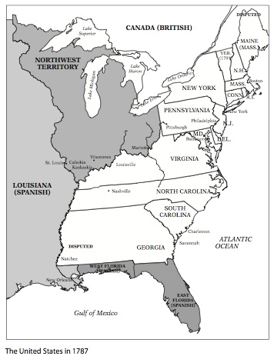

Slide 44
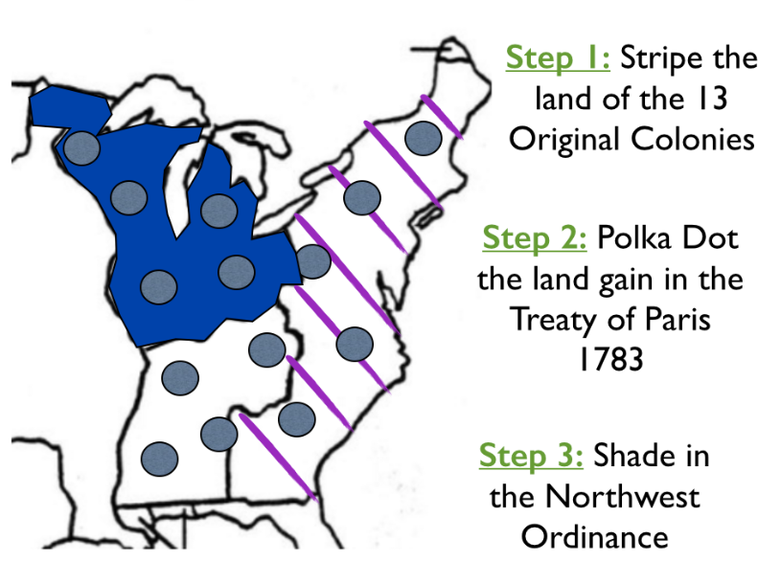

Slide 45
3. The Articles of Confederation Failed:
After Shays’ Rebellion, leaders from several states called for a new framework of government to be created.
The Articles of Confederation failed because the states had too much power.
The Articles of Confederation failed because it lacked a strong central/national/federal government.
The Articles of Confederation failed because the document had many weaknesses.
Result:
In 1787, the Constitutional Convention began to develop a new government for America.

Slide 46
